Slide 1
Ansible_test3
Authors: eb00X

Slide 2



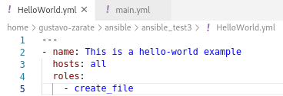

Setup hosts file

Slide 3
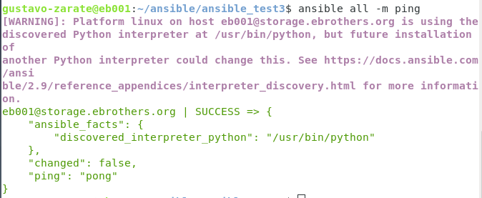
Testing Playbook

Slide 4
