Slide 1
Ansible_test4
Authors: eb00X

Slide 2
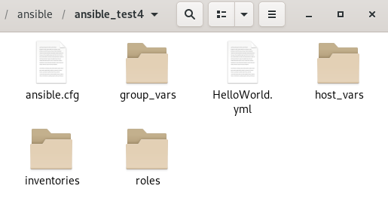


Setup hosts file

Slide 3
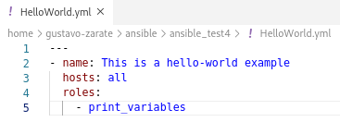



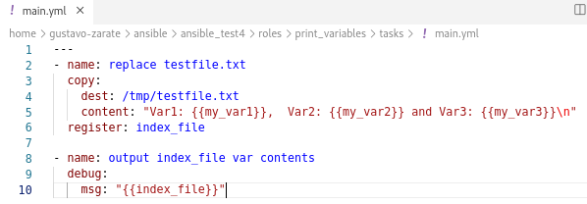
ansible-playbook HelloWorld.yml

Slide 4
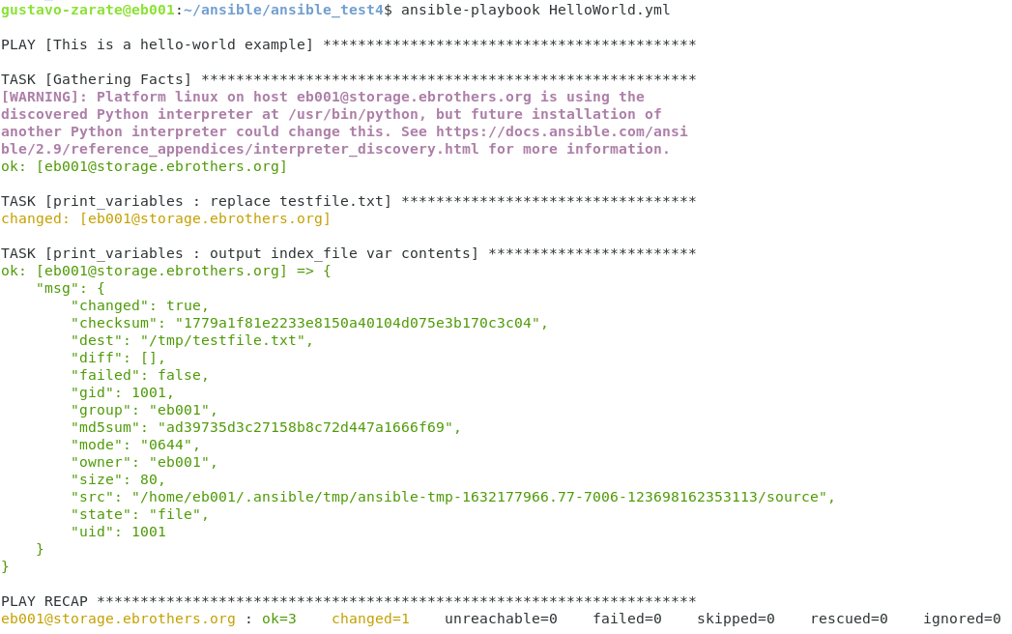
Testing Playbook

Slide 5

var1 come from roles, var2 comes from host_vars and var3 comes from group_vars

