Slide 1
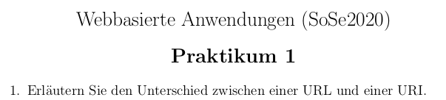
Web-based applications (SoSe2020)
Practical course 1

Slide 2
Explain the difference between a URL and a URL.
Reply:
A Uniform Resouce Identifier (URI) is a string of characters that unambiguously identifies a particular resource.
The most common form of URI is the Uniform Resource Locator.
URL
A Uniform Resource Locator is a reference to a web resource that specifies its location on a computer network and a mechanism for retrieving it
A URL is a specific type of Uniform Resource Identifier

Slide 3
Explain, in your own words, the four or five types of web applications. Which of the types can still be found on the web today?
Reply:
Statisches Web
Plug-in-Web
Dynamisches Web
Web 2.0
Web 2.0 - Single Page Applications

Slide 4
Web applications have special properties. Name them and describe them in your own words.
Reply:
Plattformabhaengig:
On the fly and on the need deployment:
Mehrere Einstiegspunkte
Lose Struktur
Ereignisgesteuerter Client und prozeduraler Server
Lebenslange Entwicklung

Slide 5

Explain how server-side scripts are processed on a server. What output formats can be generated by server-side scripts?
Reply:
Server-side programming comes into play in the development of web pages with dynamic elements and web applications. This web development technology is based on the use of scripts that are executed by the web server, with the help of the appropriate programming language, when a client requests content. A frequent task of the scripts is to extract the required data from a database and integrate it into the web project. Although the user accesses the project through HTML pages, the source code of the scripts remains hidden.The use of these server-side scripts assumes that the client will continue to send requests to the web server to deliver new and modified information to the user. This, on the one hand, places a heavy load on the server's capacity and consequently influences its response time and, on the other hand, makes a connection to the server essential in order to access the page.

Slide 6
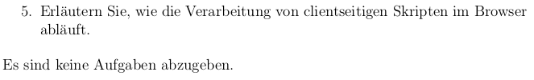
Explain how client-side scripts are processed in the browser. There are no tasks to complete.
Reply:
Client-side programming languages are also used to realize projects with dynamic content, but, unlike server-side languages, it is not the server that executes and processes the scripts, but the requesting client. For this purpose, the scripts are included in the HTML or XHTML document or written in a separate file that is linked to the main document.When a user requests a web page or a web application with such a script, the web server sends the HTML document and the script to the browser, which executes it and presents the final result. Client-side scripts also contain specific instructions to the web browser on how to react to certain actions performed by the user, such as clicking on a specific button. Often, the client has to establish further contact with the web server for this purpose. When executed in the browser, the user can see the source code, in contrast to server-side scripts. On the other hand, the interpretation of scripts is based on the assumption that the web browser understands the corresponding web programming language. Since pop-up windows and web tracking tools are also based on the client-side language and these scripts influence loading times, there are several popular browser extensions that block these scripts.

Slide 7
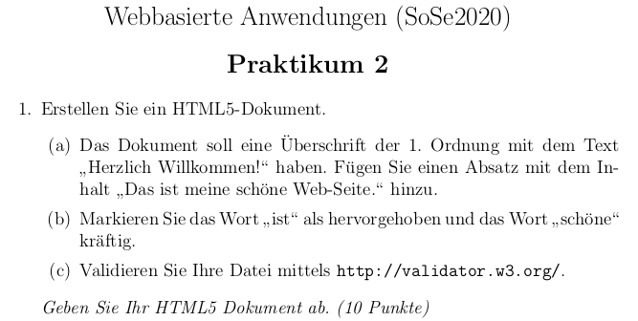
Web-based applications (SoSe2020)
Practical course 2

Slide 8
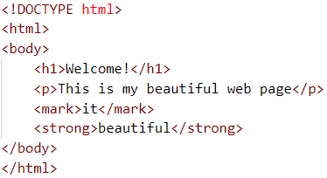
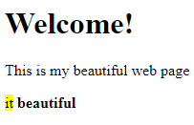
Create an HTML5 document.
  The document should have a 1st order heading with the text "Welcome!". Add a paragraph with the content "This is my beautiful web page".
  Mark the word "it" as highlighted and the word "beautiful" strongly.
  Validate your file using http://validator.w3.org/
http://apps.ebrothers.net/____frontend/open_task_eb005_wba/2020ss/01_html/practical_course_2-1/

Slide 9

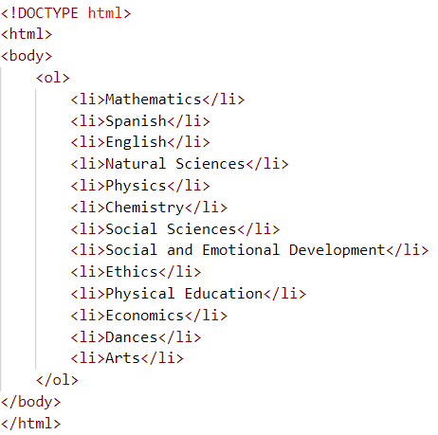
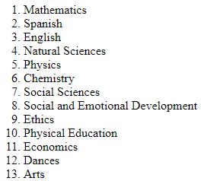
Create a second document that contains an ordered list that enumerates all of your classes for that semester. Submit your HTML5 document.
http://apps.ebrothers.net/____frontend/open_task_eb005_wba/2020ss/01_html/practical_course_2-2/

Slide 10

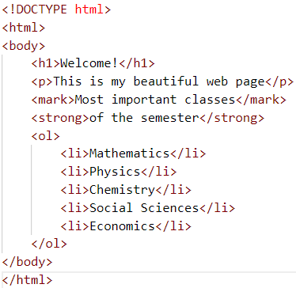
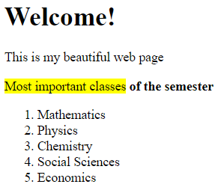
Build into the first document another paragraph referencing the second document. Type the source text excerpt.
http://apps.ebrothers.net/____frontend/open_task_eb005_wba/2020ss/01_html/practical_course_2-3/

Slide 11

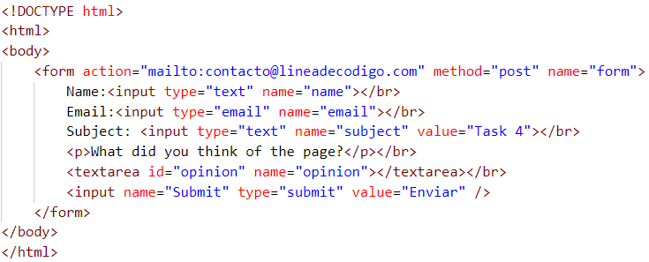
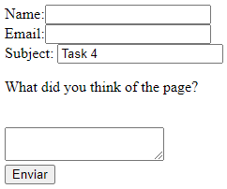
How should be a link, so that the user generates an e-mail with addressee and subject called "Task 4".
http://apps.ebrothers.net/____frontend/open_task_eb005_wba/2020ss/01_html/practical_course_2-4/

Slide 12
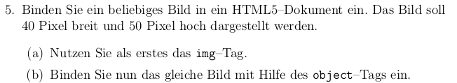
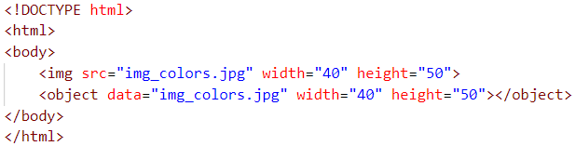

Include any image in a HTML5 document. The image should be displayed 40 pixels wide and 50 pixels high.
First, use the img tag.
Now include the same image using the object tag.
http://apps.ebrothers.net/____frontend/open_task_eb005_wba/2020ss/01_html/practical_course_2-5/

Slide 13
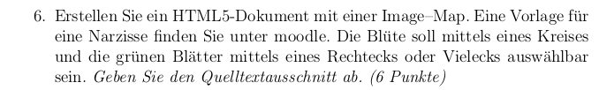

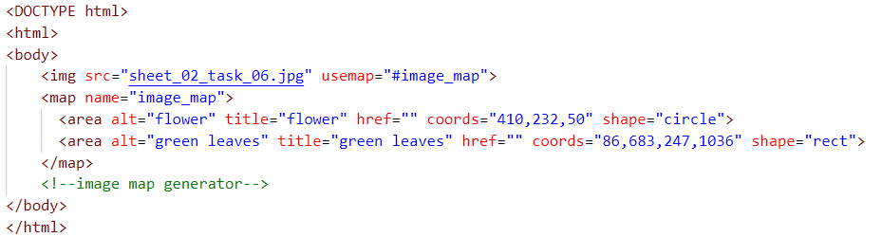
Create an HTML5 document with an image map. You can find a template for a daffodil on moodle. The flower should be selectable by a circle and the green leaves by a rectangle or polygon.
http://apps.ebrothers.net/____frontend/open_task_eb005_wba/2020ss/01_html/practical_course_2-6/

Slide 14
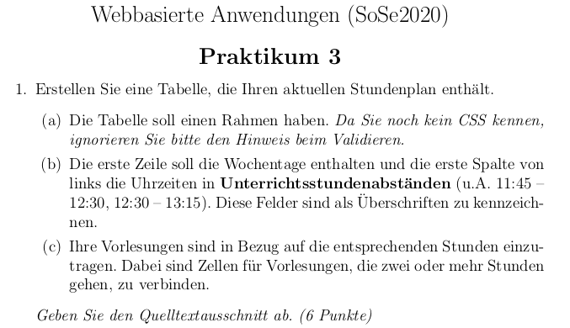
Web-based applications (SoSe2020)
Practical course 3

Slide 15
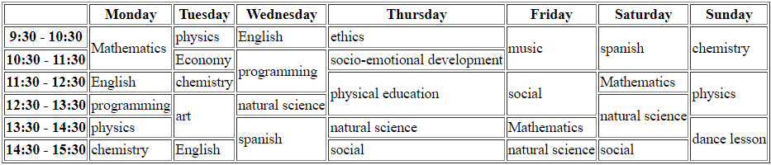
Create a table that contains your current timetable.
  The table should have a frame. Since you don't know CSS yet, please ignore the hint when validating.
  The first row should contain the days of the week and the first column from the left should contain the times in lesson intervals (including 11:45-12:30, 12:30-13:15). These fields are to be marked as headings.
  Your lectures are to be entered in relation to the appropriate hours. Cells for lectures that go for two or more hours are to be connected.
http://apps.ebrothers.net/____frontend/open_task_eb005_wba/2020ss/01_html/practical_course_3-1/

Slide 16
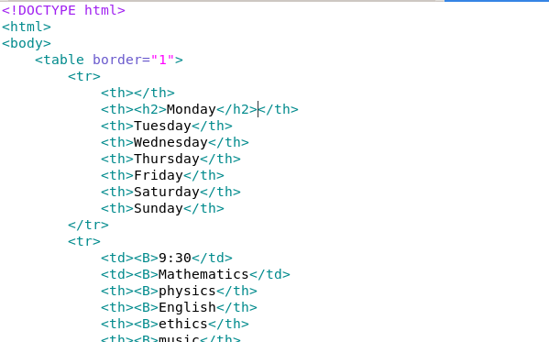
eb001: Please create documentation for bold or <B> and explain that in the platform
Please update code as well of practical course 3-1
...

Slide 17
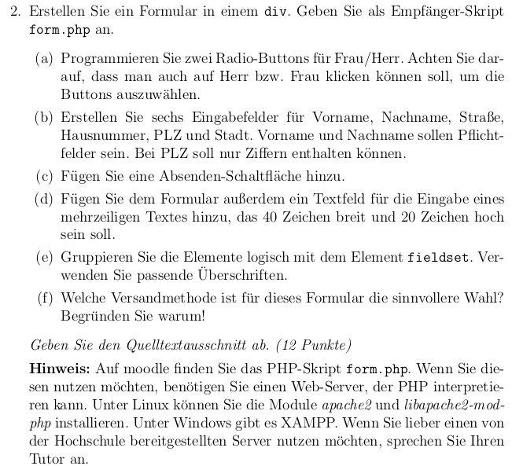
Create a form in a div. Specify form.php as the recipient script.
Program two radio buttons for Mrs/Mr. Make sure that it should also be possible to click on Mr. or Ms. to select the buttons.
Create six input fields for first name, last name, street, house number, postal code and city. First name and last name should be mandatory fields. Zip code should be able to contain only digits.
Add a submit button.
Also add a text field to the form for entering a multiline text, which should be 40 characters wide and 20 characters high.
Group the elements logically with the fieldset element. Use appropriate headings.
Which shipping metrhod makes more sense for this form? Give reasons why!
Note: On moodle you can find the PHP script from.php. If you want to use this, you need a web server that can interpret PHP. On Linux you can install the modules apache2 and libapache2-mod-php. Under Windows there is XAMPP. If you prefer to use a server provided by the university, talk to your tuto.
eb001 continues with this

Slide 18
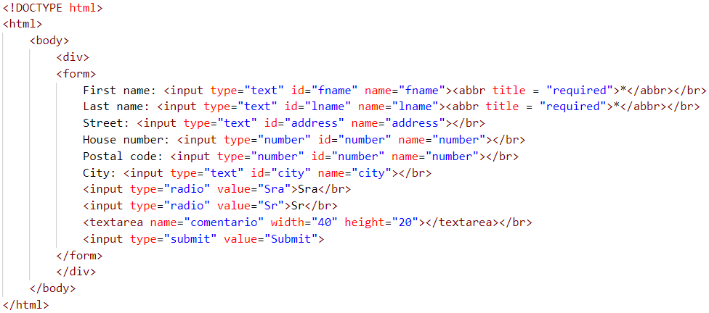
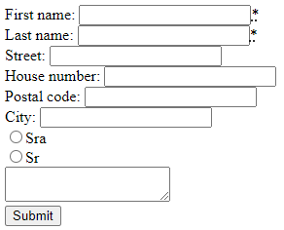
Reply:
The submit method makes more sense for this form is the input element, having the value "submit" in its type attribute because the default text of the button will be Submit (or equivalent depending on the language).
http://apps.ebrothers.net/____frontend/open_task_eb005_wba/2020ss/01_html/practical_course_3-2/

Slide 19
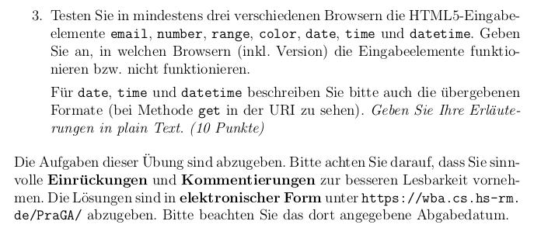
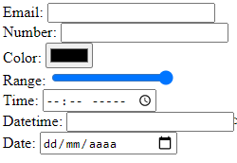
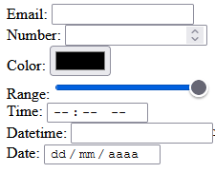
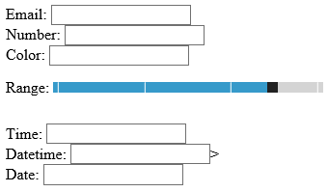
3. In at least three different browsers, test the HTML5 input elements email, number, range, color, date, time, and datetime. Indicate in which browsers (including version) the input elements work or do not work.
For date, time and datetime, please also describe the formats passed (to be seen in the URI for method get).
The tasks of this exercise are to be handed in. Please make sure that you make sensible indentations and comments for better readability. The solutions are to be submitted in electronic form at https://wba.cs.hs-rm.de/PraGA/. Please note the submission date given there.
Google Chrome
Versión 95.0.4638.69
(Build oficial) (64 bits)
Mozilla Firefox
Version 94
Windows 10
Internet Explorer
Version 20H2
(Compilacion SO 19042,1288)
http://apps.ebrothers.net/____frontend/open_task_eb005_wba/2020ss/01_html/practical_course_3-3/

