Slide 2

Kollisions
Let's imagine we have 1 object and 4 possible places
As we see, there is no possibility of collision, because we only have one object
Probability of collision: 0%
Probability of no collision: 100%

Slide 3
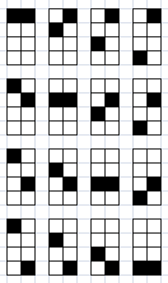
Kollisions
Let's imagine we have 2 objects and 4 possible places
As we see, there are possible collisions, because we have 2 objects. There are 4 possibilities of 16
Probability of collision: 25%
Probability of no collision: 75%

Slide 4
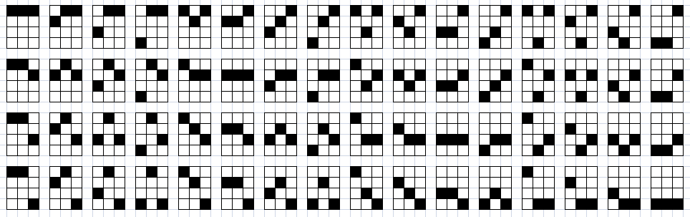
Kollisions
Let's imagine we have 3 objects and 4 possible places
As we see, there are possible collisions, because we have 3 objects. There are 4 possibilities of 16
Probability of collision: 62.5%
Probability of no collision: 37.5%

Slide 5
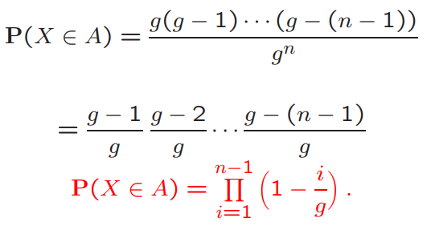
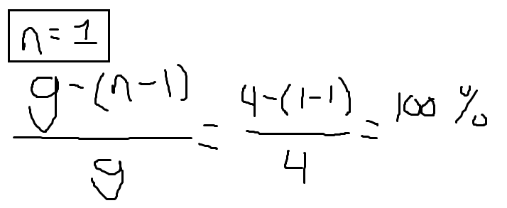

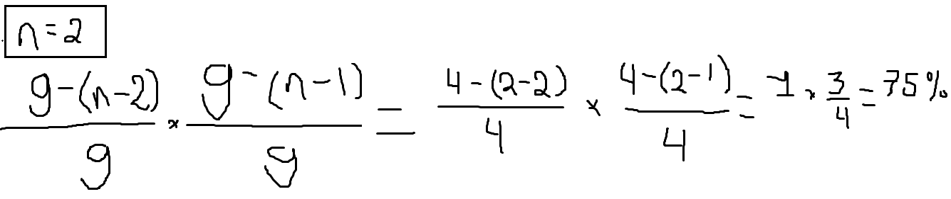
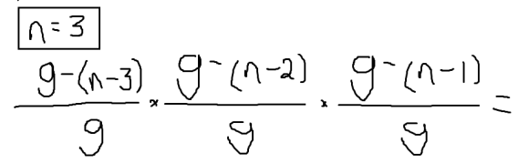
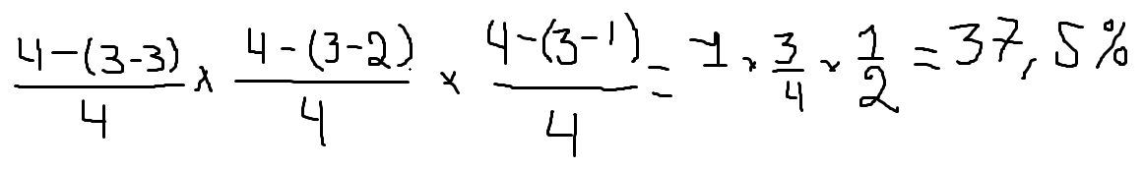
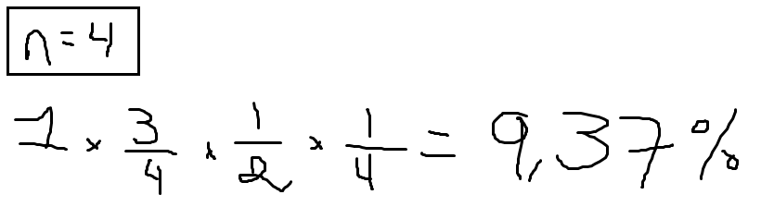
Not complete, take formula from Book
Kollisions
Let's imagine we have 4 objects and 4 possible places
As we see, there are possible collisions, because we have 4 objects. Luckily there is a formula to solve this easier.

