Slide 1

XPILOT – BOTNAME.pdf
Features
Movement - Path following
Pathfinding - Custom A*
Item Collection - Support all items
Item Handling - Support all items
Extras - Refueling, Search and Destroy, Multithreading
Debugging – Path drawing
Notes:
1

Slide 2
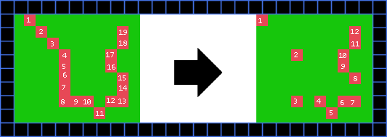
MOVEMENT – BOTNAME.pdf
Custom A* - Three parts
Generating path
2. Optimizing path
3. Making path safer
Notes:
1

Slide 3
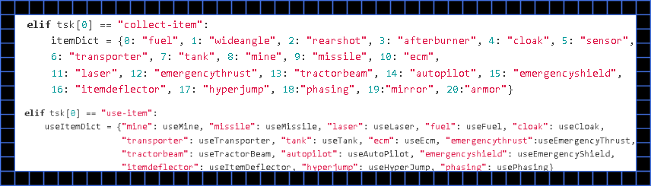
ITEMS – BOTNAME.pdf
Collecting & Handling – Dictionaries
Notes:
1

Slide 4
CHAT – BOTNAME.pdf
Standardized chat system
collect-item itemtype :[name]
use-item itemtype x y :[name]
move-to-(stop,pass,pos) x y :[name]
refuel stationId :[name]
Notes:
1

Slide 5
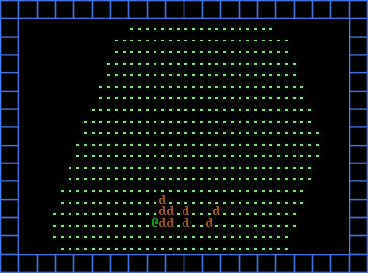
DEBUG – BOTNAME.pdf
Debugging – Map & Pathdrawing
Notes:
1

Slide 6
EXTRAS – BOTNAME.pdf
Search & Destroy – Targets
Multithreading – Calculations
Notes:
1

