Slide 1
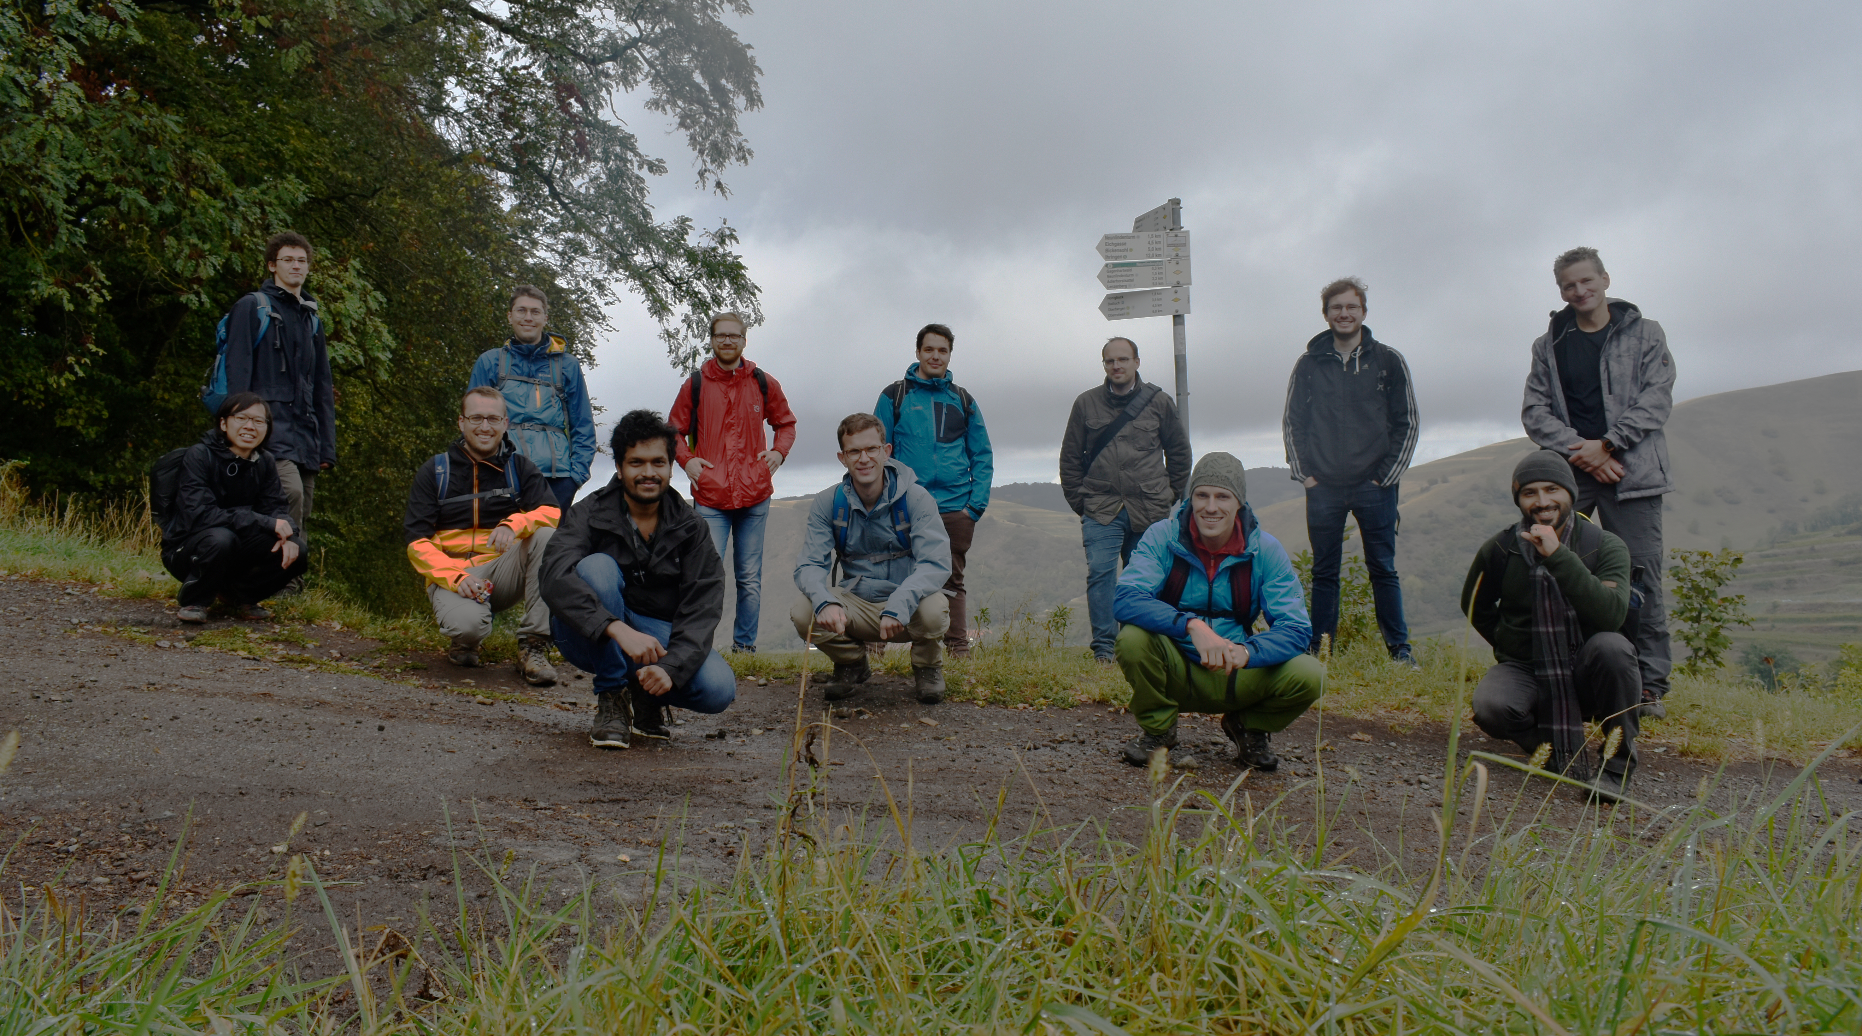
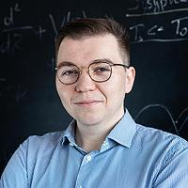
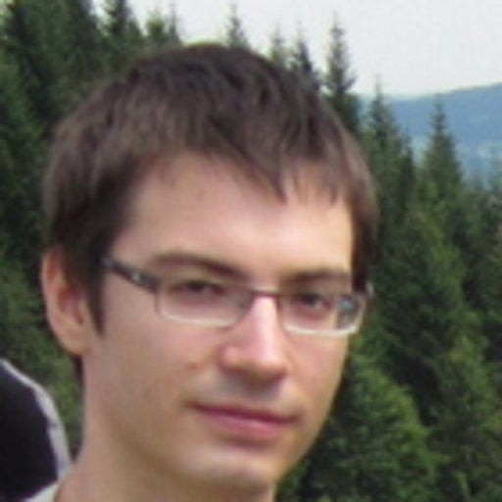






Theory collaborators:
Michał Tomza,
Krzysztof Jachymski,
Agata Wojciechowska
BaLi Team:
Fabian Thielemann, Joachim Welz, Wei Wu, Pascal Weckesser (former)
Tobias Schätz

