Slide 1
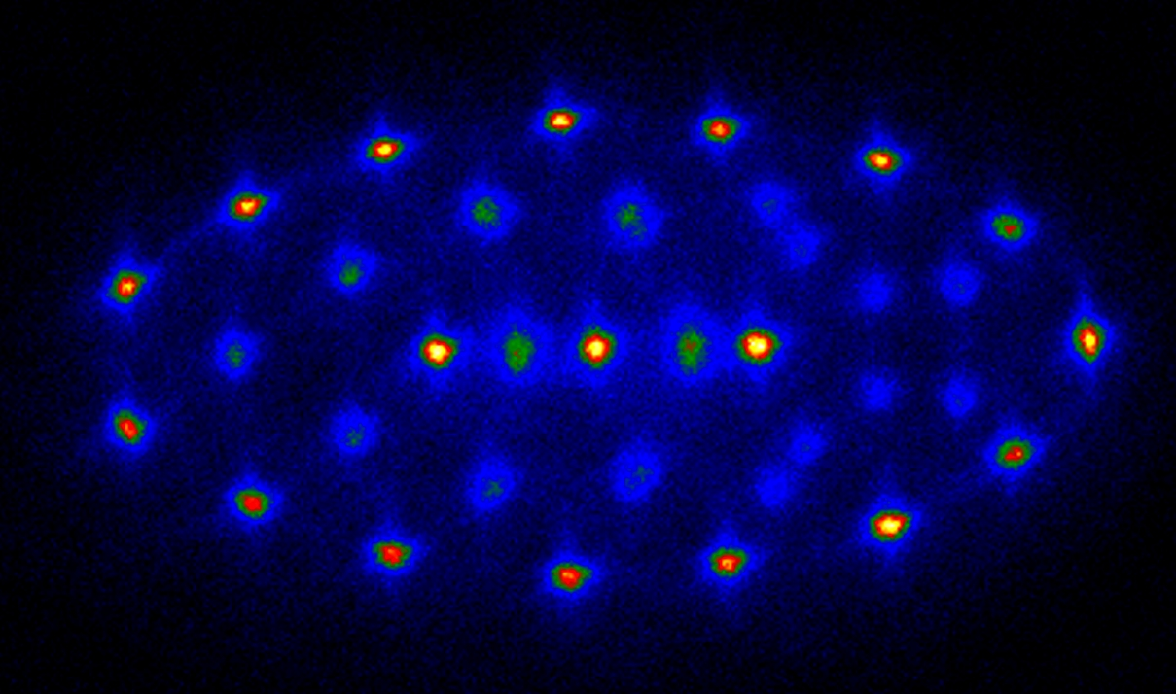
Trapping Ions and Atoms and Molecules Optically
TIAMO
Catching the wave
Optical Traps for controlling Ions & Ultracold Atoms in the quantum regime
10µm
Konstanz 2021 – Tobias Schaetz/Freiburg

Slide 2
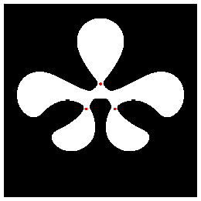
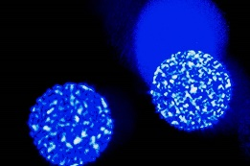
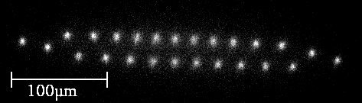

topics of the group in Freiburg
Ions (and atoms) in optical traps (optical lattices)
2D Coulomb crystals / topological defect(s) (common rf-potential)
+ arrays of (individual rf-potentials)
traps
1D – crystals
    spin-(spin)-boson
    squeezing
(2017): 3s
(2018): Coulomb Crystals
(2020): sympathetic cooling
(2021): ion-atom Feshbach
col. Moszynski, Tomza, Jachymski,
Dulieu, Morigi,
(Lukin, Coté)
col. Reznik,
Landa,
Retzker
(2017):
spectroscopy + soliton transport
- towards structural entanglement
(2016): triangle
(2019): 2D-coupling
(2019): PAT in 2D
towards Ar⁺ cleaning
Porras, Bermudez
NIST, SNL, R.Schmied,
C.Ospelkaus
20μm
20μm
(2016): thermalisation
(2017): non-Markovianity
(2019); squeezing/pair-creation
(2021) Qsim e-transfer
Porras, Breuer, Thoss
(Bermudez, Plenio)
Fey, Schützhold
Buchleitner
Notes:
In this talk I will present our proposal for the simulation of quantum spin models. I have been working in this proposal with Ignacio Cirac at the Theory Division of the MPQ in Garching.

Slide 3
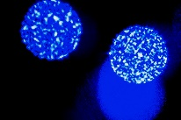
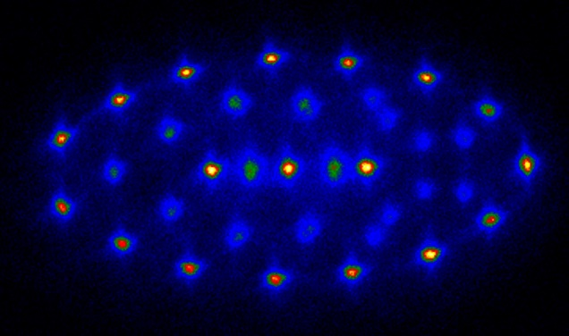
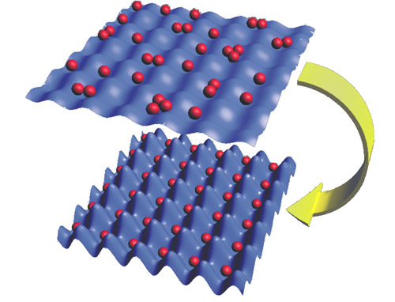
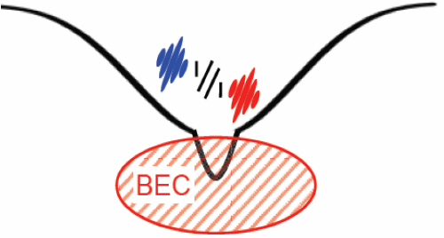
combining ions and atoms by light
60 years of
ions in radio frequency fields (10⁴ K)
30 years of
atoms in optical fields (10⁻³ K)
complete not
compete
10μm
0.1μm
deep wells
unique controllability
long range interaction
courtesy of I.Bloch
scalable
versatile geometries
novel (extended) perspectives*:
ions
atoms & ions
atom(s!) & ion(s!)
clusters/molecules
*Rep Prog Phys (2012) + J.Phys.B (2017)

Slide 4
Trapping Ions in Atoms and Molecules Optically
TIAMO - Outline
why?
^{basics} rf + hybrid traps
^{basics} all optical ion traps
how? protocol + challenges
experimental results:
- sympathetic cooling (Ba⁺ Rb) - pure ODT
- controlling ion-atom interaction (Ba⁺ Li) - still hybrid
+ some basics
Whither TIAMO/BaLiLaB ions
- ultra-cold interaction/chemistry
- towards quantum phase transitions

Slide 5
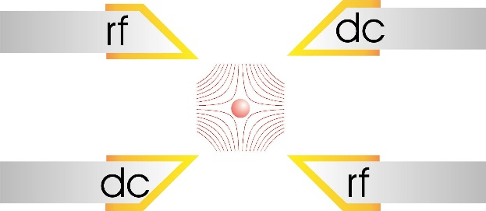
Werkzeug: die lineare Paul Falle
Paul-trap “simulation” - basics
radial cross section
ac quadrupole field
! time averaged potential !
+
~ rf
over all:
focusing
f
defocusing + focusing
(storage ring simulation)

Slide 6
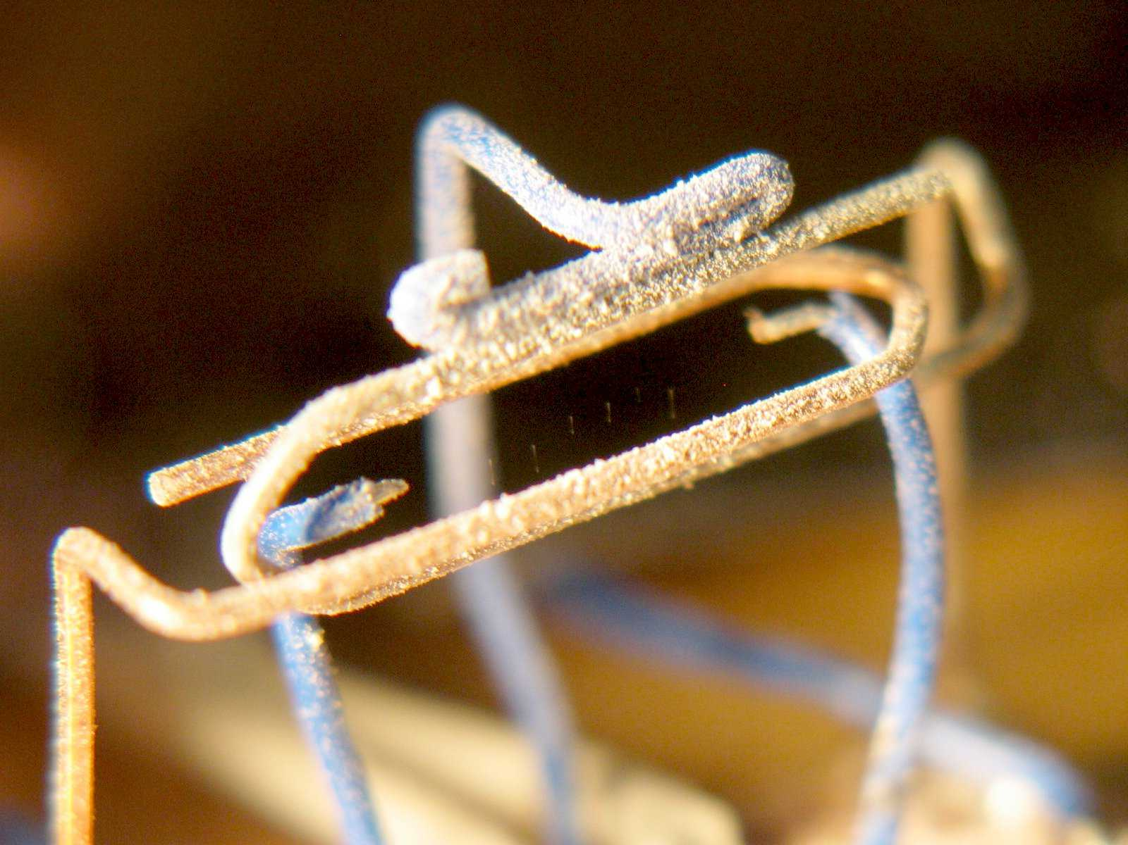
must have – a Paul trap

Slide 7
embedding ion and atoms in hybrid trap
driven by radio frequency
fundamental source of heat
still: impressive results @
Aarhus, Amsterdam (~10µK E_{coll}), Basel, Cambridge/Bonn, CQT-Singapore, Japan, Heidelberg, Innsbruck, MIT, Raman Institute, Ulm, UCLA, Weizmann, …
M. Cetina et al., Phys. Rev. Lett. 109, 253201 (2012).

Slide 8

embedding ion and atoms in hybrid trap
driven by radio frequency
fundamental source of heat
M
m
all-optical
atom shifts ion r⁻⁴ potential
all but Yb⁺/Ba⁺ (m>>) and Li (m<<) *
*V.Vuletic (2013) + T.Feldker (Rene 2020)

Slide 9
Trapping Ions in Atoms and Molecules Optically
TIAMO - Outline
why?
^{basics} rf + hybrid traps
^{basics} all optical ion traps
how? protocol + challenges
experimental results:
- sympathetic cooling (Ba⁺ Rb) - pure ODT
- controlling ion-atom interaction (Ba⁺ Li) - still hybrid
Whither TIAMO/BaLiLaB ions
- towards ultra-cold interaction/chemistry
- towards quantum phase transitions

Slide 10
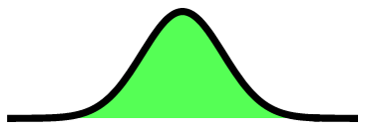

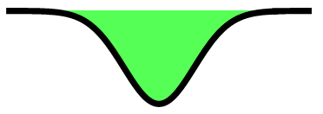

optical trapping - recap
dependent on electronic state (& species)
Δ₂
|e>
|e>
|P>
ħΔ
Δ₁
ħω₀
I,ħω_{L}
|D>
|g>
|g>
|S>
U_{opt}
- trap depth U_{opt} ~ ^{I}/Δ
- off-resonant scattering R_{phot} ~ ^{I}/Δ²
ac-Stark shift

Slide 11
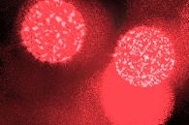
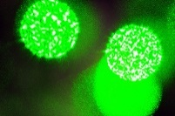
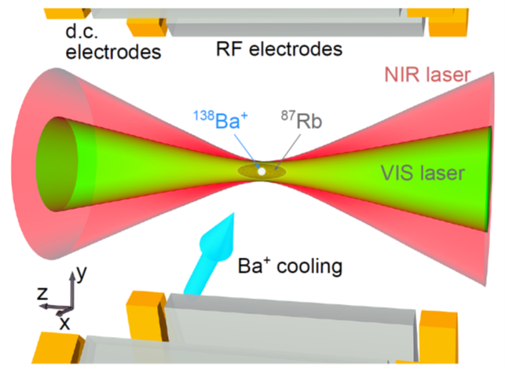

bi-chromatic ODT for atoms + ion(s)
+
bi-chromatic
(attractive - attractive)
bi-chromatic
(repulsive - attractive)
¹³⁸Ba⁺
⁸⁷Rb
For T> => NIR & VIS
¹³⁸Ba⁺ in ⁸⁷Rb
(NIR only?)
VIS
- ion in |S> trapped (VIS and NIR)
- atom in |S> trapped by NIR
- ion : Δ> from NIR (e⁻ missing)
confinement weaker
ion starts hot (T_{D}~360µK – rf-heating)
bad for: evaporative/sympathetic (pre-)cooling!
VIS
532
NIR
1064
NIR

Slide 12
matching individual potentials
+
our try
¹³⁸Ba⁺
⁸⁷Rb
VIS
NIR
VIS
+ stray field < 5 mV/m
+ dc-deconfinement (2π 11 kHz)
NIR
+ evaporativly cooled Rb (1-30µK)
+ Ba⁺ starting at T_{D}~360µK !!!
P_{NIR} < 65mW ω_{NIR} ~ 4μm
P_{VIS} < 470mW ω_{VIS} ~ 4μm

Slide 13
Trapping Ions in Atoms and Molecules Optically
TIAMO - Outline
why?
^{basics} rf + hybrid traps
^{basics} all optical ion traps
how? protocol + challenges
experimental results:
- sympathetic cooling (Ba⁺ Rb) - pure ODT
- controlling ion-atom interaction (Ba⁺ Li) - still hybrid
Whither TIAMO/BaLiLaB ions
- towards ultra-cold interaction/chemistry
- towards quantum phase transitions

Slide 14
optical ion trapping – the protocol
1
- loading into Paul-trap
- Doppler cooling* (~ 0.5 mK)
2
- switching on the dipole trap
- switching off the Paul-trap (not DC)
- storing the ion optically for t_{opt} = x ms
(experiments- absence of rf)
3
- switching Paul trap on
switching optical trap off
fluorescence detection

Slide 15
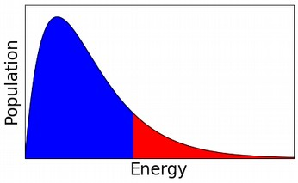
onset of sympathetic cooling
+
protocol
MOT/ODT
Doppler
cooling
~ 500 Rb
T^{Ba} ~ T_{D} = 360µK
T^{Rb} ~ 30(10)µK
rf - off
cut-off model in ODT:
U_{opt}
trapped
lost
++?cooling by adiabatic transfer?

Slide 16
onset of sympathetic cooling
+
protocol
MOT/ODT
Doppler
cooling
~ 500 Rb
T^{Ba} ~ T_{D} = 360µK
T^{Rb} ~ 30(10)µK
rf - off
with Rb
T_{D}~ 259(10)µK
current results:
+ one collision on average
~ Γ_{Langevin}~ 1.5 10³ s⁻¹ @
n_{Rb} ~ 5 10¹¹ cm⁻³
without Rb
T~357(22)µK

Slide 17
onset of sympathetic cooling
+
protocol
MOT/ODT
Doppler
cooling
onset of symapthetic
cooling in ODT
~ 500 Rb
T^{Ba} ~ T_{D} = 360µK
T^{Rb} ~ 30(10)µK
rf - off
with Rb
T_{D}~ 259(10)µK
current limitations/results:
+ one collision on average
~ Γ_{Langevin}~ 1.5 10³ s⁻¹ @
n_{Rb} ~ 5 10¹¹ cm⁻³
-- photo assisted (P_{NIR/VIS} >)
-- beam pointing (ω < 4µm)
> density fluctuation (3 body loss)
without Rb
T~357(22)µK

Slide 18
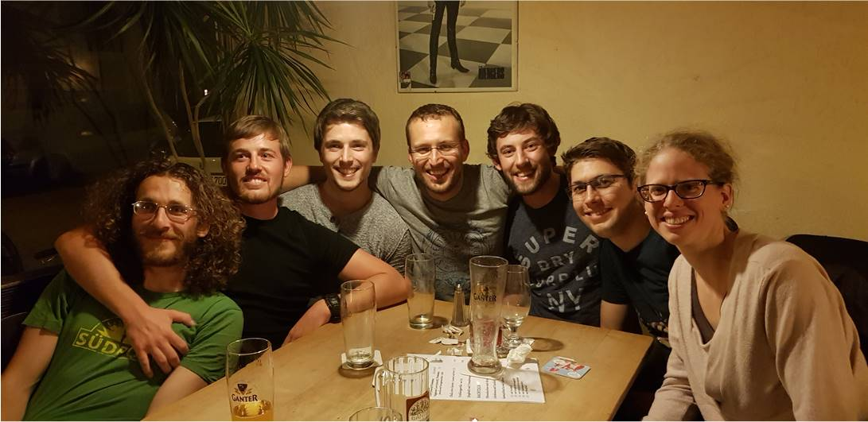
Trapping Ions in Atoms and Molecules Optically
TIAMO - Outline
why?
^{basics} rf + hybrid traps
^{basics} all optical ion traps
how? protocol + challenges
experimental results:
- sympathetic cooling (Ba⁺ Rb) - pure ODT
- controlling ion-atom interaction (Ba⁺ Li) - still hybrid
+ some basics
Whither TIAMO/BaLiLaB ions
- towards ultra-cold interaction/chemistry
- towards quantum phase transitions
+Wei
+Joachim
+
TOM

Slide 19
collision/scattering: in a nut shell
- wave function
(energy and phase)
elastic collision
(no internal change)
no energy change
phase of Ψ must change

Slide 20
collision/scattering: in a nut shell
- wave function
(energy and phase)
elastic collision
(no internal change)
no energy change
phase of Ψ must change
step by step
Ecoll
box potential
- wave function
(continuous + differentiable)
1,2
“deepening” the potential

Slide 21
collision: scattering – resonances
Ψ - wave function
energy and phase
“deepening” the potential
linking phase Ψ
scattering length a: “sin(ka)”
Box potential

Slide 22
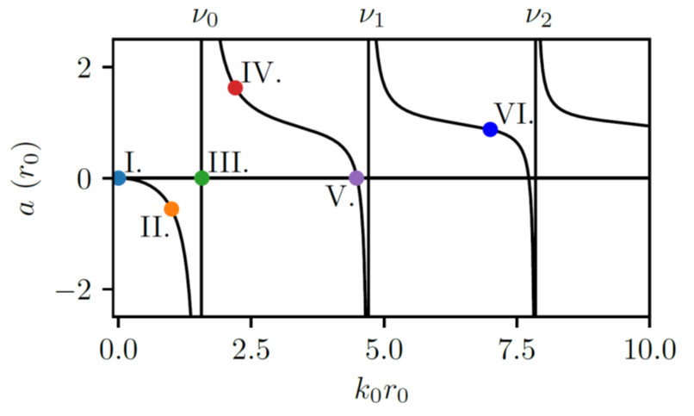
collision: scattering – resonances
Ψ - wave function
energy and phase
“deepening” the potential
νo
ν1
ν2
scattering length
scattering cross-section:
the “size” of the atom/ion

Slide 23
collisions: tuning resonances (2 channels)
ion-atom
(molecular potential energy)
quasi-bound state
=
“enhanced” interaction
e⁻spin
different internal states (spins)
different magnetic moments

Slide 24
Collisions: Tuning Resonances
quasi-bound state
=
“enhanced” interaction
B
tuning B-field/Zeeman shift
different internal states (spins)
different magnetic moments

Slide 25
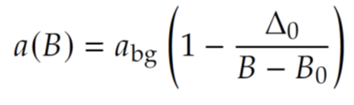
Collisions: Tuning Resonances
quasi-bound state
=
“enhanced” interaction
B
scattering length

Slide 26
controlling ion-atom interaction (hybrid trap)
Ba⁺Li [BaLiLaB]
angular momentum contribution
Feshbach resonances
(nuclear physics)
R*
E*
R*_{ion-atom} > 10 R*_{atom-atom}
E*_{ion-atom} < 10⁻² E*_{atom-atom}
atom-atom
interaction (van der Waals ~ 1/r⁶)
generic:
- different asymptotes
- density of vibrational states
- typ! scattering length
- energy scale :
ion-atom interaction (~1/r⁴)
Tomza et al. Rev.Mod:phys(2019)

Slide 27
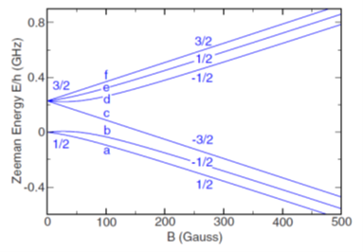
embedding ion and atoms in hybrid trap
⁶Li (fermion)
20x10³ ⁶Li spin state |2>
T_{Li} ~ 1µK ~ 0.6 T_{F}
atomic peak density ~ 10¹² cm⁻³
~ 100 collisions for thermalization
final „Temp“: ~ 100µK
→ collision energy ~ 15-30 µK

Slide 28
embedding ion and atoms in hybrid trap
inelastic
three-body loss
elastic
(sympathetic cooling)
σ₃
σ₂

Slide 29
embedding ion and atoms in hybrid trap

Slide 30
embedding ion and atoms in hybrid trap

Slide 31
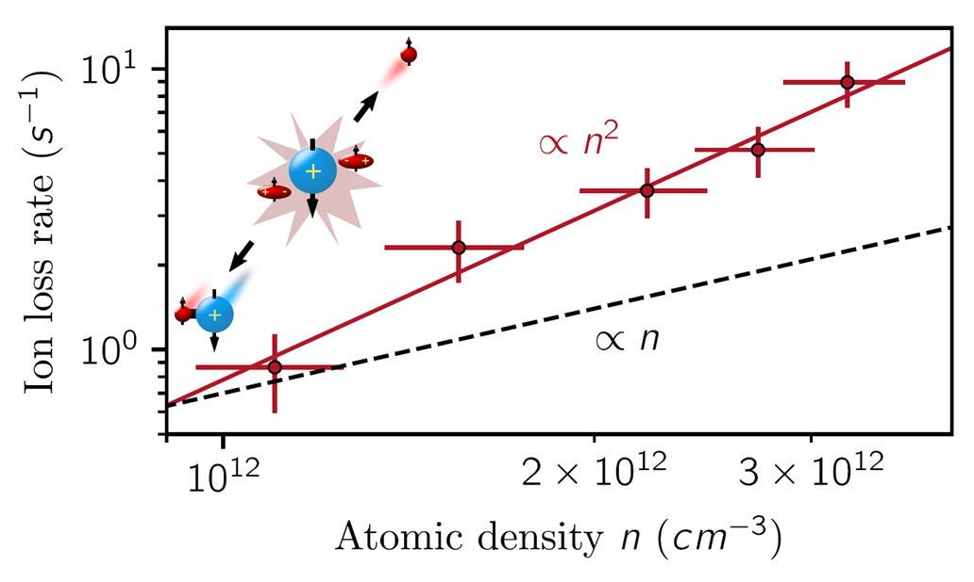
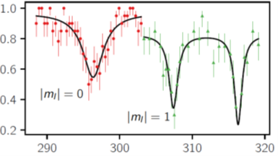
embedding ion and atoms in hybrid trap
ion loss (atomic density)
one ion + two atoms (atomic density²)
296.34G
- k₃=7.8(8)_{stat}(11)_{sys} 10⁻²⁵ cm⁶/s
- k₂=0
three body recombination (> 99%) - molecular ions – “despite Pauli”
versus
Pérez-Ríos, Jesús. arXiv:2011.03963 (2020)

Slide 32
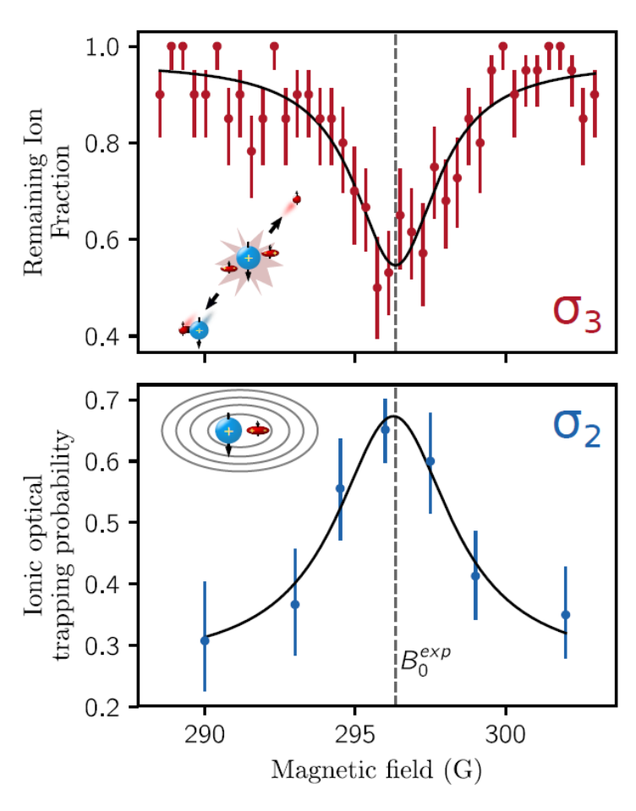
embedding ion and atoms in hybrid trap
loss feature (in hybrid trap)
see before:
atomic peak density ~ 1.3 (3)10¹² cm⁻³
interaction duration ~ 300 ms
enhanced cooling (measured in VIS ODT)
atomic peak density ~ 6.1(1.2) 10¹¹ cm⁻³
interaction duration ~ 150 ms
(ion survival ~ 96% )
speed up of cooling
controlling
two- versus three-body interaction
cooling versus loss
296.34G

Slide 33
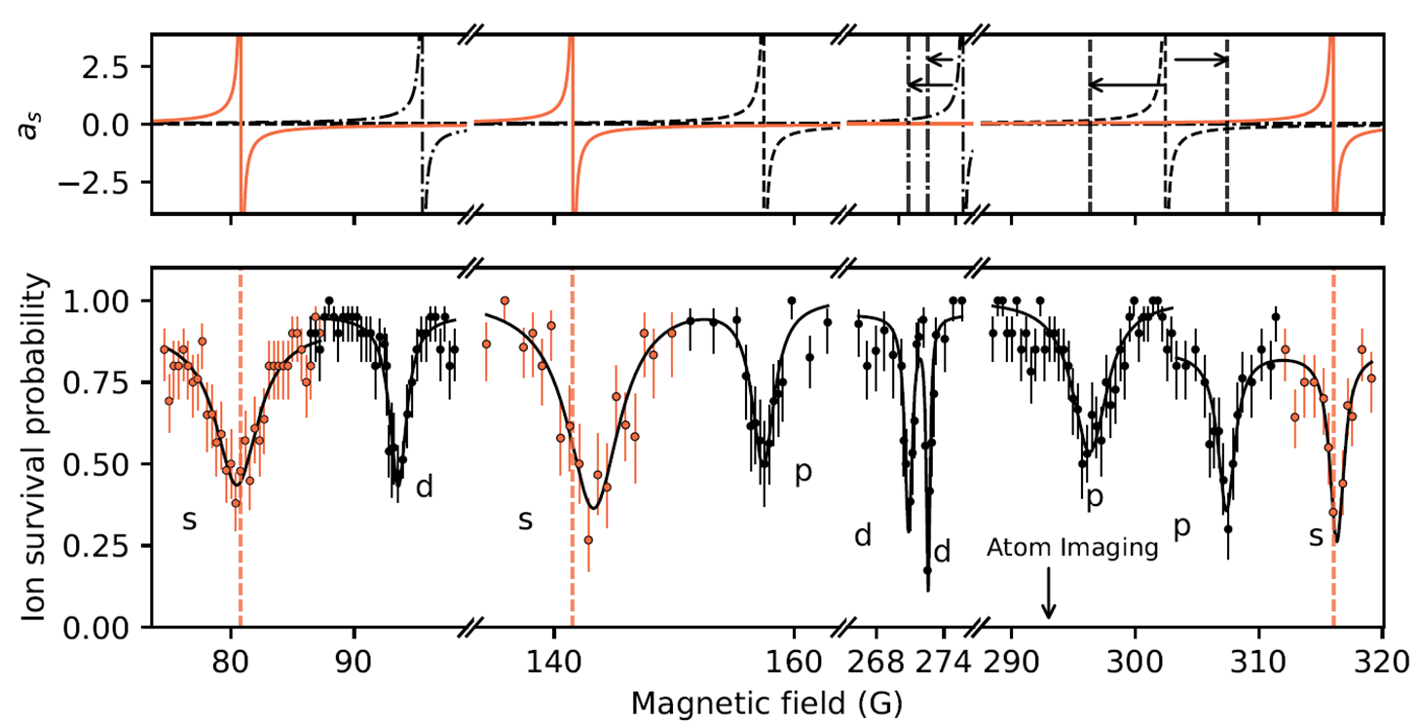
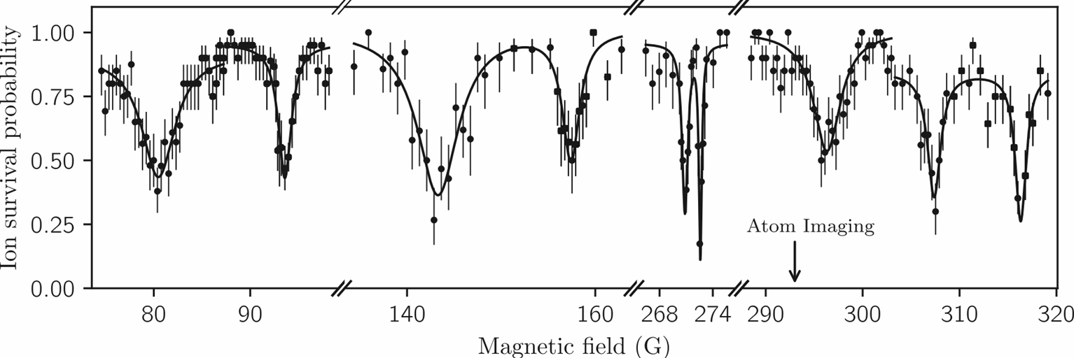
set of resonances in BaLiLaB
currently: interaction even/still in hybrid trap
Close collaboration with theory: Michal Tomza, Dariusz Wiater, Krzysztof Jachymski, Agatha Wojciechowska
what’s next?

Slide 34
Trapping Ions in Atoms and Molecules Optically
TIAMO - Summary
dipole trap for an ion (optical lattice)
- 3s: comparable to atoms – heating “<”
- coherence times >100ms
Coulomb crystals in a dipole trap
+ phonons available
(2D crystals without rf)
controlling atom-ion interaction by Feshbach resonances
onset of sympathetic cooling in pure ODT
Whither TIAMO/BaLiLaB ions
- towards ultra-cold interaction/chemistry
- towards quantum phase transitions

Slide 35

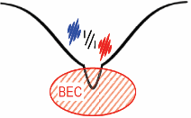
bi-chromatic trap for atoms + ion(s)
bi-chromatic dipole trap (lattice)
+
¹³⁸Ba⁺ in ^{6,7}Li (Fermion/Boson of m<<) and ⁸⁷Rb
- Feshbach resonances (ion/atom)
- evaporative/sympathetic cooling (deep in s-wave regime)
- characterizing Ba⁺ Li (⁶Li or ⁷Li,⁶Li₂)
many-body interaction (mesoscopic clusters?)
“impurity” in BEC
ultra-cold chemistry
embedding product (hybrid-box)

Slide 36
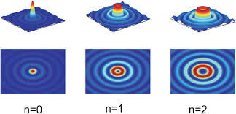
structural quantum phase-transition
complete not
compete
0.2μm
10μm
extended perspectives:
courtesy of I.Bloch
ions
atoms & ions
atom(s!) & ion(s!)
clusters/molecules
into
motional ground state (2D)
structural phase transitions
+ coherent superposition
+ state dependent conf.
+ optical lattices
+
+
+

Slide 37







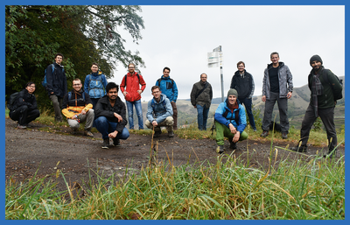
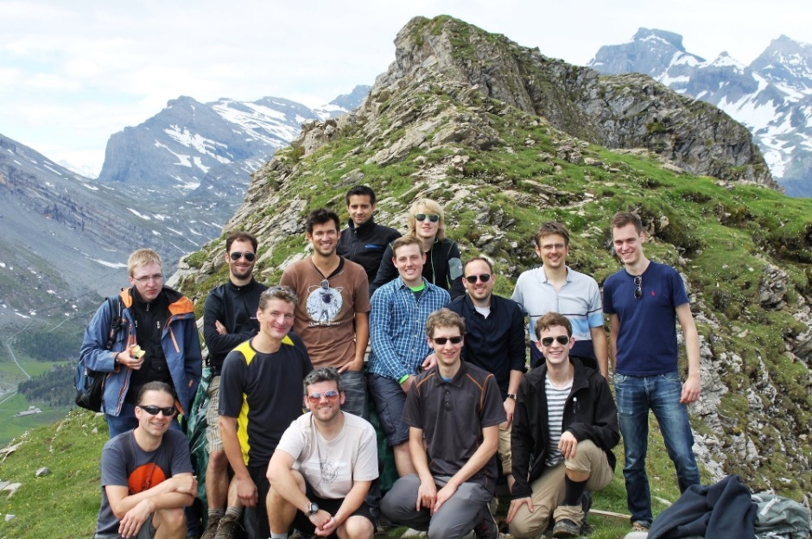
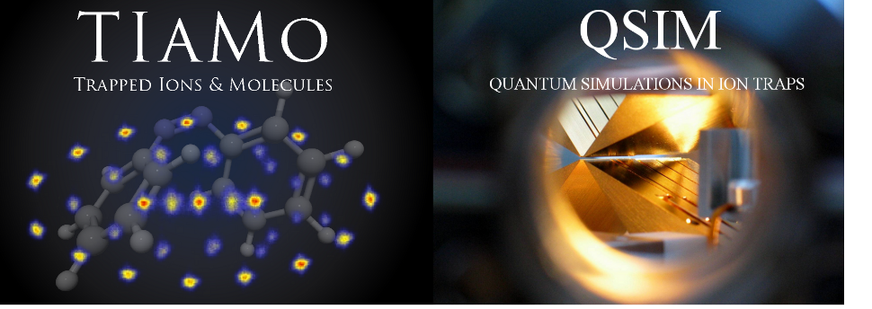
QSIM
L.Guth, F.Hasse, D.Palani, A.Das
U.Warring
TIAMO
[J. Schmidt,] D.Hönig,
A.Mohammadi [L.Karpa]
BaLi
[P.Weckesser,] F.Thielemann, J.Welz, W.Wu,
[M.Debatin,] T.Walker
QSim
Quantum Simulations (with ions)
scaling QSim in rf-surface traps
Kinks
+
TIAMO
TIAMO
Trapped Ions And MOlecules
Notes:
In this talk I will present our proposal for the simulation of quantum spin models. I have been working in this proposal with Ignacio Cirac at the Theory Division of the MPQ in Garching.

