Slide 1
Forecasting Market Trends Using Time Series Machine Learning

Slide 2
Objective
Develop a robust model to predict future market trends based on historical data.
.
.

Slide 3
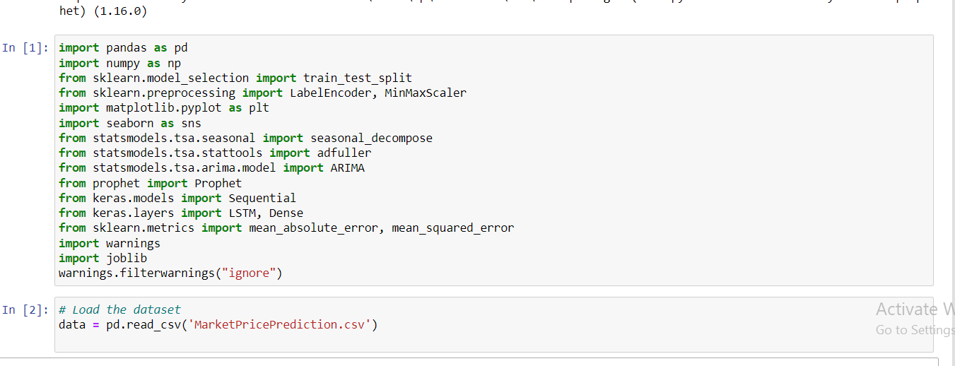
Data Description
Overview of dataset columns.
Example table of the dataset.
.

Slide 4
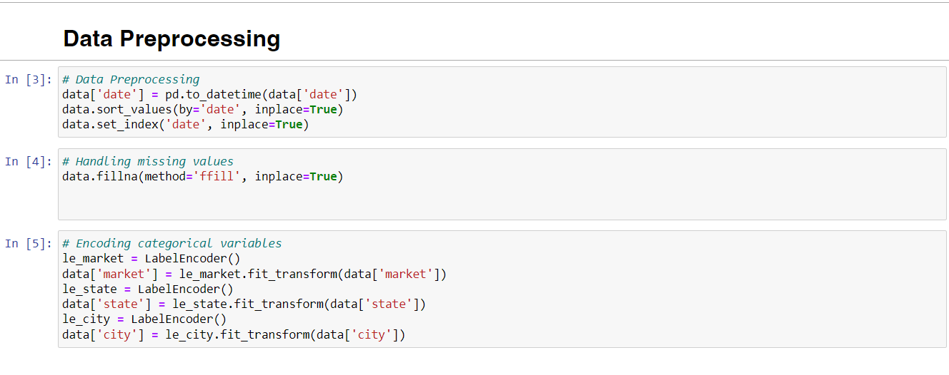
Data Preprocessing
Cleaning data, handling missing values, encoding categorical variables.

Slide 5
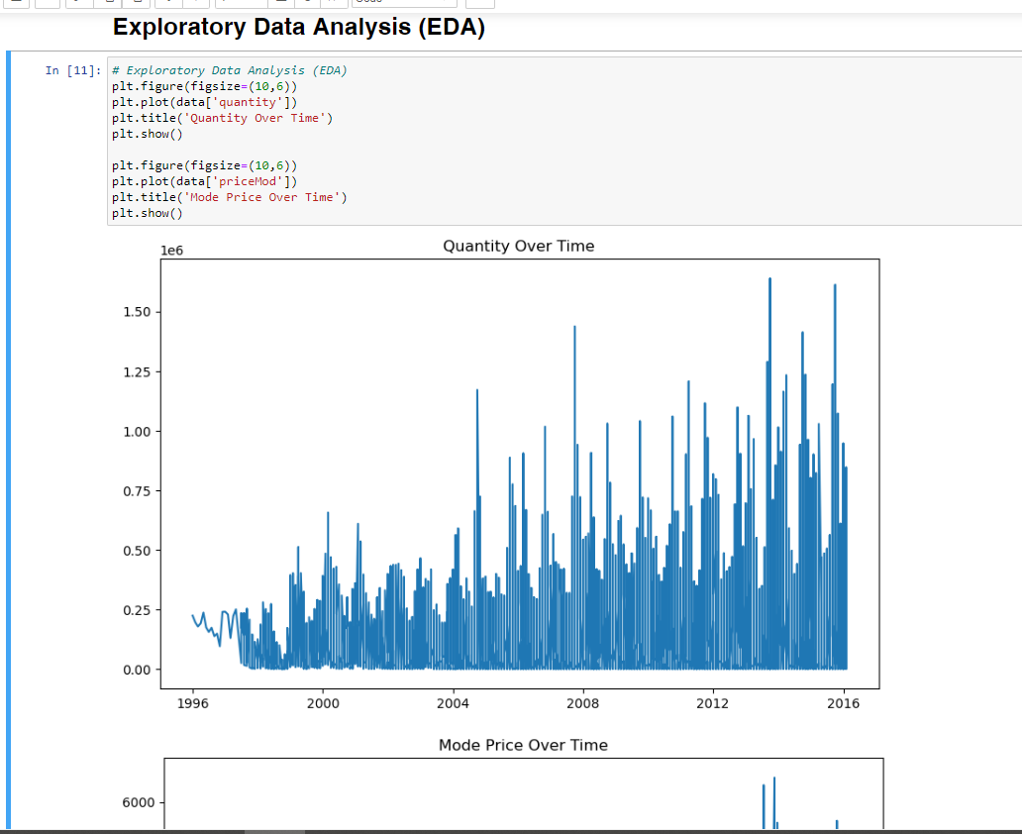
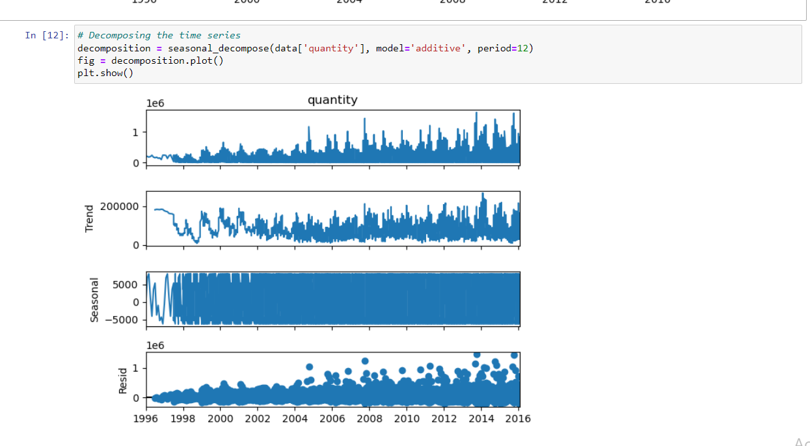
Exploratory Data Analysis (EDA)
Analyze temporal patterns, identify seasonality, trends, anomalies.
Line graphs, bar charts, histograms.

Slide 6
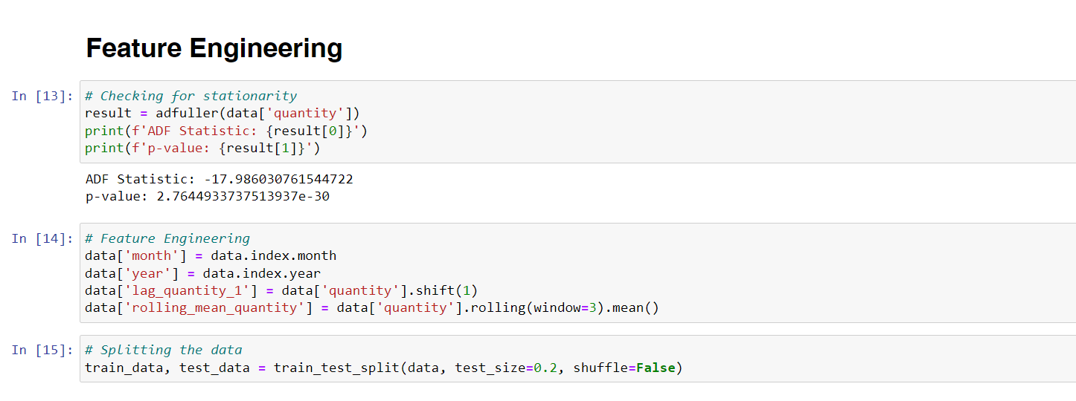
Feature Engineering
Create relevant features (lagged variables, rolling statistics, seasonal indicators).

Slide 7
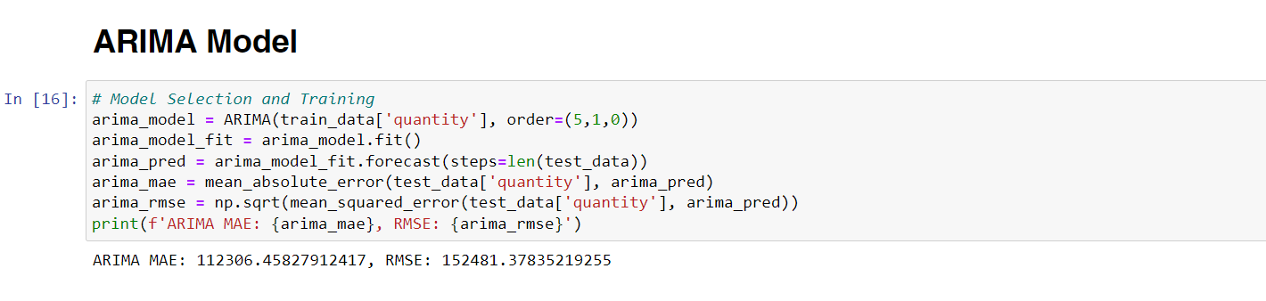
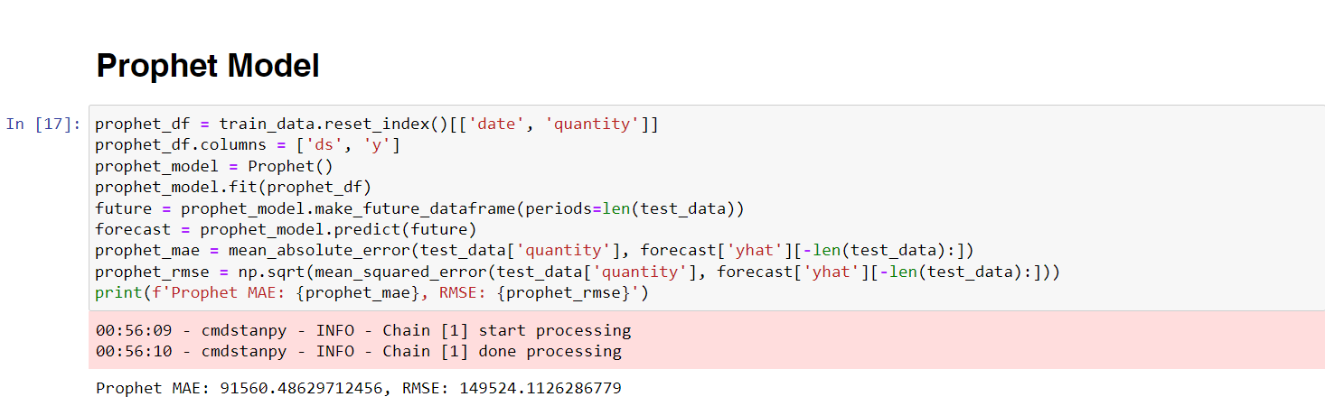
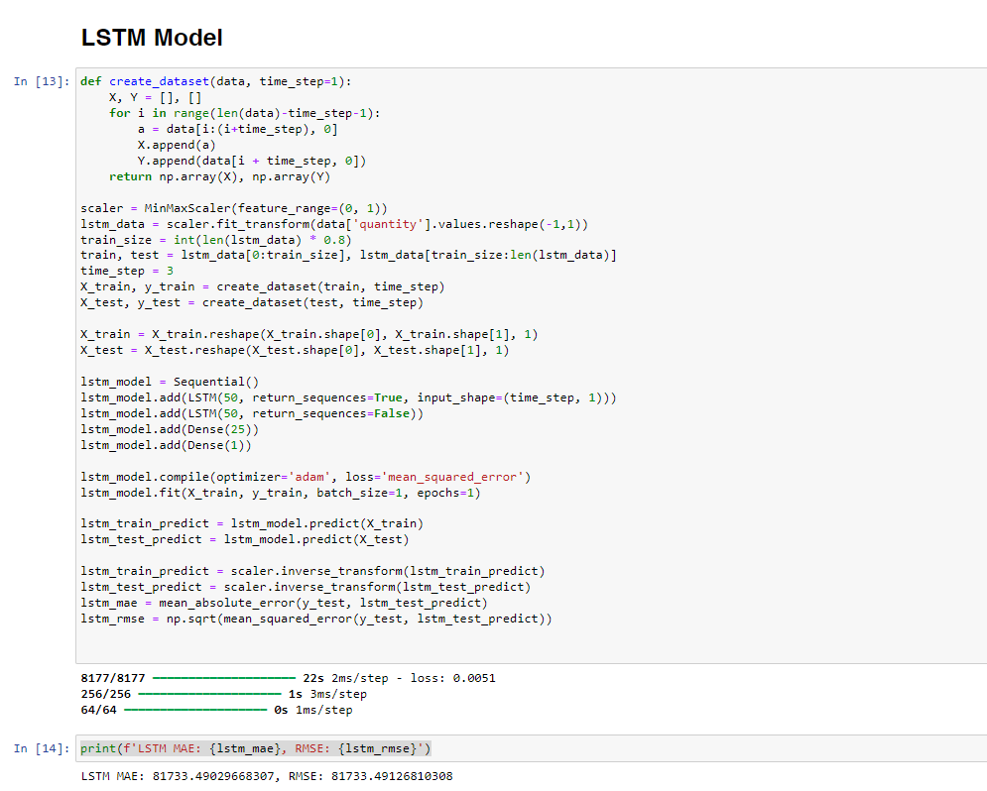
Model Selection and Training
ARIMA, Prophet, LSTM

Slide 8
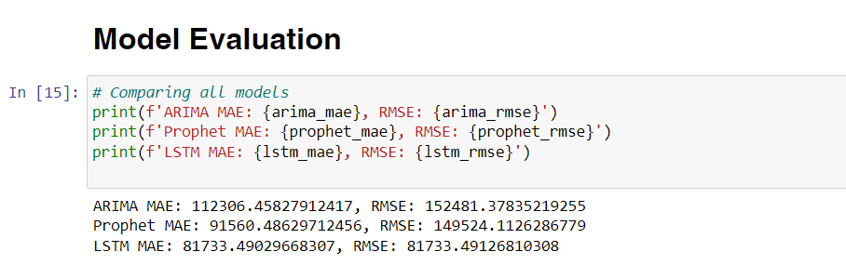
Model Evaluation
Comparing all models

Slide 9
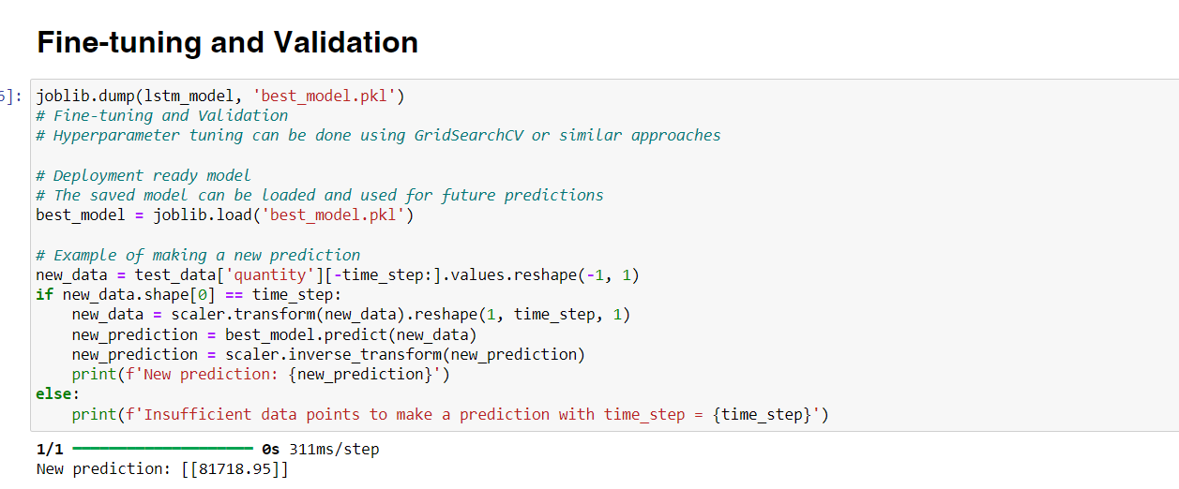
Fine-tuning and Validation
Fine-tuning model parameters, validating performance on unseen data.

Slide 10
Conclusion
Recap of project's steps and objectives.
Next steps: Implementation in real-world scenario, continuous monitoring and improvement.

Slide 11
Thank you
Ahmed Mohamed Tawab
+201020750220
ahmedtawab017@gmail.com

