Slide 1
SparkCLR
C# language binding and extensions to Apache Spark
(SparkCLR is pronounced like “Sparkler”)

Slide 2
Goals
Make C# a first-class citizen for building Apache Spark apps for the following job types
Batch jobs (RDD API)
Streaming jobs (Streaming API)
Structured data processing or SQL jobs (DataFrame API)

Slide 3
Why C# support in Apache Spark
Enable C# developers use existing .NET libraries in their Spark apps or build Spark apps ground-up in the language they love
Lower the barrier for organizations that use C# as the primary application development language to start building Spark applications without having to invest in languages like Scala, Java, Python or R
With SparkCLR it should be possible to develop apps in C# for Spark deployed to private clusters/cloud, Windows-based VMs in Azure or AWS
With Mono or .NET Core it may be possible to support SparkCLR with Spark clusters in Linux as well

Slide 4
Design goals
In Spark executors, CLR should be launched during execution if & only if needed
User-implemented custom code in C# will run outside of Spark JVM -- in CLR
Any Spark stage that does not involve user-implemented custom code in C# should just use built-in Spark functionality & the execution should be limited to JVM.
For example, the following scenarios do not involve executing custom C# code and hence execution will not involve CLR
Creating a RDD from a text file and performing row count
Projection, filtering, joining in DataFrames that do not involve C# UDF/UDAF
Re-use (design & code) from other language binding implementations in Spark (SparkR & PySpark)
Maintain fidelity with Spark public API in Scala & Java
Build SparkCLR as an extension to Spark
Spark bits should just be dependencies.

Slide 5
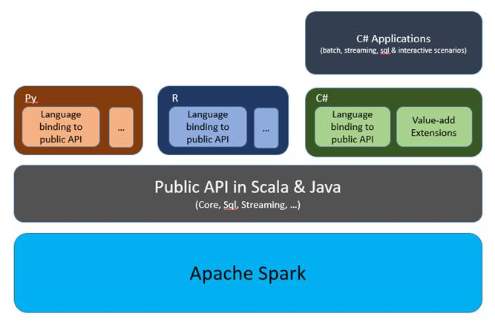
SparkCLR

Slide 6
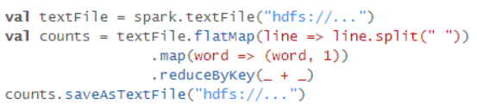
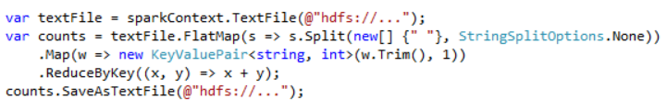
Word Count example
Scala
C#

Slide 7
Log Processing Sample in SparkCLR
Scenario – Join data in two log files using guid and compute max and avg latency metrics grouped by data center
Requests log file columns
Guid
Datacenter
ABTestId
TrafficType
Metrics log file columns
Unused
Date
Time
Guid
Lang
Country
Latency

Slide 8
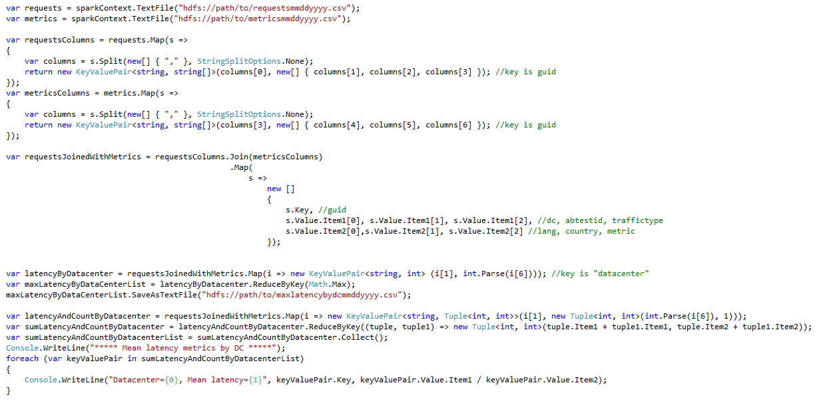
Log Processing – RDD sample in SparkCLR

Slide 9
Log Processing – DStream sample in SparkCLR
// write code here to drop text files under <directory>\test
… … …
StreamingContext ssc = StreamingContext.GetOrCreate(checkpointPath,
() =>
{
SparkContext sc = SparkCLRSamples.SparkContext;
StreamingContext context = new StreamingContext(sc, 2000);
context.Checkpoint(checkpointPath);
var lines = context.TextFileStream(Path.Combine(directory, "test"));
var words = lines.FlatMap(l => l.Split(' '));
var pairs = words.Map(w => new KeyValuePair<string, int>(w, 1));
var wordCounts = pairs.ReduceByKey((x, y) => x + y);
var join = wordCounts.Join(wordCounts, 2);
var state = join.UpdateStateByKey<string, Tuple<int, int>, int>((vs, s) => vs.Sum(x => x.Item1 + x.Item2) + s);
state.ForeachRDD((time, rdd) =>
{
object[] taken = rdd.Take(10);
});
return context;
});
ssc.Start();
ssc.AwaitTermination();

Slide 10
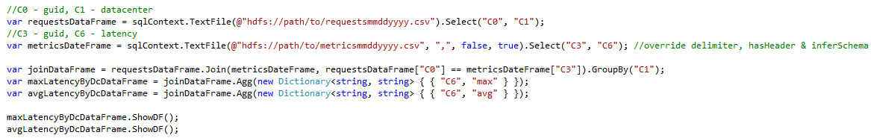
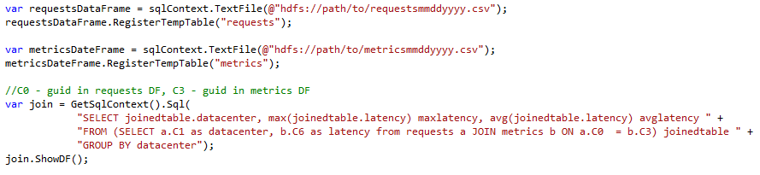
Log Processing – DataFrame sample
Using DataFrame DSL
Using DataFrame TempTable

Slide 11
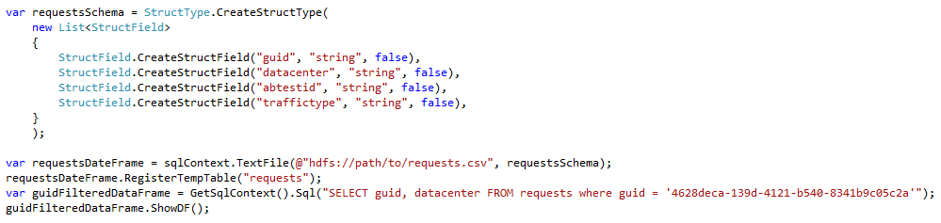
Log Processing – Schema Spec Option

Slide 12
Performance Considerations
Map & Filter RDD operations in C# require serialization & deserialization across JVM & CLR and it will have an impact on the performance. However, C# operations are pipelined within a stage to minimize unnecessary Ser/De
DataFrame operations that do not use C# UDFs will take advantage of execution plan optimization & code generation perf improvements built into Spark and there will not be any perf impact relative to Scala apps
TBD – perf comparison with Scala apps

Slide 13
Project Info
Repo - https://github.com/Microsoft/SparkCLR
License - SparkCLR is licensed under the MIT license. See LICENSE file for full license information.
Discussions - https://sparkclr.codeplex.com/discussions

Slide 14
Thanks to…
Spark community – for building Spark ☺
SparkR and PySpark developers – SparkCLR reuses design and code from these implementations
Reynold Xin and Josh Rosen from Databricks for the review and feedback on SparkCLR design doc
Ram Sriharsha and Ram Venkatesh from Hortonworks for their comments on the early project ideas

Slide 15
Implementation Details

Slide 16
Driver-side IPC Interop
Using a Netty server as a proxy to JVM

Slide 17
Driver-side implementation in SparkCLR
Driver-side interaction between JVM & CLR is the same for RDD and DataFrame APIs
Drivers perform the discretization of streams in Streaming API. SparkCLR Streaming API implementation will include that

Slide 18
DataFrame

Slide 19
JVM
Sql
Context
(Spark)
Data
Frame
(Spark)
create
5
8
Use jsc & create DF in JVM
Called by sparkclr-submit.cmd
CSharpRunner
Launches Netty server creating
proxy for JVM calls
CSharpBackend
1
Invokes method on DF
12
Invokes JVM-method
to create context
4
7
Invokes JVM-method
to create SC
SqlContext has
reference to SC in JVM
2
Driver
(user code)
Init
SqlContext
3
Launches C#
sub-process
create DF
6
9
Java/Scala component
DataFrame
DF has reference
to DF in JVM
Operation
C# component
10
Invokes JVM-method
All components will be SparkCLR contributions
except for user code and Spark components
11

Slide 20
RDD

Slide 21
JVM
Spark
Context
(Spark)
RDD
(Spark)
CSharpRDD
create
5
8
Use jsc & create JRDD
13
Called by sparkclr-submit.cmd
CSharpRunner
Launches Netty server creating
proxy for JVM calls
CSharpBackend
1
Invokes JVM-method
to create context
4
7
Invokes JVM-method
to create RDD
SparkContext has
reference to SC in JVM
2
Driver
(user code)
Init
SparkContext
3
Launches C#
sub-process
Invokes JVM-method
to create C#RDD
create RDD
12
6
9
Java/Scala component
RDD
RDD has reference
to RDD in JVM
C# operation
create
PipelinedRDD
C# component
10
11
All components will be SparkCLR contributions
except for user code and Spark components

Slide 22
DStream

Slide 23
JVM
Callback to C#Process
To create C#RDD
Java
Streaming
Context
(Spark)
Java
DStream
(Spark)
CSharp
DStream
14
create
5
8
Use jssc & create JDStream
13
Called by sparkclr-submit.cmd
CSharpRunner
Launches Netty server creating
proxy for JVM calls
CSharpBackend
1
Invokes JVM-method
to create context
4
7
Invokes JVM-method
to create JavaDStream
2
Driver
(user code)
Init
Streaming
Context
3
StreamingContext has reference
to JavaSSC in JVM
Launches C#
sub-process
Invokes JVM-method
to create C#DStream
create RDD
15
6
9
12
DStream has reference
to JavaDStream in JVM
Continue to the
Above RDD graph
Java/Scala component
DStream
C# operation
create
Transformed
DStream
RDD
C# component
10
11
All components will be SparkCLR contributions
except for user code and Spark components

Slide 24
Executor-side IPC Interop
Using pipes to send data between JVM & CLR

Slide 25
C# Lambda in RDD
Similar to Python implementation

Slide 26
Launch executable
as sub-process
CSharpRDD
SparkCLR
Worker
Serialize data
& user-implemented C# lambda
and send through socket
Spark calls
Compute()
Serialize processed data and
send through socket
Java/Scala component
CSharpRDD implementation extends PythonRDD
Note that CSharpRDD is not used when there is no
user-implemented custom C# code. In such cases CSharpWorker
is not involved in execution.
C# component

Slide 27
C# UDFs in DataFrame
Similar to Python implementation

Slide 28
Spark
UDF Core
(Python)
C#
Worker
4
Run UDF
3
Pickled data
C#
Driver
2
Run SQL with UDF
1
Register UDF
sqlContext.RegisterFunction<bool, string, int>("PeopleFilter", (name, age) => name == "Bill" && age > 40, "boolean");
sqlContext.Sql("SELECT name, address.city, address.state FROM people where PeopleFilter(name, age)")

Slide 29
SparkCLR Streaming API
Similar to Python implementation

Slide 30
StreamingContext ssc = new StreamingContext(sc, 1000);
var lines = ssc.TextFileStream(Path.GetDirectoryName(SparkCLRExamples.GetInputDataPath("words.txt")));
var filtered = lines.Filter(l => l.Contains("dog"));
filtered.Print();
ssc.Start();
ssc.AwaitTermination();
ssc.Stop();

Slide 31
Additional Samples

Slide 32
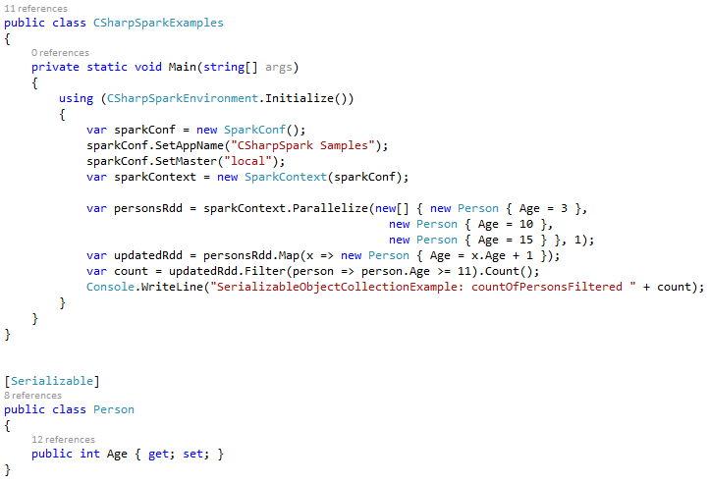
Serializable Object Sample

Slide 33
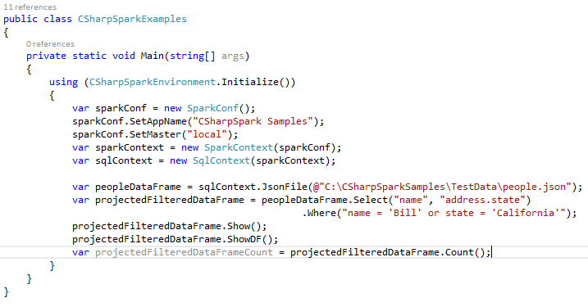
Project & Filter Sample

Slide 34
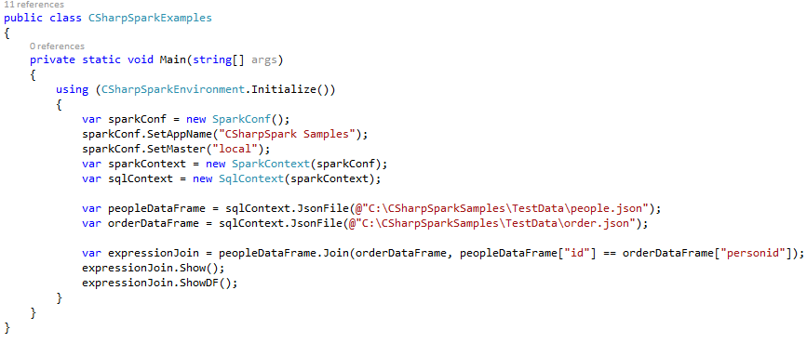
Join Sample

Slide 35
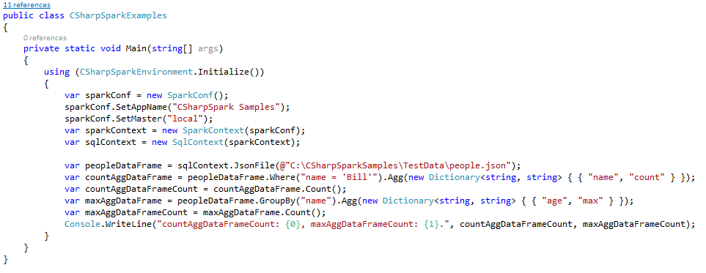
Aggregate Sample

