Slide 1
Industrial Attachment Management System (IAMS)
Tawanda Kamhamba | R223985C
BSc Honours Computer Science — FCEIC
Supervisor: Dr. Gombiro
University of Zimbabwe | June 2026

Slide 2
1. Introduction
Student: Tawanda Kamhamba
Registration Number: R223985C
Program : HCS
Project Title: Industrial Attachment Management System (IAMS)
Supervisor: Dr. Gombiro — Department of Computer Science, FCEIC
Web-based platform centralising industrial attachment workflows

Slide 3
1(d) Brief Background of the Problem
Industrial attachment connects academic learning with workplace practice
Coordination required among students, companies, supervisors, and administrators
Many institutions still use paper forms, email, WhatsApp, and scattered storage
This causes delays, lost documents, and poor visibility of student progress
Faculty needs a central digital system to manage attachment at scale

Slide 4
2(a) What Problem Is Being Addressed?
Fragmented, manual management of industrial attachment programmes
No single platform for registration, assumption, orientation, contracts, logbooks, reports, visits, grades
Difficulty assigning and monitoring students to supervisors and host companies
Assessment records stored separately and inconsistently

Slide 5
2(b) Why Is It Important?
Attachment quality depends on timely monitoring and accurate records
Manual processes are error-prone and hard to scale (Sulaiman et al., 2022)
Institutions cannot easily demonstrate programme effectiveness
Poor coordination frustrates students, supervisors, and industry partners

Slide 6
2(c) Who Is Affected by the Problem?
Students — delayed feedback, unclear requirements, lost submissions
Institutional supervisors — difficulty tracking assigned students and visits
Company supervisors — informal grading and communication channels
Faculty administrators — heavy workload counting registrations and reports
Host companies — limited structured feedback mechanisms

Slide 7
3(a) General Objective
Develop IAMS: a role-based web application centralising industrial attachment management
Support students, institutional supervisors, company supervisors, and administrators
Replace fragmented manual processes with one integrated digital platform
Enable monitoring, scheduling, assessment, and reporting from one source of truth

Slide 8
3(b) Specific Objectives — Student Module
Secure login using registration number and password
Instructions page and onboarding guidance
Industrial registration and assumption of duty submission
Orientation checklist, contract upload, weekly e-logbook, final report upload
Visit date selection, supervisor assignment requests, issue reporting

Slide 9
3(b) Specific Objectives — Supervisor & Admin
Supervisor dashboard for assigned students and document review
Visit scheduling: publish dates → students select → notifications
Visit grading, e-logbook marks, report marks, final grade computation
Password-protected company and visiting supervisor assessment forms
Admin analytics, supervisor assignment, in-system notifications

Slide 10
3(c) Expected Outcomes
Working web prototype replacing paper-based processes
Centralised MySQL database of attachment records
Faster supervisor monitoring and grade aggregation
Real-time admin analytics and improved audit trail
Foundation for future integration with institutional systems (e.g. Emhare)

Slide 11
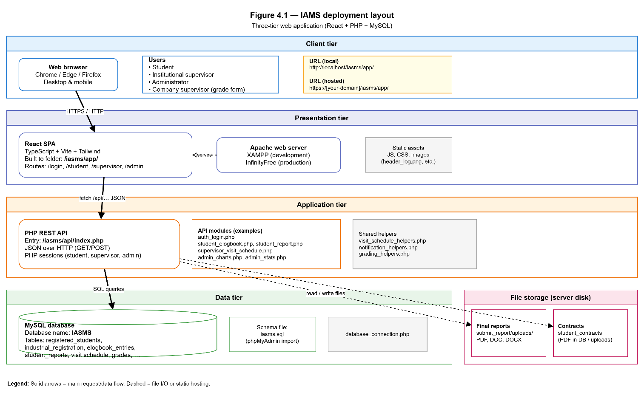
4(a) System Architecture Diagram
Three-tier architecture:
Presentation: React 18 SPA (TypeScript, Vite, Tailwind CSS)
Application: PHP REST JSON API with session-based RBAC
Data: MySQL relational database (IASMS)
Flow: Browser → React (/iasms/app) → PHP API → MySQL + file storage

Slide 12
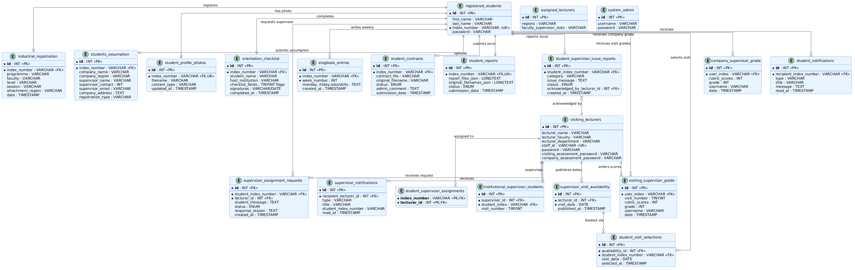
4(b) Database Design — ER Diagram
Normalised MySQL schema (iasms.sql)
Core: registered_students, industrial_registration, students_assumption
Documents: student_contracts, student_reports, orientation_checklist
Activity: elogbook_entries, supervisor_visit_availability, student_visit_selections
Assessment: visiting_supervisor_grade, company_supervisor_grade

Slide 13
4(c) Class Diagram
Frontend: StudentLayout, SupervisorLayout, AdminLayout
Pages: RegisterPage, ELogbookPage, SupervisorDashboard, AdminDashboard
Backend: auth_login.php, student_*.php, supervisor_*.php, admin_*.php
Helpers: grading_helpers, notification_helpers, visit_schedule_helpers

Slide 14
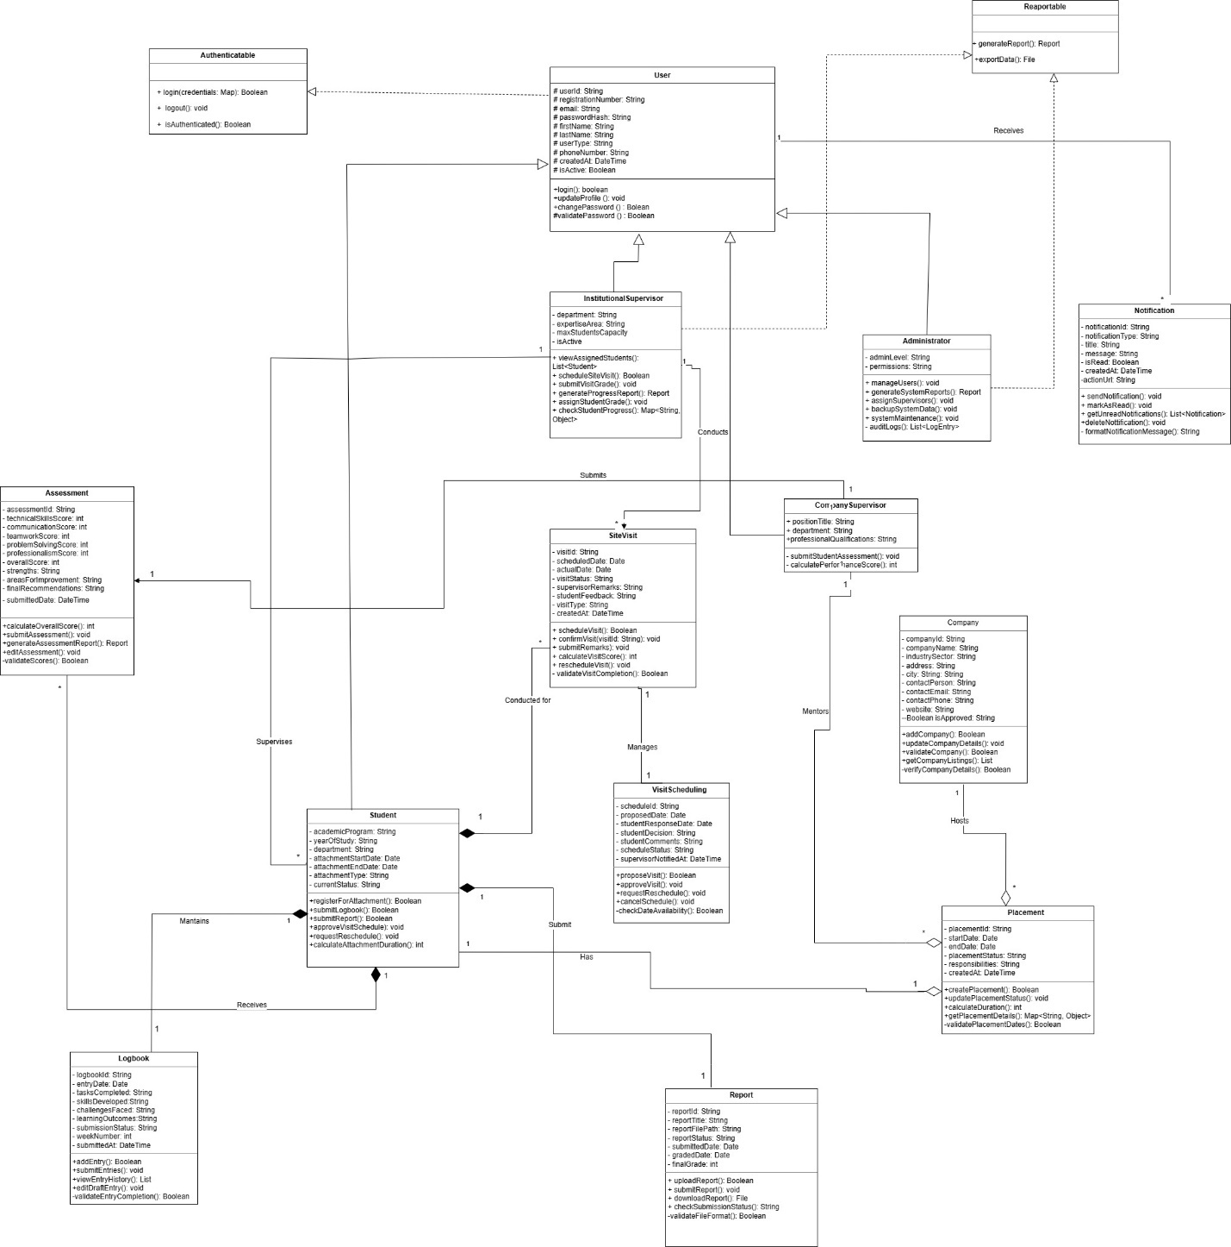

Slide 15
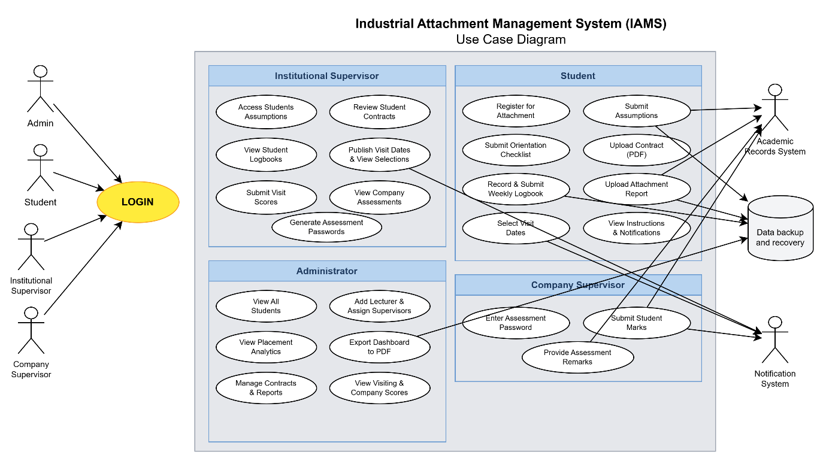
4(d) Use Case Diagram
Actors: Student, Institutional Supervisor, Company Supervisor, Administrator
Student: login, register, submit forms, e-logbook, upload documents, select visit
Supervisor: review documents, publish visits, enter scores
Admin: view analytics, assign supervisors, monitor submissions

Slide 16
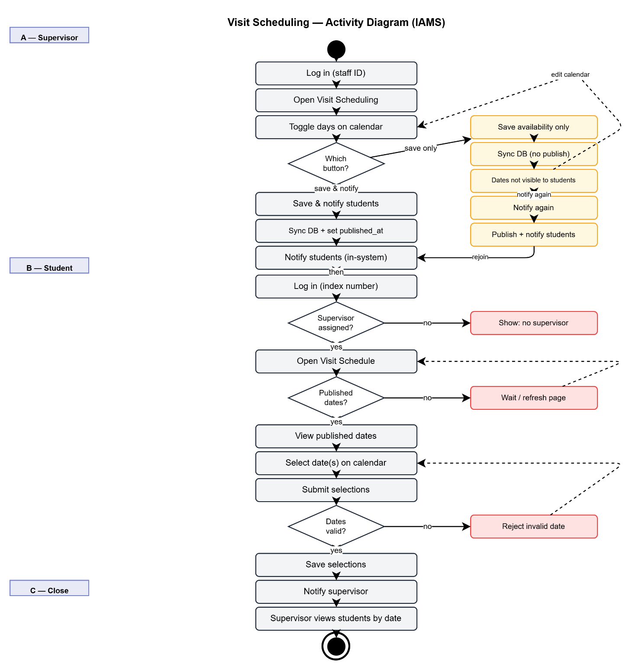
4(e) Workflow / Process Flowchart
Student journey: Login → Registration → Assumption → Orientation → E-Logbook → Contract → Report
Visit workflow: Supervisor publishes dates → Student selects → Visit → Scores recorded
Grading: Company score + Visit scores + E-logbook mark + Report mark → Final grade

Slide 17
Technology Stack
Frontend: React 18, TypeScript, Vite, Tailwind CSS, Recharts, React Router
Backend: PHP 8 on Apache (XAMPP), REST JSON API
Database: MySQL / MariaDB
Tools: Postman, Git, Draw.io, jsPDF | Methodology: Agile Scrum (16 weeks)

Slide 18
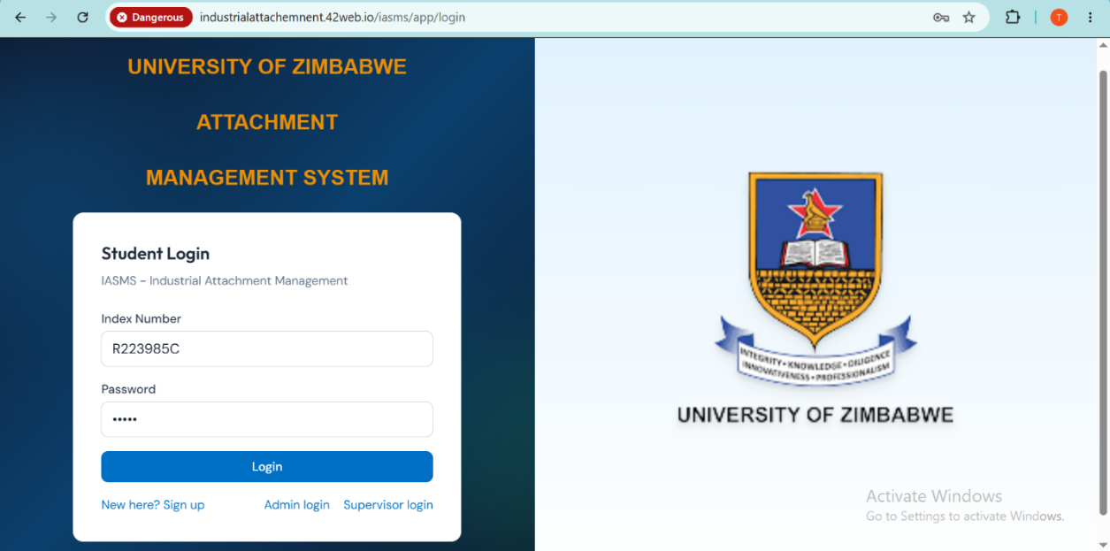
5(a) Demo — Login & Registration
Multi-role login: Student (index + password), Supervisor (staff ID), Admin
Onboarding guard blocks modules until registration and assumption complete
Industrial registration: programme, faculty, level, session
Assumption form: company, region, supervisor contacts, attachment period

Slide 19
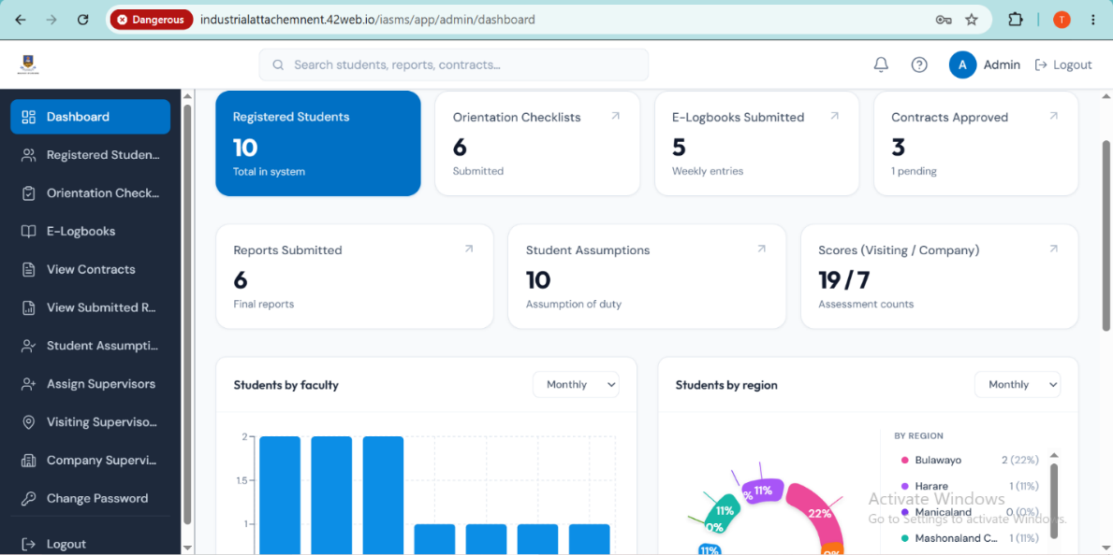
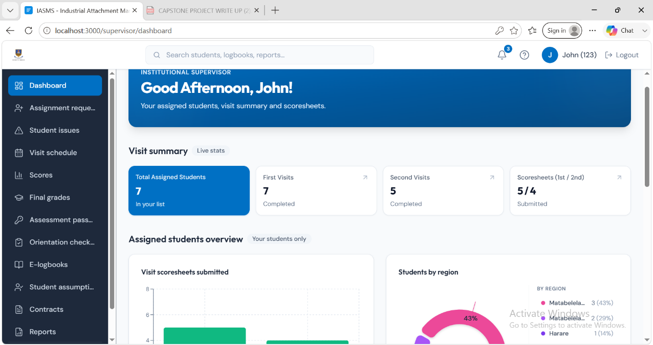
5(b) Main System Features
Student portal: dashboard, orientation, e-logbook, contract, report, visit schedule
Supervisor portal: assigned students, logbook review, visit scheduling, scores, grades
Admin portal: student lists, document viewers, assign supervisors, score overviews
Supervisor assignment requests and student issue reporting
A- Admin Dashboard, B- Supervisor dashboard

Slide 20
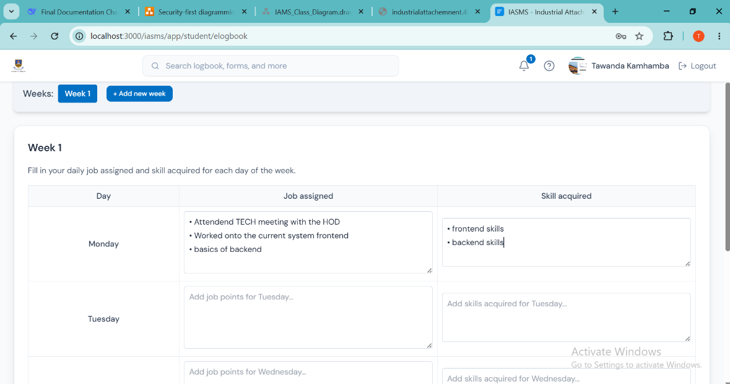
5(c) Data Input and Processing
Weekly e-logbook: Mon–Fri job assigned & skill acquired → elogbook_entries
PDF contract upload; single final report (PDF/DOC/DOCX)
Supervisor logbook comments trigger student notifications
Final grade computed from company, visit, e-logbook, and report marks

Slide 21
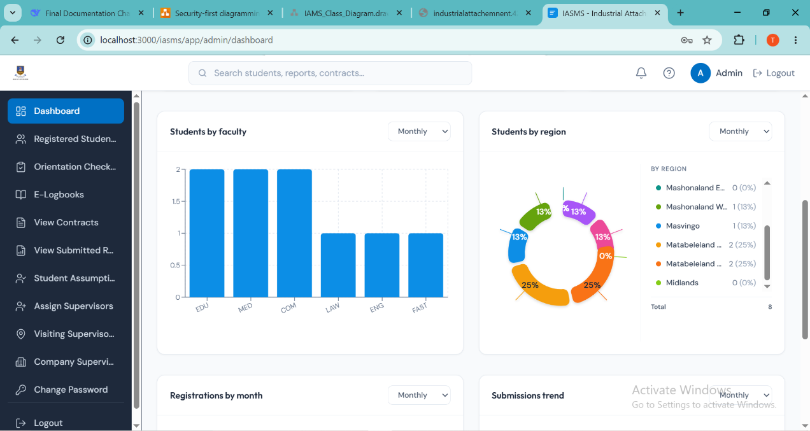
5(d) Reports and Dashboards
Admin charts: registrations by month, assumptions trend, faculty bar chart, region pie chart
Printable admin dashboard PDF summary (jsPDF)
Authenticated download of contracts and reports
UAT pass rate: 97.8% (44/45 tasks)

Slide 22
5(e) AI / ML Functionality
Not applicable to this project
IAMS is an administrative information system — not a machine learning product
Evaluation: functional correctness, usability, response time, RBAC
Future work: predictive analytics on placement success

Slide 23
5(f) Mobile App Functionality
No native mobile application (Android/iOS) was developed
IAMS is a responsive web application on desktop and mobile browsers
Tested on Chrome, Edge, Firefox and Android mobile viewport
Tailwind CSS responsive layouts support field attachment use

Slide 24
5(g) Security & Conclusion
RBAC via PHP sessions on all protected API endpoints
ProtectedRoute and StudentOnboardingGuard on frontend
File upload validation; SQL injection mitigation; HTTPS on production
Conclusion: IAMS centralises attachment management using React + PHP + MySQL
Thank you — Questions?

