Slide 1
COE 202: Digital Logic Design Number Systems Part 3
Courtesy of Dr. Ahmad Almulhem

Slide 2
Objectives
Binary codes
Binary coded decimal (BCD)
Other Decimal Codes
Gray Code
ASCII Code
Error Detecting Code

Slide 3
Binary Codes
A n-bit binary code is a binary string of 0s and 1s of size n.
It can represent 2^{n} different elements.
4 elements can be coded using 2 bits
8 elements can be coded using 3 bits
Given the number of elements to be coded, there is a minimum number of bits, but no maximum !

Slide 4
Binary Coded Decimal (BCD)
Human communicating with computers
Humans understand decimal
Computers understands binary
Solution: Convert Decimal-Binary-Decimal
Need to store decimal numbers as binary codes

Slide 5
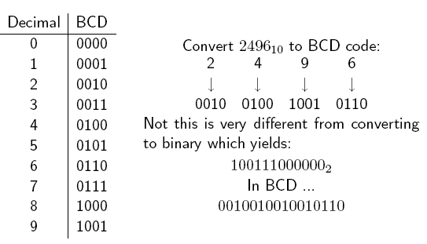
Binary Coded Decimal (BCD)
BCD Code uses 4 bits to represent the 10 decimal digits {0 to 9}
6 BCD codes unused
The weights of the individual positions of the bits of a BCD code are: 2³=8, 2²=4, 2¹=2, 2⁰=1

Slide 6
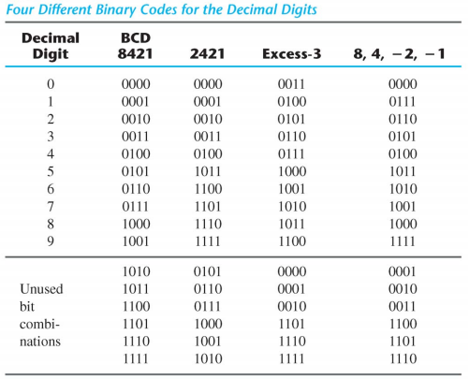
Other Decimal Codes
4 bits = 16 different codes
Only 10 needed to represent the 10 decimal digits.
Many possible codes!
2421 and excess-3 are self-complementing (9’s complement can be obtained by inverting bits)
src: Mano’s book

Slide 7
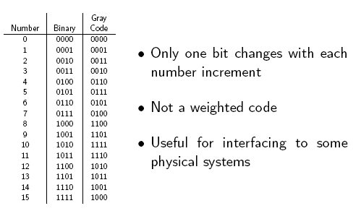
Gray Code
Gray code represents decimal numbers 0 to 15 using 16 4-bit codes
Gray codes of two adjacent decimal numbers differ by only one bit
Example:
(5)₁₀ = 0111
(6)₁₀ = 0101
(7)₁₀ = 0100

Slide 8
ASCII Character Code
ASCII an abbreviation of “American Standard Code for Information Interchange”
A 7-bit code (128 characters)
94 printable, 34 non-printable (control)
2x26 English letters (A,…Z, a,…z)
10 decimal digits (0,1,…9)
32 Special Characters such as %, *, $, … etc.
Usually stored as a byte (8 bits)
The extra bit is used for other purposes

Slide 9
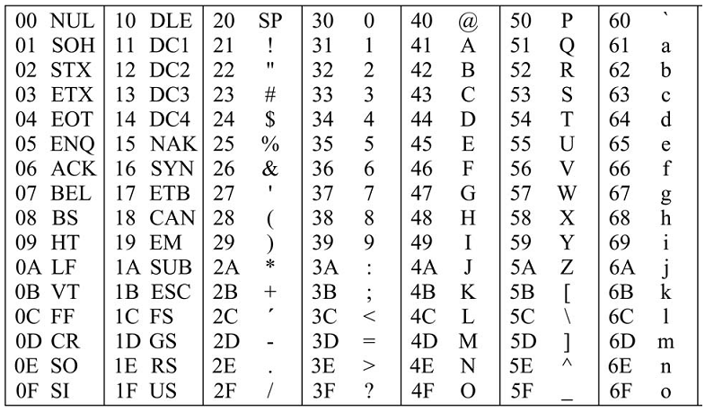
ASCII Character Code

Slide 10
ASCII Character Code
capital vs small
A difference of
(20)₁₆ = 32₁₀

Slide 11
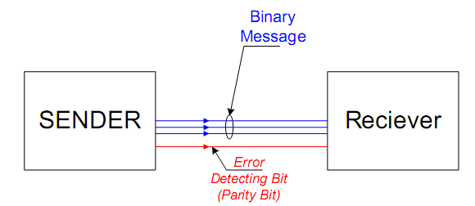
Error Detecting Code
In data communication, errors may happen
One code change into another code
How to detect errors?
Add an extra bit called a parity bit such that
Number of 1’s is even (even parity) or odd (odd parity)

Slide 12
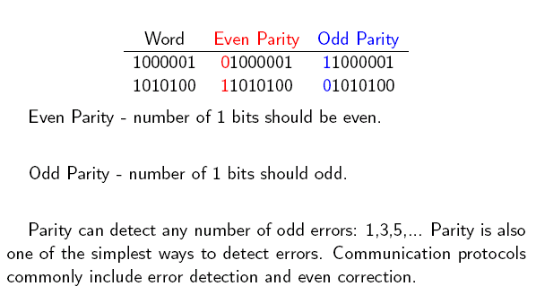
Error Detecting Code
ASCII A =
ASCII T =

Slide 13
Conclusions
Bits are bits
Modern digital devices represent everything as collections of bits
A computer is one such digital device
You can encode anything with sufficient 1’s and 0’s
Binary codes (BCD, gray code)
Text (ASCII)
Sound (.wav, .mp3, ...)
Pictures (.jpg, .gif, .tiff)

