Slide 1
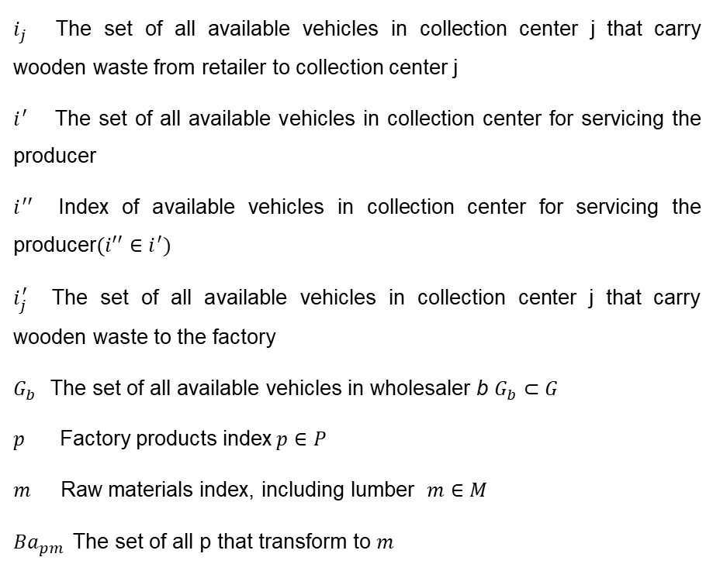
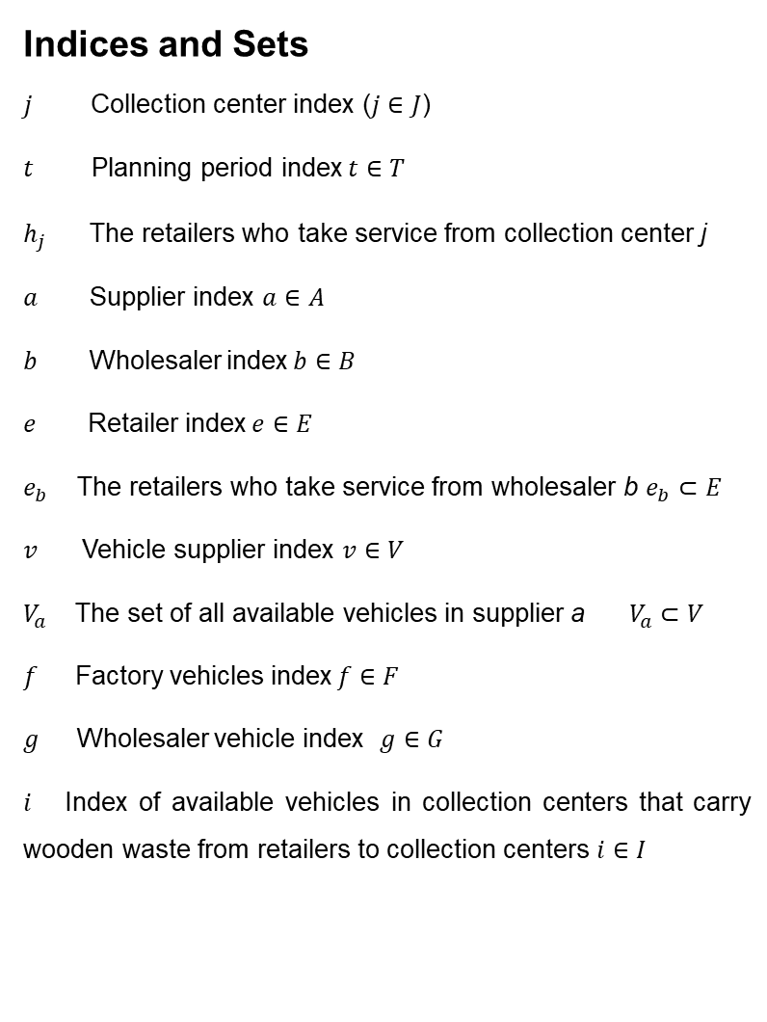
Index & Sets
Indices and Sets
$j$ Collection center index ($j∈J$)
$t$ Planning period index$t∈T$
$h_{j}$ The retailers who take service from collection center j
$a$ Supplier index $a∈A$
$b$ Wholesaler index$b∈B$
$e$ Retailer index$e∈E$
$e_{b}$The retailers who take service from wholesaler b $e_{b}⊂E$
$v$ Vehicle supplier index $v∈V$
$V_{a}$The set of all available vehicles in supplier a $V_{a}⊂V$
$f$ Factory vehicles index$f∈F$
$g$ Wholesaler vehicle index $g∈G$
$i$ Index of available vehicles in collection centers that carry wooden waste from retailers to collection centers $i∈I$
$i_{j}$The set of all available vehicles in collection center j that carry wooden waste from retailer to collection center j
$i^{′}$The set of all available vehicles in collection center for servicing the producer
$i^{′′}$Index of available vehicles in collection center for servicing the producer$({i′}^{′}∈i^{′})$
$i_{j}^{′}$The set of all available vehicles in collection center j that carry wooden waste to the factory
$G_{b}$The set of all available vehicles in wholesaler b $G_{b}⊂G$
$p$ Factory products index$p∈P$
$m$ Raw materials index, including lumber $m∈M$
${Ba}_{pm}$The set of all p that transform to $m$
10

Slide 2
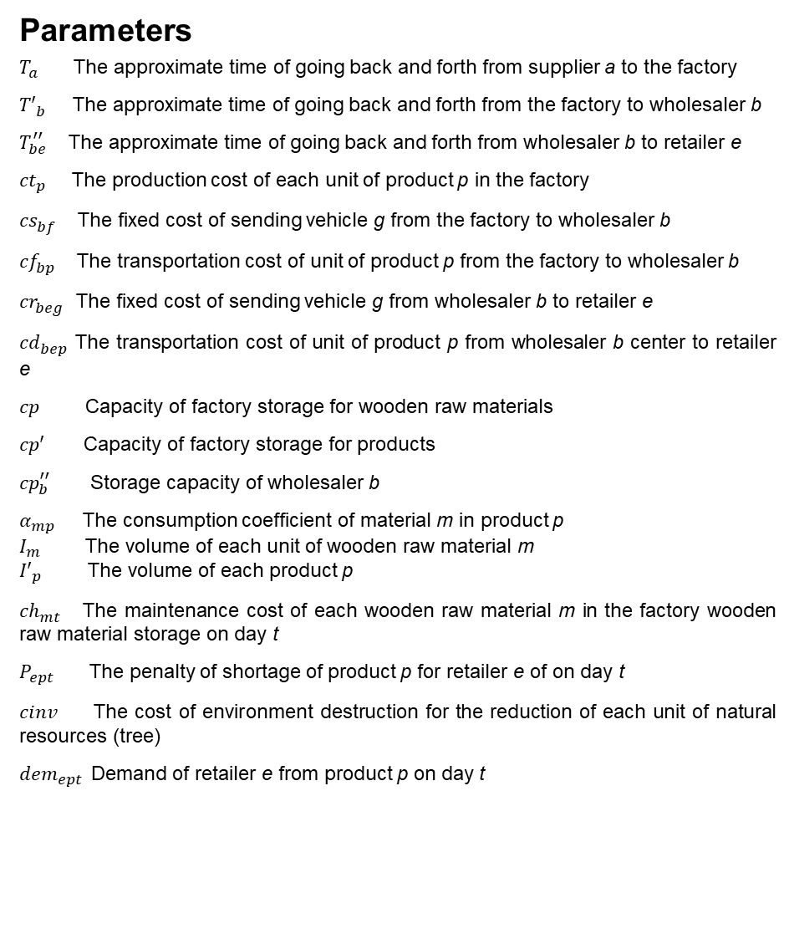
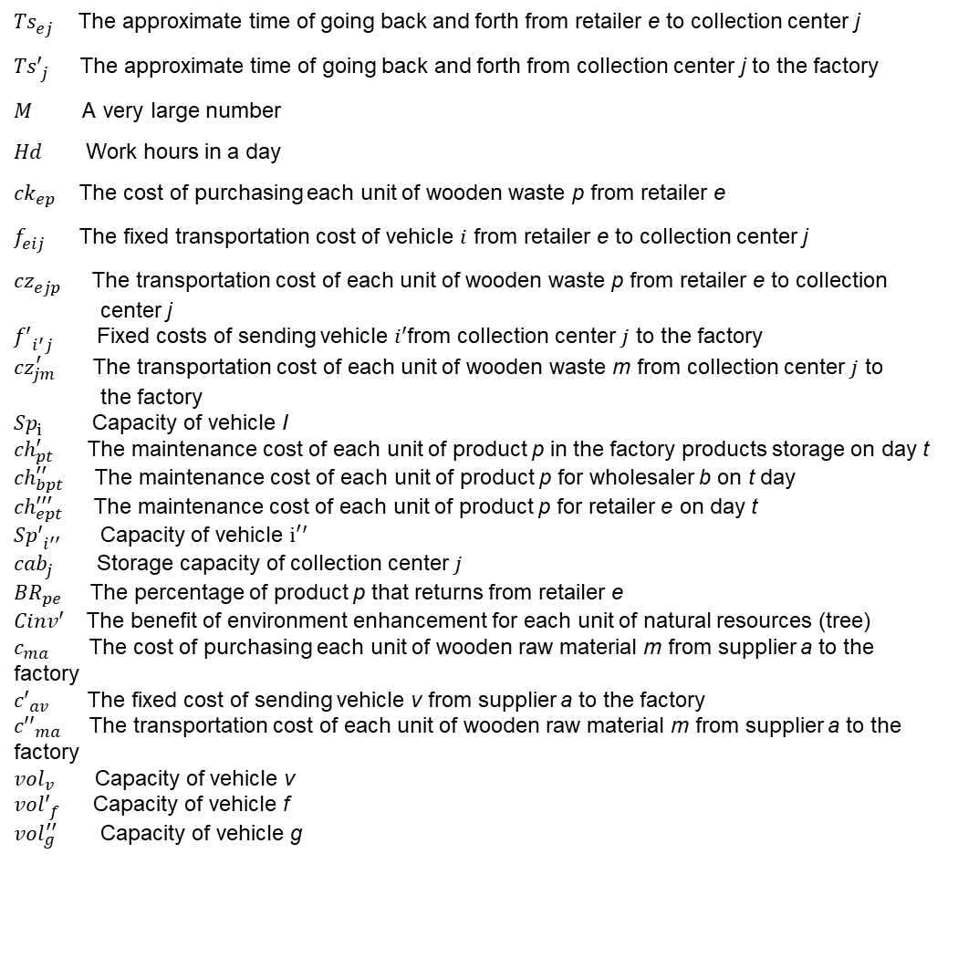
Parameters
Parameters
$T_{a}$The approximate time of going back and forth from supplier a to the factory
${T′}_{b}^{ }$The approximate time of going back and forth from the factory to wholesaler b
$T_{be}^{′′}$The approximate time of going back and forth from wholesaler b to retailer e
${ct}_{p}^{ }$The production cost of each unit of product p in the factory
${cs}_{bf}^{ }$The fixed cost of sending vehicle g from the factory to wholesaler b
${cf}_{bp}^{ }$The transportation cost of unit of product p from the factory to wholesaler b
${cr}_{beg}^{ }$The fixed cost of sending vehicle g from wholesaler b to retailer e
${cd}_{bep}^{ }$The transportation cost of unit of product p from wholesaler b center to retailer e
$cp$ Capacity of factory storage for wooden raw materials
$cp′$ Capacity of factory storage for products
${cp}_{b}^{′′}$ Storage capacity of wholesaler b
$α_{mp}$ The consumption coefficient of material m in product p
$I_{m}$ The volume of each unit of wooden raw material m
${I′}_{p}$ The volume of each product p
${ch}_{mt}^{ }$The maintenance cost of each wooden raw material m in the factory wooden raw material storage on day t
$P_{ept}$ The penalty of shortage of product p for retailer e of on day t
${cinv}_{ }$ The cost of environment destruction for the reduction of each unit of natural resources (tree)
${dem}_{ept}$Demand of retailer e from product p on day t
${Ts}_{ej}^{ }$ The approximate time of going back and forth from retailer e to collection center j
${Ts′}_{j}^{ }$ The approximate time of going back and forth from collection center j to the factory
$M$ A very large number
$Hd$ Work hours in a day
${ck}_{ep}^{ }$The cost of purchasing each unit of wooden waste p from retailer e
$f_{eij}^{ }$The fixed transportation cost of vehicle $i$ from retailer e to collection center j
${cz}_{ejp}^{ }$ The transportation cost of each unit of wooden waste p from retailer e to collection
center j
${f′}_{i^{′}j}^{ }$ Fixed costs of sending vehicle $i′$from collection center $j$ to the factory
${cz}_{jm}^{′}$ The transportation cost of each unit of wooden waste m from collection center $j$ to
the factory
${Sp}_{i}^{ }$ Capacity of vehicle I
${ch}_{pt}^{′}$The maintenance cost of each unit of product p in the factory products storage on day t
${ch}_{bpt}^{′′}$ The maintenance cost of each unit of product p for wholesaler b on t day
${ch}_{ept}^{′′′}$ The maintenance cost of each unit of product p for retailer e on day t
${Sp′}_{i^{′′}}^{ }$ Capacity of vehicle $i^{′}′$
${cab}_{j}^{ }$ Storage capacity of collection center $j$
${BR}_{pe}$The percentage of product p that returns from retailer e
${Cinv′}_{ }$ The benefit of environment enhancement for each unit of natural resources (tree)
$c_{ma}$ The cost of purchasing each unit of wooden raw material m from supplier a to the factory
${c′}_{av}$The fixed cost of sending vehicle v from supplier a to the factory
${c′′}_{ma}$The transportation cost of each unit of wooden raw material m from supplier a to the factory
${vol}_{v}$ Capacity of vehicle v
${vol′}_{f}^{ }$ Capacity of vehicle f
${vol}_{g}^{′′}$ Capacity of vehicle g
10

Slide 3
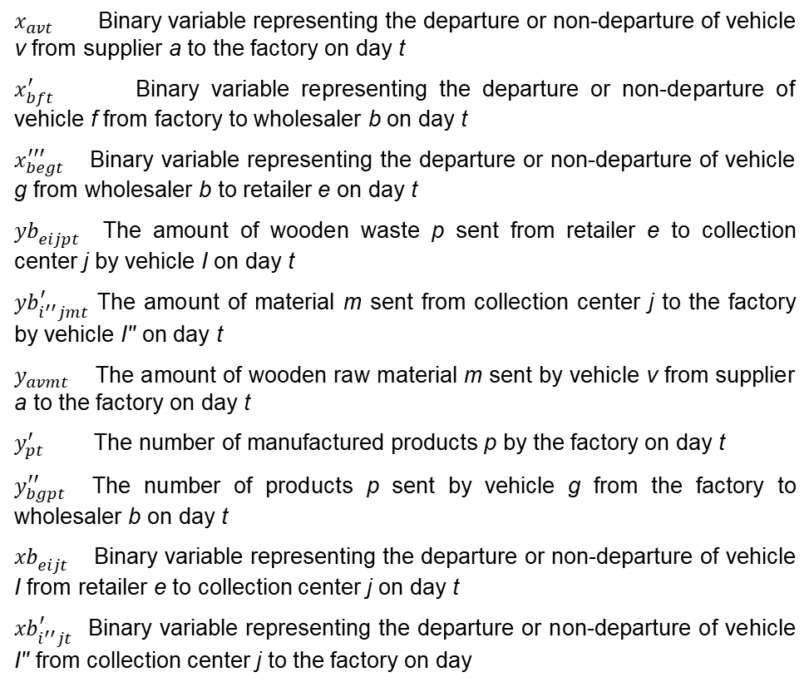
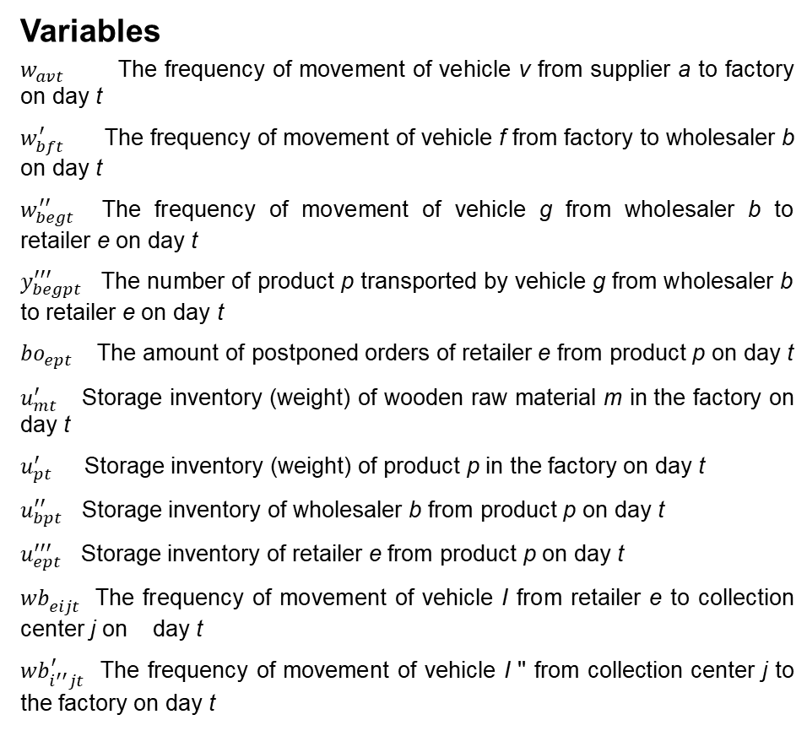
Variables
Variables
$w_{avt}$ The frequency of movement of vehicle v from supplier a to factory on day t
$w_{bft}^{′}$ The frequency of movement of vehicle f from factory to wholesaler b on day t
$w_{begt}^{′′}$The frequency of movement of vehicle g from wholesaler b to retailer e on day t
$y_{begpt}^{′′′}$ The number of product p transported by vehicle g from wholesaler b to retailer e on day t
${bo}_{ept}$ The amount of postponed orders of retailer e from product p on day t
$u_{mt}^{′}$ Storage inventory (weight) of wooden raw material m in the factory on day t
$u_{pt}^{′}$ Storage inventory (weight) of product p in the factory on day t
$u_{bpt}^{′′}$ Storage inventory of wholesaler b from product p on day t
$u_{ept}^{′′′}$ Storage inventory of retailer e from product p on day t
${wb}_{eijt}^{ }$The frequency of movement of vehicle I from retailer e to collection center j on day t
${wb}_{i^{′′}jt}^{′}$ The frequency of movement of vehicle I '' from collection center j to the factory on day t
$x_{avt}$ Binary variable representing the departure or non-departure of vehicle v from supplier a to the factory on day t
$x_{bft}^{′}$ Binary variable representing the departure or non-departure of vehicle f from factory to wholesaler b on day t
$x_{begt }^{′′′}$Binary variable representing the departure or non-departure of vehicle g from wholesaler b to retailer e on day t
${yb}_{eijpt}^{ }$ The amount of wooden waste p sent from retailer e to collection center j by vehicle I on day t
${yb}_{i^{′′}jmt}^{′}$ The amount of material m sent from collection center j to the factory by vehicle I'' on day t
$y_{avmt}$ The amount of wooden raw material m sent by vehicle v from supplier a to the factory on day t
$y_{pt}^{′}$ The number of manufactured products p by the factory on day t
$y_{bgpt}^{′′}$The number of products p sent by vehicle g from the factory to wholesaler b on day t
${xb}_{eijt}^{ }$ Binary variable representing the departure or non-departure of vehicle I from retailer e to collection center j on day t
${xb}_{i^{′′}jt}^{′}$Binary variable representing the departure or non-departure of vehicle I'' from collection center j to the factory on day
10

Slide 4
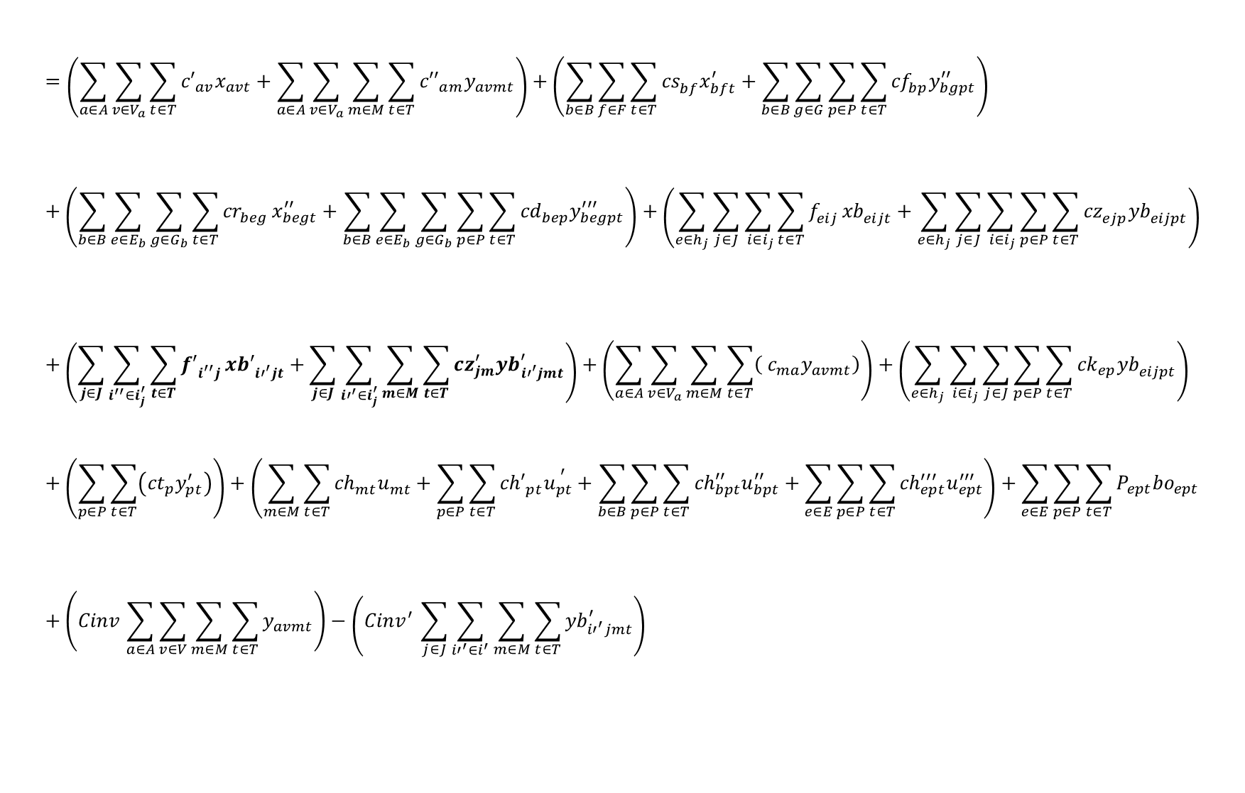
Objective function
Objective Function
Transportation Cost
$$=\left(\sum_{a∈A}{\sum_{v∈V_{a}}{\sum_{t∈T}{{c′}_{av}x_{avt}}}}+\sum_{a∈A}{\sum_{v∈V_{a}}{\sum_{m∈M}{\sum_{t∈T}{{c′′}_{am}y_{avmt}}}}}\right)+\left(\sum_{b∈B}{\sum_{f∈F}{\sum_{t∈T}{{cs}_{bf}^{ }x_{bft}^{′}}}}+\sum_{b∈B}{\sum_{g∈G}{\sum_{p∈P}{\sum_{t∈T}{{cf}_{bp}^{ }y_{bgpt}^{′′}}}}}\right)+\left(\sum_{b∈B}{\sum_{e∈E_{b}}{\sum_{g∈G_{b}}{\sum_{t∈T}{{cr}_{beg}^{ }}x_{begt}^{′′}}}}+\sum_{b∈B}{\sum_{e∈E_{b}}{\sum_{g∈G_{b}}{\sum_{p∈P}{\sum_{t∈T}{{cd}_{bep}^{ }y_{begpt}^{′′′}}}}}}\right)+\left(\sum_{e∈h_{j}}{\sum_{j∈J}{\sum_{{ i∈i}_{j}}{\sum_{t∈T}{f_{eij}^{ }}{xb}_{eijt}^{ }}}}+\sum_{e∈h_{j}}{\sum_{j∈J}{\sum_{{ i∈i}_{j}}{\sum_{p∈P}{\sum_{t∈T}{{cz}_{ejp}^{ }{yb}_{eijpt}^{ }}}}}}\right)+\left(\sum_{j∈J}{\sum_{i^{′′}∈i_{j}^{′}}{\sum_{t∈T}{{f′}_{i^{′′}j}^{ }}{xb′}_{{i′}^{′}jt}^{ }}}+\sum_{j∈J}{\sum_{{i′}^{′}∈i_{j}^{′}}{\sum_{m∈M}{\sum_{t∈T}{{cz}_{jm}^{′}{yb}_{{i′}^{′}jmt}^{′}}}}}\right)+\left(\sum_{a∈A}{\sum_{v∈V_{a}}{\sum_{m∈M}{\sum_{t∈T}{\left( c_{ma}y_{avmt}\right)}}}}\right)+\left(\sum_{e∈h_{j}}{\sum_{{ i∈i}_{j}}{\sum_{j∈J}{\sum_{p∈P}{\sum_{t∈T}{{ck}_{ep}^{ }{yb}_{eijpt}^{ }}}}}}\right)+\left(\sum_{p∈P}{\sum_{t∈T}{\left({ct}_{p}^{ }y_{pt}^{′}\right)}}\right)+\left(\sum_{m∈M}{\sum_{t∈T}{{ch}_{mt}^{ }u_{mt}^{ }}}+\sum_{p∈P}{\sum_{t∈T}{{ch′}_{pt}^{ }u_{pt}^{ ^{′}}}}+\sum_{b∈B}{\sum_{p∈P}{\sum_{t∈T}{{ch}_{bpt}^{′′}u_{bpt}^{′′}}}}+\sum_{e∈E}{\sum_{p∈P}{\sum_{t∈T}{{ch}_{ept}^{′′′}u_{ept}^{′′′}}}}\right)+\sum_{e∈E}{\sum_{p∈P}{\sum_{t∈T}{P_{ept}{bo}_{ept}}}}+\left({Cinv}_{ }\sum_{a∈A}{\sum_{v∈V}{\sum_{m∈M}{\sum_{t∈T}{y_{avmt}}}}}\right)−\left({{Cinv}^{′}}_{ }\sum_{j∈J}{\sum_{{i′}^{′}∈i^{′}}{\sum_{m∈M}{\sum_{t∈T}{{yb}_{{i′}^{′}jmt}^{′}}}}}\right)$$
Min Z
Purchasing Cost
Production Cost
Shortage
Cost
Maintenance Cost
Environmental Effect Cost
11

Slide 5

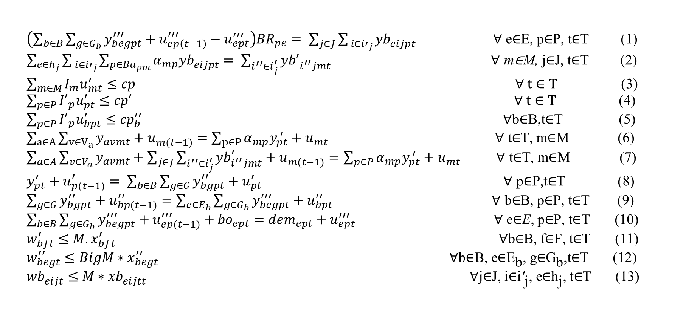
Constraints
Model Constraints
$\left(\sum_{b∈B}{\sum_{g∈G_{b}}{y_{begpt}^{′′′}}}+u_{ep\left(t−1\right)}^{′′′}−u_{ept}^{′′′}\right){BR}_{pe}= \sum_{j∈J}{\sum_{{ i∈i′}_{j}}{{yb}_{eijpt}^{ }}} \text{∀ }\text{e}\text{∈}\text{E}\text{, }\text{p}\text{∈}\text{P}\text{, }\text{t}\text{∈}\text{T}$ (1)
$\sum_{e∈h_{j}}{\sum_{{ i∈i′}_{j}}{\sum_{p∈{Ba}_{pm}}{α_{mp}{yb}_{eijpt}^{ }}}}= \sum_{i^{′′}∈i_{j}^{′}}{{yb′}_{i^{′′}jmt}^{ }}$ $\text{∀ }\text{m}\text{∈}\text{M}\text{, }\text{j}\text{∈}\text{J}\text{, }\text{t}\text{∈}\text{T}$ (2) $\sum_{m∈M}{I_{m}u_{mt}^{′}}≤cp$ $∀ t∈T$ $\text{(}\text{3}\text{) }$
$\sum_{p∈P}{{I′}_{p}u_{pt}^{′}}≤cp′$ $∀ t∈T \text{(}\text{4}\text{) }\sum_{p∈P}{{{I′}_{p}u}_{bpt}^{′}}≤{cp}_{b}^{′′}$ $\text{∀}\text{b}\text{∈}\text{B}\text{,}\text{t}\text{∈}\text{T}$ $\text{(}\text{5}\text{) }$ $\sum_{a∈A}{\sum_{v∈V_{a}}{y_{avmt}+u_{m(t−1)}^{ }}}=\sum_{p∈P}{α_{mp}y_{pt}^{ ′}+u_{mt}^{ }}$ $\text{∀ }\text{t}\text{∈}\text{T}\text{, }\text{m}\text{∈}\text{M}$ (6)
$\sum_{a∈A}{\sum_{v∈V_{a}}{y_{avmt}+\sum_{j∈J}{\sum_{i^{′′}∈i_{j}^{′}}{{yb}_{i^{′′}jmt}^{′}}}+u_{m(t−1)}^{ }}}=\sum_{p∈P}{α_{mp}y_{pt}^{ ′}+u_{mt}^{ }}$ $\text{∀ }\text{t}\text{∈}\text{T}\text{, }\text{m}\text{∈}\text{M}$ $\text{(}\text{7}\text{) }$
$y_{pt}^{′}+u_{p(t−1)}^{′}= \sum_{b∈B}{\sum_{g∈G}{y_{bgpt}^{′′}}+u_{pt}^{′}}$ $\text{∀ }\text{p}\text{∈}\text{P}\text{,}\text{t}\text{∈}\text{T}$ (8)
$\sum_{g∈G}{y_{bgpt}^{′′}}+u_{bp(t−1)}^{′′}=\sum_{e∈E_{b}}{\sum_{g∈G_{b}}{y_{begpt}^{′′′}}}+u_{bpt}^{′′}$ $\text{∀ }\text{b}\text{∈}\text{B}\text{, }\text{p}\text{∈}\text{P}\text{, }\text{t}\text{∈}\text{T}$ (9)
$\sum_{b∈B}{\sum_{g∈G_{b}}{y_{begpt}^{′′′}}}+u_{ep(t−1)}^{′′′}+{bo}_{ept}={dem}_{ept}+u_{ept}^{′′′}$ $\text{∀ }\text{e}\text{∈}\text{E}\text{, }\text{p}\text{∈}\text{P}\text{, }\text{t}\text{∈}\text{T}$ (10)
$w_{bft}^{′}≤M.x_{bft}^{′}$ $\text{∀}\text{b}\text{∈}\text{B}\text{, }\text{f}\text{∈}\text{F}\text{, }\text{t}\text{∈}\text{T}$ (11)
$w_{begt}^{′′}≤BigM∗x_{begt}^{′′}$ $\text{∀}\text{b}\text{∈}\text{B}\text{, }\text{e}\text{∈}{\text{E}}_{\text{b}}\text{, }\text{g}\text{∈}{\text{G}}_{\text{b}}\text{,}\text{t}\text{∈}\text{T}$ (12)
${wb}_{eijt}^{ }≤M∗{xb}_{eijtt}^{ }$ ${ \text{∀}\text{j}\text{∈}\text{J}\text{, }\text{i}\text{∈}\text{i}\text{′}}_{\text{j}}\text{, }\text{e}\text{∈}{\text{h}}_{\text{j}}\text{, }\text{t}\text{∈}\text{T}$ (13)
Factory
Capacity
Inventory
Vehicle
Frequency

Slide 6
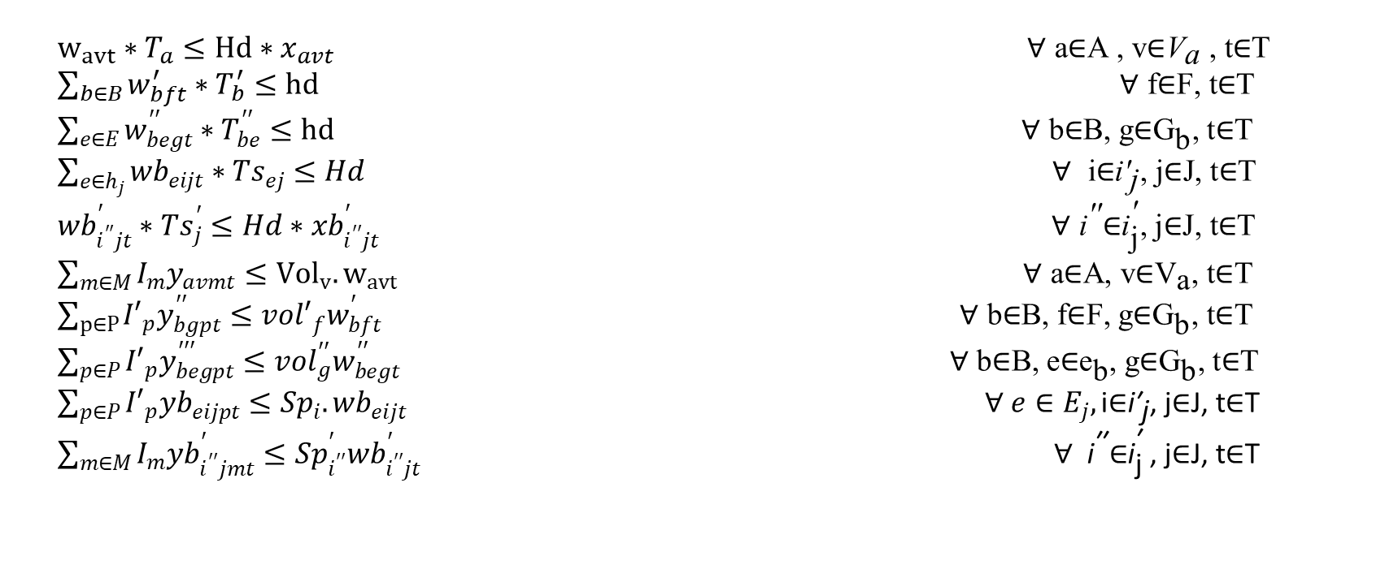
Constraints
Model Constraints
$w_{avt}∗T_{a}≤Hd∗x_{avt}$ $\text{∀ }\text{a}\text{∈}\text{A}\text{ , }\text{v}\text{∈}{\text{V}}_{\text{a} }\text{, }\text{t}\text{∈}\text{T}$
$\sum_{b∈B}{w_{bft}^{′}∗T_{b}^{′}}≤hd$ $\text{∀ }\text{f}\text{∈}\text{F}\text{, }\text{t}\text{∈}\text{T}$
$\sum_{e∈E}{w_{begt}^{′′}∗T_{be}^{′′}}≤hd$ $\text{∀ }\text{b}\text{∈}\text{B}\text{, }\text{g}\text{∈}{\text{G}}_{\text{b}}\text{, }\text{t}\text{∈}\text{T}$
$\sum_{e∈h_{j}}{{wb}_{eijt}^{ }∗{Ts}_{ej}^{ }}≤Hd$ $\text{∀ }{\text{i}\text{∈}\text{i}\text{′}}_{\text{j}}\text{, }\text{j}\text{∈}\text{J}\text{, }\text{t}\text{∈}\text{T}$
${wb}_{i^{′′}jt}^{′}∗{Ts}_{j}^{′}≤Hd∗{xb}_{i^{′′}jt}^{′}$ $\text{∀ }{\text{i}}^{\text{′′}}\text{∈}{\text{i}}_{\text{j}}^{\text{′}}\text{, }\text{j}\text{∈}\text{J}\text{, }\text{t}\text{∈}\text{T}$
$\sum_{m∈M}{I_{m}y_{avmt}}≤{Vol}_{v}.w_{avt}$ $\text{∀ }\text{a}\text{∈}\text{A}\text{, }\text{v}\text{∈}{\text{V}}_{\text{a}}\text{, }\text{t}\text{∈}\text{T}$
$\sum_{p∈P}{{I′}_{p}y_{bgpt}^{′′}}≤{vol′}_{f}^{ }w_{bft}^{′}$ $\text{∀ }\text{b}\text{∈}\text{B}\text{, }\text{f}\text{∈}\text{F}\text{, }\text{g}\text{∈}{\text{G}}_{\text{b}}\text{, }\text{t}\text{∈}\text{T}$
$\sum_{p∈P}{{I′}_{p}y_{begpt}^{′′′}}≤{vol}_{g}^{′′}w_{begt}^{′′}$ $\text{∀ }\text{b}\text{∈}\text{B}\text{, }\text{e}\text{∈}{\text{e}}_{\text{b}}\text{, }\text{g}\text{∈}{\text{G}}_{\text{b}}\text{, }\text{t}\text{∈}\text{T}$
$\sum_{p∈P}{{I′}_{p}{yb}_{eijpt}^{ }}≤{Sp}_{i}^{ }{.wb}_{eijt}^{ }$ $∀ e∈E_{j},{\text{i}\text{∈}\text{i}\text{′}}_{\text{j}}\text{, }\text{j}\text{∈}\text{J}\text{, }\text{t}\text{∈}\text{T}$
$\sum_{m∈M}{I_{m}{yb}_{i^{′′}jmt}^{′}}≤{Sp}_{i^{′′}}^{′}{wb}_{i^{′′}jt}^{′}$ $\text{ ∀ }{\text{i}}^{\text{′′}}\text{∈}{\text{i}}_{\text{j}}^{\text{′ }}\text{, }\text{j}\text{∈}\text{J}\text{, }\text{t}\text{∈}\text{T}$
(14)
(15)
Number
of Trips
(16)
(17)
(18)
(19)
(20)
Vehicle Capacity
(21)
(22)
(23)
13

Slide 7
z = trans_cost + purchas_cost + prod_cost + maintain_cost + shortage_cost + environ_cost + panalty_cost
#1 shows the quantity of the returned products from retailer to collection center
#2 shows that amount of recycled material from collection center to factory
#3~4 indicates that the quantities of raw materials and products in factory are less than the factory capacity
#5 indicates that the quantities of products in retailer are less than the retailer capacity
#6~10 shows that the inventory of factory (raw materials and products), wholesaler and retailer where the weight of the products remains same while moving from one stage to another
#11~13 shows that the vehicle frequency of factory to wholesaler, wholesaler to retailer and retailer to collection center is less than or equal the departure and non-departure of vehicle
#14~18 number of trips possible, considering the working hour and the number of vehicles available at each stage
#19~23 are related to vehicle capacities in weight and volume for the transportations among the stages

