Slide 1

A MULTI-PERIOD MATHEMATICAL MODEL IN WOODEN PRODUCTS
SUPPLY CHAIN CONSIDERING ENVIRONMENTAL EFFECTS
Supervisor
Moddassir Khan Nayeem
Lecturer
Department of Industrial and Production Engineering (IPE)
Yousuf Abdullah Shafin
201936010
Tawfiq Hasan Hafizi
201936040
Md Faisal Moheuddin
201936048
Military Institute of Science and Technology (MIST)

Slide 2
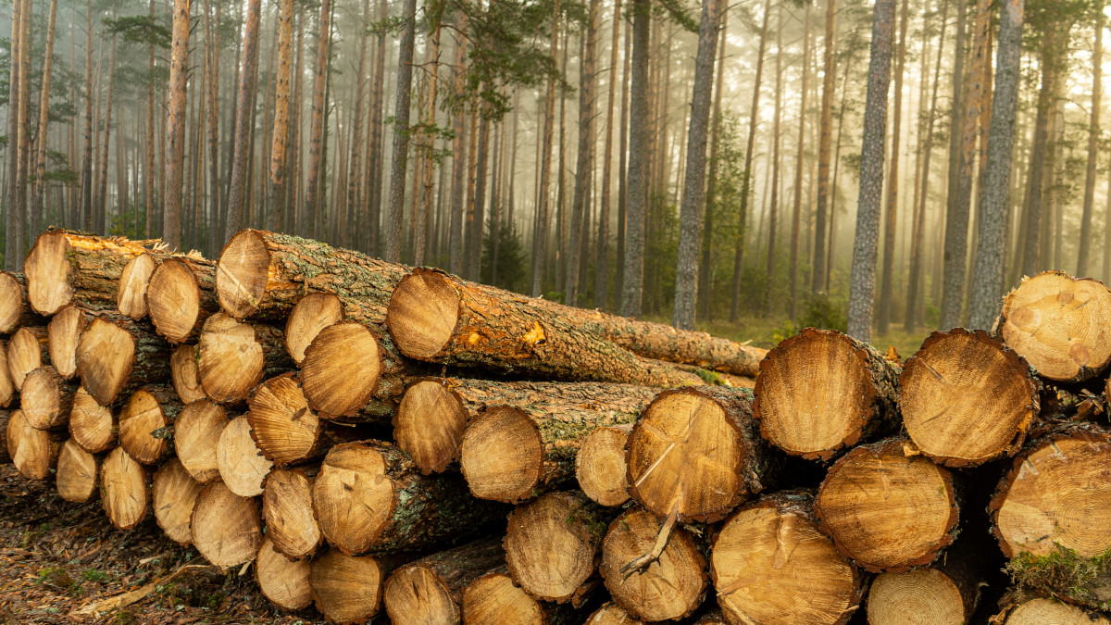


Introduction
The wood industry or lumber industry is the industry concerned with forestry, logging, timber trade, and the production of primary forest products and wood products (e.g. furniture) and secondary products like wood pulp for the pulp and paper industry.
Log
Pulp
Furniture
2

Slide 3
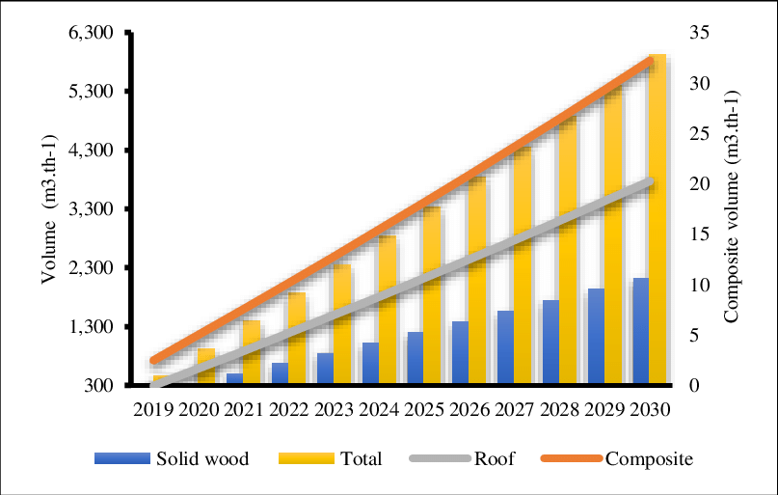
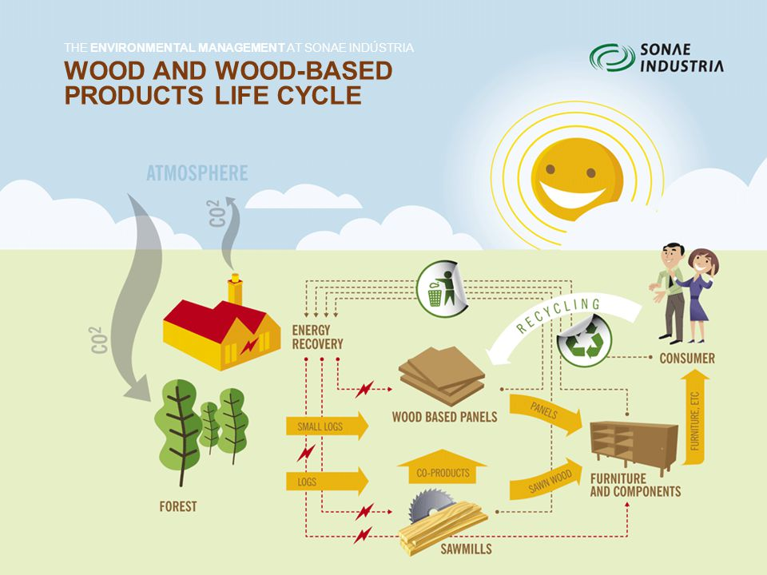
Motivation
Why have we chosen wooden product supply chain?
The global wood products market size is expected to grow from $631.11 billion in 2021 to $684.26 billion in 2022 at a compound annual growth rate (CAGR) of 8.4%. The wood products market is expected to grow to $903.33 billion in 2026 at a CAGR of 7.2%.
Huge Market but not that much research work.
Maximum utilization of natural resource and optimization of the supply chain network.
Recycle the wooden waste to make it Environment friendly.
3

Slide 4


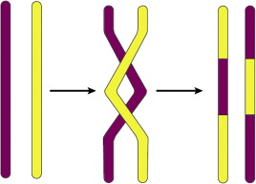





Objective
Optimization of five echelon close loop wooden product supply chain.
Environmental effect consideration.
Finding out the best solution comparing the results between a genetic algorithm developed by us and optimization software GAMS.
Collection centre
Supplier
Factory
Wholesaler
Retailer
Customer
GA Crossover
4

Slide 5
Literature Review
Article | Network Type | Uncertainty | Period | Sustainability | Industries | Approach
(Bandyopadhyay, et al. 2014) | Reverse network | No | Single Period | No | General | Modified NSGA-II
(Meng et al., 2016) | Reverse network | Returned products, demand, | Single Period | Considered Sustainable planning | General | Hierarchical genetic algorithms
(García-Durañona et al., 2016) | Reverse network | Demand | Two period | Considered environmental effects | Multi-products | Fuzzy linear programming
(Li et al., 2017) | Reverse network | Demand | Single Period | No | Multi-products | Genetic Algorithm
(Pedram et al., 2017) | Close-loop (forward and reverse network) | Demand, return products | Multi-period | No | Multi-products | Linear programming
(Heydari et al., 2018) | Reverse network | Capacity | Single Period | Considered Sustainable planning | General | Game Theory
(Salehi-Amiri et al.,2021) | Close-loop (forward and reverse network) | Demand and Capacity | Multi- Period | No | Walnut industry | Mixed Integer Linear programming
Ours | Close-loop (forward and reverse network) | Demand | Multi period | Considering environmental effects | Wooden products | GAMS & Genetic Algorithm
5

Slide 6







Network Diagram
Collection Center
Factory
Customer
Supplier
Wholesaler
Retailer
6

Slide 7
Assumptions
The supply chain shortfall is permitted.
There are two different types of vehicles including departure and non-departure vehicle.
The factory has a limited capacity and varied product types.
Each product unit's production cost will be the same.
The transportation costs will be unaffected by the various paths between each link in the supply chain.
The supplier's raw materials are completely reliable. When needed, they can always provide the required raw materials.
The model considers demand uncertainty.
Vehicle capacity is bounded.
At any point in the supply chain, loading and unloading time is not factored.
7

Slide 8
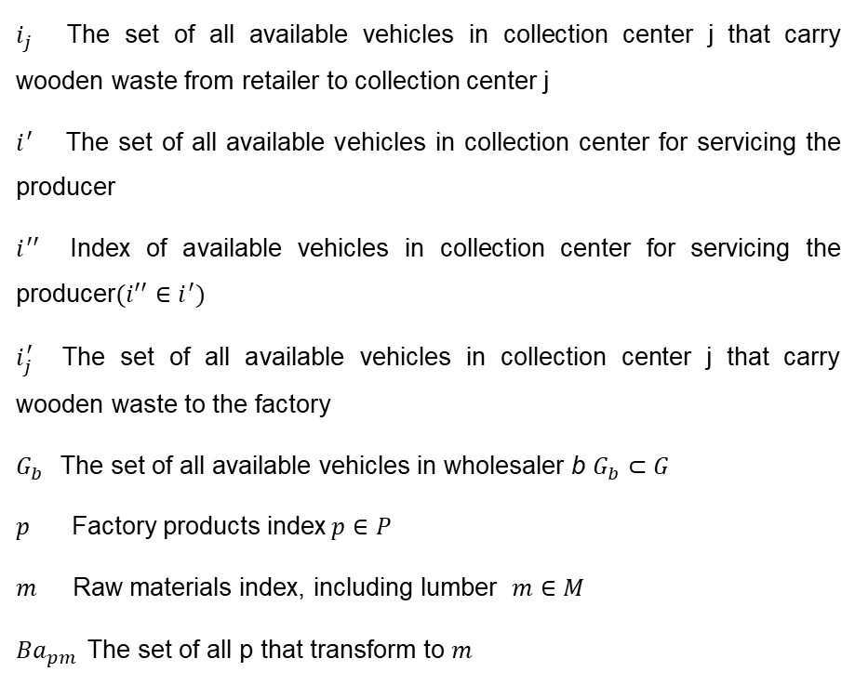
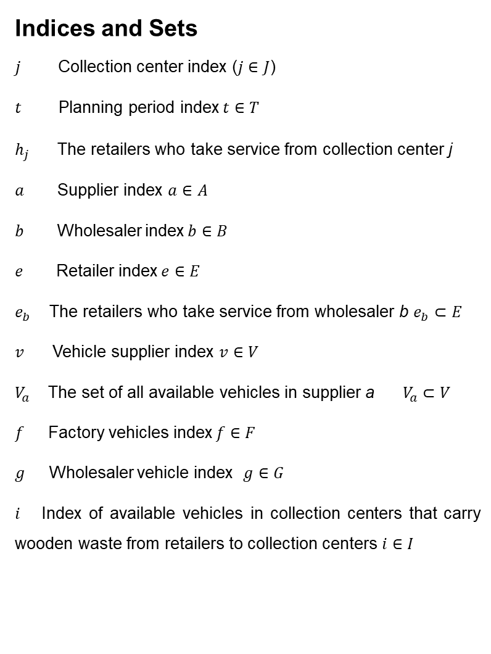
Mathematical formulation (Notations)
Indices and Sets
$j$ Collection center index ($j∈J$)
$t$ Planning period index$t∈T$
$h_{j}$ The retailers who take service from collection center j
$a$ Supplier index $a∈A$
$b$ Wholesaler index$b∈B$
$e$ Retailer index$e∈E$
$e_{b}$The retailers who take service from wholesaler b $e_{b}⊂E$
$v$ Vehicle supplier index $v∈V$
$V_{a}$The set of all available vehicles in supplier a $V_{a}⊂V$
$f$ Factory vehicles index$f∈F$
$g$ Wholesaler vehicle index $g∈G$
$i$ Index of available vehicles in collection centers that carry wooden waste from retailers to collection centers $i∈I$
$i_{j}$The set of all available vehicles in collection center j that carry wooden waste from retailer to collection center j
$i^{′}$The set of all available vehicles in collection center for servicing the producer
$i^{′′}$Index of available vehicles in collection center for servicing the producer$({i′}^{′}∈i^{′})$
$i_{j}^{′}$The set of all available vehicles in collection center j that carry wooden waste to the factory
$G_{b}$The set of all available vehicles in wholesaler b $G_{b}⊂G$
$p$ Factory products index$p∈P$
$m$ Raw materials index, including lumber $m∈M$
${Ba}_{pm}$The set of all p that transform to $m$
8

Slide 9
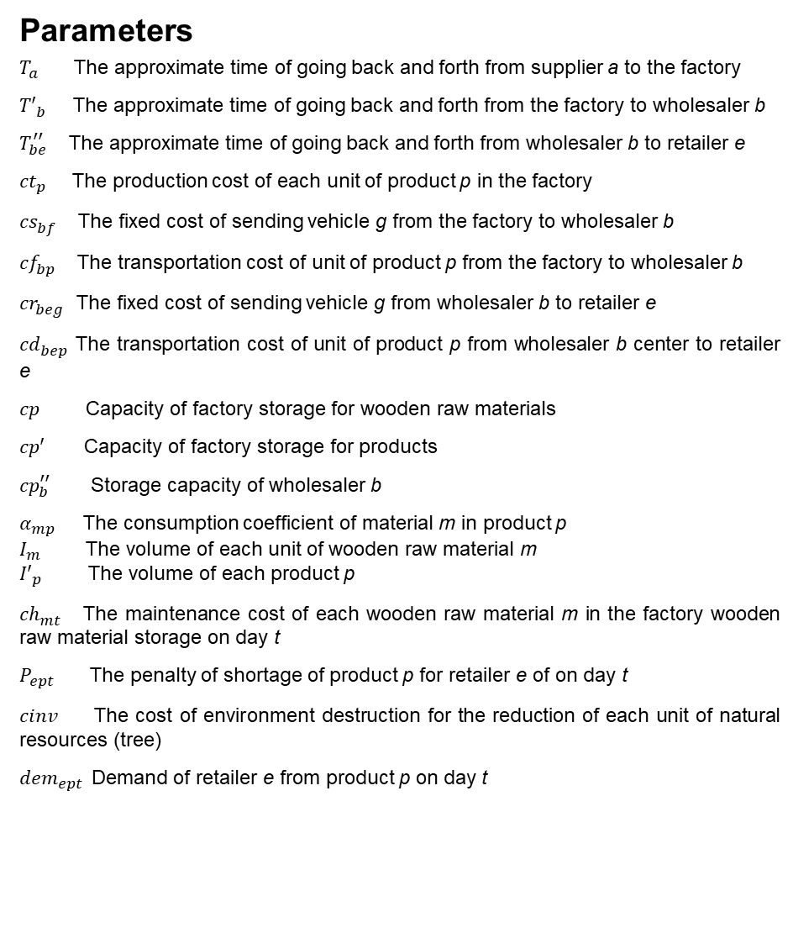
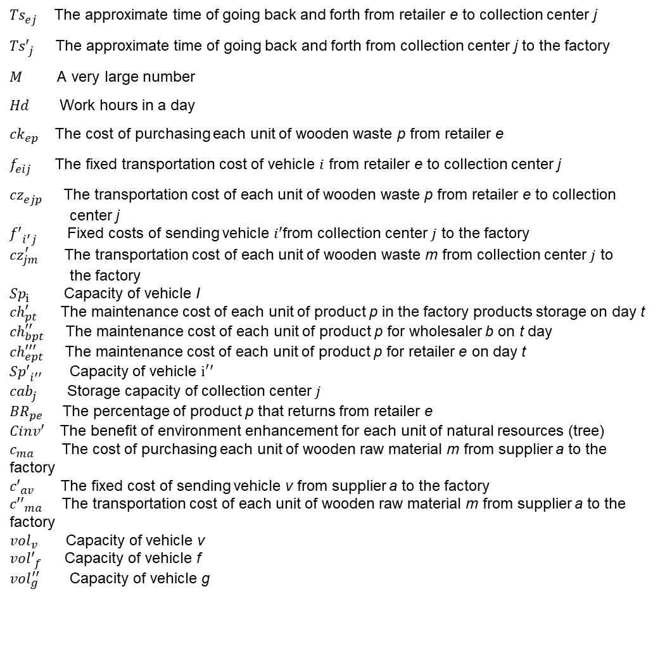
Mathematical formulation (Notations)
Parameters
$T_{a}$The approximate time of going back and forth from supplier a to the factory
${T′}_{b}^{ }$The approximate time of going back and forth from the factory to wholesaler b
$T_{be}^{′′}$The approximate time of going back and forth from wholesaler b to retailer e
${ct}_{p}^{ }$The production cost of each unit of product p in the factory
${cs}_{bf}^{ }$The fixed cost of sending vehicle g from the factory to wholesaler b
${cf}_{bp}^{ }$The transportation cost of unit of product p from the factory to wholesaler b
${cr}_{beg}^{ }$The fixed cost of sending vehicle g from wholesaler b to retailer e
${cd}_{bep}^{ }$The transportation cost of unit of product p from wholesaler b center to retailer e
$cp$ Capacity of factory storage for wooden raw materials
$cp′$ Capacity of factory storage for products
${cp}_{b}^{′′}$ Storage capacity of wholesaler b
$α_{mp}$ The consumption coefficient of material m in product p
$I_{m}$ The volume of each unit of wooden raw material m
${I′}_{p}$ The volume of each product p
${ch}_{mt}^{ }$The maintenance cost of each wooden raw material m in the factory wooden raw material storage on day t
$P_{ept}$ The penalty of shortage of product p for retailer e of on day t
${cinv}_{ }$ The cost of environment destruction for the reduction of each unit of natural resources (tree)
${dem}_{ept}$Demand of retailer e from product p on day t
${Ts}_{ej}^{ }$ The approximate time of going back and forth from retailer e to collection center j
${Ts′}_{j}^{ }$ The approximate time of going back and forth from collection center j to the factory
$M$ A very large number
$Hd$ Work hours in a day
${ck}_{ep}^{ }$The cost of purchasing each unit of wooden waste p from retailer e
$f_{eij}^{ }$The fixed transportation cost of vehicle $i$ from retailer e to collection center j
${cz}_{ejp}^{ }$ The transportation cost of each unit of wooden waste p from retailer e to collection
center j
${f′}_{i^{′}j}^{ }$ Fixed costs of sending vehicle $i′$from collection center $j$ to the factory
${cz}_{jm}^{′}$ The transportation cost of each unit of wooden waste m from collection center $j$ to
the factory
${Sp}_{i}^{ }$ Capacity of vehicle I
${ch}_{pt}^{′}$The maintenance cost of each unit of product p in the factory products storage on day t
${ch}_{bpt}^{′′}$ The maintenance cost of each unit of product p for wholesaler b on t day
${ch}_{ept}^{′′′}$ The maintenance cost of each unit of product p for retailer e on day t
${Sp′}_{i^{′′}}^{ }$ Capacity of vehicle $i^{′}′$
${cab}_{j}^{ }$ Storage capacity of collection center $j$
${BR}_{pe}$The percentage of product p that returns from retailer e
${Cinv′}_{ }$ The benefit of environment enhancement for each unit of natural resources (tree)
$c_{ma}$ The cost of purchasing each unit of wooden raw material m from supplier a to the factory
${c′}_{av}$The fixed cost of sending vehicle v from supplier a to the factory
${c′′}_{ma}$The transportation cost of each unit of wooden raw material m from supplier a to the factory
${vol}_{v}$ Capacity of vehicle v
${vol′}_{f}^{ }$ Capacity of vehicle f
${vol}_{g}^{′′}$ Capacity of vehicle g
9

Slide 10
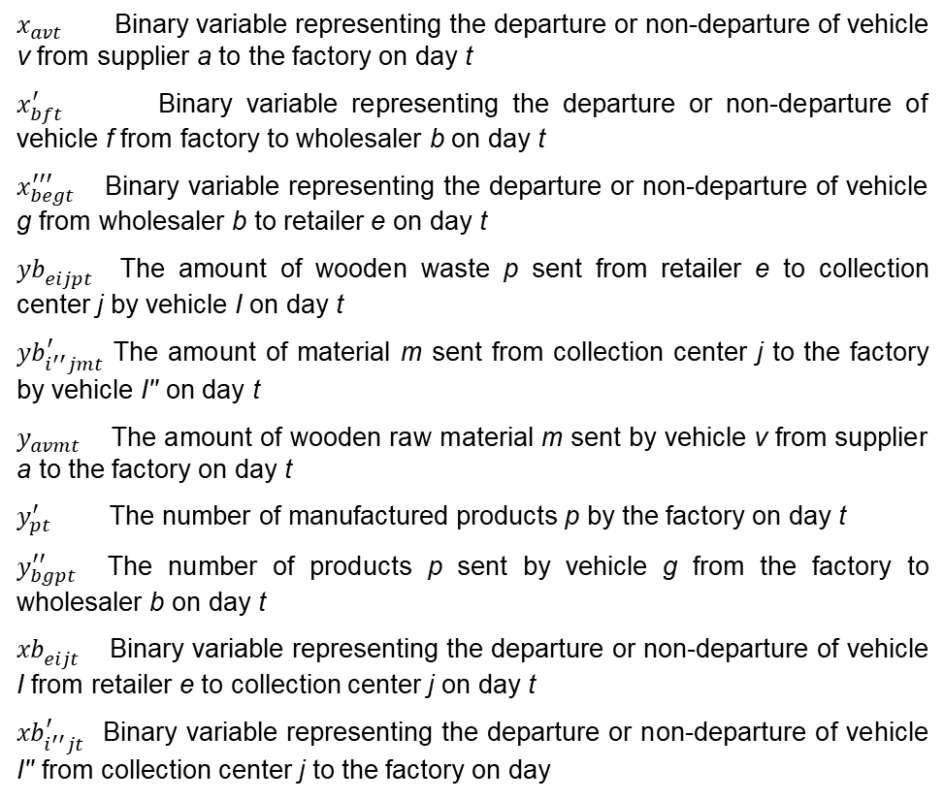
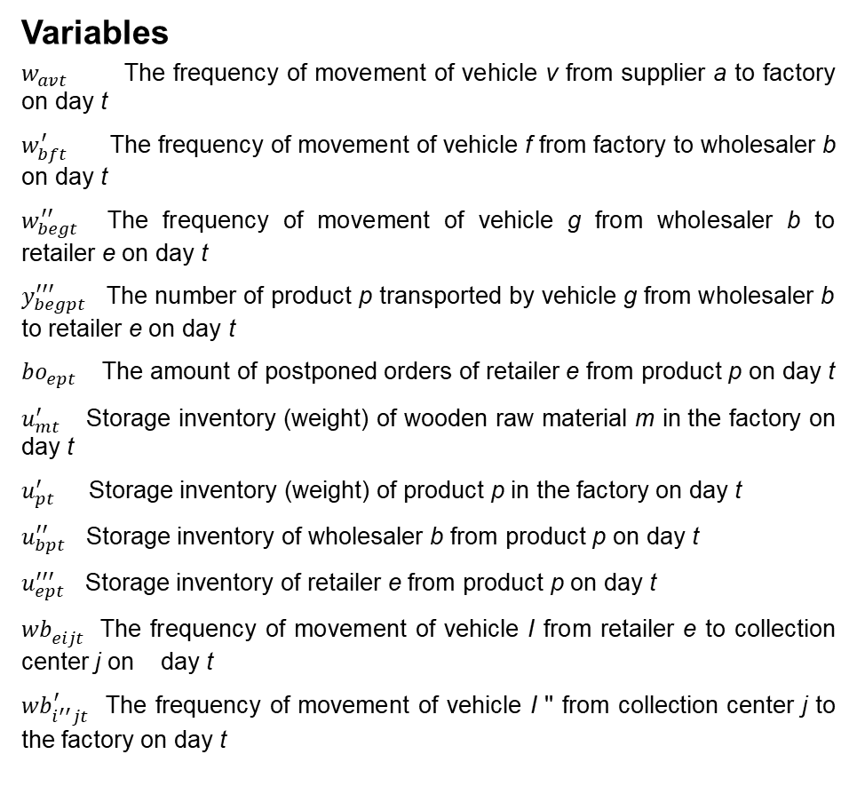
Mathematical formulation (Notations)
Variables
$w_{avt}$ The frequency of movement of vehicle v from supplier a to factory on day t
$w_{bft}^{′}$ The frequency of movement of vehicle f from factory to wholesaler b on day t
$w_{begt}^{′′}$The frequency of movement of vehicle g from wholesaler b to retailer e on day t
$y_{begpt}^{′′′}$ The number of product p transported by vehicle g from wholesaler b to retailer e on day t
${bo}_{ept}$ The amount of postponed orders of retailer e from product p on day t
$u_{mt}^{′}$ Storage inventory (weight) of wooden raw material m in the factory on day t
$u_{pt}^{′}$ Storage inventory (weight) of product p in the factory on day t
$u_{bpt}^{′′}$ Storage inventory of wholesaler b from product p on day t
$u_{ept}^{′′′}$ Storage inventory of retailer e from product p on day t
${wb}_{eijt}^{ }$The frequency of movement of vehicle I from retailer e to collection center j on day t
${wb}_{i^{′′}jt}^{′}$ The frequency of movement of vehicle I '' from collection center j to the factory on day t
$x_{avt}$ Binary variable representing the departure or non-departure of vehicle v from supplier a to the factory on day t
$x_{bft}^{′}$ Binary variable representing the departure or non-departure of vehicle f from factory to wholesaler b on day t
$x_{begt }^{′′′}$Binary variable representing the departure or non-departure of vehicle g from wholesaler b to retailer e on day t
${yb}_{eijpt}^{ }$ The amount of wooden waste p sent from retailer e to collection center j by vehicle I on day t
${yb}_{i^{′′}jmt}^{′}$ The amount of material m sent from collection center j to the factory by vehicle I'' on day t
$y_{avmt}$ The amount of wooden raw material m sent by vehicle v from supplier a to the factory on day t
$y_{pt}^{′}$ The number of manufactured products p by the factory on day t
$y_{bgpt}^{′′}$The number of products p sent by vehicle g from the factory to wholesaler b on day t
${xb}_{eijt}^{ }$ Binary variable representing the departure or non-departure of vehicle I from retailer e to collection center j on day t
${xb}_{i^{′′}jt}^{′}$Binary variable representing the departure or non-departure of vehicle I'' from collection center j to the factory on day
10

Slide 11
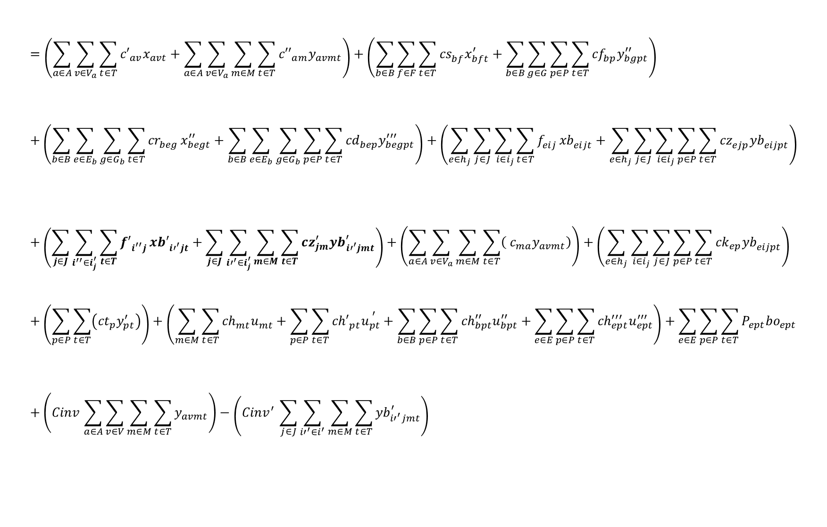
Mathematical formulation (Notations)
Objective Function
Transportation Cost
$$=\left(\sum_{a∈A}{\sum_{v∈V_{a}}{\sum_{t∈T}{{c′}_{av}x_{avt}}}}+\sum_{a∈A}{\sum_{v∈V_{a}}{\sum_{m∈M}{\sum_{t∈T}{{c′′}_{am}y_{avmt}}}}}\right)+\left(\sum_{b∈B}{\sum_{f∈F}{\sum_{t∈T}{{cs}_{bf}^{ }x_{bft}^{′}}}}+\sum_{b∈B}{\sum_{g∈G}{\sum_{p∈P}{\sum_{t∈T}{{cf}_{bp}^{ }y_{bgpt}^{′′}}}}}\right)+\left(\sum_{b∈B}{\sum_{e∈E_{b}}{\sum_{g∈G_{b}}{\sum_{t∈T}{{cr}_{beg}^{ }}x_{begt}^{′′}}}}+\sum_{b∈B}{\sum_{e∈E_{b}}{\sum_{g∈G_{b}}{\sum_{p∈P}{\sum_{t∈T}{{cd}_{bep}^{ }y_{begpt}^{′′′}}}}}}\right)+\left(\sum_{e∈h_{j}}{\sum_{j∈J}{\sum_{{ i∈i}_{j}}{\sum_{t∈T}{f_{eij}^{ }}{xb}_{eijt}^{ }}}}+\sum_{e∈h_{j}}{\sum_{j∈J}{\sum_{{ i∈i}_{j}}{\sum_{p∈P}{\sum_{t∈T}{{cz}_{ejp}^{ }{yb}_{eijpt}^{ }}}}}}\right)+\left(\sum_{j∈J}{\sum_{i^{′′}∈i_{j}^{′}}{\sum_{t∈T}{{f′}_{i^{′′}j}^{ }}{xb′}_{{i′}^{′}jt}^{ }}}+\sum_{j∈J}{\sum_{{i′}^{′}∈i_{j}^{′}}{\sum_{m∈M}{\sum_{t∈T}{{cz}_{jm}^{′}{yb}_{{i′}^{′}jmt}^{′}}}}}\right)+\left(\sum_{a∈A}{\sum_{v∈V_{a}}{\sum_{m∈M}{\sum_{t∈T}{\left( c_{ma}y_{avmt}\right)}}}}\right)+\left(\sum_{e∈h_{j}}{\sum_{{ i∈i}_{j}}{\sum_{j∈J}{\sum_{p∈P}{\sum_{t∈T}{{ck}_{ep}^{ }{yb}_{eijpt}^{ }}}}}}\right)+\left(\sum_{p∈P}{\sum_{t∈T}{\left({ct}_{p}^{ }y_{pt}^{′}\right)}}\right)+\left(\sum_{m∈M}{\sum_{t∈T}{{ch}_{mt}^{ }u_{mt}^{ }}}+\sum_{p∈P}{\sum_{t∈T}{{ch′}_{pt}^{ }u_{pt}^{ ^{′}}}}+\sum_{b∈B}{\sum_{p∈P}{\sum_{t∈T}{{ch}_{bpt}^{′′}u_{bpt}^{′′}}}}+\sum_{e∈E}{\sum_{p∈P}{\sum_{t∈T}{{ch}_{ept}^{′′′}u_{ept}^{′′′}}}}\right)+\sum_{e∈E}{\sum_{p∈P}{\sum_{t∈T}{P_{ept}{bo}_{ept}}}}+\left({Cinv}_{ }\sum_{a∈A}{\sum_{v∈V}{\sum_{m∈M}{\sum_{t∈T}{y_{avmt}}}}}\right)−\left({{Cinv}^{′}}_{ }\sum_{j∈J}{\sum_{{i′}^{′}∈i^{′}}{\sum_{m∈M}{\sum_{t∈T}{{yb}_{{i′}^{′}jmt}^{′}}}}}\right)$$
Min Z
Purchasing Cost
Production Cost
Shortage
Cost
Maintenance Cost
Environmental Effect Cost
11

Slide 12

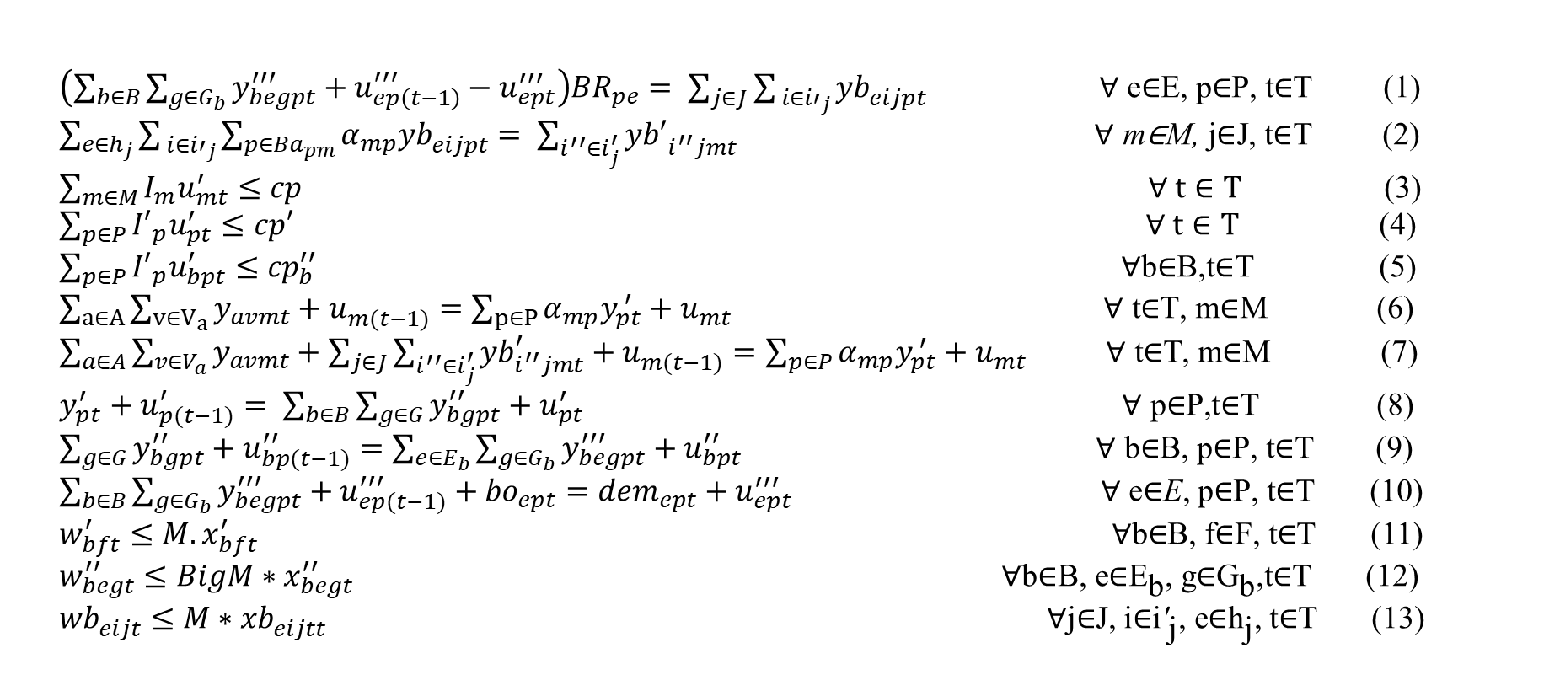
Mathematical formulation (Notations)
Model Constraints
$\left(\sum_{b∈B}{\sum_{g∈G_{b}}{y_{begpt}^{′′′}}}+u_{ep\left(t−1\right)}^{′′′}−u_{ept}^{′′′}\right){BR}_{pe}= \sum_{j∈J}{\sum_{{ i∈i′}_{j}}{{yb}_{eijpt}^{ }}} \text{∀ }\text{e}\text{∈}\text{E}\text{, }\text{p}\text{∈}\text{P}\text{, }\text{t}\text{∈}\text{T}$ (1)
$\sum_{e∈h_{j}}{\sum_{{ i∈i′}_{j}}{\sum_{p∈{Ba}_{pm}}{α_{mp}{yb}_{eijpt}^{ }}}}= \sum_{i^{′′}∈i_{j}^{′}}{{yb′}_{i^{′′}jmt}^{ }}$ $\text{∀ }\text{m}\text{∈}\text{M}\text{, }\text{j}\text{∈}\text{J}\text{, }\text{t}\text{∈}\text{T}$ (2) $\sum_{m∈M}{I_{m}u_{mt}^{′}}≤cp$ $∀ t∈T$ $\text{(}\text{3}\text{) }$
$\sum_{p∈P}{{I′}_{p}u_{pt}^{′}}≤cp′$ $∀ t∈T \text{(}\text{4}\text{) }\sum_{p∈P}{{{I′}_{p}u}_{bpt}^{′}}≤{cp}_{b}^{′′}$ $\text{∀}\text{b}\text{∈}\text{B}\text{,}\text{t}\text{∈}\text{T}$ $\text{(}\text{5}\text{) }$ $\sum_{a∈A}{\sum_{v∈V_{a}}{y_{avmt}+u_{m(t−1)}^{ }}}=\sum_{p∈P}{α_{mp}y_{pt}^{ ′}+u_{mt}^{ }}$ $\text{∀ }\text{t}\text{∈}\text{T}\text{, }\text{m}\text{∈}\text{M}$ (6)
$\sum_{a∈A}{\sum_{v∈V_{a}}{y_{avmt}+\sum_{j∈J}{\sum_{i^{′′}∈i_{j}^{′}}{{yb}_{i^{′′}jmt}^{′}}}+u_{m(t−1)}^{ }}}=\sum_{p∈P}{α_{mp}y_{pt}^{ ′}+u_{mt}^{ }}$ $\text{∀ }\text{t}\text{∈}\text{T}\text{, }\text{m}\text{∈}\text{M}$ $\text{(}\text{7}\text{) }$
$y_{pt}^{′}+u_{p(t−1)}^{′}= \sum_{b∈B}{\sum_{g∈G}{y_{bgpt}^{′′}}+u_{pt}^{′}}$ $\text{∀ }\text{p}\text{∈}\text{P}\text{,}\text{t}\text{∈}\text{T}$ (8)
$\sum_{g∈G}{y_{bgpt}^{′′}}+u_{bp(t−1)}^{′′}=\sum_{e∈E_{b}}{\sum_{g∈G_{b}}{y_{begpt}^{′′′}}}+u_{bpt}^{′′}$ $\text{∀ }\text{b}\text{∈}\text{B}\text{, }\text{p}\text{∈}\text{P}\text{, }\text{t}\text{∈}\text{T}$ (9)
$\sum_{b∈B}{\sum_{g∈G_{b}}{y_{begpt}^{′′′}}}+u_{ep(t−1)}^{′′′}+{bo}_{ept}={dem}_{ept}+u_{ept}^{′′′}$ $\text{∀ }\text{e}\text{∈}\text{E}\text{, }\text{p}\text{∈}\text{P}\text{, }\text{t}\text{∈}\text{T}$ (10)
$w_{bft}^{′}≤M.x_{bft}^{′}$ $\text{∀}\text{b}\text{∈}\text{B}\text{, }\text{f}\text{∈}\text{F}\text{, }\text{t}\text{∈}\text{T}$ (11)
$w_{begt}^{′′}≤BigM∗x_{begt}^{′′}$ $\text{∀}\text{b}\text{∈}\text{B}\text{, }\text{e}\text{∈}{\text{E}}_{\text{b}}\text{, }\text{g}\text{∈}{\text{G}}_{\text{b}}\text{,}\text{t}\text{∈}\text{T}$ (12)
${wb}_{eijt}^{ }≤M∗{xb}_{eijtt}^{ }$ ${ \text{∀}\text{j}\text{∈}\text{J}\text{, }\text{i}\text{∈}\text{i}\text{′}}_{\text{j}}\text{, }\text{e}\text{∈}{\text{h}}_{\text{j}}\text{, }\text{t}\text{∈}\text{T}$ (13)
Factory
Capacity
Inventory
Vehicle
Frequency
12

Slide 13
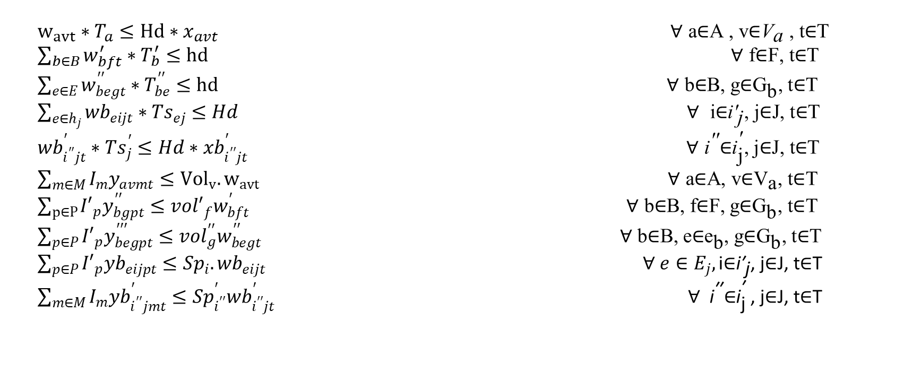
Mathematical formulation (Notations)
Model Constraints
$w_{avt}∗T_{a}≤Hd∗x_{avt}$ $\text{∀ }\text{a}\text{∈}\text{A}\text{ , }\text{v}\text{∈}{\text{V}}_{\text{a} }\text{, }\text{t}\text{∈}\text{T}$
$\sum_{b∈B}{w_{bft}^{′}∗T_{b}^{′}}≤hd$ $\text{∀ }\text{f}\text{∈}\text{F}\text{, }\text{t}\text{∈}\text{T}$
$\sum_{e∈E}{w_{begt}^{′′}∗T_{be}^{′′}}≤hd$ $\text{∀ }\text{b}\text{∈}\text{B}\text{, }\text{g}\text{∈}{\text{G}}_{\text{b}}\text{, }\text{t}\text{∈}\text{T}$
$\sum_{e∈h_{j}}{{wb}_{eijt}^{ }∗{Ts}_{ej}^{ }}≤Hd$ $\text{∀ }{\text{i}\text{∈}\text{i}\text{′}}_{\text{j}}\text{, }\text{j}\text{∈}\text{J}\text{, }\text{t}\text{∈}\text{T}$
${wb}_{i^{′′}jt}^{′}∗{Ts}_{j}^{′}≤Hd∗{xb}_{i^{′′}jt}^{′}$ $\text{∀ }{\text{i}}^{\text{′′}}\text{∈}{\text{i}}_{\text{j}}^{\text{′}}\text{, }\text{j}\text{∈}\text{J}\text{, }\text{t}\text{∈}\text{T}$
$\sum_{m∈M}{I_{m}y_{avmt}}≤{Vol}_{v}.w_{avt}$ $\text{∀ }\text{a}\text{∈}\text{A}\text{, }\text{v}\text{∈}{\text{V}}_{\text{a}}\text{, }\text{t}\text{∈}\text{T}$
$\sum_{p∈P}{{I′}_{p}y_{bgpt}^{′′}}≤{vol′}_{f}^{ }w_{bft}^{′}$ $\text{∀ }\text{b}\text{∈}\text{B}\text{, }\text{f}\text{∈}\text{F}\text{, }\text{g}\text{∈}{\text{G}}_{\text{b}}\text{, }\text{t}\text{∈}\text{T}$
$\sum_{p∈P}{{I′}_{p}y_{begpt}^{′′′}}≤{vol}_{g}^{′′}w_{begt}^{′′}$ $\text{∀ }\text{b}\text{∈}\text{B}\text{, }\text{e}\text{∈}{\text{e}}_{\text{b}}\text{, }\text{g}\text{∈}{\text{G}}_{\text{b}}\text{, }\text{t}\text{∈}\text{T}$
$\sum_{p∈P}{{I′}_{p}{yb}_{eijpt}^{ }}≤{Sp}_{i}^{ }{.wb}_{eijt}^{ }$ $∀ e∈E_{j},{\text{i}\text{∈}\text{i}\text{′}}_{\text{j}}\text{, }\text{j}\text{∈}\text{J}\text{, }\text{t}\text{∈}\text{T}$
$\sum_{m∈M}{I_{m}{yb}_{i^{′′}jmt}^{′}}≤{Sp}_{i^{′′}}^{′}{wb}_{i^{′′}jt}^{′}$ $\text{ ∀ }{\text{i}}^{\text{′′}}\text{∈}{\text{i}}_{\text{j}}^{\text{′ }}\text{, }\text{j}\text{∈}\text{J}\text{, }\text{t}\text{∈}\text{T}$
(14)
(15)
Number
of Trips
(16)
(17)
(18)
(19)
(20)
Vehicle Capacity
(21)
(22)
(23)
13

Slide 14
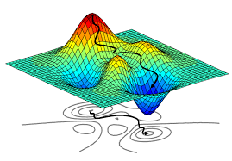
Solution Approach
Solution
GAMS
GA
Local and Global Optimization
General Algebraic
Modeling System
Genetic Algorithm
14

Slide 15



Solution Approach
General Algebraic Modeling System (GAMS)
Optimization Model Formulation in GAMS
GAMS is a high-level model specially designed for modeling linear, nonlinear and mixed integer optimization problems.
Model description,
preprocessing, solver
GAMS solution report
Input file
Global and Local search method for nonlinear optimization
GAMS
Select Solver
Input File
Output File
Optional calls for other solvers and external Programs
15

Slide 16
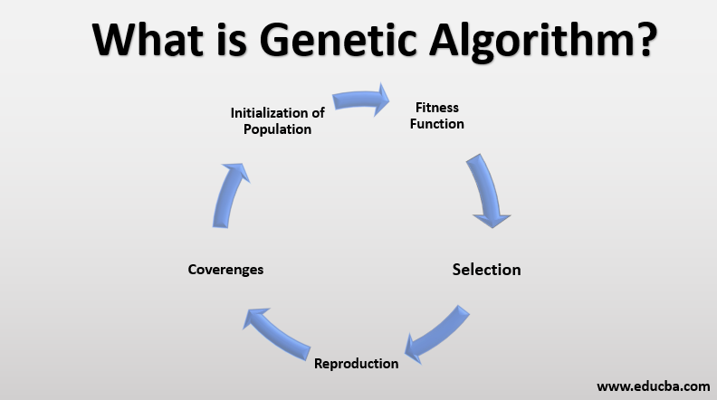
Solution Approach
Genetic Algorithm (GA)
A genetic algorithm is a metaheuristic inspired by the process of natural selection that belongs to the larger class of evolutionary algorithms.
16

Slide 17
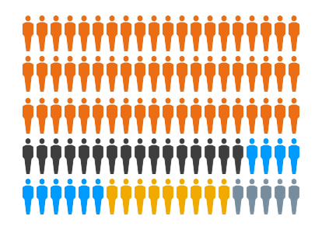
Solution Approach
Initial Population
INITIAL POPULATION
The first step of any genetic algorithm is to generate a set of possible solutions randomly as an initial generation or population to the problem. For that case assume we are generating 100 random population.
SELECTION
EVALUATE FITNESS
CROSSOVER
MUTATION
TERMINATING
CONDITION
PRINT RESULTS
17

Slide 18
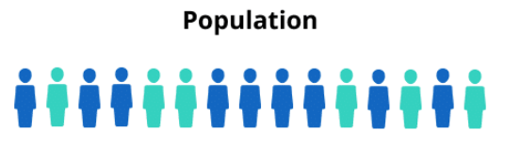

Solution Approach
Tournament Selection
INITIAL POPULATION
Tournament selection is a method of selecting an individual from a population of individuals in a genetic algorithm. Tournament selection involves running several "tournaments" among a few individuals chosen at random from the population. The winner of each tournament is selected for crossover.
SELECTION
EVALUATE FITNESS
CROSSOVER
MUTATION
TERMINATING
CONDITION
PRINT RESULTS
18

Slide 19
Solution Approach
Fitness Test
INITIAL POPULATION
Now we will test the score of each three individual population and we will select the first and second top scorer for next generation parents.
SELECTION
EVALUATE FITNESS
CROSSOVER
MUTATION
TERMINATING
CONDITION
2nd
1st
3rd
PRINT RESULTS
19

Slide 20
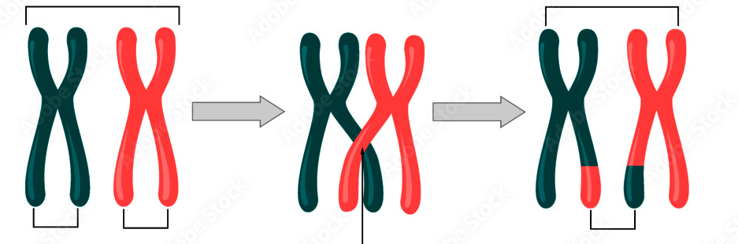
Solution Approach
Crossover
INITIAL POPULATION
In genetic algorithms and evolutionary computation, crossover, also called recombination, is a genetic operator used to combine the genetic information of two parents to generate new offspring
SELECTION
EVALUATE FITNESS
CROSSOVER
Parents
Offspring
MUTATION
TERMINATING
CONDITION
P1
P2
Crossing Over
Crossover Point
PRINT RESULTS
20

Slide 21
Solution Approach
Mutation
INITIAL POPULATION
Mutation is a genetic operator used to maintain genetic diversity from one generation of a population of genetic algorithm chromosomes to the next. It is analogous to biological mutation.
SELECTION
EVALUATE FITNESS
Before Mutation
CROSSOVER
0 | 0 | 0 | 1 | 1 | 0 | 1 | 0 | 1
MUTATION
Random bit flip
TERMINATING
CONDITION
0 | 1 | 0 | 1 | 1 | 1 | 1 | 0 | 0
After Mutation
PRINT RESULTS
21

Slide 22
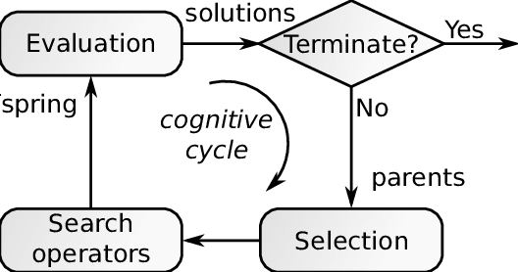
Solution Approach
Terminating Condition
INITIAL POPULATION
The termination condition of a Genetic Algorithm is important in determining when a GA run will end.
SELECTION
EVALUATE FITNESS
CROSSOVER
Generation Count
MUTATION
TERMINATING
CONDITION
PRINT RESULTS
22

Slide 23
Solution Approach
Optimization Result
INITIAL POPULATION
Finally we get our optimum result for the 100 generation.
SELECTION
EVALUATE FITNESS
CROSSOVER
MUTATION
TERMINATING
CONDITION
Global Minima
PRINT RESULTS
23

Slide 24
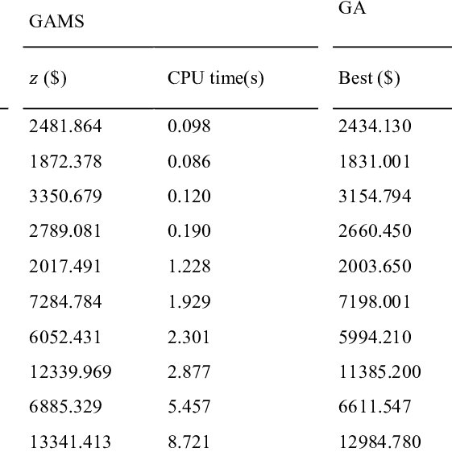
Result
GAMS
vs
GA
Fig : Comparing results
14

Slide 25
Thank You

