Slide 1

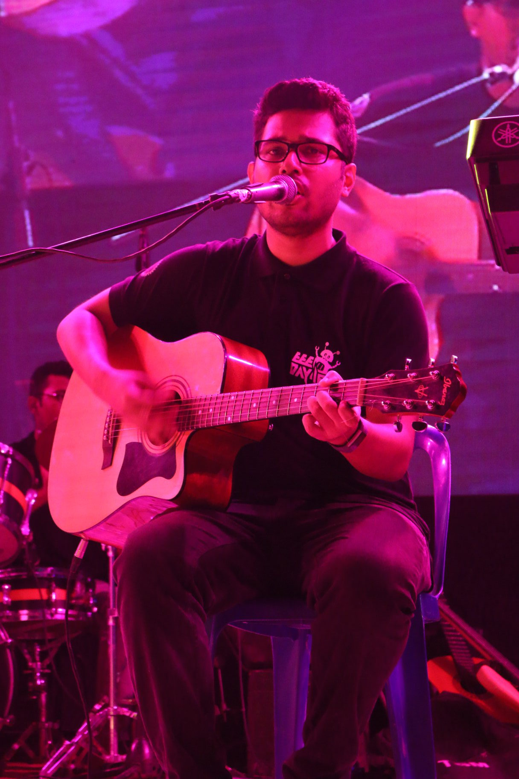
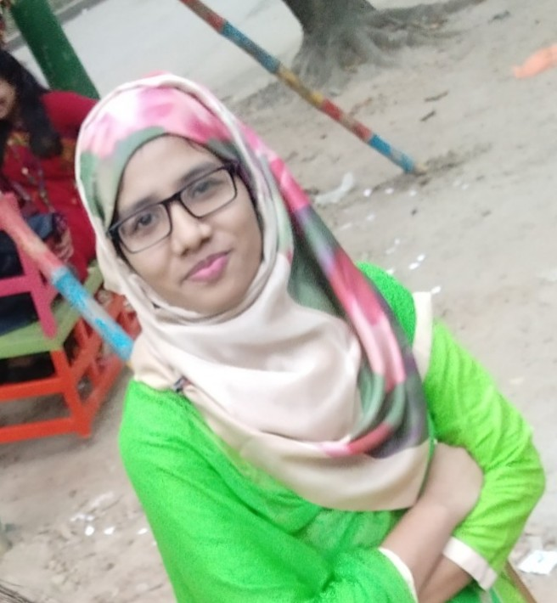

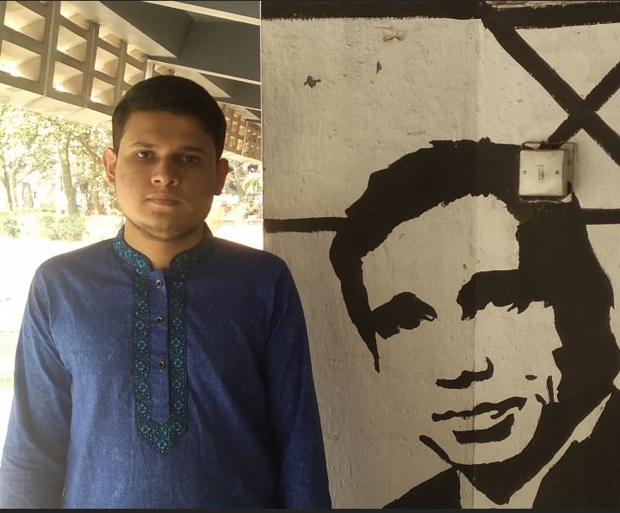
Speech To Braille Generation For People With Auditory And Visual Impairment
Submitted by : Group-C.P7
DEPARTMENT OF ELECTRICAL AND ELECTRONICS ENGINEERING
BANGLADESH UNIVERSITY OF ENGINEERING AND TECHNOLOGY
EEE416-MICROPROCESSOR AND EMBEDDED SYSTEMS LABORATORY
Ishraq Tashdid
1606142
Asad-Uz-Zaman
1606165
Mst. Rumi Akter
1606171
Md. Tawheedul Islam
1606173

Slide 2
Outline
Summary
Background
Methods
Simulation
PCB layout and 3d rendering
Future Outlook
Conclusion

Slide 3
Summary
A software program of phone that captures the spoken words of a speaker and converts them to text, and then converts each letters into Braille signals. We have implemented this in Proteus where, using a Bluetooth module we captured the converted texts from a software and sent the texts to STM32F103C6. Finally STM32F103C6 converts the texts into Braille and shows them via LED lights.
Here for clear understanding we have showed the part of sending texts to STM32F103C6 with the help of two bluetooth module.

Slide 4
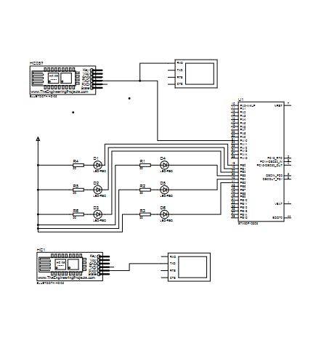
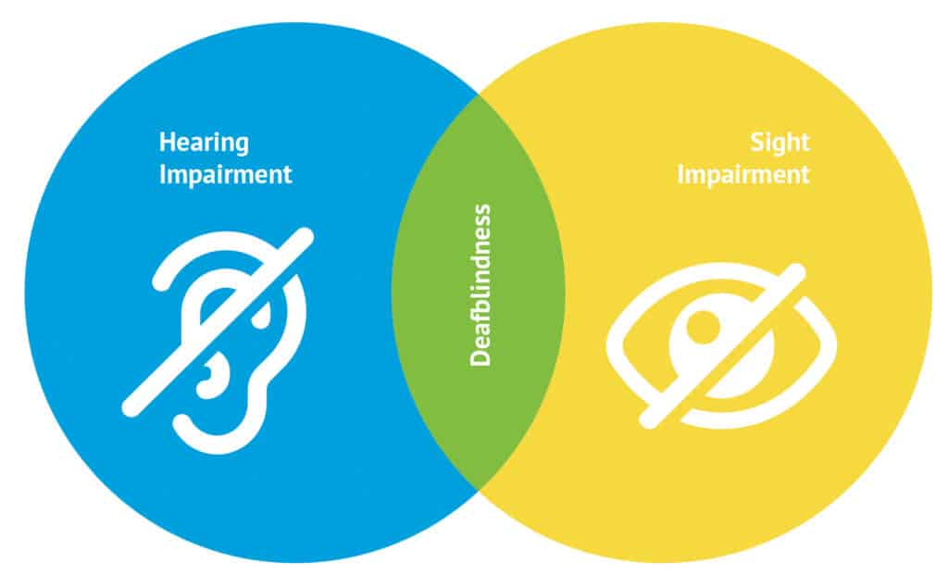
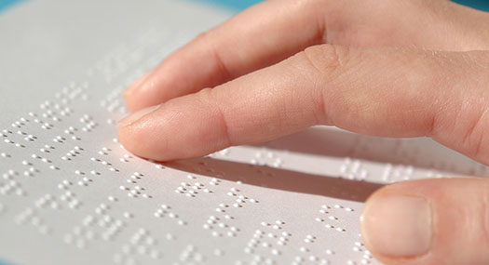
Background
Deafblind people are unable to hear or see. Thus, regular communication is very hard for them. They need the sense of touch (Braille system) to communicate. But not everyone is aware of the Braille language. Our device bridge the gap between these two people.

Slide 5
Names of Components used
STM32F103C6
LED
Resistors
Bluetooth module
Virtual terminal
Power Supply
Wire

Slide 6
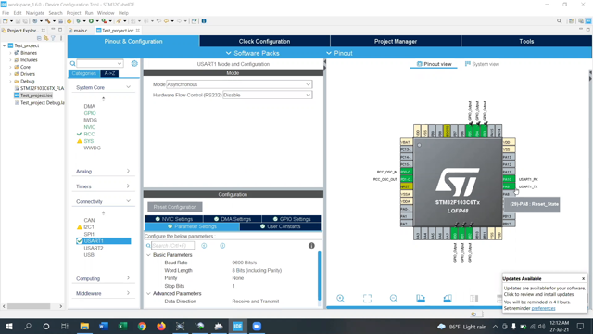
Methodology

Slide 7
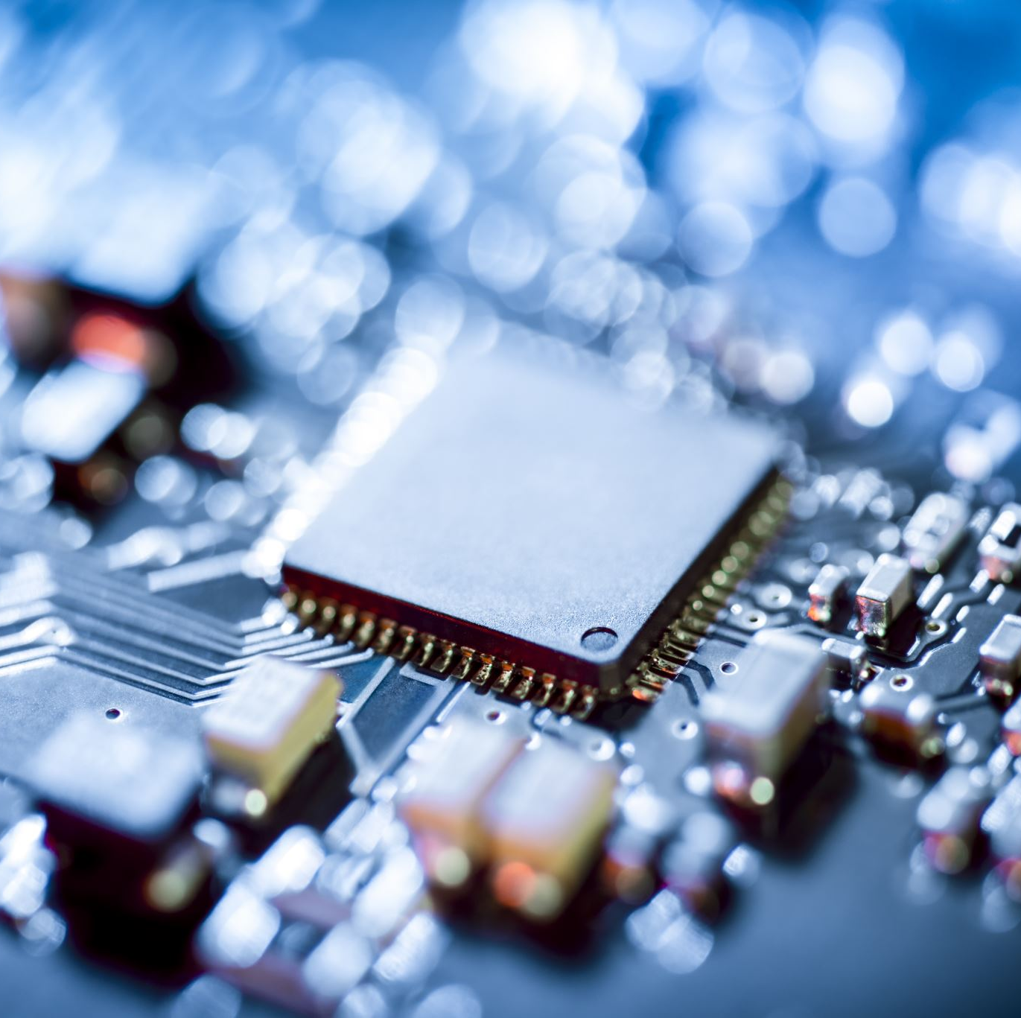
Circuit Diagram
Visit Proteus Circuit Diagram

Slide 8
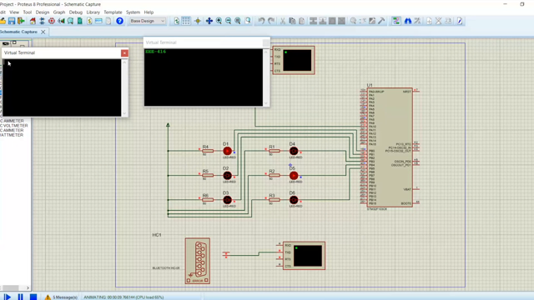
Simulation

Slide 9
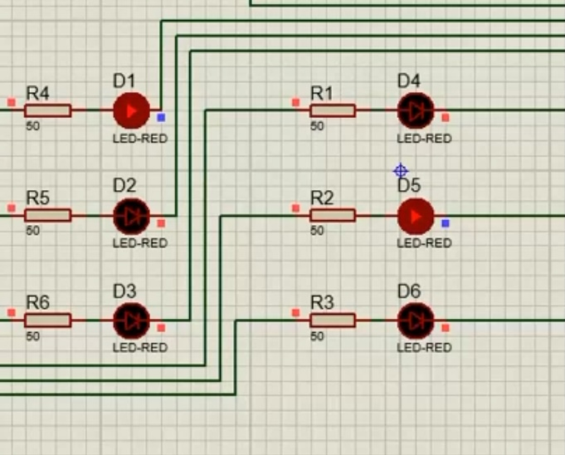
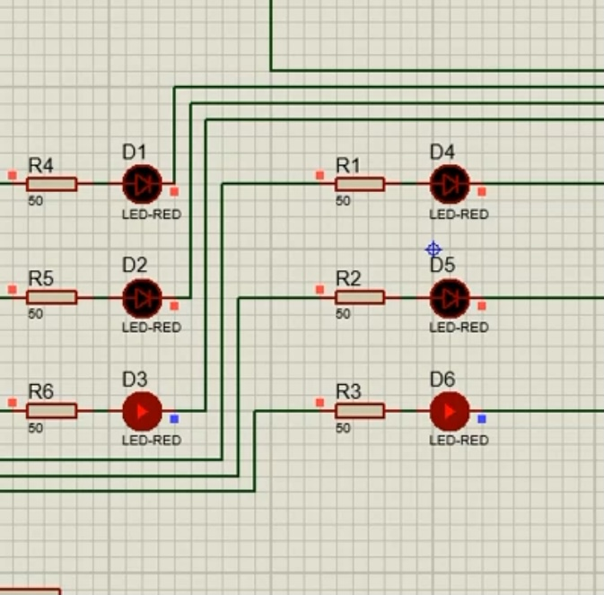
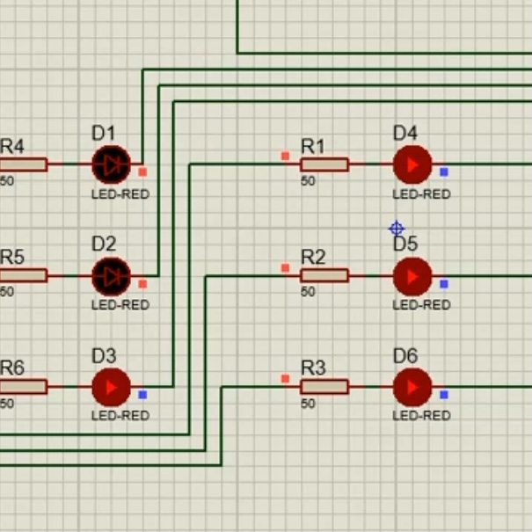
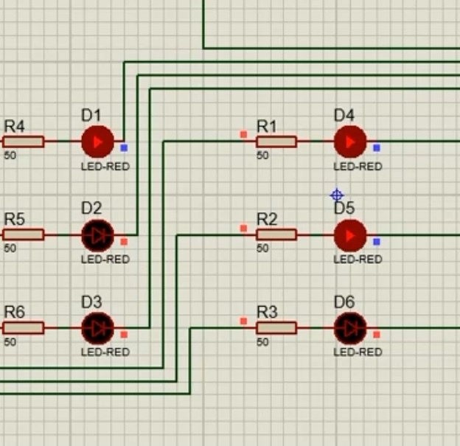
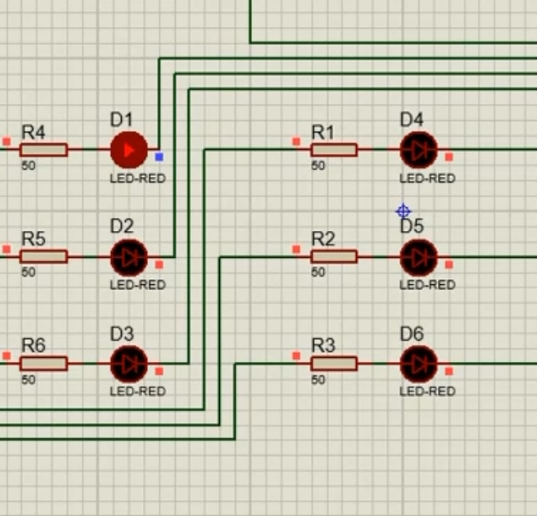
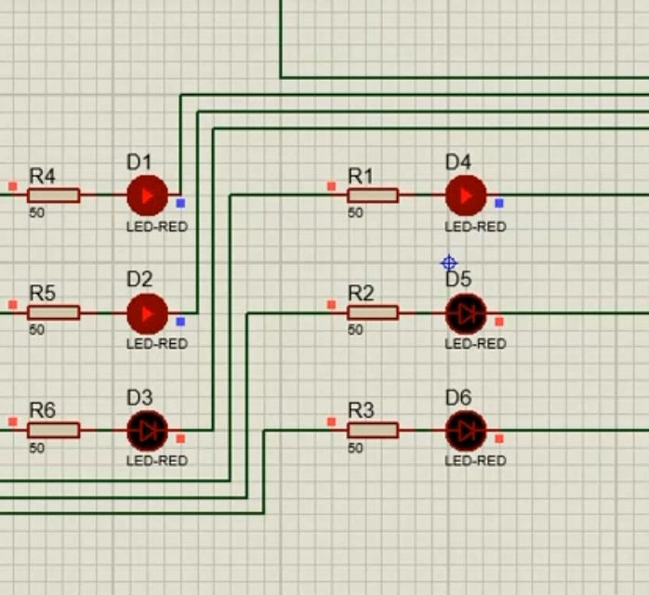
Results
Output Braille Sequence for "EEE-416"
E E E - 4 1 6

Slide 10
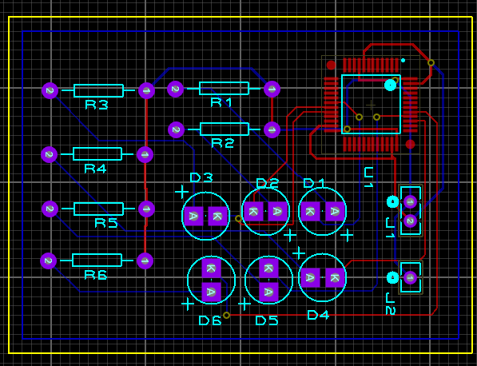
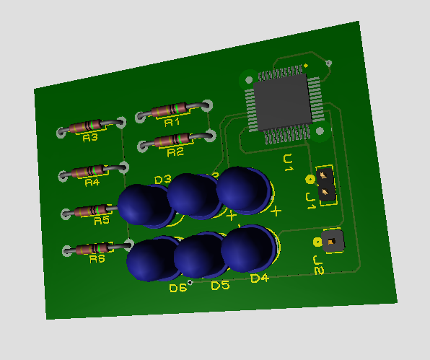
PCB Layout & 3D Rendering

Slide 11
Future Outlook
Hardware Implementation with stepper motor
Better Bluetooth Connectivity
Deep Learning integration
Creating a standalone device comprising of speech detectors & scanning sensors as well.
Braille output can be presented in a sequence format for better readability.

Slide 12
Conclusion
Finally we can come to a conclusion that because of difficulty we have implemented the full project in software by following proper algorithm . And we have been able to show the braille presentation of letters, digits, punctuation marks.

Slide 13
References
https://www.st.com/en/microcontrollers-microprocessors/stm32-32-bit-arm-cortex-mcus.html
https://en.wikipedia.org/wiki/STM32
https://www.youtube.com/watch?v=X10KgBLBM_c
https://link.springer.com/chapter/10.1007/978-1-84628-867-8_14
https://www.sciencedirect.com/science/article/pii/S2214785320407710

Slide 14
Detailed Methods
Used Proteus for Demonstrating STM32 Project
Used Proteus for designing PCB for our project
Used STM32CubeIDE for developing codes on STM32
Used De Vinci Resolve for editing the presentation video
Besides MS Word, MS Powerpoint were used to organize our overall project.
Used Virtual Serial Port Driver for communication between bluetooth modules in proteus

Slide 15

Source Codes
Visit STM32 Code Link

Slide 16
Difficulties
STM32 language
Teammates from different remote areas
Weak connection between bluetooth modules
Hardware implementation was not possible due to covid situation

