Slide 1
Introduction to
Artificial Intelligence

Slide 2
Artificial Intelligence

Slide 3
O
X X
Search
O X

Slide 4
P → Q P
Knowledge
Q

Slide 5
Uncertainty

Slide 6


Optimization

Slide 7

Inbox
Learning
Spam

Slide 8
Neural Networks

Slide 9
NP
NP
PP
Language
ADJ
N
P
N
artificial with intelligence
python

Slide 10
Search

Slide 11


1 |  | 2 |  | 3 |  | 4
5 |  | 6 |  | 7 |  | 8
9 |  | 10 |  | 11 |  | 12
13 |  | 14 |  | 15

Slide 12


Slide 13
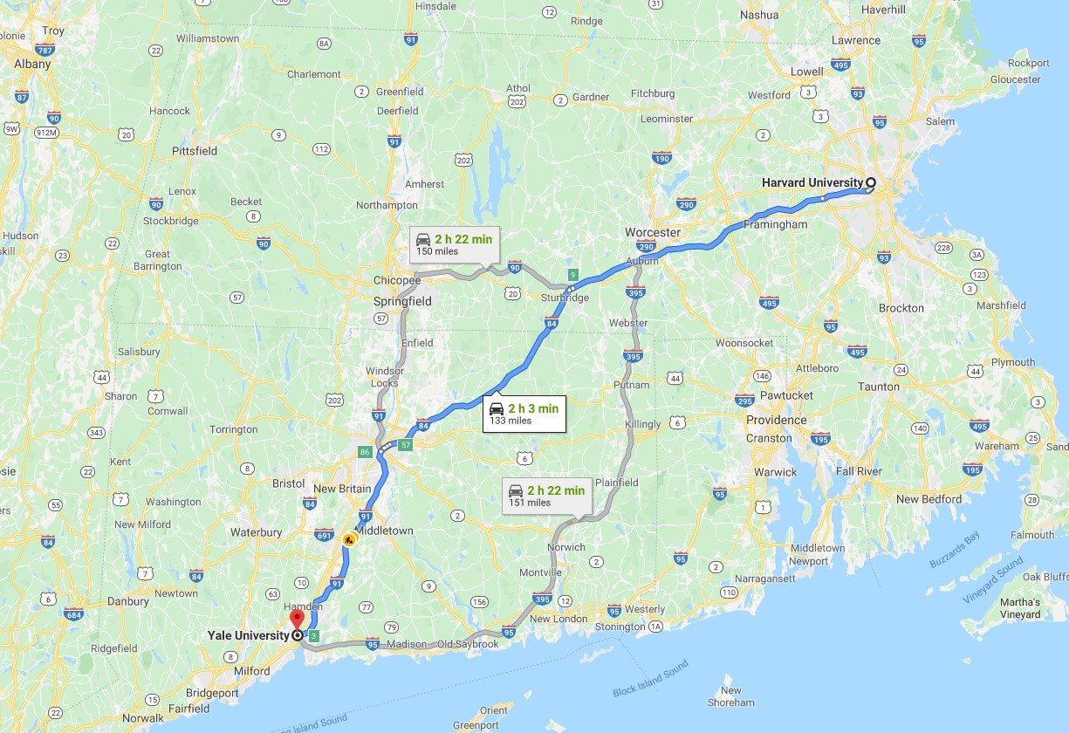

Slide 14
Search Problems

Slide 15
agent
entity that perceives its environment and acts upon that environment

Slide 16
state
a configuration of the agent and its environment

Slide 17
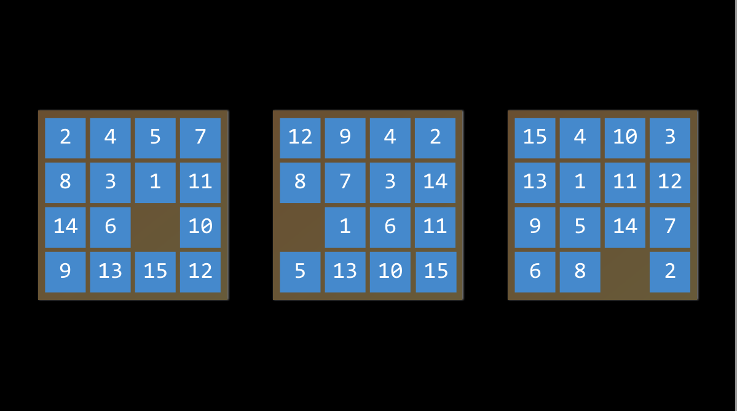

Slide 18
initial state
the state in which the agent begins

Slide 19


initial state
2 |  | 4 |  | 5 |  | 7
8 |  | 3 |  | 1 |  | 11
14 |  | 6 |  |  |  | 10
9 |  | 13 |  | 15 |  | 12

Slide 20
actions
choices that can be made in a state

Slide 21
actions
ACTIONS(s) returns the set of actions that can be executed in state s

Slide 22
1
2
actions
3
4

Slide 23
transition model
a description of what state results from performing any applicable action in any state

Slide 24
transition model
RESULT(s, a) returns the state resulting from performing action a in state s

Slide 25
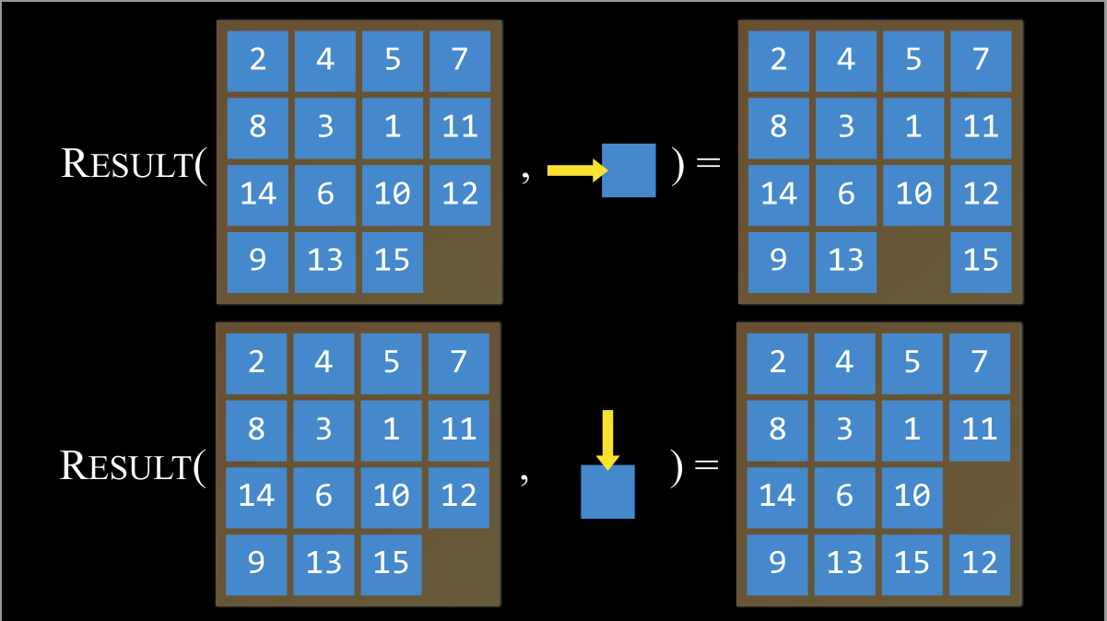



2
4
5
7
2
4
5
7
8 3 1 11
8 3 1 11
RESULT(
,
) =
14 |  | 6 |  | 10 |  | 12 |  | 14 |  | 6 |  | 10 |  | 12
9 |  | 13 |  | 15 |  |  |  | 9 |  | 13 |  |  |  | 15
2 |  | 4 |  | 5 |  | 7 |  | 2 |  | 4 |  | 5 |  | 7
8 3 1 11
8 3 1 11
RESULT(
,
) =
14 |  | 6 |  | 10 | 12 | 14 |  | 6 |  | 10
9 |  | 13 |  | 15 |  | 9 |  | 13 |  | 15 |  | 12

Slide 26
transition model
2
4
5
7
2
4
5
7
8 3 1 11
8 3 1 11
RESULT(
,
) =
14 |  | 6 |  | 10 | 12 | 14 |  | 6 |  | 10
9 |  | 13 |  | 15 |  | 9 |  | 13 |  | 15 |  | 12

Slide 27
state space
the set of all states reachable from the initial state by any sequence of actions

Slide 28
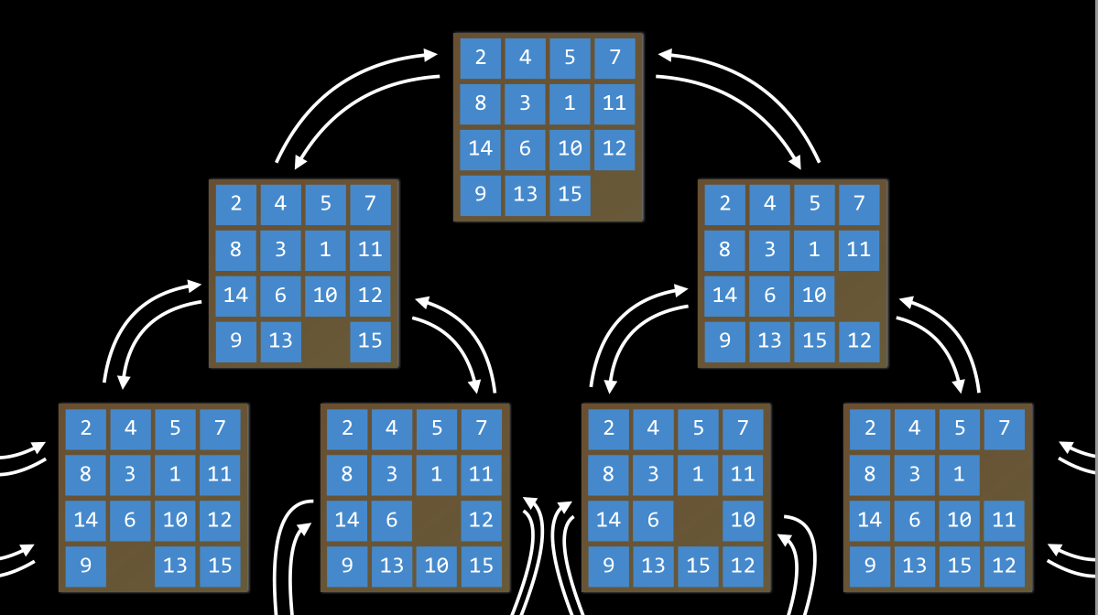

Slide 30
goal test
way to determine whether a given state is a goal state

Slide 31
path cost
numerical cost associated with a given path

Slide 32
A
B
C
D
E
F
G
I
K
H
J
L
M

Slide 33
A
4
2
B
2
5
1
C
D
6
E
F
G
3
2
3
I
4
K
3
H
4
2
J
1
2
L
M

Slide 34
A
1
1
B
1
1
1
C
D
1
E
F
G
1
1
1
I
1
K
1
H
1
1
J
1
1
L
M

Slide 35
Search Problems
initial state
actions
transition model
goal test
path cost function

Slide 36
solution
a sequence of actions that leads from the initial state to a goal state

Slide 37
optimal solution
a solution that has the lowest path cost among all solutions

Slide 38
node
a data structure that keeps track of
a state
a parent (node that generated this node)
an action (action applied to parent to get node)
a path cost (from initial state to node)

Slide 39
Class node: state = [[]] parent = parentNode action = “Move Left” path_cost = parentNode.path_cost + cost(p,c) node ob;

Slide 40
Approach
Start with a frontier that contains the initial state.
Repeat:
  If the frontier is empty, then no solution.
  Remove a node from the frontier.
  If node contains goal state, return the solution.
Expand node, add resulting nodes to the frontier.

Slide 41
Find a path from A to E.
A
B
Frontier
C
D
Start with a frontier that contains the initial state.
Repeat:
  If the frontier is empty, then no solution.
  Remove a node from the frontier.
  If node contains goal state, return the solution.
Expand node, add resulting nodes to the frontier.
E
F

Slide 42
Find a path from A to E.
A
B
Frontier
A
C
D
Start with a frontier that contains the initial state.
Repeat:
  If the frontier is empty, then no solution.
  Remove a node from the frontier.
  If node contains goal state, return the solution.
Expand node, add resulting nodes to the frontier.
E
F

Slide 43
Find a path from A to E.
A
B
Frontier
C
D
Start with a frontier that contains the initial state.
Repeat:
  If the frontier is empty, then no solution.
  Remove a node from the frontier.
  If node contains goal state, return the solution.
Expand node, add resulting nodes to the frontier.
E
F

Slide 44
Find a path from A to E.
A
B
Frontier
B
C
D
Start with a frontier that contains the initial state.
Repeat:
  If the frontier is empty, then no solution.
  Remove a node from the frontier.
  If node contains goal state, return the solution.
Expand node, add resulting nodes to the frontier.
E
F

Slide 45
Find a path from A to E.
A
B
Frontier
C
D
Start with a frontier that contains the initial state.
Repeat:
  If the frontier is empty, then no solution.
  Remove a node from the frontier.
  If node contains goal state, return the solution.
Expand node, add resulting nodes to the frontier.
E
F

Slide 46
Find a path from A to E.
A
B
Frontier
C
D
C
D
Start with a frontier that contains the initial state.
Repeat:
  If the frontier is empty, then no solution.
  Remove a node from the frontier.
  If node contains goal state, return the solution.
Expand node, add resulting nodes to the frontier.
E
F

Slide 47
Find a path from A to E.
A
B
Frontier
D
C
D
Start with a frontier that contains the initial state.
Repeat:
  If the frontier is empty, then no solution.
  Remove a node from the frontier.
  If node contains goal state, return the solution.
Expand node, add resulting nodes to the frontier.
E
F

Slide 48
Find a path from A to E.
A
B
Frontier
E
D
C
D
Start with a frontier that contains the initial state.
Repeat:
  If the frontier is empty, then no solution.
  Remove a node from the frontier.
  If node contains goal state, return the solution.
Expand node, add resulting nodes to the frontier.
E
F

Slide 49
Find a path from A to E.
A
B
Frontier
D
C
D
Start with a frontier that contains the initial state.
Repeat:
  If the frontier is empty, then no solution.
  Remove a node from the frontier.
  If node contains goal state, return the solution.
Expand node, add resulting nodes to the frontier.
E
F

Slide 50
Find a path from A to E.
A
B
Frontier
D
C
D
Start with a frontier that contains the initial state.
Repeat:
  If the frontier is empty, then no solution.
  Remove a node from the frontier.
  If node contains goal state, return the solution.
Expand node, add resulting nodes to the frontier.
E
F

Slide 51
What could go wrong?

Slide 52
Find a path from A to E.
A
B
Frontier
C
D
E
F

Slide 53
Find a path from A to E.
A
B
Frontier
A
C
D
E
F

Slide 54
Find a path from A to E.
A
B
Frontier
C
D
E
F

Slide 55
Find a path from A to E.
A
B
Frontier
B
C
D
E
F

Slide 56
Find a path from A to E.
A
B
Frontier
C
D
E
F

Slide 57
Find a path from A to E.
A
B
Frontier
A C D
C
D
E
F

Slide 58
Find a path from A to E.
A
B
Frontier
C D
C
D
E
F

Slide 59
Revised Approach
Start with a frontier that contains the initial state.
Start with an empty explored set.
Repeat:
  If the frontier is empty, then no solution.
  Remove a node from the frontier.
  If node contains goal state, return the solution.
  Add the node to the explored set.
Expand node, add resulting nodes to the frontier if they aren't already in the frontier or the explored set.

Slide 60
Revised Approach
Start with a frontier that contains the initial state.
Start with an empty explored set.
Repeat:
  If the frontier is empty, then no solution.
  Remove a node from the frontier.
  If node contains goal state, return the solution.
  Add the node to the explored set.
Expand node, add resulting nodes to the frontier if they aren't already in the frontier or the explored set.

Slide 61
stack
last-in first-out data type

Slide 62
Find a path from A to E.
A
B
Frontier
C
D
Explored Set
E
F

Slide 63
Find a path from A to E.
A
B
Frontier
A
C
D
Explored Set
E
F

Slide 64
Find a path from A to E.
A
B
Frontier
C
D
Explored Set
A
E
F

Slide 65
Find a path from A to E.
A
B
Frontier
B
C
D
Explored Set
A
E
F

Slide 66
Find a path from A to E.
A
B
Frontier
C
D
Explored Set
A B
E
F

Slide 67
Find a path from A to E.
A
B
Frontier
C
D
C
D
Explored Set
A B
E
F

Slide 68
Find a path from A to E.
A
B
Frontier
C
C
D
Explored Set
A B
D
E
F

Slide 69
Find a path from A to E.
A
B
Frontier
C
F
C
D
Explored Set
A B
D
E
F

Slide 70
Find a path from A to E.
A
B
Frontier
C
C
D
Explored Set
A B
D
F
E
F

Slide 71
Find a path from A to E.
A
B
Frontier
C
D
Explored Set
A B
D
F
C
E
F

Slide 72
Find a path from A to E.
A
B
Frontier
E
C
D
Explored Set
A B
D
F
C
E
F

Slide 73
Find a path from A to E.
A
B
Frontier
C
D
Explored Set
A B
D
F
C
E
F

Slide 74
Depth-First Search

Slide 75
depth-first search
search algorithm that always expands the deepest node in the frontier

Slide 76
Breadth-First Search

Slide 77
breadth-first search
search algorithm that always expands the shallowest node in the frontier

Slide 78
queue
first-in first-out data type

Slide 79
Find a path from A to E.
A
B
Frontier
C
D
Explored Set
E
F

Slide 80
Find a path from A to E.
A
B
Frontier
A
C
D
Explored Set
E
F

Slide 81
Find a path from A to E.
A
B
Frontier
C
D
Explored Set
A
E
F

Slide 82
Find a path from A to E.
A
B
Frontier
B
C
D
Explored Set
A
E
F

Slide 83
Find a path from A to E.
A
B
Frontier
C
D
Explored Set
A B
E
F

Slide 84
Find a path from A to E.
A
B
Frontier
C
D
C
D
Explored Set
A B
E
F

Slide 85
Find a path from A to E.
A
B
Frontier
D
C
D
Explored Set
A B
C
E
F

Slide 86
Find a path from A to E.
A
B
Frontier
D
E
C
D
Explored Set
A B
C
E
F

Slide 87
Find a path from A to E.
A
B
Frontier
E
C
D
Explored Set
A B
C
D
E
F

Slide 88
Find a path from A to E.
A
B
Frontier
E
F
C
D
Explored Set
A B
C
D
E
F

Slide 89
Find a path from A to E.
A
B
Frontier
F
C
D
Explored Set
A B
C
D
E
F

Slide 90
Depth-First Search
 |  |  |  |  |  |  |  |  |  |  | B
A

Slide 91
Depth-First Search
 |  |  |  |  |  |  |  |  |  |  | B
A

Slide 92
Depth-First Search
 |  |  |  |  |  |  |  |  |  |  | B
A

Slide 93
Depth-First Search
 |  |  |  |  |  |  |  |  |  |  | B
A

Slide 94
Depth-First Search
 |  |  |  |  |  |  |  |  |  |  | B
A

Slide 95
Depth-First Search
 |  |  |  |  |  |  |  |  |  |  | B
A

Slide 96
Depth-First Search
 |  |  |  |  |  |  |  |  |  |  | B
A

Slide 97
Depth-First Search
 |  |  |  |  |  |  |  |  |  |  | B
A

Slide 98
Depth-First Search
 |  |  |  |  |  |  |  |  |  |  | B
A

Slide 99
Depth-First Search
 |  |  |  |  |  |  |  |  |  |  | B
A

Slide 100
Depth-First Search
 |  |  |  |  |  |  |  |  |  |  | B
A

Slide 101
Depth-First Search
 |  |  |  |  |  |  |  |  |  |  | B
A

Slide 102
Depth-First Search
 |  |  |  |  |  |  |  |  |  |  | B
A

Slide 103
Depth-First Search
 |  |  |  |  |  |  |  |  |  |  | B
A

Slide 104
Depth-First Search
 |  |  |  |  |  |  |  |  |  |  | B
A

Slide 105
Depth-First Search
 |  |  |  |  |  |  |  |  |  |  | B
A

Slide 106
Depth-First Search
 |  |  |  |  |  |  |  |  |  |  | B
A

Slide 107
Depth-First Search
 |  |  |  |  |  |  |  |  |  |  | B
A

Slide 108
Depth-First Search
 |  |  |  |  |  |  |  |  |  |  | B
A

Slide 109
Depth-First Search
 |  |  |  |  |  |  |  |  |  |  | B
A

Slide 110
Depth-First Search
 |  |  |  |  |  |  |  |  |  |  | B
A

Slide 111
Depth-First Search
 |  |  |  |  |  |  |  |  |  |  | B
A

Slide 112
Depth-First Search
 |  |  |  |  |  |  |  |  |  |  | B
A

Slide 113
Depth-First Search
 |  |  |  |  |  |  |  |  |  |  | B
A

Slide 114
Depth-First Search
 |  |  |  |  |  |  |  |  |  |  | B
A

Slide 115
Depth-First Search
 |  |  |  |  |  |  |  |  |  |  | B
A

Slide 116
Depth-First Search
 |  |  |  |  |  |  |  |  |  |  | B
A

Slide 117
Depth-First Search
 |  |  |  |  |  |  |  |  |  |  | B
A

Slide 118
Depth-First Search
 |  |  |  |  |  |  |  |  |  |  | B
A

Slide 119
Depth-First Search
 |  |  |  |  |  |  |  |  |  |  | B
A

Slide 120
Depth-First Search
 |  |  |  |  |  |  |  |  |  |  | B
A

Slide 121
Depth-First Search
 |  |  |  |  |  |  |  |  |  |  | B
A

Slide 122
Depth-First Search
 |  |  |  |  |  |  |  |  |  |  | B
A

Slide 123
Depth-First Search
 |  |  |  |  |  |  |  |  |  |  | B
A

Slide 124
Depth-First Search
 |  |  |  |  |  |  |  |  |  |  | B
A

Slide 125
Depth-First Search
 |  |  |  |  |  |  |  |  |  |  | B
A

Slide 126
Depth-First Search
 |  |  |  |  |  |  |  |  |  |  | B
A

Slide 127
Depth-First Search
 |  |  | B
A

Slide 128
Depth-First Search
 |  |  | B
A

Slide 129
Depth-First Search
 |  |  | B
A

Slide 130
Depth-First Search
 |  |  | B
A

Slide 131
Depth-First Search
 |  |  | B
A

Slide 132
Depth-First Search
 |  |  | B
A

Slide 133
Depth-First Search
 |  |  | B
A

Slide 134
Depth-First Search
 |  |  | B
A

Slide 135
Depth-First Search
 |  |  | B
A

Slide 136
Depth-First Search
 |  |  | B
A

Slide 137
Depth-First Search
 |  |  | B
A

Slide 138
Breadth-First Search
 |  |  | B
A

Slide 139
Breadth-First Search
 |  |  | B
A

Slide 140
Breadth-First Search
 |  |  | B
A

Slide 141
Breadth-First Search
 |  |  | B
A

Slide 142
Breadth-First Search
 |  |  | B
A

Slide 143
Breadth-First Search
 |  |  | B
A

Slide 144
Breadth-First Search
 |  |  | B
A

Slide 145
Breadth-First Search
 |  |  | B
A

Slide 146
Breadth-First Search
 |  |  | B
A

Slide 147
Breadth-First Search
 |  |  | B
A

Slide 148
Breadth-First Search
 |  |  | B
A

Slide 149
Breadth-First Search
 |  |  | B
A

Slide 150
Breadth-First Search
 |  |  |  |  |  |  |  |  |  |  | B
A

Slide 151
Breadth-First Search
 |  |  |  |  |  |  |  |  |  |  | B
A

Slide 152
Breadth-First Search
 |  |  |  |  |  |  |  |  |  |  | B
A

Slide 153
Breadth-First Search
 |  |  |  |  |  |  |  |  |  |  | B
A

Slide 154
Breadth-First Search
 |  |  |  |  |  |  |  |  |  |  | B
A

Slide 155
Breadth-First Search
 |  |  |  |  |  |  |  |  |  |  | B
A

Slide 156
Breadth-First Search
 |  |  |  |  |  |  |  |  |  |  | B
A

Slide 157
Breadth-First Search
 |  |  |  |  |  |  |  |  |  |  | B
A

Slide 158
Breadth-First Search
 |  |  |  |  |  |  |  |  |  |  | B
A

Slide 159
Breadth-First Search
 |  |  |  |  |  |  |  |  |  |  | B
A

Slide 160
Breadth-First Search
 |  |  |  |  |  |  |  |  |  |  | B
A

Slide 161
Breadth-First Search
 |  |  |  |  |  |  |  |  |  |  | B
A

Slide 162
Breadth-First Search
 |  |  |  |  |  |  |  |  |  |  | B
A

Slide 163
Breadth-First Search
 |  |  |  |  |  |  |  |  |  |  | B
A

Slide 164
Breadth-First Search
 |  |  |  |  |  |  |  |  |  |  | B
A

Slide 165
Breadth-First Search
 |  |  |  |  |  |  |  |  |  |  | B
A

Slide 166
Breadth-First Search
 |  |  |  |  |  |  |  |  |  |  | B
A

Slide 167
Breadth-First Search
 |  |  |  |  |  |  |  |  |  |  | B
A

Slide 168
Breadth-First Search
 |  |  |  |  |  |  |  |  |  |  | B
A

Slide 169
Breadth-First Search
 |  |  |  |  |  |  |  |  |  |  | B
A

Slide 170
Breadth-First Search
 |  |  |  |  |  |  |  |  |  |  | B
A

Slide 171
Breadth-First Search
 |  |  |  |  |  |  |  |  |  |  | B
A

Slide 172
Breadth-First Search
 |  |  |  |  |  |  |  |  |  |  | B
A

Slide 173
Breadth-First Search
 |  |  |  |  |  |  |  |  |  |  | B
A

Slide 174
Breadth-First Search
 |  |  |  |  |  |  |  |  |  |  | B
A

Slide 175
Breadth-First Search
 |  |  |  |  |  |  |  |  |  |  | B
A

Slide 176
Breadth-First Search
 |  |  |  |  |  |  |  |  |  |  | B
A

Slide 177
Breadth-First Search
 |  |  |  |  |  |  |  |  |  |  | B
A

Slide 178
Breadth-First Search
 |  |  |  |  |  |  |  |  |  |  | B
A

Slide 179
Breadth-First Search
 |  |  |  |  |  |  |  |  |  |  | B
A

Slide 180
Breadth-First Search
 |  |  |  |  |  |  |  |  |  |  | B
A

Slide 181
Breadth-First Search
 |  |  |  |  |  |  |  |  |  |  | B
A

Slide 182
Breadth-First Search
 |  |  |  |  |  |  |  |  |  |  | B
A

Slide 183
Breadth-First Search
 |  |  |  |  |  |  |  |  |  |  | B
A

Slide 184
Breadth-First Search
 |  |  |  |  |  |  |  |  |  |  | B
A

Slide 185
Breadth-First Search
 |  |  |  |  |  |  |  |  |  |  | B
A

Slide 186
Breadth-First Search
 |  |  |  |  |  |  |  |  |  |  | B
A

Slide 187
Breadth-First Search
 |  |  |  |  |  |  |  |  |  |  | B
A

Slide 188
Breadth-First Search
 |  |  |  |  |  |  |  |  |  |  | B
A

Slide 189
Breadth-First Search
 |  |  |  |  |  |  |  |  |  |  | B
A

Slide 190
Breadth-First Search
 |  |  |  |  |  |  |  |  |  |  | B
A

Slide 191
Breadth-First Search
 |  |  |  |  |  |  |  |  |  |  | B
A

Slide 192
Breadth-First Search
 |  |  |  |  |  |  |  |  |  |  | B
A

Slide 193
Breadth-First Search
 |  |  |  |  |  |  |  |  |  |  | B
A

Slide 194
Breadth-First Search
 |  |  |  |  |  |  |  |  |  |  | B
A

Slide 195
Breadth-First Search
 |  |  |  |  |  |  |  |  |  |  | B
A

Slide 196
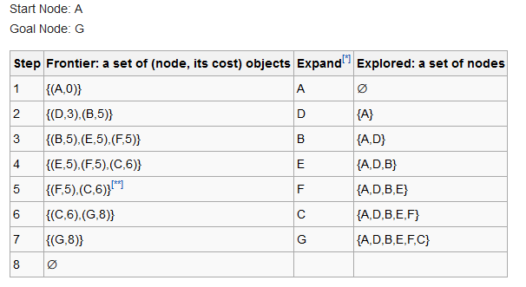
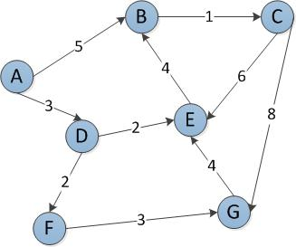
Uniform-cost search

Slide 197
→Use DFS or BFS when all the step costs are equal.
→Use UCS when all the step costs are not equal.

Slide 198
uninformed search / Blind Search
search strategy that uses no problem- specific knowledge
Examples:
BFS
DFS (Improvement of DFS: Backtracking)
UCS
Depth Limited Search
Iterative deepening depth-first search
Bidirectional search

Slide 199
informed search/ Heuristic Search
search strategy that uses problem-specific knowledge to find solutions more efficiently.
Greedy best-first search
A* search
Memory-bounded heuristic search

Slide 200
greedy best-first search
search algorithm that expands the node that is closest to the goal, as estimated by a heuristic function h(n)

Slide 201
Heuristic function?
 |  |  |  |  |  |  |  |  |  |  | B
A

Slide 202
Heuristic function?
 |  |  |  |  |  |  |  |  |  |  | B
 |  |  |  |  |  |  | D
 | C
A

Slide 203
Heuristic function? Manhattan distance.
B
D
C
A

Slide 204
Greedy Best-First Search
11 |  | 9 |  | 7 |  |  |  | 3 | 2 |  | B
12 |  | 10 |  | 8 | 7 | 6 |  | 4 |  |  | 1
13 | 12 | 11 |  | 9 |  | 7 | 6 | 5 |  |  | 2
 | 13 |  |  | 10 |  | 8 |  | 6 |  |  | 3
 | 14 | 13 | 12 | 11 |  | 9 |  | 7 | 6 | 5 | 4
 |  |  | 13 |  |  | 10
A | 16 | 15 | 14 |  |  | 11 | 10 | 9 | 8 | 7 | 6

Slide 205
Greedy Best-First Search
11 |  | 9 |  | 7 |  |  |  | 3 | 2 |  | B
12 |  | 10 |  | 8 | 7 | 6 |  | 4 |  |  | 1
13 | 12 | 11 |  | 9 |  | 7 | 6 | 5 |  |  | 2
 | 13 |  |  | 10 |  | 8 |  | 6 |  |  | 3
 | 14 | 13 | 12 | 11 |  | 9 |  | 7 | 6 | 5 | 4
 |  |  | 13 |  |  | 10
A | 16 | 15 | 14 |  |  | 11 | 10 | 9 | 8 | 7 | 6

Slide 206
Greedy Best-First Search
11 |  | 9 |  | 7 |  |  |  | 3 | 2 |  | B
12 |  | 10 |  | 8 | 7 | 6 |  | 4 |  |  | 1
13 | 12 | 11 |  | 9 |  | 7 | 6 | 5 |  |  | 2
 | 13 |  |  | 10 |  | 8 |  | 6 |  |  | 3
 | 14 | 13 | 12 | 11 |  | 9 |  | 7 | 6 | 5 | 4
 |  |  | 13 |  |  | 10
A | 16 | 15 | 14 |  |  | 11 | 10 | 9 | 8 | 7 | 6

Slide 207
Greedy Best-First Search
11 |  | 9 |  | 7 |  |  |  | 3 | 2 |  | B
12 |  | 10 |  | 8 | 7 | 6 |  | 4 |  |  | 1
13 | 12 | 11 |  | 9 |  | 7 | 6 | 5 |  |  | 2
 | 13 |  |  | 10 |  | 8 |  | 6 |  |  | 3
 | 14 | 13 | 12 | 11 |  | 9 |  | 7 | 6 | 5 | 4
 |  |  | 13 |  |  | 10
A | 16 | 15 | 14 |  |  | 11 | 10 | 9 | 8 | 7 | 6

Slide 208
Greedy Best-First Search
11 |  | 9 |  | 7 |  |  |  | 3 | 2 |  | B
12 |  | 10 |  | 8 | 7 | 6 |  | 4 |  |  | 1
13 | 12 | 11 |  | 9 |  | 7 | 6 | 5 |  |  | 2
 | 13 |  |  | 10 |  | 8 |  | 6 |  |  | 3
 | 14 | 13 | 12 | 11 |  | 9 |  | 7 | 6 | 5 | 4
 |  |  | 13 |  |  | 10
A | 16 | 15 | 14 |  |  | 11 | 10 | 9 | 8 | 7 | 6

Slide 209
Greedy Best-First Search
11 |  | 9 |  | 7 |  |  |  | 3 | 2 |  | B
12 |  | 10 |  | 8 | 7 | 6 |  | 4 |  |  | 1
13 | 12 | 11 |  | 9 |  | 7 | 6 | 5 |  |  | 2
 | 13 |  |  | 10 |  | 8 |  | 6 |  |  | 3
 | 14 | 13 | 12 | 11 |  | 9 |  | 7 | 6 | 5 | 4
 |  |  | 13 |  |  | 10
A | 16 | 15 | 14 |  |  | 11 | 10 | 9 | 8 | 7 | 6

Slide 210
Greedy Best-First Search
11 |  | 9 |  | 7 |  |  |  | 3 | 2 |  | B
12 |  | 10 |  | 8 | 7 | 6 |  | 4 |  |  | 1
13 | 12 | 11 |  | 9 |  | 7 | 6 | 5 |  |  | 2
 | 13 |  |  | 10 |  | 8 |  | 6 |  |  | 3
 | 14 | 13 | 12 | 11 |  | 9 |  | 7 | 6 | 5 | 4
 |  |  | 13 |  |  | 10
A | 16 | 15 | 14 |  |  | 11 | 10 | 9 | 8 | 7 | 6

Slide 211
Greedy Best-First Search
11 |  | 9 |  | 7 |  |  |  | 3 | 2 |  | B
12 |  | 10 |  | 8 | 7 | 6 |  | 4 |  |  | 1
13 | 12 | 11 |  | 9 |  | 7 | 6 | 5 |  |  | 2
 | 13 |  |  | 10 |  | 8 |  | 6 |  |  | 3
 | 14 | 13 | 12 | 11 |  | 9 |  | 7 | 6 | 5 | 4
 |  |  | 13 |  |  | 10
A | 16 | 15 | 14 |  |  | 11 | 10 | 9 | 8 | 7 | 6

Slide 212
Greedy Best-First Search
11 |  | 9 |  | 7 |  |  |  | 3 | 2 |  | B
12 |  | 10 |  | 8 | 7 | 6 |  | 4 |  |  | 1
13 | 12 | 11 |  | 9 |  | 7 | 6 | 5 |  |  | 2
 | 13 |  |  | 10 |  | 8 |  | 6 |  |  | 3
 | 14 | 13 | 12 | 11 |  | 9 |  | 7 | 6 | 5 | 4
 |  |  | 13 |  |  | 10
A | 16 | 15 | 14 |  |  | 11 | 10 | 9 | 8 | 7 | 6

Slide 213
Greedy Best-First Search
11 |  | 9 |  | 7 |  |  |  | 3 | 2 |  | B
12 |  | 10 |  | 8 | 7 | 6 |  | 4 |  |  | 1
13 | 12 | 11 |  | 9 |  | 7 | 6 | 5 |  |  | 2
 | 13 |  |  | 10 |  | 8 |  | 6 |  |  | 3
 | 14 | 13 | 12 | 11 |  | 9 |  | 7 | 6 | 5 | 4
 |  |  | 13 |  |  | 10
A | 16 | 15 | 14 |  |  | 11 | 10 | 9 | 8 | 7 | 6

Slide 214
Greedy Best-First Search
11 |  | 9 |  | 7 |  |  |  | 3 | 2 |  | B
12 |  | 10 |  | 8 | 7 | 6 |  | 4 |  |  | 1
13 | 12 | 11 |  | 9 |  | 7 | 6 | 5 |  |  | 2
 | 13 |  |  | 10 |  | 8 |  | 6 |  |  | 3
 | 14 | 13 | 12 | 11 |  | 9 |  | 7 | 6 | 5 | 4
 |  |  | 13 |  |  | 10
A | 16 | 15 | 14 |  |  | 11 | 10 | 9 | 8 | 7 | 6

Slide 215
Greedy Best-First Search
11 |  | 9 |  | 7 |  |  |  | 3 | 2 |  | B
12 |  | 10 |  | 8 | 7 | 6 |  | 4 |  |  | 1
13 | 12 | 11 |  | 9 |  | 7 | 6 | 5 |  |  | 2
 | 13 |  |  | 10 |  | 8 |  | 6 |  |  | 3
 | 14 | 13 | 12 | 11 |  | 9 |  | 7 | 6 | 5 | 4
 |  |  | 13 |  |  | 10
A | 16 | 15 | 14 |  |  | 11 | 10 | 9 | 8 | 7 | 6

Slide 216
Greedy Best-First Search
11 |  | 9 |  | 7 |  |  |  | 3 | 2 |  | B
12 |  | 10 |  | 8 | 7 | 6 |  | 4 |  |  | 1
13 | 12 | 11 |  | 9 |  | 7 | 6 | 5 |  |  | 2
 | 13 |  |  | 10 |  | 8 |  | 6 |  |  | 3
 | 14 | 13 | 12 | 11 |  | 9 |  | 7 | 6 | 5 | 4
 |  |  | 13 |  |  | 10
A | 16 | 15 | 14 |  |  | 11 | 10 | 9 | 8 | 7 | 6

Slide 217
Greedy Best-First Search
11 |  | 9 |  | 7 |  |  |  | 3 | 2 |  | B
12 |  | 10 |  | 8 | 7 | 6 |  | 4 |  |  | 1
13 | 12 | 11 |  | 9 |  | 7 | 6 | 5 |  |  | 2
 | 13 |  |  | 10 |  | 8 |  | 6 |  |  | 3
 | 14 | 13 | 12 | 11 |  | 9 |  | 7 | 6 | 5 | 4
 |  |  | 13 |  |  | 10
A | 16 | 15 | 14 |  |  | 11 | 10 | 9 | 8 | 7 | 6

Slide 218
Greedy Best-First Search
11 |  | 9 |  | 7 |  |  |  | 3 | 2 |  | B
12 |  | 10 |  | 8 | 7 | 6 |  | 4 |  |  | 1
13 | 12 | 11 |  | 9 |  | 7 | 6 | 5 |  |  | 2
 | 13 |  |  | 10 |  | 8 |  | 6 |  |  | 3
 | 14 | 13 | 12 | 11 |  | 9 |  | 7 | 6 | 5 | 4
 |  |  | 13 |  |  | 10
A | 16 | 15 | 14 |  |  | 11 | 10 | 9 | 8 | 7 | 6

Slide 219
Greedy Best-First Search
11 |  | 9 |  | 7 |  |  |  | 3 | 2 |  | B
12 |  | 10 |  | 8 | 7 | 6 |  | 4 |  |  | 1
13 | 12 | 11 |  | 9 |  | 7 | 6 | 5 |  |  | 2
 | 13 |  |  | 10 |  | 8 |  | 6 |  |  | 3
 | 14 | 13 | 12 | 11 |  | 9 |  | 7 | 6 | 5 | 4
 |  |  | 13 |  |  | 10
A | 16 | 15 | 14 |  |  | 11 | 10 | 9 | 8 | 7 | 6

Slide 220
Greedy Best-First Search
11 |  | 9 |  | 7 |  |  |  | 3 | 2 |  | B
12 |  | 10 |  | 8 | 7 | 6 |  | 4 |  |  | 1
13 | 12 | 11 |  | 9 |  | 7 | 6 | 5 |  |  | 2
 | 13 |  |  | 10 |  | 8 |  | 6 |  |  | 3
 | 14 | 13 | 12 | 11 |  | 9 |  | 7 | 6 | 5 | 4
 |  |  | 13 |  |  | 10
A | 16 | 15 | 14 |  |  | 11 | 10 | 9 | 8 | 7 | 6

Slide 221
Greedy Best-First Search
11 |  | 9 |  | 7 |  |  |  | 3 | 2 |  | B
12 |  | 10 |  | 8 | 7 | 6 |  | 4 |  |  | 1
13 | 12 | 11 |  | 9 |  | 7 | 6 | 5 |  |  | 2
 | 13 |  |  | 10 |  | 8 |  | 6 |  |  | 3
 | 14 | 13 | 12 | 11 |  | 9 |  | 7 | 6 | 5 | 4
 |  |  | 13 |  |  | 10
A | 16 | 15 | 14 |  |  | 11 | 10 | 9 | 8 | 7 | 6

Slide 222
Greedy Best-First Search
11 |  | 9 |  | 7 |  |  |  | 3 | 2 |  | B
12 |  | 10 |  | 8 | 7 | 6 |  | 4 |  |  | 1
13 | 12 | 11 |  | 9 |  | 7 | 6 | 5 |  |  | 2
 | 13 |  |  | 10 |  | 8 |  | 6 |  |  | 3
 | 14 | 13 | 12 | 11 |  | 9 |  | 7 | 6 | 5 | 4
 |  |  | 13 |  |  | 10
A | 16 | 15 | 14 |  |  | 11 | 10 | 9 | 8 | 7 | 6

Slide 223
Greedy Best-First Search
11 |  | 9 |  | 7 |  |  |  | 3 | 2 |  | B
12 |  | 10 |  | 8 | 7 | 6 |  | 4 |  |  | 1
13 | 12 | 11 |  | 9 |  | 7 | 6 | 5 |  |  | 2
 | 13 |  |  | 10 |  | 8 |  | 6 |  |  | 3
 | 14 | 13 | 12 | 11 |  | 9 |  | 7 | 6 | 5 | 4
 |  |  | 13 |  |  | 10
A | 16 | 15 | 14 |  |  | 11 | 10 | 9 | 8 | 7 | 6

Slide 224
Greedy Best-First Search
11 |  | 9 |  | 7 |  |  |  | 3 | 2 |  | B
12 |  | 10 |  | 8 | 7 | 6 |  | 4 |  |  | 1
13 | 12 | 11 |  | 9 |  | 7 | 6 | 5 |  |  | 2
 | 13 |  |  | 10 |  | 8 |  | 6 |  |  | 3
 | 14 | 13 | 12 | 11 |  | 9 |  | 7 | 6 | 5 | 4
 |  |  | 13 |  |  | 10
A | 16 | 15 | 14 |  |  | 11 | 10 | 9 | 8 | 7 | 6

Slide 225
Greedy Best-First Search
11 |  | 9 |  | 7 |  |  |  | 3 | 2 |  | B
12 |  | 10 |  | 8 | 7 | 6 |  | 4 |  |  | 1
13 | 12 | 11 |  | 9 |  | 7 | 6 | 5 |  |  | 2
 | 13 |  |  | 10 |  | 8 |  | 6 |  |  | 3
 | 14 | 13 | 12 | 11 |  | 9 |  | 7 | 6 | 5 | 4
 |  |  | 13 |  |  | 10
A | 16 | 15 | 14 |  |  | 11 | 10 | 9 | 8 | 7 | 6

Slide 226
Greedy Best-First Search
11 |  | 9 |  | 7 |  |  |  | 3 | 2 |  | B
12 |  | 10 |  | 8 | 7 | 6 |  | 4 |  |  | 1
13 | 12 | 11 |  | 9 |  | 7 | 6 | 5 |  |  | 2
 | 13 |  |  | 10 |  | 8 |  | 6 |  |  | 3
 | 14 | 13 | 12 | 11 |  | 9 |  | 7 | 6 | 5 | 4
 |  |  | 13 |  |  | 10
A | 16 | 15 | 14 |  |  | 11 | 10 | 9 | 8 | 7 | 6

Slide 227
Greedy Best-First Search
11 |  | 9 |  | 7 |  |  |  | 3 | 2 |  | B
12 |  | 10 |  | 8 | 7 | 6 |  | 4 |  |  | 1
13 | 12 | 11 |  | 9 |  | 7 | 6 | 5 |  |  | 2
 | 13 |  |  | 10 |  | 8 |  | 6 |  |  | 3
 | 14 | 13 | 12 | 11 |  | 9 |  | 7 | 6 | 5 | 4
 |  |  | 13 |  |  | 10
A | 16 | 15 | 14 |  |  | 11 | 10 | 9 | 8 | 7 | 6

Slide 228
Greedy Best-First Search
11 |  | 9 |  | 7 |  |  |  | 3 | 2 |  | B
12 |  | 10 |  | 8 | 7 | 6 |  | 4 |  |  | 1
13 | 12 | 11 |  | 9 |  | 7 | 6 | 5 |  |  | 2
 | 13 |  |  | 10 |  | 8 |  | 6 |  |  | 3
 | 14 | 13 | 12 | 11 |  | 9 |  | 7 | 6 | 5 | 4
 |  |  | 13 |  |  | 10
A | 16 | 15 | 14 |  |  | 11 | 10 | 9 | 8 | 7 | 6

Slide 229
Greedy Best-First Search
11 |  | 9 |  | 7 |  |  |  | 3 | 2 |  | B
12 |  | 10 |  | 8 | 7 | 6 |  | 4 |  |  | 1
13 | 12 | 11 |  | 9 |  | 7 | 6 | 5 |  |  | 2
 | 13 |  |  | 10 |  | 8 |  | 6 |  |  | 3
 | 14 | 13 | 12 | 11 |  | 9 |  | 7 | 6 | 5 | 4
 |  |  | 13 |  |  | 10
A | 16 | 15 | 14 |  |  | 11 | 10 | 9 | 8 | 7 | 6

Slide 230
Greedy Best-First Search
11 |  | 9 |  | 7 |  |  |  | 3 | 2 |  | B
12 |  | 10 |  | 8 | 7 | 6 |  | 4 |  |  | 1
13 | 12 | 11 |  | 9 |  | 7 | 6 | 5 |  |  | 2
 | 13 |  |  | 10 |  | 8 |  | 6 |  |  | 3
 | 14 | 13 | 12 | 11 |  | 9 |  | 7 | 6 | 5 | 4
 |  |  | 13 |  |  | 10
A | 16 | 15 | 14 |  |  | 11 | 10 | 9 | 8 | 7 | 6

Slide 231
Greedy Best-First Search
 | 10 | 9 | 8 | 7 | 6 | 5 | 4 | 3 | 2 | 1 | B
 | 11 |  |  |  |  |  |  |  |  |  | 1
 | 12 |  | 10 | 9 | 8 | 7 | 6 | 5 | 4 |  | 2
 | 13 |  | 11 |  |  |  |  |  | 5 |  | 3
 | 14 | 13 | 12 |  | 10 | 9 | 8 | 7 | 6 |  | 4
 |  |  | 13 |  | 11 |  |  |  |  |  | 5
A | 16 | 15 | 14 |  | 12 | 11 | 10 | 9 | 8 | 7 | 6

Slide 232
Greedy Best-First Search
 | 10 | 9 | 8 | 7 | 6 | 5 | 4 | 3 | 2 | 1 | B
 | 11 |  |  |  |  |  |  |  |  |  | 1
 | 12 |  | 10 | 9 | 8 | 7 | 6 | 5 | 4 |  | 2
 | 13 |  | 11 |  |  |  |  |  | 5 |  | 3
 | 14 | 13 | 12 |  | 10 | 9 | 8 | 7 | 6 |  | 4
 |  |  | 13 |  | 11 |  |  |  |  |  | 5
A | 16 | 15 | 14 |  | 12 | 11 | 10 | 9 | 8 | 7 | 6

Slide 233
Greedy Best-First Search
 | 10 | 9 | 8 | 7 | 6 | 5 | 4 | 3 | 2 | 1 | B
 | 11 |  |  |  |  |  |  |  |  |  | 1
 | 12 |  | 10 | 9 | 8 | 7 | 6 | 5 | 4 |  | 2
 | 13 |  | 11 |  |  |  |  |  | 5 |  | 3
 | 14 | 13 | 12 |  | 10 | 9 | 8 | 7 | 6 |  | 4
 |  |  | 13 |  | 11 |  |  |  |  |  | 5
A | 16 | 15 | 14 |  | 12 | 11 | 10 | 9 | 8 | 7 | 6

Slide 234
Evaluation function:
Uniform cost search: f(n) = g(n)
Greedy Best first search: f(n) = h(n)
A* Search: f(n) = g(n) + h(n)
Here, g(n) = Path cost (Cost from start state/node) h(n) = Heuristic function

Slide 235
A* search
search algorithm that expands node with lowest value of g(n) + h(n)
g(n) = cost to reach node
h(n) = estimated cost to goal

Slide 236
A* Search
 | 10 | 9 | 8 | 7 | 6 | 5 | 4 | 3 | 2 | 1 | B
 | 11 |  |  |  |  |  |  |  |  |  | 1
 | 12 |  | 10 | 9 | 8 | 7 | 6 | 5 | 4 |  | 2
 | 13 |  | 11 |  |  |  |  |  | 5 |  | 3
 | 14 | 13 | 12 |  | 10 | 9 | 8 | 7 | 6 |  | 4
 |  |  | 13 |  | 11 |  |  |  |  |  | 5
A | 16 | 15 | 14 |  | 12 | 11 | 10 | 9 | 8 | 7 | 6

Slide 237
A* Search
 | 10 | 9 | 8 | 7 | 6 | 5 | 4 | 3 | 2 | 1 | B
 | 11 |  |  |  |  |  |  |  |  |  | 1
 | 12 |  | 10 | 9 | 8 | 7 | 6 | 5 | 4 |  | 2
 | 13 |  | 11 |  |  |  |  |  | 5 |  | 3
 | 14 | 13 | 12 |  | 10 | 9 | 8 | 7 | 6 |  | 4
 |  |  | 13 |  | 11 |  |  |  |  |  | 5
A | 1+16 | 15 | 14 |  | 12 | 11 | 10 | 9 | 8 | 7 | 6

Slide 238
A* Search
 | 10 | 9 | 8 | 7 | 6 | 5 | 4 | 3 | 2 | 1 | B
 | 11 |  |  |  |  |  |  |  |  |  | 1
 | 12 |  | 10 | 9 | 8 | 7 | 6 | 5 | 4 |  | 2
 | 13 |  | 11 |  |  |  |  |  | 5 |  | 3
 | 14 | 13 | 12 |  | 10 | 9 | 8 | 7 | 6 |  | 4
 |  |  | 13 |  | 11 |  |  |  |  |  | 5
A | 1+16 | 2+15 | 14 |  | 12 | 11 | 10 | 9 | 8 | 7 | 6

Slide 239
A* Search
 | 10 | 9 | 8 | 7 | 6 | 5 | 4 | 3 | 2 | 1 | B
 | 11 |  |  |  |  |  |  |  |  |  | 1
 | 12 |  | 10 | 9 | 8 | 7 | 6 | 5 | 4 |  | 2
 | 13 |  | 11 |  |  |  |  |  | 5 |  | 3
 | 14 | 13 | 12 |  | 10 | 9 | 8 | 7 | 6 |  | 4
 |  |  | 13 |  | 11 |  |  |  |  |  | 5
A | 1+16 | 2+15 | 3+14 |  | 12 | 11 | 10 | 9 | 8 | 7 | 6

Slide 240
A* Search
 | 10 | 9 | 8 | 7 | 6 | 5 | 4 | 3 | 2 | 1 | B
 | 11 |  |  |  |  |  |  |  |  |  | 1
 | 12 |  | 10 | 9 | 8 | 7 | 6 | 5 | 4 |  | 2
 | 13 |  | 11 |  |  |  |  |  | 5 |  | 3
 | 14 | 13 | 12 |  | 10 | 9 | 8 | 7 | 6 |  | 4
 |  |  | 4+13 |  | 11 |  |  |  |  |  | 5
A | 1+16 | 2+15 | 3+14 |  | 12 | 11 | 10 | 9 | 8 | 7 | 6

Slide 241
A* Search
 | 10 | 9 | 8 | 7 | 6 | 5 | 4 | 3 | 2 | 1 | B
 | 11 |  |  |  |  |  |  |  |  |  | 1
 | 12 |  | 10 | 9 | 8 | 7 | 6 | 5 | 4 |  | 2
 | 13 |  | 11 |  |  |  |  |  | 5 |  | 3
 | 14 | 13 | 5+12 |  | 10 | 9 | 8 | 7 | 6 |  | 4
 |  |  | 4+13 |  | 11 |  |  |  |  |  | 5
A | 1+16 | 2+15 | 3+14 |  | 12 | 11 | 10 | 9 | 8 | 7 | 6

Slide 242
A* Search
 | 10 | 9 | 8 | 7 | 6 | 5 | 4 | 3 | 2 | 1 | B
 | 11 |  |  |  |  |  |  |  |  |  | 1
 | 12 |  | 10 | 9 | 8 | 7 | 6 | 5 | 4 |  | 2
 | 13 |  | 6+11 |  |  |  |  |  | 5 |  | 3
 | 14 | 13 | 5+12 |  | 10 | 9 | 8 | 7 | 6 |  | 4
 |  |  | 4+13 |  | 11 |  |  |  |  |  | 5
A | 1+16 | 2+15 | 3+14 |  | 12 | 11 | 10 | 9 | 8 | 7 | 6

Slide 243
A* Search
 | 10 | 9 | 8 | 7 | 6 | 5 | 4 | 3 | 2 | 1 | B
 | 11 |  |  |  |  |  |  |  |  |  | 1
 | 12 |  | 7+10 | 9 | 8 | 7 | 6 | 5 | 4 |  | 2
 | 13 |  | 6+11 |  |  |  |  |  | 5 |  | 3
 | 14 | 13 | 5+12 |  | 10 | 9 | 8 | 7 | 6 |  | 4
 |  |  | 4+13 |  | 11 |  |  |  |  |  | 5
A | 1+16 | 2+15 | 3+14 |  | 12 | 11 | 10 | 9 | 8 | 7 | 6

Slide 244
A* Search
 | 10 | 9 | 8 | 7 | 6 | 5 | 4 | 3 | 2 | 1 | B
 | 11 |  |  |  |  |  |  |  |  |  | 1
 | 12 |  | 7+10 | 8+9 | 8 | 7 | 6 | 5 | 4 |  | 2
 | 13 |  | 6+11 |  |  |  |  |  | 5 |  | 3
 | 14 | 13 | 5+12 |  | 10 | 9 | 8 | 7 | 6 |  | 4
 |  |  | 4+13 |  | 11 |  |  |  |  |  | 5
A | 1+16 | 2+15 | 3+14 |  | 12 | 11 | 10 | 9 | 8 | 7 | 6

Slide 245
A* Search
 | 10 | 9 | 8 | 7 | 6 | 5 | 4 | 3 | 2 | 1 | B
 | 11 |  |  |  |  |  |  |  |  |  | 1
 | 12 |  | 7+10 | 8+9 | 9+8 | 7 | 6 | 5 | 4 |  | 2
 | 13 |  | 6+11 |  |  |  |  |  | 5 |  | 3
 | 14 | 13 | 5+12 |  | 10 | 9 | 8 | 7 | 6 |  | 4
 |  |  | 4+13 |  | 11 |  |  |  |  |  | 5
A | 1+16 | 2+15 | 3+14 |  | 12 | 11 | 10 | 9 | 8 | 7 | 6

Slide 246
A* Search
 | 10 | 9 | 8 | 7 | 6 | 5 | 4 | 3 | 2 | 1 | B
 | 11 |  |  |  |  |  |  |  |  |  | 1
 | 12 |  | 7+10 | 8+9 | 9+8 | 10+7 | 6 | 5 | 4 |  | 2
 | 13 |  | 6+11 |  |  |  |  |  | 5 |  | 3
 | 14 | 13 | 5+12 |  | 10 | 9 | 8 | 7 | 6 |  | 4
 |  |  | 4+13 |  | 11 |  |  |  |  |  | 5
A | 1+16 | 2+15 | 3+14 |  | 12 | 11 | 10 | 9 | 8 | 7 | 6

Slide 247
A* Search
 | 10 | 9 | 8 | 7 | 6 | 5 | 4 | 3 | 2 | 1 | B
 | 11 |  |  |  |  |  |  |  |  |  | 1
 | 12 |  | 7+10 | 8+9 | 9+8 | 10+7 | 11+6 | 5 | 4 |  | 2
 | 13 |  | 6+11 |  |  |  |  |  | 5 |  | 3
 | 14 | 13 | 5+12 |  | 10 | 9 | 8 | 7 | 6 |  | 4
 |  |  | 4+13 |  | 11 |  |  |  |  |  | 5
A | 1+16 | 2+15 | 3+14 |  | 12 | 11 | 10 | 9 | 8 | 7 | 6

Slide 248
A* Search
 | 10 | 9 | 8 | 7 | 6 | 5 | 4 | 3 | 2 | 1 | B
 | 11 |  |  |  |  |  |  |  |  |  | 1
 | 12 |  | 7+10 | 8+9 | 9+8 | 10+7 | 11+6 | 12+5 | 4 |  | 2
 | 13 |  | 6+11 |  |  |  |  |  | 5 |  | 3
 | 14 | 13 | 5+12 |  | 10 | 9 | 8 | 7 | 6 |  | 4
 |  |  | 4+13 |  | 11 |  |  |  |  |  | 5
A | 1+16 | 2+15 | 3+14 |  | 12 | 11 | 10 | 9 | 8 | 7 | 6

Slide 249
A* Search
 | 10 | 9 | 8 | 7 | 6 | 5 | 4 | 3 | 2 | 1 | B
 | 11 |  |  |  |  |  |  |  |  |  | 1
 | 12 |  | 7+10 | 8+9 | 9+8 | 10+7 | 11+6 | 12+5 | 13+4 |  | 2
 | 13 |  | 6+11 |  |  |  |  |  | 5 |  | 3
 | 14 | 13 | 5+12 |  | 10 | 9 | 8 | 7 | 6 |  | 4
 |  |  | 4+13 |  | 11 |  |  |  |  |  | 5
A | 1+16 | 2+15 | 3+14 |  | 12 | 11 | 10 | 9 | 8 | 7 | 6

Slide 250
A* Search
 | 10 | 9 | 8 | 7 | 6 | 5 | 4 | 3 | 2 | 1 | B
 | 11 |  |  |  |  |  |  |  |  |  | 1
 | 12 |  | 7+10 | 8+9 | 9+8 | 10+7 | 11+6 | 12+5 | 13+4 |  | 2
 | 13 |  | 6+11 |  |  |  |  |  | 14+5 |  | 3
 | 14 | 13 | 5+12 |  | 10 | 9 | 8 | 7 | 6 |  | 4
 |  |  | 4+13 |  | 11 |  |  |  |  |  | 5
A | 1+16 | 2+15 | 3+14 |  | 12 | 11 | 10 | 9 | 8 | 7 | 6

Slide 251
A* Search
 | 10 | 9 | 8 | 7 | 6 | 5 | 4 | 3 | 2 | 1 | B
 | 11 |  |  |  |  |  |  |  |  |  | 1
 | 12 |  | 7+10 | 8+9 | 9+8 | 10+7 | 11+6 | 12+5 | 13+4 |  | 2
 | 13 |  | 6+11 |  |  |  |  |  | 14+5 |  | 3
 | 14 | 6+13 | 5+12 |  | 10 | 9 | 8 | 7 | 6 |  | 4
 |  |  | 4+13 |  | 11 |  |  |  |  |  | 5
A | 1+16 | 2+15 | 3+14 |  | 12 | 11 | 10 | 9 | 8 | 7 | 6

Slide 252
A* Search
 | 10 | 9 | 8 | 7 | 6 | 5 | 4 | 3 | 2 | 1 | B
 | 11 |  |  |  |  |  |  |  |  |  | 1
 | 12 |  | 7+10 | 8+9 | 9+8 | 10+7 | 11+6 | 12+5 | 13+4 |  | 2
 | 13 |  | 6+11 |  |  |  |  |  | 14+5 |  | 3
 | 14 | 6+13 | 5+12 |  | 10 | 9 | 8 | 7 | 15+6 |  | 4
 |  |  | 4+13 |  | 11 |  |  |  |  |  | 5
A | 1+16 | 2+15 | 3+14 |  | 12 | 11 | 10 | 9 | 8 | 7 | 6

Slide 253
A* Search
 | 10 | 9 | 8 | 7 | 6 | 5 | 4 | 3 | 2 | 1 | B
 | 11 |  |  |  |  |  |  |  |  |  | 1
 | 12 |  | 7+10 | 8+9 | 9+8 | 10+7 | 11+6 | 12+5 | 13+4 |  | 2
 | 13 |  | 6+11 |  |  |  |  |  | 14+5 |  | 3
 | 7+14 | 6+13 | 5+12 |  | 10 | 9 | 8 | 7 | 15+6 |  | 4
 |  |  | 4+13 |  | 11 |  |  |  |  |  | 5
A | 1+16 | 2+15 | 3+14 |  | 12 | 11 | 10 | 9 | 8 | 7 | 6

Slide 254
A* Search
 | 10 | 9 | 8 | 7 | 6 | 5 | 4 | 3 | 2 | 1 | B
 | 11 |  |  |  |  |  |  |  |  |  | 1
 | 12 |  | 7+10 | 8+9 | 9+8 | 10+7 | 11+6 | 12+5 | 13+4 |  | 2
 | 8+13 |  | 6+11 |  |  |  |  |  | 14+5 |  | 3
 | 7+14 | 6+13 | 5+12 |  | 10 | 9 | 8 | 7 | 15+6 |  | 4
 |  |  | 4+13 |  | 11 |  |  |  |  |  | 5
A | 1+16 | 2+15 | 3+14 |  | 12 | 11 | 10 | 9 | 8 | 7 | 6

Slide 255
A* Search
 | 10 | 9 | 8 | 7 | 6 | 5 | 4 | 3 | 2 | 1 | B
 | 11 |  |  |  |  |  |  |  |  |  | 1
 | 9+12 |  | 7+10 | 8+9 | 9+8 | 10+7 | 11+6 | 12+5 | 13+4 |  | 2
 | 8+13 |  | 6+11 |  |  |  |  |  | 14+5 |  | 3
 | 7+14 | 6+13 | 5+12 |  | 10 | 9 | 8 | 7 | 15+6 |  | 4
 |  |  | 4+13 |  | 11 |  |  |  |  |  | 5
A | 1+16 | 2+15 | 3+14 |  | 12 | 11 | 10 | 9 | 8 | 7 | 6

Slide 256
A* Search
 | 10 | 9 | 8 | 7 | 6 | 5 | 4 | 3 | 2 | 1 | B
 | 10+11 |  |  |  |  |  |  |  |  |  | 1
 | 9+12 |  | 7+10 | 8+9 | 9+8 | 10+7 | 11+6 | 12+5 | 13+4 |  | 2
 | 8+13 |  | 6+11 |  |  |  |  |  | 14+5 |  | 3
 | 7+14 | 6+13 | 5+12 |  | 10 | 9 | 8 | 7 | 15+6 |  | 4
 |  |  | 4+13 |  | 11 |  |  |  |  |  | 5
A | 1+16 | 2+15 | 3+14 |  | 12 | 11 | 10 | 9 | 8 | 7 | 6

Slide 257
A* Search
 | 11+10 | 9 | 8 | 7 | 6 | 5 | 4 | 3 | 2 | 1 | B
 | 10+11 |  |  |  |  |  |  |  |  |  | 1
 | 9+12 |  | 7+10 | 8+9 | 9+8 | 10+7 | 11+6 | 12+5 | 13+4 |  | 2
 | 8+13 |  | 6+11 |  |  |  |  |  | 14+5 |  | 3
 | 7+14 | 6+13 | 5+12 |  | 10 | 9 | 8 | 7 | 15+6 |  | 4
 |  |  | 4+13 |  | 11 |  |  |  |  |  | 5
A | 1+16 | 2+15 | 3+14 |  | 12 | 11 | 10 | 9 | 8 | 7 | 6

Slide 258
A* Search
 | 11+10 | 12+9 | 8 | 7 | 6 | 5 | 4 | 3 | 2 | 1 | B
 | 10+11 |  |  |  |  |  |  |  |  |  | 1
 | 9+12 |  | 7+10 | 8+9 | 9+8 | 10+7 | 11+6 | 12+5 | 13+4 |  | 2
 | 8+13 |  | 6+11 |  |  |  |  |  | 14+5 |  | 3
 | 7+14 | 6+13 | 5+12 |  | 10 | 9 | 8 | 7 | 15+6 |  | 4
 |  |  | 4+13 |  | 11 |  |  |  |  |  | 5
A | 1+16 | 2+15 | 3+14 |  | 12 | 11 | 10 | 9 | 8 | 7 | 6

Slide 259
A* Search
 | 11+10 | 12+9 | 13+8 | 7 | 6 | 5 | 4 | 3 | 2 | 1 | B
 | 10+11 |  |  |  |  |  |  |  |  |  | 1
 | 9+12 |  | 7+10 | 8+9 | 9+8 | 10+7 | 11+6 | 12+5 | 13+4 |  | 2
 | 8+13 |  | 6+11 |  |  |  |  |  | 14+5 |  | 3
 | 7+14 | 6+13 | 5+12 |  | 10 | 9 | 8 | 7 | 15+6 |  | 4
 |  |  | 4+13 |  | 11 |  |  |  |  |  | 5
A | 1+16 | 2+15 | 3+14 |  | 12 | 11 | 10 | 9 | 8 | 7 | 6

Slide 260
A* Search
 | 11+10 | 12+9 | 13+8 | 14+7 | 6 | 5 | 4 | 3 | 2 | 1 | B
 | 10+11 |  |  |  |  |  |  |  |  |  | 1
 | 9+12 |  | 7+10 | 8+9 | 9+8 | 10+7 | 11+6 | 12+5 | 13+4 |  | 2
 | 8+13 |  | 6+11 |  |  |  |  |  | 14+5 |  | 3
 | 7+14 | 6+13 | 5+12 |  | 10 | 9 | 8 | 7 | 15+6 |  | 4
 |  |  | 4+13 |  | 11 |  |  |  |  |  | 5
A | 1+16 | 2+15 | 3+14 |  | 12 | 11 | 10 | 9 | 8 | 7 | 6

Slide 261
A* Search
 | 11+10 | 12+9 | 13+8 | 14+7 | 15+6 | 5 | 4 | 3 | 2 | 1 | B
 | 10+11 |  |  |  |  |  |  |  |  |  | 1
 | 9+12 |  | 7+10 | 8+9 | 9+8 | 10+7 | 11+6 | 12+5 | 13+4 |  | 2
 | 8+13 |  | 6+11 |  |  |  |  |  | 14+5 |  | 3
 | 7+14 | 6+13 | 5+12 |  | 10 | 9 | 8 | 7 | 15+6 |  | 4
 |  |  | 4+13 |  | 11 |  |  |  |  |  | 5
A | 1+16 | 2+15 | 3+14 |  | 12 | 11 | 10 | 9 | 8 | 7 | 6

Slide 262
A* Search
 | 11+10 | 12+9 | 13+8 | 14+7 | 15+6 | 16+5 | 4 | 3 | 2 | 1 | B
 | 10+11 |  |  |  |  |  |  |  |  |  | 1
 | 9+12 |  | 7+10 | 8+9 | 9+8 | 10+7 | 11+6 | 12+5 | 13+4 |  | 2
 | 8+13 |  | 6+11 |  |  |  |  |  | 14+5 |  | 3
 | 7+14 | 6+13 | 5+12 |  | 10 | 9 | 8 | 7 | 15+6 |  | 4
 |  |  | 4+13 |  | 11 |  |  |  |  |  | 5
A | 1+16 | 2+15 | 3+14 |  | 12 | 11 | 10 | 9 | 8 | 7 | 6

Slide 263
A* Search
 | 11+10 | 12+9 | 13+8 | 14+7 | 15+6 | 16+5 | 17+4 | 3 | 2 | 1 | B
 | 10+11 |  |  |  |  |  |  |  |  |  | 1
 | 9+12 |  | 7+10 | 8+9 | 9+8 | 10+7 | 11+6 | 12+5 | 13+4 |  | 2
 | 8+13 |  | 6+11 |  |  |  |  |  | 14+5 |  | 3
 | 7+14 | 6+13 | 5+12 |  | 10 | 9 | 8 | 7 | 15+6 |  | 4
 |  |  | 4+13 |  | 11 |  |  |  |  |  | 5
A | 1+16 | 2+15 | 3+14 |  | 12 | 11 | 10 | 9 | 8 | 7 | 6

Slide 264
A* Search
 | 11+10 | 12+9 | 13+8 | 14+7 | 15+6 | 16+5 | 17+4 | 18+3 | 2 | 1 | B
 | 10+11 |  |  |  |  |  |  |  |  |  | 1
 | 9+12 |  | 7+10 | 8+9 | 9+8 | 10+7 | 11+6 | 12+5 | 13+4 |  | 2
 | 8+13 |  | 6+11 |  |  |  |  |  | 14+5 |  | 3
 | 7+14 | 6+13 | 5+12 |  | 10 | 9 | 8 | 7 | 15+6 |  | 4
 |  |  | 4+13 |  | 11 |  |  |  |  |  | 5
A | 1+16 | 2+15 | 3+14 |  | 12 | 11 | 10 | 9 | 8 | 7 | 6

Slide 265
A* Search
 | 11+10 | 12+9 | 13+8 | 14+7 | 15+6 | 16+5 | 17+4 | 18+3 | 19+2 | 1 | B
 | 10+11 |  |  |  |  |  |  |  |  |  | 1
 | 9+12 |  | 7+10 | 8+9 | 9+8 | 10+7 | 11+6 | 12+5 | 13+4 |  | 2
 | 8+13 |  | 6+11 |  |  |  |  |  | 14+5 |  | 3
 | 7+14 | 6+13 | 5+12 |  | 10 | 9 | 8 | 7 | 15+6 |  | 4
 |  |  | 4+13 |  | 11 |  |  |  |  |  | 5
A | 1+16 | 2+15 | 3+14 |  | 12 | 11 | 10 | 9 | 8 | 7 | 6

Slide 266
A* Search
 | 11+10 | 12+9 | 13+8 | 14+7 | 15+6 | 16+5 | 17+4 | 18+3 | 19+2 | 20+1 | B
 | 10+11 |  |  |  |  |  |  |  |  |  | 1
 | 9+12 |  | 7+10 | 8+9 | 9+8 | 10+7 | 11+6 | 12+5 | 13+4 |  | 2
 | 8+13 |  | 6+11 |  |  |  |  |  | 14+5 |  | 3
 | 7+14 | 6+13 | 5+12 |  | 10 | 9 | 8 | 7 | 15+6 |  | 4
 |  |  | 4+13 |  | 11 |  |  |  |  |  | 5
A | 1+16 | 2+15 | 3+14 |  | 12 | 11 | 10 | 9 | 8 | 7 | 6

Slide 267
A* search
optimal if
h(n) is admissible (never overestimates the true cost), and
h(n) is consistent (for every node n and
successor n' with step cost c, h(n) ≤ h(n') + c)

Slide 268
Adversarial Search

Slide 269
O X O X X O X

Slide 270
O X O X X O X

Slide 271
Minimax

Slide 272
O X X
X O X
O
X
O O
O O X X X O
X O
O X X
X O X
-1
0
1

Slide 273
Minimax
MAX (X) aims to maximize score.
MIN (O) aims to minimize score.

Slide 274
Game
S0 : initial state
PLAYER(s) : returns which player to move in state s
ACTIONS(s) : returns legal moves in state s
RESULT(s, a) : returns state after action a taken in state s
TERMINAL(s) : checks if state s is a terminal state
UTILITY(s) : final numerical value for terminal state s

Slide 275
Initial State

Slide 276
PLAYER(s)
PLAYER(
) = X
PLAYER(
) = O
X

Slide 277
ACTIONS(s)
X O
X ) = {
O
,
}
ACTIONS(
O X
O
X
O

Slide 278
RESULT(s, a)
X O O X X X O
O X O O X X X O
RESULT(
,
O
) =

Slide 279
TERMINAL(s)
O
TERMINAL(
) = false
O X
X O X
O X
O X
TERMINAL(
) = true
X O X

Slide 280
UTILITY(s)
O X
UTILITY(
) = 1
O X
X O X
O X X X O
UTILITY(
) = -1
O X O

Slide 281
O | X | O
O | X | X
X | X | O
VALUE: 1

Slide 282
PLAYER(s) = O
MIN-VALUE:
0
 | X | O
O | X | X
X |  | O
O | X | O
O | X | X
X |  | O
 | X | O
O | X | X
X | O | O
MAX-VALUE:
1
MAX-VALUE:
0
O | X | O
O | X | X
X | X | O
X | X | O
O | X | X
X | O | O
VALUE:
1
VALUE:
0

Slide 283
PLAYER(s) = O
MIN-VALUE:
0
 | X | O
O | X | X
X |  | O
O | X | O
O | X | X
X |  | O
 | X | O
O | X | X
X | O | O
MAX-VALUE:
1
MAX-VALUE:
0
O | X | O
O | X | X
X | X | O
X | X | O
O | X | X
X | O | O
VALUE:
1
VALUE:
0

Slide 284
1
MAX-VALUE:
 | X | O
O | X
X |  | O
PLAYER(s) = X
MIN-VALUE:
0
 | X | O
O | X | X
X |  | O
MIN-VALUE:
-1
X | X | O
O | X
X |  | O
VALUE:
1
 | X | O
O | X
X | X | O
O | X | O
O | X | X
X |  | O
 | X | O
O | X | X
X | O | O
X | X | O
O | X | O
X |  | O
X | X | O
O | X
X | O | O
MAX-VALUE:
1
MAX-VALUE:
0
VALUE:
-1
MAX-VALUE:
0
O | X | O
O | X | X
X | X | O
X | X | O
O | X | X
X | O | O
X | X | O
O | X | X
X | O | O
VALUE:
1
VALUE:
0
VALUE:
0

Slide 285
9
5
3
9

Slide 286
8
9
8
5
3
9
2
8

Slide 287
Minimax
Given a state s:
  MAX picks action a in ACTIONS(s) that produces highest value of MIN-VALUE(RESULT(s, a))
  MIN picks action a in ACTIONS(s) that produces smallest value of MAX-VALUE(RESULT(s, a))

Slide 288
Minimax
function MAX-VALUE(state): if TERMINAL(state):
return UTILITY(state)
v = -∞
for action in ACTIONS(state):
v = MAX(v, MIN-VALUE(RESULT(state, action))) return v

Slide 289
Minimax
function MIN-VALUE(state): if TERMINAL(state):
return UTILITY(state)
v = ∞
for action in ACTIONS(state):
v = MIN(v, MAX-VALUE(RESULT(state, action))) return v

Slide 290
Optimizations

Slide 291
4
4
3
2
4
8
5
9
3
7
2
4
6

Slide 292
4
4
≤3
≤2
4
8
5
9
3
2

Slide 293
Alpha-Beta Pruning

Slide 294
255,168
total possible Tic-Tac-Toe games

Slide 295
288,000,000,000
total possible chess games after four moves each

Slide 296
10
29000
total possible chess games (lower bound)

Slide 297
Depth-Limited Minimax

Slide 298
evaluation function
function that estimates the expected utility of the game from a given state

Slide 300
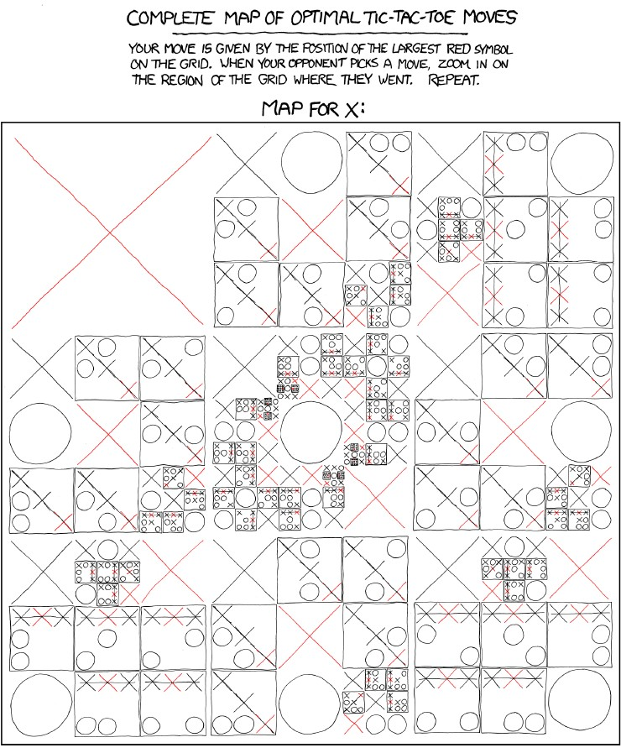
https://xkcd.com/832/

Slide 301
Search

Slide 302
Introduction to
Artificial Intelligence

