Slide 1
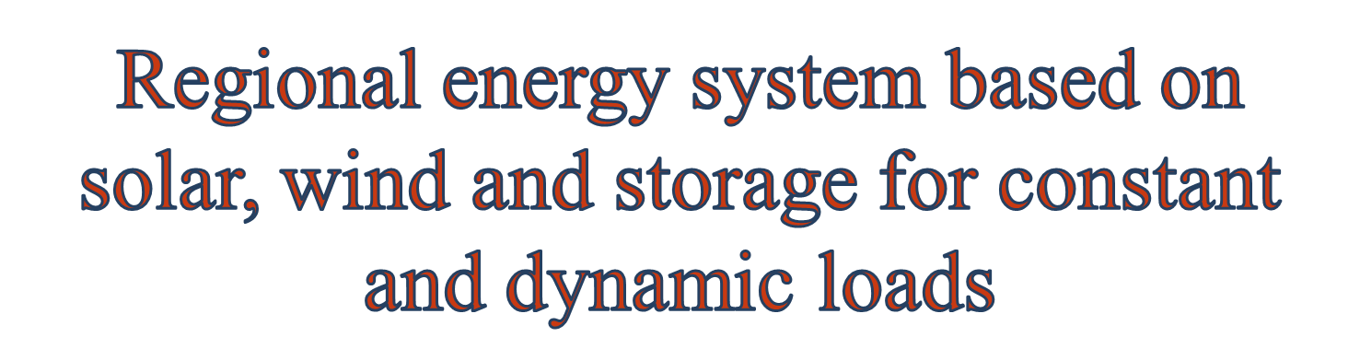
by
Tawhid Jayed Bin Jafar
Supervisor: Dipl.-Ing. Stefan Balluff

Slide 2


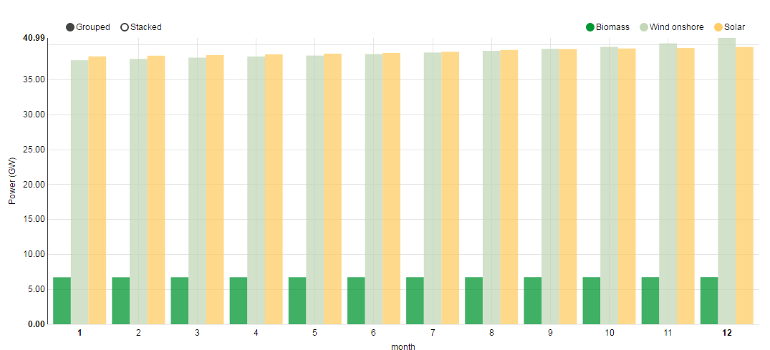
8th May 2016: Commercial consumers were paid to use electricity
2015:
  PV production
    36(Ger) / 101 (EU) TWh
  Wind production
    87(Ger) / 307 (EU) TWh
  Installed PV + Wind
    PV: 39.70 MW
    Wind: 40.99 MW
Figure: Installed PV and wind in Germany (2015)
Notes:
Germany had so much renewable energy on Sunday that it had to pay people to use electricity on Sunday that it had to pay people to use electricity.
Solar, wind, hydro and biomass plants were supplying about 55 GW of the 63 GW being consumed, or 87%
2015: www.agora-energiewende.de
Image: https://www.energy-charts.de/power_inst.htm

Slide 3

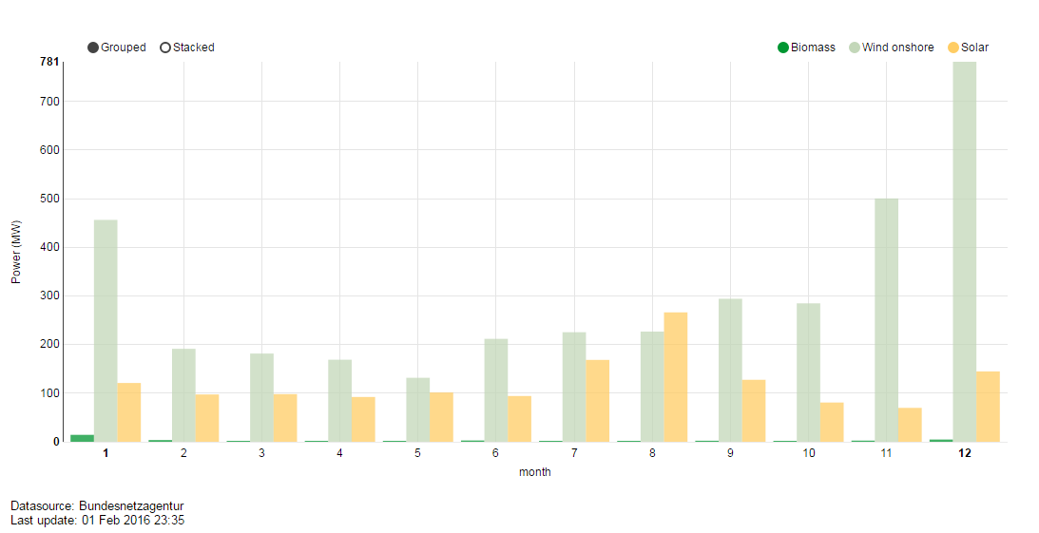
Wind
  Higher output
  Higher randomness
PV
  Lower output
  Relatively consistent
Load
  Constant
  Dynamic
Energy Storage
Figure: PV and wind power production in 2015

Slide 4

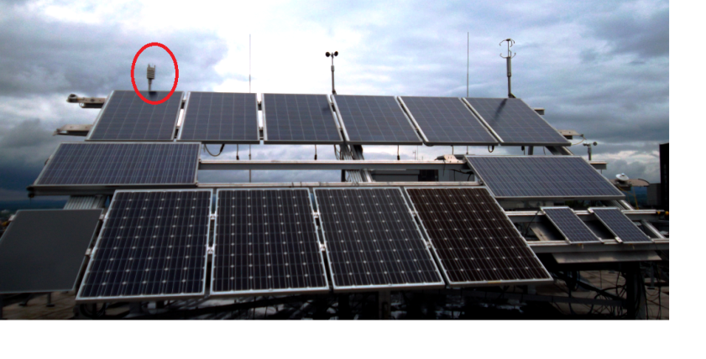
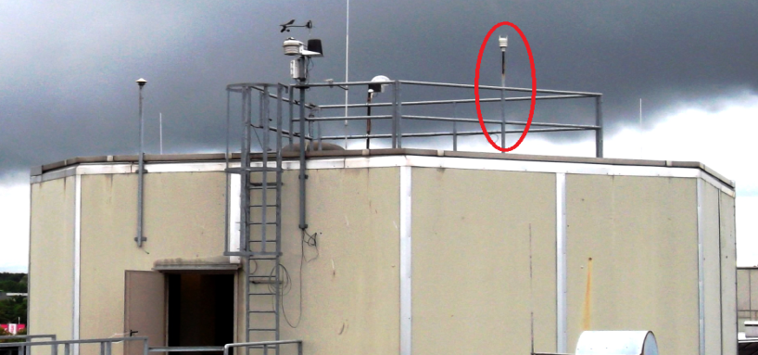
Place: University of Paderborn campus (rooftop of E building)
Height: 15.24 meter (approx.)
Figure – 1:
  Red circle: wxt_rack
  Yellow circle: PV module
Figure – 2:
  Red circle: wxt_turm
Figure – 1
Figure – 2

Slide 5

PV (MPP): August, 2013 – April, 2015
Wind speed(rack): April,2014 – May,2014
July, 2014 – June, 2015
Wind speed(turm): January,2014 – June, 2015
Common period: April,2014 – March, 2015 …
Problems:
  Sampling rate: Wind speed is measured as 5 minutes average
  PV MPP is measured in every 10 seconds
  Sampling time: Different for different devices.
  Different for same device also.
  Missing data

Slide 6

Type of missing data:
Invalid Character ( `)´, `$´ … )
Blank space
Solution: Fill / interpolate the missing data
Sample data:
For PV
  Elast: (3 years data in one big text file)
  31.07.2013;10:59:50;148269;310713;105634;S;0242;Uk;0050;Ik;02228;Ul;035320;Um;029740;Im;02101;Pm;062483;A;020,7;T;029,4;04;
  For wind
  Turm: (File names indicate date: YAT-Log-20140212-142247.log)
  (12:58:58.93)0R0,Dn=324D,Dm=129D,Dx=231D,Sn=0.4M,Sm=2.2M,Sx=5.0M,Ta=8.7C,Tp=9.0C,Ua=58.1P,Pa=1000.1H,Rc=0.00M,Rd=0s,Ri=0.0M,Hc=0.0M,Hd=0s,Hi=0.0M,Rp=27.9M,Hp=0.0M,Th=9.2C,Vh=24.1N,Vs=25.1V,Vr=3.528V,Id=Hel

Slide 7
Steps for solution:
  Parsing date, time, and required data as string.
  Date, time stirng → Convert to timestamp tuples → “Align” timestamps for same 10s interval → 10:59:50 = 10:59:59 and 12:58:58.93 = 12:58:50
  Reassign data to modified timestamp.
  Data is now ready to fill / interpolate in the missing timestamp tuples.
  How many data are missing?

Slide 8
Number of available data points for one year (Apr,14 – Mar,15):
PV missing data: 75 (10 seconds resolution)
Wind missing data (Turm): 147 (5 mins resolution)
Consider the missing data as maintenance down time, bird migration (Vogelzug) etc.
 | No. of 10sec timestamps | No. of 5 min timestamps
Ideal | 3153600 | 105120
elast | 3153535
Rack |  | 95286
Turm |  | 104973
→ Not a big Problem
→ Interpolate?

Slide 9

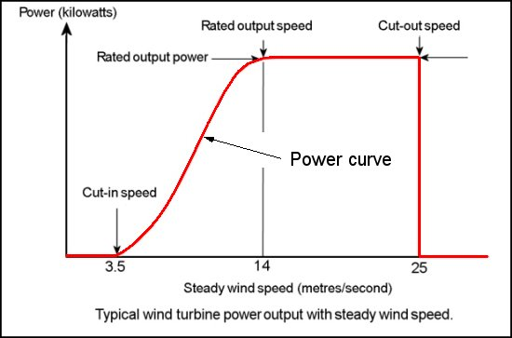
Types of wind turbine
Small wind turbine (≤ 100 KW)
Large wind turbine
Power curve
  Cut – in speed
  Rated speed
  Cut – out speed

Slide 10


Height of the wind turbine
Type of the area
Wind speed at different heights:
V₁ is the wind speed (in m/s) at height H₁ (in meters)
V₂ is the known wind speed (in meters per second) at height H₂ (in meters)
α is the exponent that varies dependent upon the stability of the atmosphere
α = 0.6 for stable air above human inhabited areas

Slide 11

Step – 1: Histogram of wind speed
Step – 2: Select a power curve
Step – 3: Calculate Annual Energy Production (AEP) :
AEP = ∑E_{i} = ∑ f_{i}P_{i}
E_{i} = Energy per wind speed bin i
F_{i} = Frequency of wind speed bin i
P_{i} = Power in wind speed bin i

Slide 12

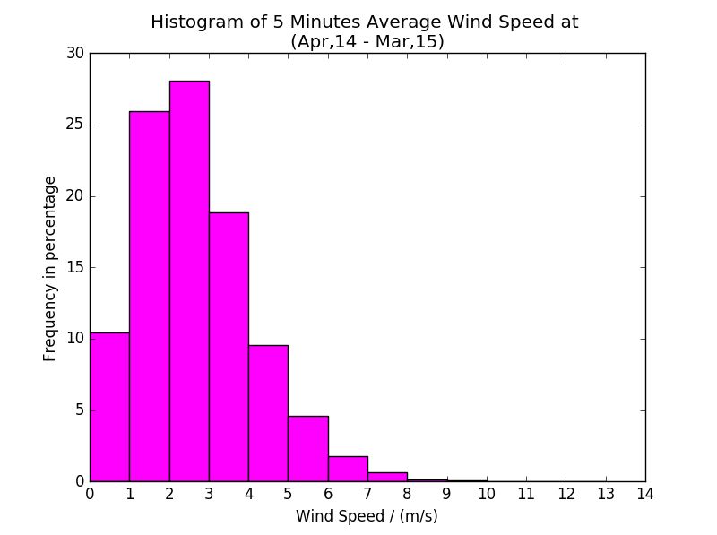

Slide 13

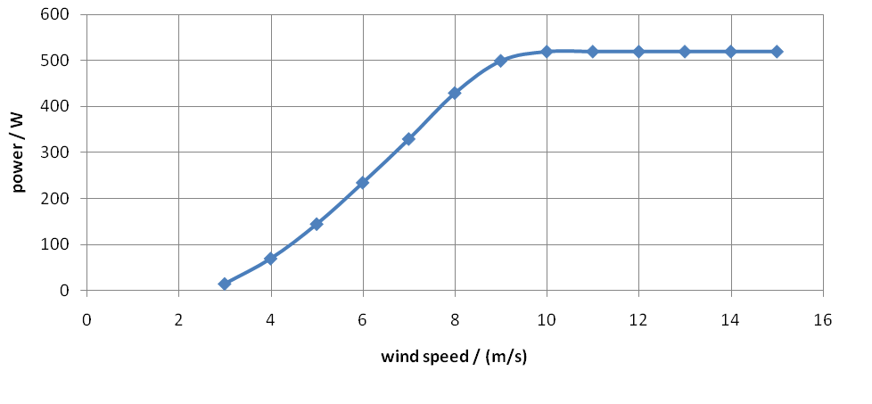
Power curve of 500W wind turbine
Cut-in wind speed = 2.7 m/s
Rated wind speed = 10 m/s
Cut-out wind speed = 25 m/s

Slide 14

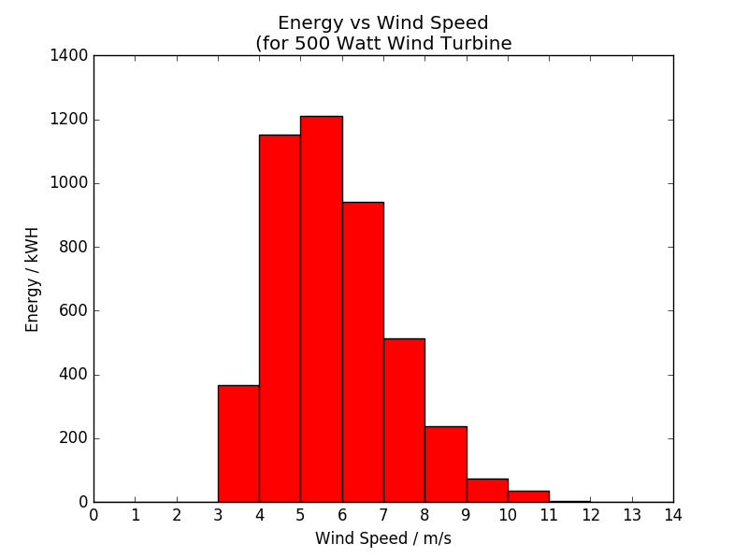
Annual energy production = 454.13 kWh

Slide 15

Dynamic load: 7 days data from a normal house.
Days: 19-25 November, 2001 (Mon-Sun)
No missing data, but requires to “align” load data to suitable –timestamps.
Static load: Time average of the dynamic load
  Comparison between the effect of static and dynamic load becomes easy.

Slide 16

Assume, initially the storage is full charged.
Calculate for each timestamp over the entire period:
Storage at [i] step = Storage at [i-1] step + PV generation at [i] step + Wind generation [i] step – Load [i] step
Observe:
  If there is any outage.
  The dynamic behavior of the storage.
  Final storage at the end of the calculation

Slide 17

3 days 7 days 1mon 1yr
Pv storage turines

Slide 18

Consider:
500W wind turbine
350Wp PV panel
4.5kwh battery
Assume, initially the storage is full charged.
Cost estimation
500W wind turbine = 300€
350Wp PV panel = 350€
1kwh Li-ion battery = 125€

Slide 19

Scenario – 1
Energy and Power Overview
Date | November 07 – 09 | Average wind power | 191.14 W
PV | 350*6 Wp = 2100 Wp | Total energy in 3 days | 29.72 kWH
Maximum PV power | 1241 W | Average load | 764.05 W
Average PV power | 221.60 W | Initial storage | 4.5 kWh
Wind | 500*6 W = 3000 W | No. of outage | 0
Wind Turbine Height | 15.24 m | Longest consecutive outage | 0
Maximum wind power | 1410 W | Final storage | 3.85 kWh
Cost Overview
PV cost | 2100 | Battery cost | 562.5
Wind cost | 1800 | Total cost | 4462.5

Slide 20

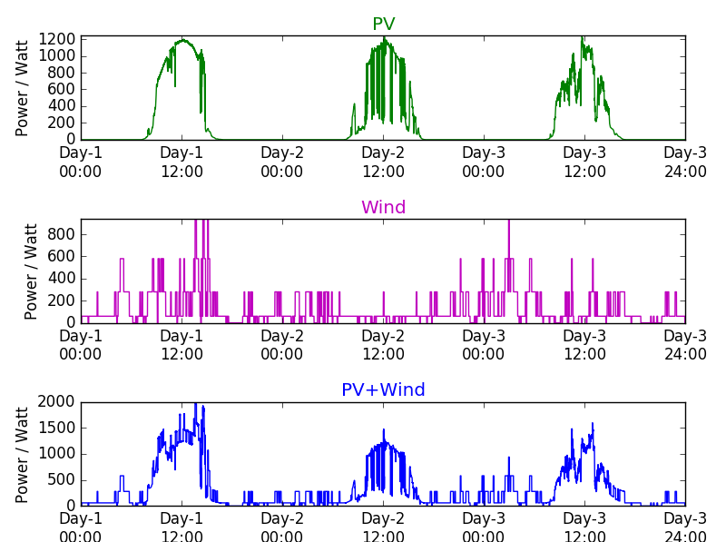
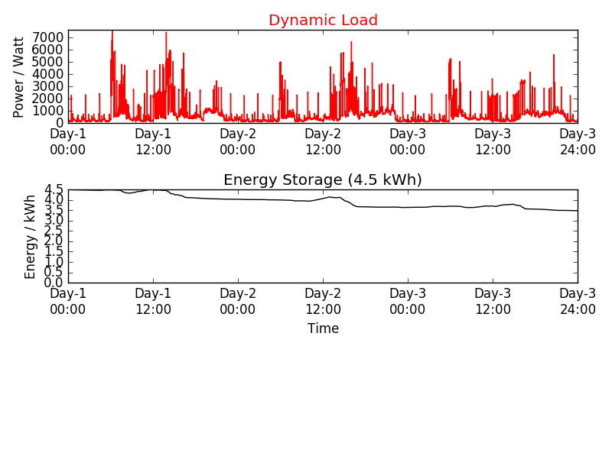

Slide 21
Scenario – 2
Energy and Power Overview
Days | 3 | Maximum wind power | 3000W
Date | November 07 – 09 | Average wind power | 816.49 W
Type of load | Dynamic | Total energy in 3 days | 74.74 kWH
PV | 350*6 Wp = 2100 Wp | Average load | 764.05 W
Maximum PV power | 1241.082 W | Initial storage | 4.5 kWh
Average PV power | 166.99 W | No. of outage | 0
Wind | 500*6 W = 3000 W | Longest consecutive outage | 0
Wind Turbine Height | 30 m | Final storage | 3.99 kWh
Cost Overview
PV cost | 2100 | Battery cost | 562.5
Wind cost | 1800 | Total cost | 4462.5

Slide 22

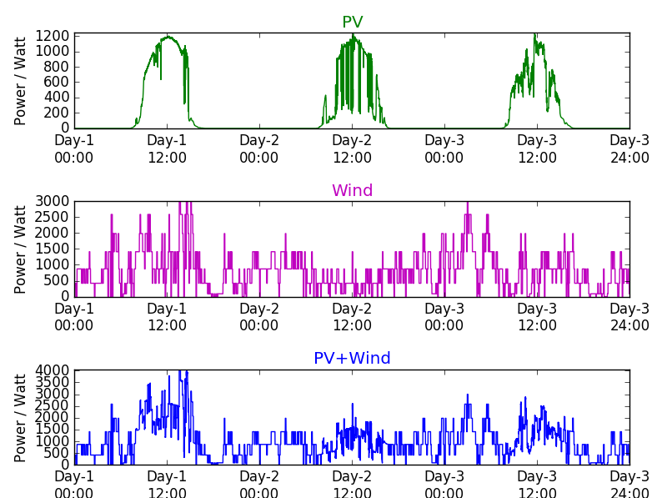
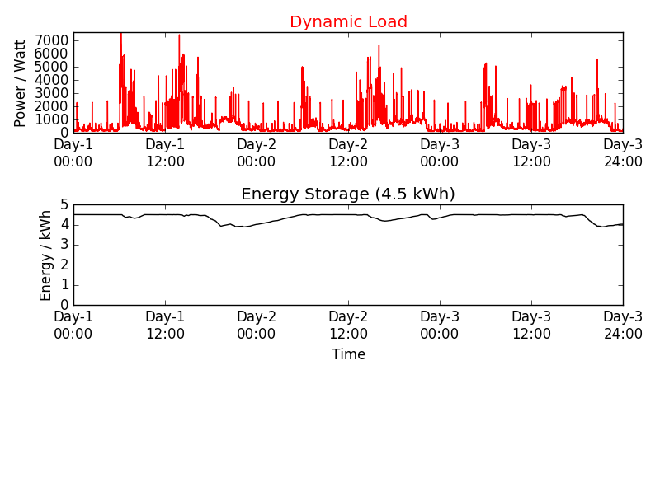

Slide 23
Scenario – 3
Energy and Power Overview
Days | 3 | Maximum wind power | 1410W
Date | November 07 – 09 | Average wind power | 191.145 W
Type of load | Constant | Total energy in 3 days | 29.72 kWH
PV | 350*6 Wp = 2100 Wp | Average load | 764.00 W
Maximum PV power | 1241.082 W | Initial storage | 4.5 kWh
Average PV power | 221.60 W | No. of outage | 0
Wind | 500*6 W = 3000 W | Longest consecutive outage | 0
Wind Turbine Height | 15.24 m | Final storage | 1.97 kWh
Cost Overview
PV cost | 7000 | Battery cost | 562.5
Wind cost | 300 | Total cost | 7862.5

Slide 24

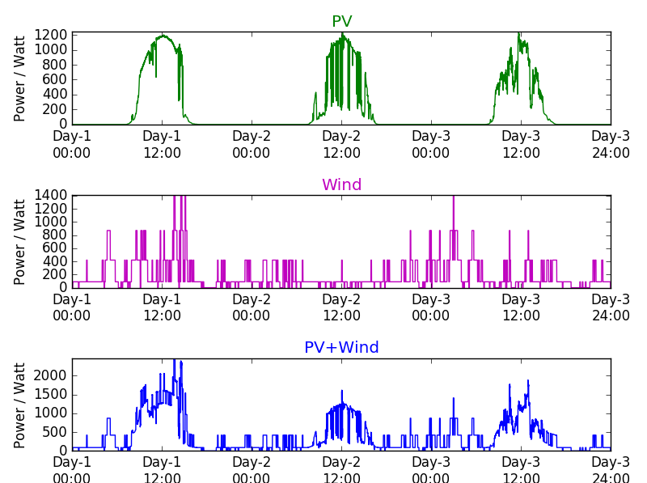
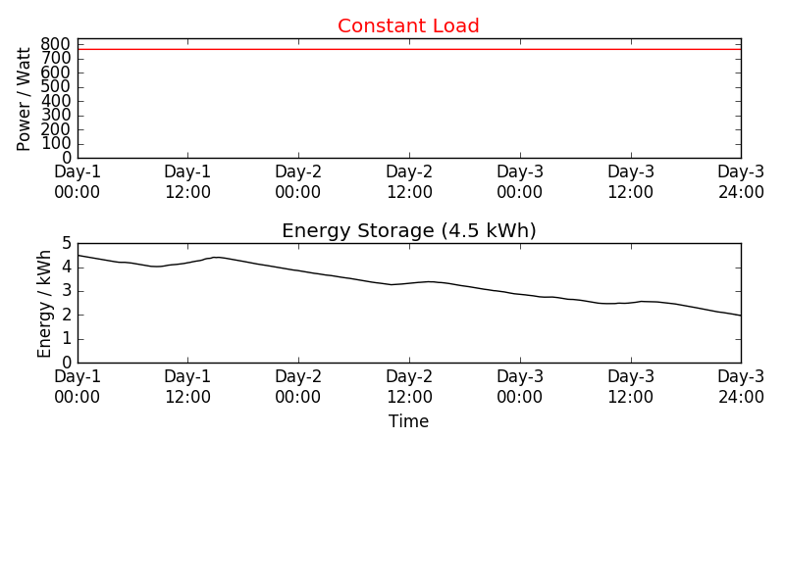

Slide 25
Scenario – 4
Energy and Power Overview
Days | 3 | Maximum wind power | 1410W
Date | November 07 – 09 | Average wind power | 191.145 W
Type of load | Constant | Total energy in 3 days | 74.74 kWH
PV | 350*6 Wp = 2100 Wp | Average load | 764.00 W
Maximum PV power | 1241.082 W | Initial storage | 4.5 kWh
Average PV power | 221.60 W | No. of outage | 0
Wind | 500*6 W = 3000 W | Longest consecutive outage | 0
Wind Turbine Height | 15.24 m | Final storage | 4.27 kWh
Cost Overview
PV cost | 7000 | Battery cost | 562.5
Wind cost | 300 | Total cost | 7862.5

Slide 26

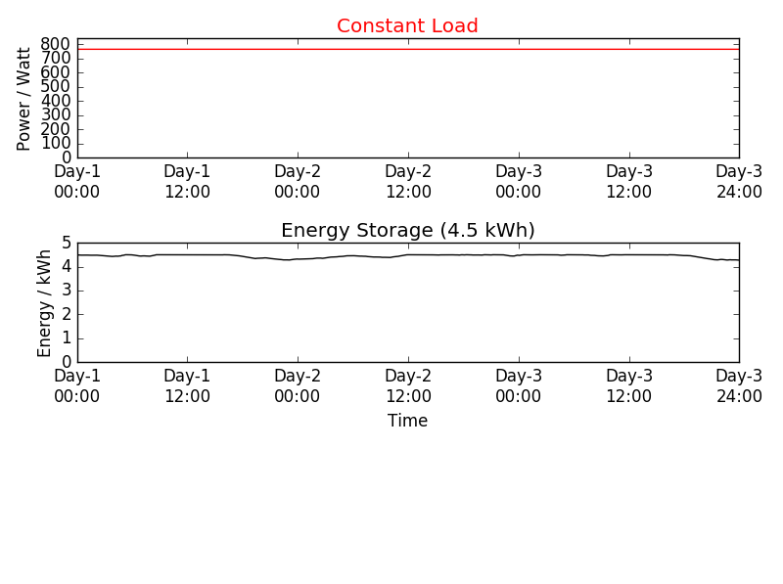

Slide 27

Create several scenario by varying
  no. of PV modules
  no. of wind turbines
  height of wind turbines
  storage capacity
  initial condition of the storage (full charged or half charged) etc.
Observe the effects
Try to find an optimal solution for:
  The whole year.
  Part of the year (i.e. only winter season or only spring season)

