Slide 1

Project Seminar
Energy Consumption
Impact of modern communication systems on energy consumption and potential for energy savings
^{Final presentation}
Supervisor: Yassin Bouyraaman,M.Sc.M.Sc.

Slide 2
Agenda
Part 1: Impact of communication systems
Part 2: Energy consumption by communication systems
Part 3: Energy saving by monitoring and controlling of communication systems
Part 4: Researches on energy saving techniques in communication systems.

Slide 3
Policy: How can ICT contribute?
Impact of Information and Communication System
Power for ICT & ICT for Power
ICT can bring about direct efficiency gains
  measuring, monitoring, intelligent management and control, etc
ICT can help drive behavioural change
  provide reliable data to governments, industries, citizens about energy consumption / carbon emissions
  enable comparative analyses: identification of common inefficiencies, best practices and opportunities
  Structural changes: crowdsourcing, teleworking, videoconferencing

Slide 4

Where can ICT Contribute
Two main issues
  Supply << Demand
    Requires investments of billions
  Ability to pay is limited
    Often, power companies are loss-making; some of that is inefficiency
  Where can ICT contribute?
    Components of power sector vertical
      Generation
      Transmission
      Distribution
      Consumption
One can not do real-time power flow management (transactions and billing) for transmission level flows
  Today, pools operate based on historical or aggregated information
One can not measure demand (usage) from all consumers in real-time with high granularity
What has changed to make these outdated –

Slide 5












Can We Measure The Contribution Of ICT?
Model to calculate the electricity consumption for IT appliances
Electricity consumption for ICT
Appliance Stock
Time of use per appliance
Power input per appliance
Equipment rate Households
Number of households
Active mode
Standby Mode
Consequences are:
Lack of reliable data
Targets set by individual organizations cannot be compared
Best practices are not transferrable across the industry
‘Green' claims by the industry are spurious
15.01.2014

Slide 6
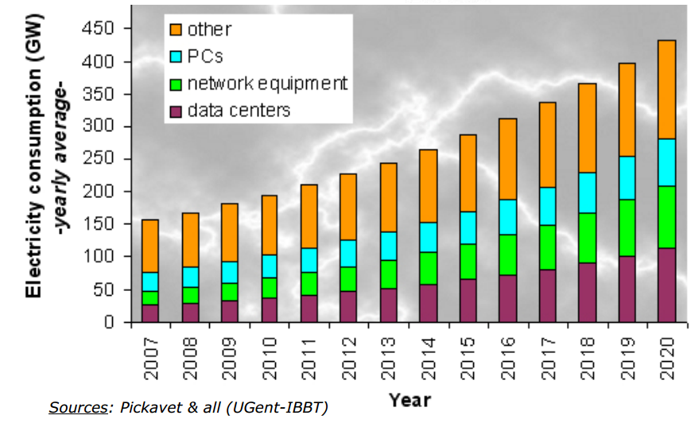
Total Electricity Consumption Of ICT Appliances:

Slide 7
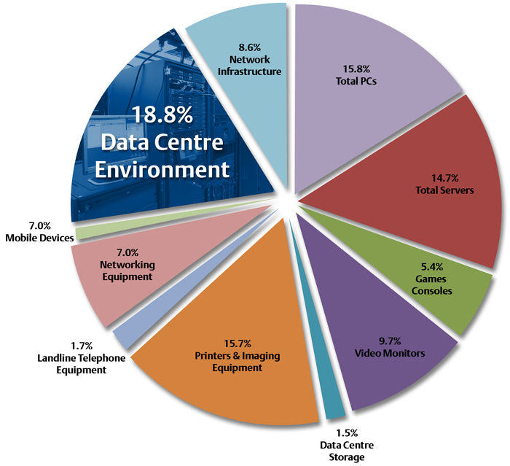
Share of Energy Consumption
Energy Consumption By ICT Sector
In general, the telecommunication sector accounts for approximately 4% of the global electricity consumption.
It is observed that almost 50% (including the operation of servers) is due to the operation of telecommunication networks. These includes be Data centers, servers, mobile networks, WLANs, LANs and fixed line networks.
Concerning the fixed line networks, more than 70% of the overall power consumption occurs in the user segment (power is distributed) and only 30% is due to the operator OPEX.
On the other hand for mobile networks, a portion of 10% of the overall power consumption corresponds to the cellular user whereas 90% is incurred by the operator OPEX.

Slide 8
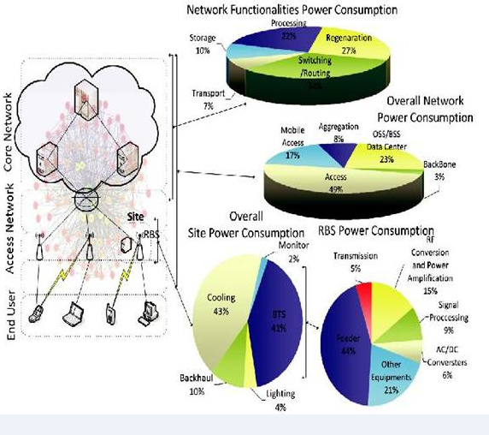
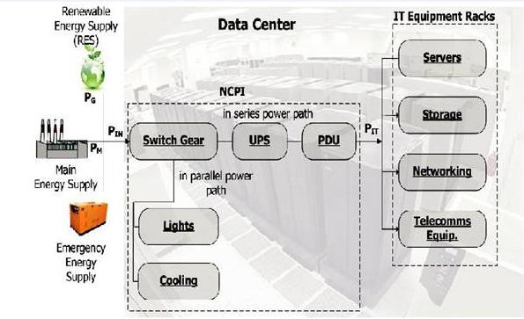
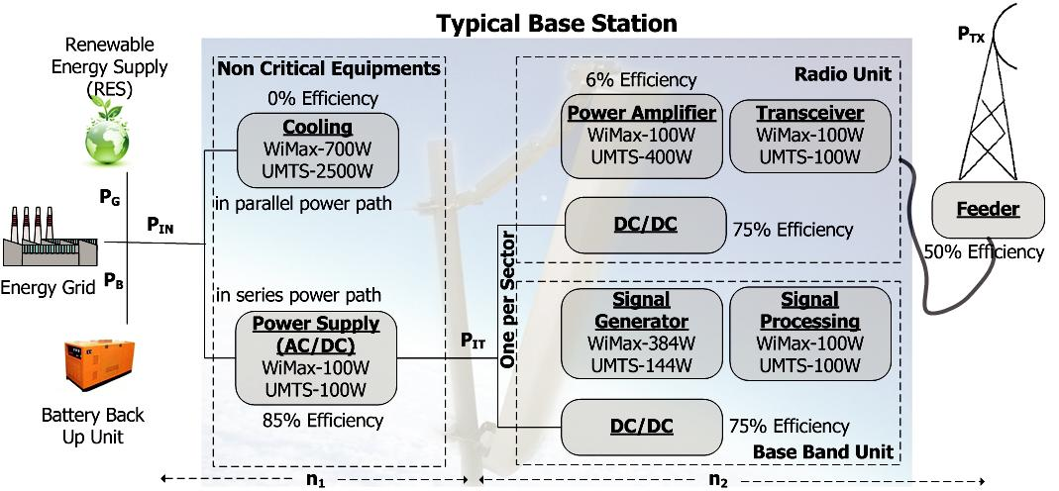
Energy Consumption By Different Sectors
Fig02: Structure of
a typical
Data Center
Fig01: Power consumption in
different layers of the network

Slide 9
Energy Consumption By ICT Sector
Wireless Data |  |  |  | Miscelleneous |  |  | Mobile
Technology | Action | Power | Tech. | Action | Power | Tech. | Action | Power | Energy
 |  | [mW] |  |  | [mW] |  |  | [mW] | [J]
Bluetooth | BT off | 12 | CPU usage | 2% | 55 | Voice | Making a voice call (3G) | 1265.7
 | BT on | 15 |  | 25% | 310 |  | Receiving a voice call (3G) | 1224.3
 | BT connected and idle | 67 |  | 50% | 462 |  | Idle (3G) | 25.3
 | BT discovery | 223 |  | 75% | 561 |  | Making a voice call (2G) | 683.6
 |  |  |  | 100% | 612 |  | Receiving a voice call (2G | 612.7
 | BT receiving | 425 | Mobile TV | Watching Mobile TV with | 790 |  | Idle (2G) | 15.1
 | BT sending | 432 |  | DVB-H |  | Video | Making a video call (3G) | 2210
WiFi | In connection | 868 | Display | Black background 20% | 63 |  | Receiving a video call (3G) | 2145
IEEE802.11 | In disconnection | 135 |  | intensity |  | SMS | 100 bytes length (2G) |  | 1.72
(infrastruct | Idle | 58 |  | Black background 60% | 98.65 |  | 150 bytes length (2G) |  | 2.35
ure mode) | Idle in power save mode | 26 |  | Black background 100% | 259.65 |  | 200 bytes length (2G) |  | 2.52
 | Downloading@4.5Mbps | 1450 |  | White background 20% | 196.56 |  | 250 bytes length (2G) |  | 2.64
WiFi | Sending @ 700 kB/s | 1629 |  | White background 60% | 254.16 |  | 300 bytes length (2G) |  | 3.15
IEEE802.11 | Receiving | 1375 |  | White background 100% | 527.05 |  | 100 bytes length (3G) |  | 2.24
(ad hoc) | Idle | 979 |  | Screensaver mode | 13.86 |  | 150 bytes length (3G) |  | 3.22
2G | Downloading@44Kbps | 500 | Memory | Saving 1 Mb on drive C | 587.7 |  | 200 bytes length (3G) |  | 3.42
 | Handover 2G->3G | 1389 |  | Saving 1 Mb on drive E | 612.8 |  | 250 bytes length (3G) |  | 3.56
3G | Downloading@1Mbps | 1400 |  | Saving 1 Mb on drive D | 560 |  | 300 bytes length (3G) |  | 4.22
 | Handover 3G->2G | 591

Slide 10
Power Consumption Factors:
1. Network Equipment: The physical network equipment in the network is the major contributor to the power consumption of Internet infrastructure. This includes equipment in the access, metro, and core networks.
2. Capacity Planning: Telecommunications network owners need to allow for traffic peaks, future growth, and the protection/restoration of services. This requires some overbuilding of the network which, in turn, increases the power consumption of the network.
3. Services/Cloud Facilities: A significant amount of Internet traffic arises from a wide range of web-based services and resources available to end users via the Internet. Examples of these include cloud services, content delivery, and storage as a service. The data centers that provide these services require significant amounts of equipment and power to function.
Energy Consumption By ICT Sector

Slide 11
Energy Consumption By ICT Sector
4. Demographics: The Internet is an intra- and international network. The physical distance between population centers has a direct impact on the power consumption of the network.
5. Service Scenarios: Power consumption is strongly influenced by the type of service being provided. The network will provide the following types of services:
Shared services
Dedicated services requiring quality of service (QoS)
Service Management

Slide 12
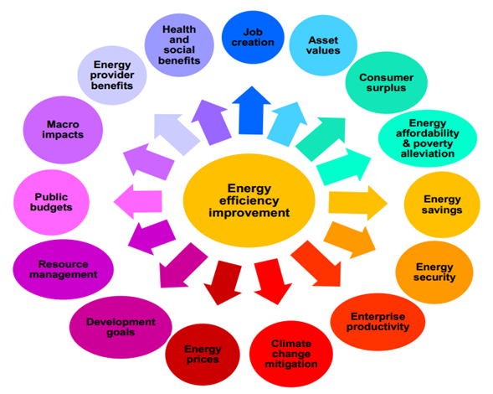
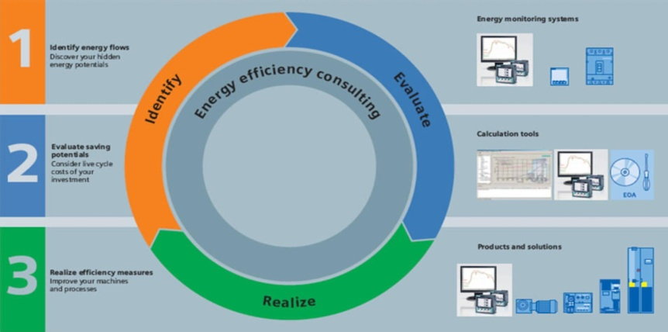
Modern communication system potentials for energy savings
Contribution in saving energy consumption
Renewable energy sources and smart grid will primarily depend on intelligent sharing of information.
By continuous monitoring the energy consumption of equipments & machinery we can easily identify the reasons for its over consumption, evaluate them and realize the effect after the improvements.
These goals have to be assisted by increasing automation within factories, which can provide better visibility and efficiency.
By using the control and regulation process we can save 45% of energy ( research conducted at Bremen University).

Slide 13
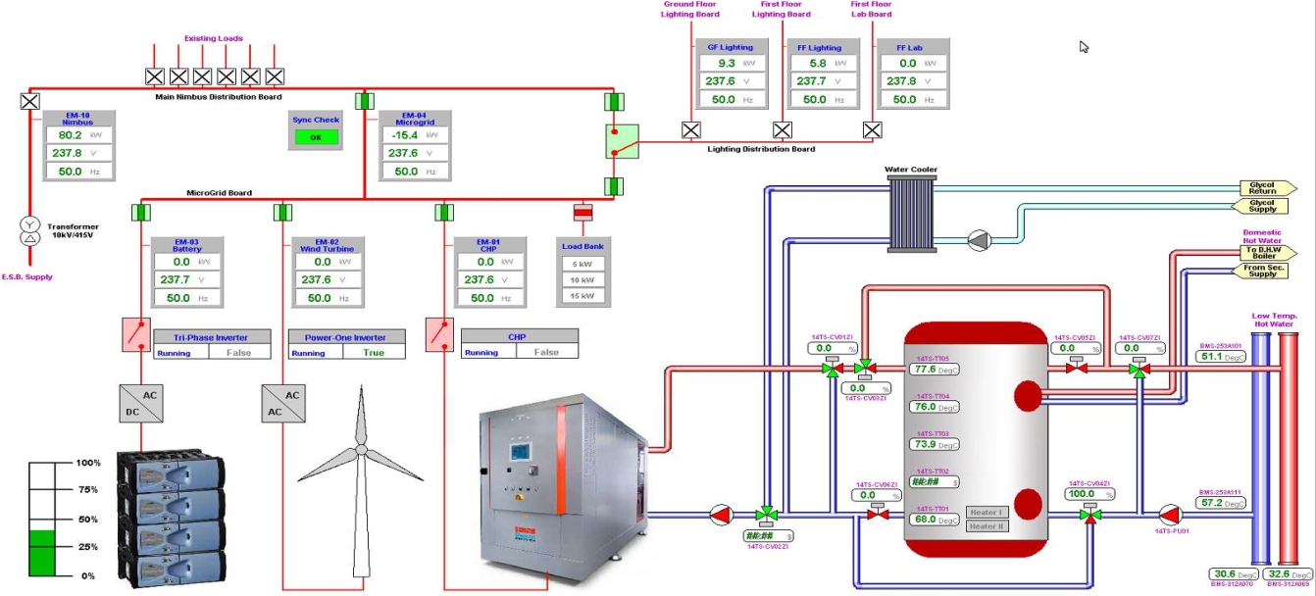
Modern communication system potentials for energy savings
Development of data control centre
Distribution systems serve as the link from the power generation to the power consumption. This system provides the safe and reliable transfer of information to the central system.
SCADA systems have to be implemented to monitor and control electrical power grids, this system also extracts the efficiencies of individual processes and control the generation by getting feedback from customer utilization.
SCADA System is optimized for large and complex distributed power plants like PV power systems, hydro-electric power systems, wind power systems, cogeneration plants and it also monitors the consumption of energy in factories, houses markets and the losses due to transmission.

Slide 14
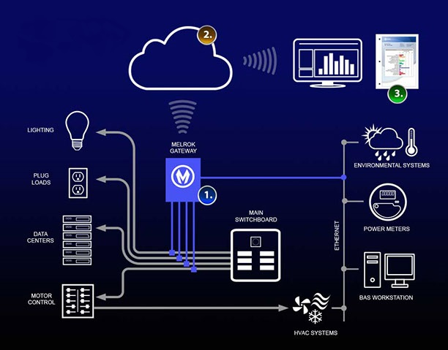
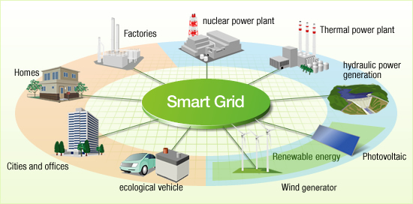
Modern communication system potentials for energy savings
Automation in home
1/3 of energy consumption is spent on HVAC system and other related equipments. By Implementing a system which utilizes the information of an environment to automatically control the usage of electric appliances we can save 46% of total energy.
Multi-hop device collect information from the environment through sensors and transfer it to the control server and finally control server generates signals to power-line control devices.
Synco Home Automation - SIEMENS
Heating, ventilation, lights, blinds and other devices like smoke detectors are controlled and varied according to the outdoor temperature.
30% of energy is saved.

Slide 15
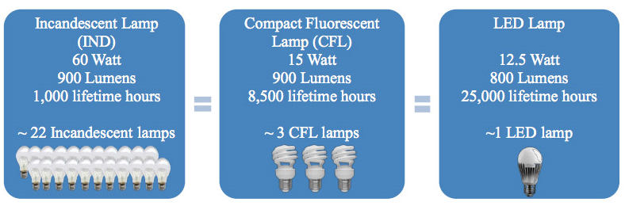
Modern communication system potentials for energy savings
Other strategies
Use of energy efficient devices
Energy storage in under load period
Raising awareness of energy consumption efficiency
Introduction of incentive/penalty mechanisms
Support for technology R&D

Slide 16
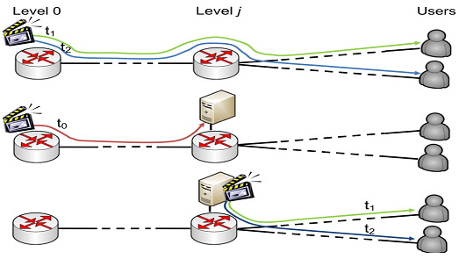
Future Energy Saving Techniques
Smart content distribution
Videos will represent 86% of the global consumer traffic by 2016.
Here the content is first fetched into the caches and stored for a certain maximum amount of time according to demand.
More than 8% energy saving is achievable with reduction of 18% in the bandwidth.
Energy optimal file distribution
The present algorithms are designed to minimize the download time
They are not optimal in terms of energy.
In this scheme the download capacity of hosts are utilized to provide service to other hosts.
Can reduce more than 50% energy consumption depending on file distribution system.
15.01.2014

Slide 17
Future Energy Saving Techniques (Cont. 02)
Optical bypass in IP Routers
Modern backbone IP nodes consume up to 60% of the total power.
The traffic which are not intended for the IP node, remains in the optical layer and bypass the IP.
For large networks, this technique can contribute to energy savings up to 50%.
Adaptive routing at IP and WDM layers
Many IP links are composed of bundled links of the lower layer.
It is possible to temporarily decrease their capacity and deactivate the excessive resources.
Traffic can be re-routed from some links, and delivered to the target nodes via alternative paths.
Energy plan based on sleep modes
About 60% power savings can be obtained by setting backup IP routers into sleep-mode.
15.01.2014

Slide 18
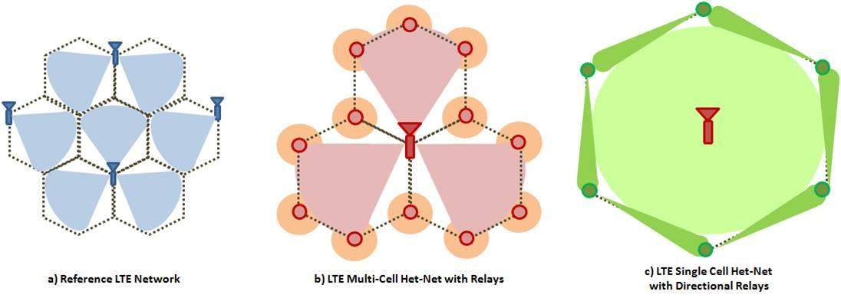
Future Energy Saving Techniques (Cont. 03)
Elastic optical networking
This is a scheme based on this OFDM technique.
It implements the variable Light-Path capacity.
It improves spectral the efficiency for which congestion of the network is reduced.
3G to 4G Migration
Spectral efficiency is improved due to spectrum access
Increased bandwidth allows up to 70% capacity improvement and 35-50% energy reduction.
Dynamic Cells
Relays can reduce the number of cells
It can save operational energy consumption of the network by approximately 50%.
15.01.2014

Slide 19

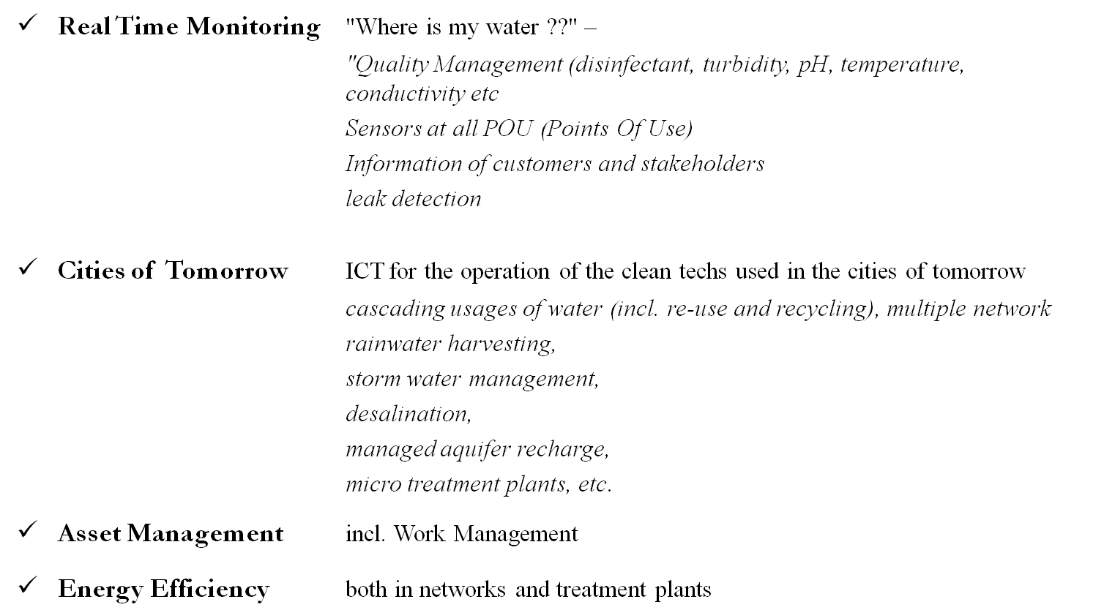

Example: ICT for Water Management

Slide 20
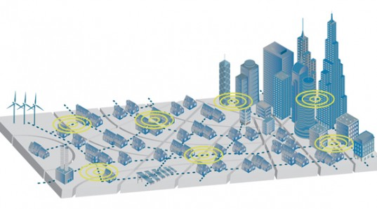
Industrial Efforts Accross the World
In February 2014, CISCO and AGT Intl. started "Smart City“ project, an extended version of smart grid, which will include IoE (internet of everything).
In 2013 GreenTouch, using analytical optimization and theoretical calculations, envisioned a estimated reduction of energy consumption upto 90 percent by 2020.
Fig: Imagined Smart City
In December 2013, ELTEK, Norway, had introduced a 380/48 VDC converter for data centers which is claimed to have industry leading 98.2% efficiency.
In Puducherry, India, 1400 consumers are brought under smart grid in December 2013. The result was 15-20% reduction of energy consumption.
According to British Gas, by February 2014, 54% of households using smart meters are saving upto £75 a year on their energy bills.

Slide 21
References
http://www.cisco.com/web/strategy/docs/scc/ioe_citizen_svcs_white_paper_idc_2013.pdf
http://www.greentouch.org/index.php?mact=News,cntnt01,detail,0&cntnt01articleid=26&cntnt01origid=15&cntnt01detailtemplate=press_release_detail&cntnt01returnid=105
http://www.tkn.tuberlin.de/fileadmin/fg112/Internals/Idzikowski13_LeRouzic_TRENDbigpictureon.pdf
http://ec.europa.eu/information_society/activities/sustainable_growth/index_en.htm
http://journal.telfor.rs/published/no3/no03_p01_fin.pdf
http://www.researchgate.net/publication/224248235_Survey_on_Energy_Consumption_Entities_on_the_Smartphone_Platform/file/60b7d51a4f1ac8816c.pdf
http://www.researchgate.net/publication/224224694_Power_consumption_and_energy_efficiency_in_the_internet/file/e0b4951f5865aebfba.pdf
http://de2011.computing.dundee.ac.uk/wp-content/uploads/2011/11/Reducing-Energy-Consumption-of-Wireless-Communications.pdf
http://www.siemens.de/buildingtechnologies/de/de/gebaeudeautomation-hlk/home-automation-system-synco-living/seiten/home-automation-system-synco-living.aspx

Slide 22
Thank You

