Slide 1
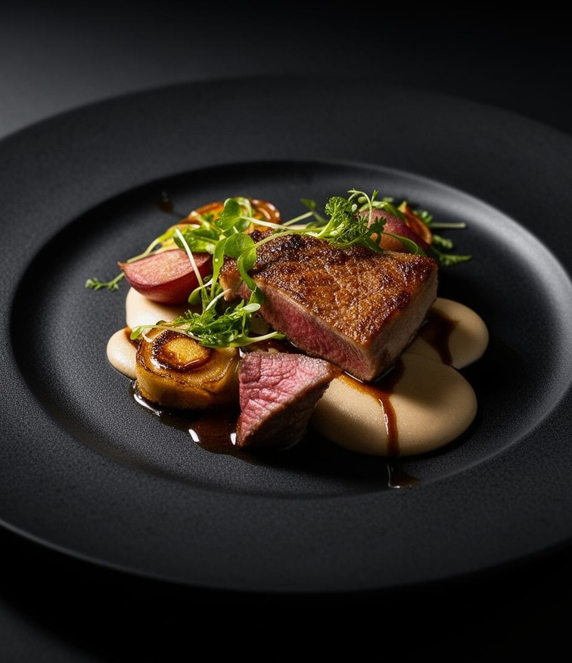
ServeOS
RESTAURANT MANAGEMENT, CONNECTED
One platform.
Every restaurant
workflow.
Restaurant websites, QR ordering,
team workflows and AI support.
Start with a 7-day free trial
WEBSITE • ORDERS • OPERATIONS
PRODUCT BRIEF / 14 OCT 2026
01 / 07
Notes:
ServeOS is a SaaS platform for restaurant owners and the teams serving their guests. This brief covers the current product and packages.

Slide 2
ServeOS
THE OPPORTUNITY
Bring scattered work into one flow.
A connected experience for the guest, the restaurant team and the platform operator.
01 / DISCOVERY
02 / SERVICE
03 / MANAGEMENT
Be visible online
Keep service moving
Stay in control
Publish a restaurant website
and keep the digital menu
easy to browse.
Connect table ordering,
waiter service and
kitchen tickets.
Manage staff, subscriptions,
branding and business tools
from dedicated panels.
PRODUCT BRIEF / 14 OCT 2026
02 / 07
Notes:
The product is designed to connect restaurant discovery, ordering and daily operations. We make no quantified efficiency or revenue claims.

Slide 3
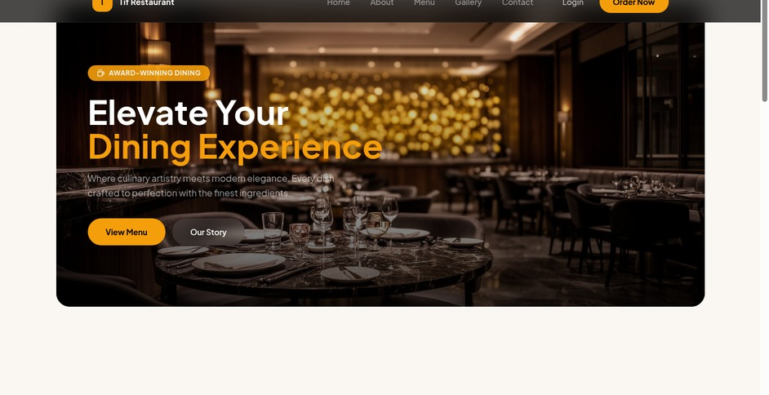
ServeOS
GUEST EXPERIENCE
A restaurant website that can take orders.
Your public presence
Restaurant pages, branding and themes.
Your digital menu
Categories, prices, images and availability.
Your table ordering
QR links connect guests to the right menu.
PRODUCT INTERFACE PREVIEW
PRODUCT BRIEF / 14 OCT 2026
03 / 07
Notes:
Guests can discover a restaurant and browse its image-rich digital menu. Table QR ordering connects the guest to the appropriate restaurant and table. Preview imagery comes from project demo assets.

Slide 4
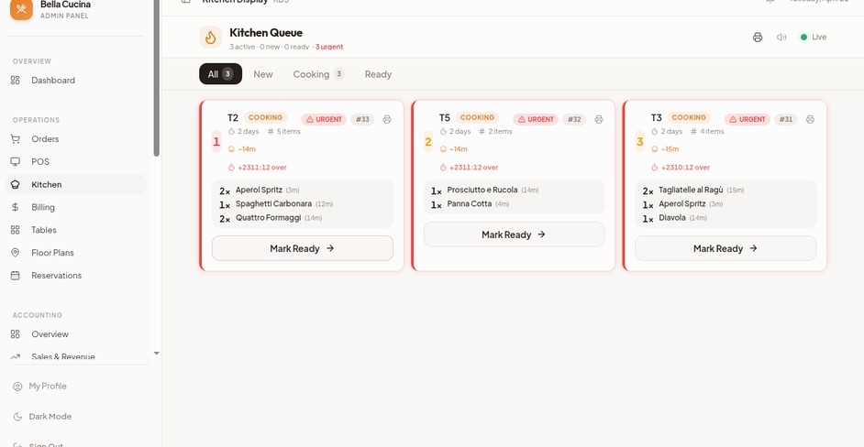
ServeOS
RESTAURANT OPERATIONS
Give every team member the right workspace.
Owner & admin
Menus, staff, orders, billing and settings.
Kitchen & waiter
Dedicated panels for tickets and service.
Business tools
Accounting, loyalty, promotions and reports.
PRODUCT INTERFACE PREVIEW / FEATURES DEPEND ON PACKAGE AND ROLE
PRODUCT BRIEF / 14 OCT 2026
04 / 07
Notes:
Restaurant owners and admins create staff accounts with specific roles. Modules and capacity depend on the subscription, role and active add-ons.

Slide 5
ServeOS
SUPPORT & SAAS CONTROL
ServeOS AI, backed by a human team.
Customer support
Platform administration
01 Customer message
Restaurant tenants and packages
Payment review and add-on catalog
Website themes and domains
Support inbox and AI knowledge
Gemini API connection settings
A question from website or restaurant chat.
02 ServeOS AI
Customer-language replies using published guides.
03 Answer or human handoff
Admins can review drafts and take over the chat.
AI REPLIES REQUIRE AN AVAILABLE, CONFIGURED GEMINI CONNECTION.
PRODUCT BRIEF / 14 OCT 2026
05 / 07
Notes:
ServeOS AI supports automatic replies and reviewed drafts using an editable platform knowledge base. Human requests and unsupported issues can be handed to the support team. Gemini service availability is required. Platform admins control tenants, packages, payment review, themes, domains and AI settings.

Slide 6
ServeOS
PACKAGES
Start free. Choose the term that fits.
Current platform package prices in Bangladeshi taka (BDT).
7-DAY FREE TRIAL / New restaurants / No automatic charge
MONTHLY
3 MONTHS
6 MONTHS
YEARLY
349
944
1,444
2,197
BDT total / 1 month
BDT total / 3 months
BDT total / 6 months
BDT total / 12 months
Try the platform
Most popular
Longer commitment
Best value
PRODUCT BRIEF / 14 OCT 2026
06 / 07
Notes:
Prices were checked against the local public package catalog on 14 October 2026. Amounts are totals for the stated term, not monthly equivalents. The seven-day trial applies to new restaurants. Prices and features are editable by platform administrators.

Slide 7
ServeOS
GETTING STARTED
From signup to your first table scan.
01
02
03
Create your restaurant
Set up your team & menu
Share your restaurant
Sign up and complete
the restaurant details.
Add dishes, photos,
tables and staff accounts.
Share the public website
and test your table QR links.
ServeOS / One platform for the restaurant and the team behind it.
PRODUCT BRIEF / 14 OCT 2026
07 / 07
Notes:
Start with the free trial, set up the restaurant menu and staff, then test the guest ordering experience. ServeOS is the product name; the demo remains a local application rather than a publicly hosted deployment.

