Slide 1

Video Surveillance for Fall Detection and Patient Monitoring
Tawhid Joarder(1407004)
Priyo Ranjan Kundu (1407044)
Supervisor: Dr. Sk. Mohammad Masudul Ahsan Professor Department of Computer Science & Engineering Khulna University of Engineering & Technology (KUET)

Slide 2
Outline
Introduction
Objectives
Related Works
Proposed Method
Background Subtraction
Morphological operations
YOLO – You Only Look Once
MHI – Motion History Image
Elliptical Approximation
Fall Detection Phase
Experiment Results
Future Scope
Conclusion

Slide 3
Introduction
Falls are one of the major risk for seniors and patients living alone, often causing severe injuries.
An old man or a patient, who is trying to move or walk can fall suddenly.
To monitor this kind of situation a caregiver must be present.
A video surveillance system!
- with the help of cameras which could detect falls and inform about it, can solve it.

Slide 4
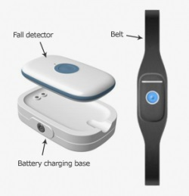
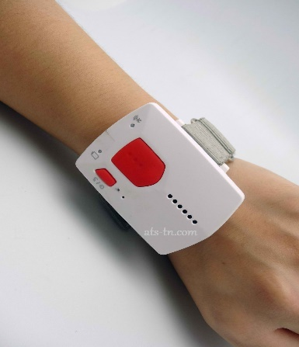
Objectives
To replace wearable devices , push button or alarm .
Fig 1 : Wearable Fall Detection Devices[11]
Security and quickness of intervention for the seniors.
Relief from stress for caregivers.
Images videotaped a few seconds before the fall occurrence would be a valuable source of information .

Slide 5
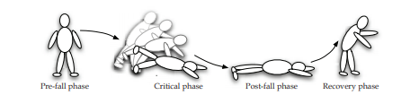
Fall Detection Phases
Fig 2 : The different phases of a fall event .[ 1]
Pre-fall phase.
Critical phase.
Post-fall phase.
Recovery phase.

Slide 6
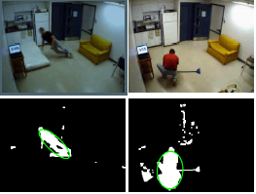
Related Works
Caroline Rougier et al. proposed a method of detecting fall using Human Shape Change and Motion History image(MHI).
Fig 3: Caroline Rougier et al.’s proposed Method [1 ]

Slide 7
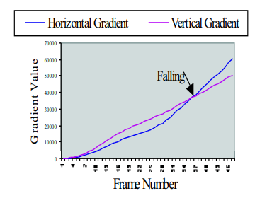
Related Works
In paper[4], Vishwakarma et al have presented a method for automatic detection system. Their approach contains two main components
object detection and
a fall model. For object detection.
Fall is detected by observing the aspect ratio, horizontal and vertical gradient values of the object.
Figure 4 : comparison of horizontal and vertical gradients. [4 ]

Slide 8
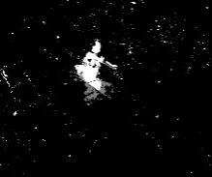

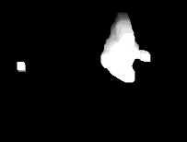
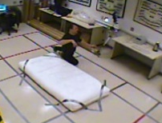
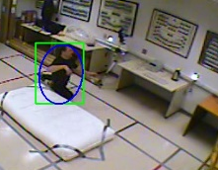
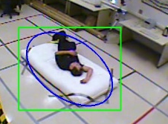
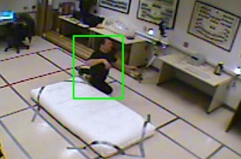
Proposed Method
Performing Background Subtraction
Applying Morphological operations
Calculating C-motion from MHI
FALL
Input Frame
Combination of BS and Yolo and Ellipse Estimation
Check low C-motion and Rectangle analysis of 5 frames
Human Detection using YOLO
Fig 5: workflow of our proposed method

Slide 9
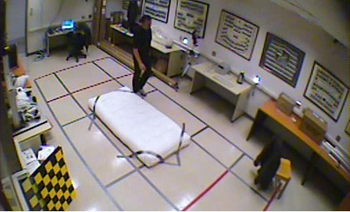
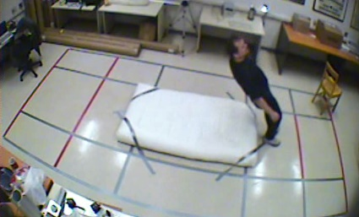
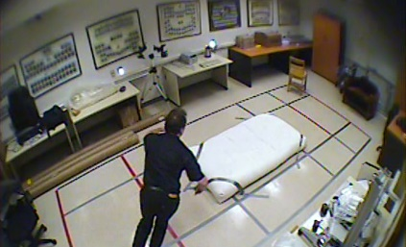
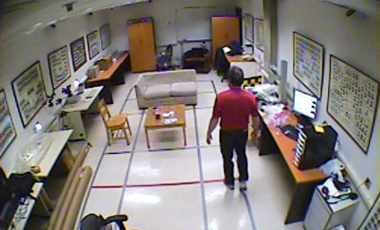
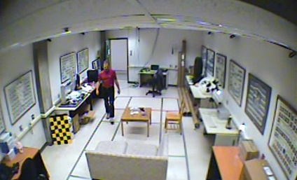
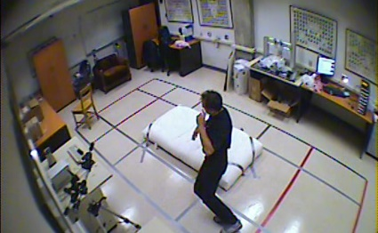
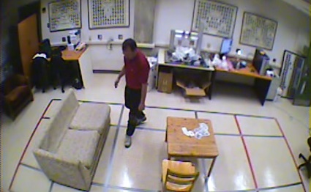
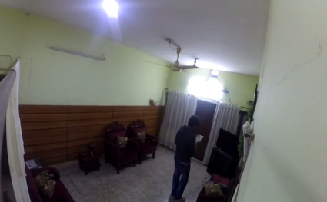
Dataset
Fig 6: video captured from 8 different angles.
Dataset are made actually using monocular camera, set in different positions and from different angles.
Most part of the dataset are collected from First Source [14].
Few are collected from second source [15]
Rest of the dataset is made by ourselves.

Slide 10
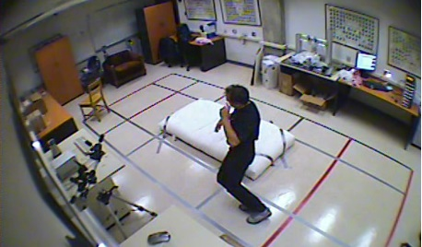
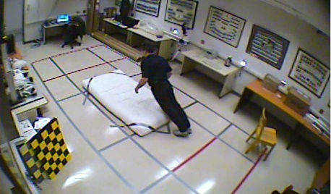

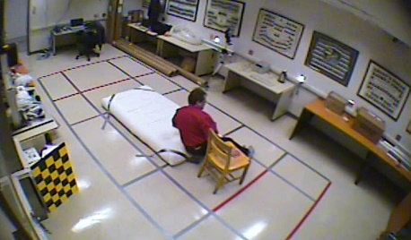
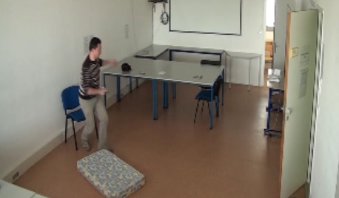
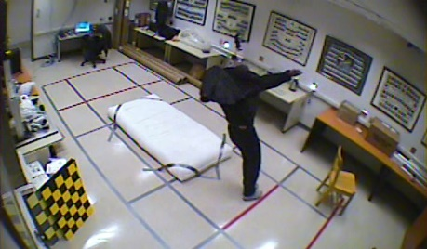
Dataset
Falling conditions can be captured from different angles and from different positions in different circumstances. Here are some falling scenarios:
(a) Loss of balance
(b) Forward fall
(c) Fall while standing still
(d) Fall when sitting down
(e) Fall after standing
(f) Backward fall
Figure 7 : Various fall scenarios

Slide 11
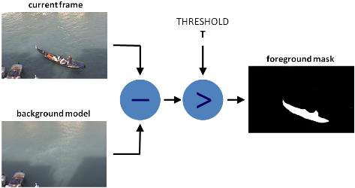
Background Subtraction
An image's foreground is extracted for further processing .
The approach is to detect the moving objects from the difference between the current frame and a reference frame, often called "background image“.
Fig 8 : Background Subtraction Method[17]

Slide 12
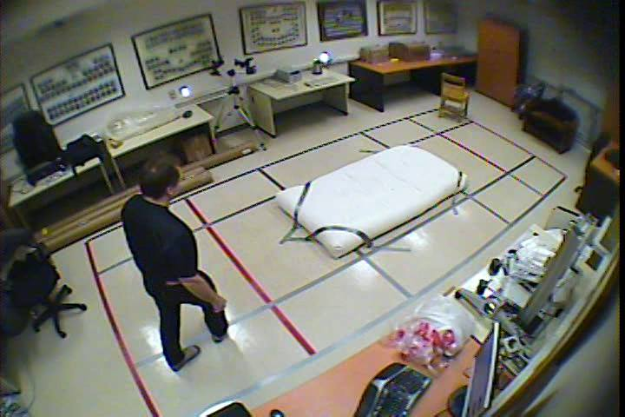
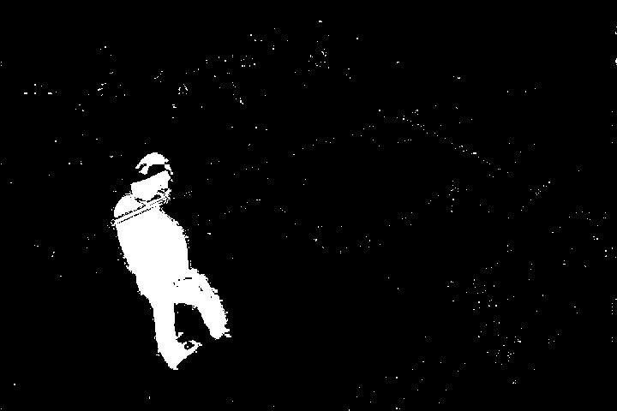
Background Subtraction
The output of background subtraction human detection looks like:
(a) Input image.
(b)After background subtraction.
Fig 9: Background subtraction.
If no movement, whole image is considered as background.
Human without movement can not be detected.
Other moving objects get detected.

Slide 13
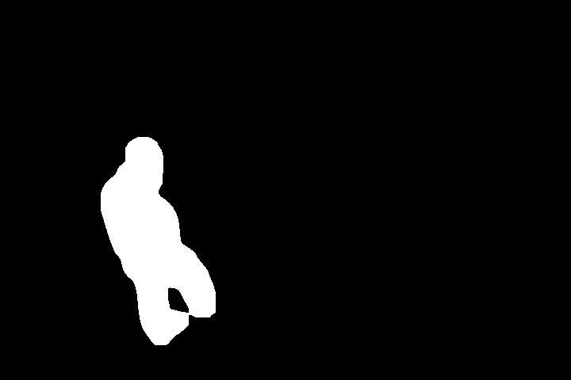
Morphological Operations
Outputs of background subtraction is pretty noisy.
Divides the whole image into contours, human detection becomes hard.
(a) Noisy image.
(a) After Morphological operation.
Fig 10: Morphological Operations.
Two morphological operations are used. (i) Image blurring (ii)
Opening.
Image Blurring usually removes high frequency contents ( eg: noise, edges from the image.
Opening is erosion followed by dilation, removes noises.

Slide 14
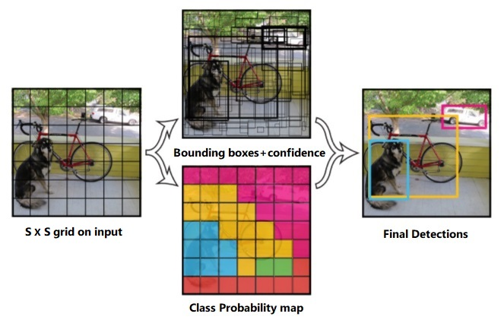
YOLO – You Only Look Once
Yolo[16] architecture is like FCNN ( Fully Conventional Neural Network.
A single Neural Network is applied to the full image.
NN divides the image into regions and predicts bounding boxes and probabilities for each region.
Bounding boxes are weighted by predicted probabilities.
Yolo is extremely fast in real time detection.
Fig 11: Workflow of YOLO [16].

Slide 15
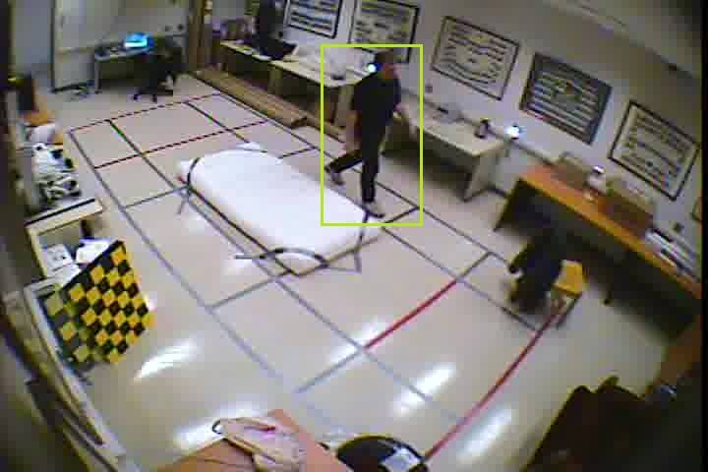
YOLO – You Only Look Once
Fig 11: Detection of human using YOLO.
We used a pre-trained model to find the class value of the class “person”.
If class value is other than “person” , we made it zero.
Human is detected by a rectangular bounding box placed around it.

Slide 16
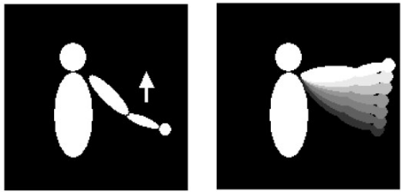
Motion History Image (MHI)
MHI pixel intensity is a function of the motion history at that location where brighter value correspond to a more recent motion.
Gray-scale MHI can demonstrate the flow direction of the motion.
keeps a history of temporal changes at each pixel location.
moving parts of a video sequence can be engraved with a single image.
Fig 11: Motion History Image.

Slide 17

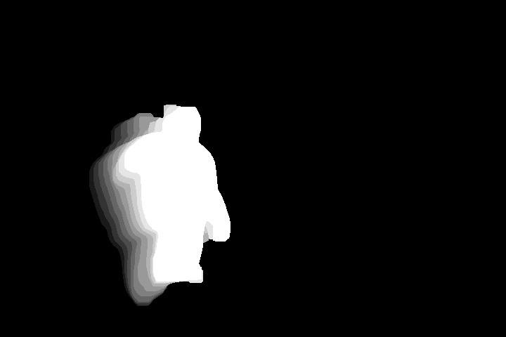
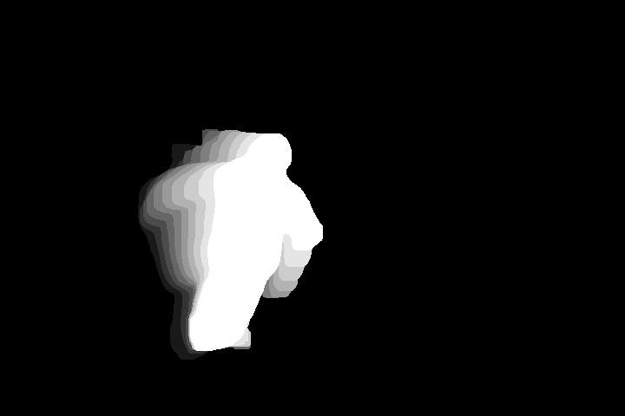
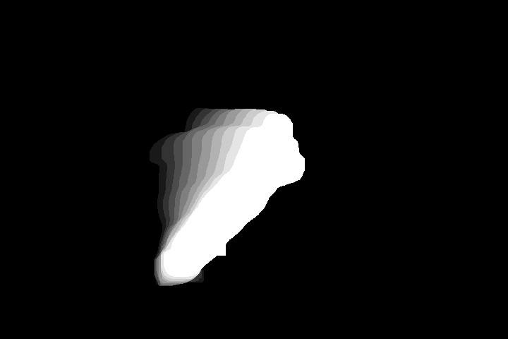
Motion History Image (MHI)
Gray-scale images where more recently moving pixels are brighter.
MHI is used to calculate movement coefficient C(motion).
moving parts of a video sequence can be engraved with a single image.
C(motion) represents recent movement in a frame.
If C(motion)= 0 , then no movements.
Fig 11: Implementation of MHI on our dataset.

Slide 18
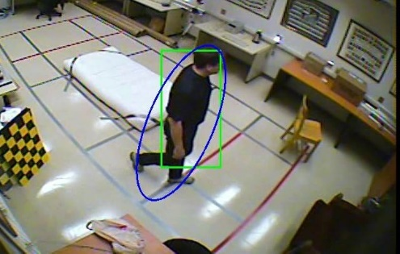
Elliptical approximation
An ellipsoid contour is superimposed over the human shape to follow changes.
Elliptical estimation returns an ellipse, defined by
Fig 11: Elliptical approximation around a human.
center (x, y)
orientation angle θ
lengths of major (a) and minor (b) axes

Slide 19



Elliptical approximation(Cont.)
The center of the ellipse is obtained by :
The angle between the major axis of the person :
The major semi-axis a and the minor semi axis
b of the ellipse :

Slide 20
Fall Detection Phase
After performing MHI and elliptical estimation, the parameters we use to detect the fall are:
C(motion) : C(motion) > 1.3 indicates a possible fall.
σθ : change in orientation angle.
If σθ > 15 degree, there is a possible indication of fall.
σ(a/b) : Express the ratio of major and minor axes of the ellipse.
If σ(a/b) > 0.3 , it indicates a possible fall.
After estimating all these parameter values,
if detected human remains motionless for 5 consecutive frames.
the w/h of the bounding rectangle > 1.1 for those 5 frames.
-the fall is surely detected.

Slide 21
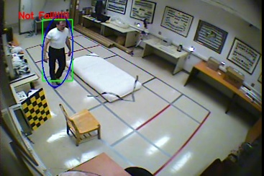
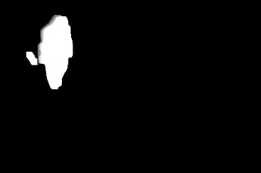
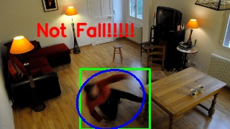
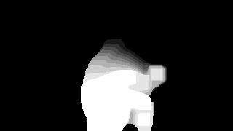
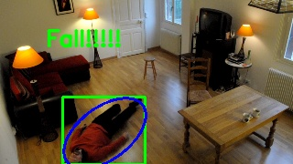
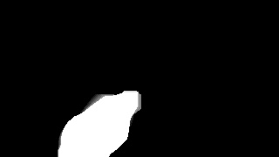
Fall Detection Phase
C(motion) = 1.15
σθ = 0.58
σ(a/b) =0.038
So, Not fall
Fig 12 : Standing ; Not fall.
C(motion) = 1.58 > 1.3
σθ = 18.91 > 15 degree
w/h = 1.15 > 1.1
So, Critical stage. We have to check then next consecutive frames.
Fig 13 : Prefall stage ; Not fall yet.
C(motion) = 1.04 < 1.3 It indicates lack of motion after a fall.
w/h = 1.22 > 1.1
So, Fall is detected.
Fig 14 : Fall is confirmed.

Slide 22
Experiments Results
Fig 15 : Dataset from [13]
Fig 16: Dataset from[14]
Fig 17: Our Dataset

Slide 23
Experiments Results(Cont.)
Fig 18 : Combined Result

Slide 24
Experiments Results(Cont.)
We find that in overall, the system accuracy is 90.28% with a sensitivity and specificity of 69.48% and 96.03% respectively.
We compared our method with the existing methods which is shown in the Table below:
Method
Rougier et
al.[1]
Homa et al.[20]
Ours
Sensitivity
88%
92.80%
69.48%
Specificity
87.5%
97.60%
96.03%

Slide 25
Future Scope
System can be made more robust to different lighting conditions.
Audio information from the microphone of the webcam. Eg : A speech recognition algorithm that can identify cries like “Help!”
3-D shape information can be used to detect fall more accurately.
Machine learning can be used to detect fall. In that case, lying
/ falling people can be used as training dataset.

Slide 26
Conclusion
Our developed method allows real time fall detection.
To Perform this method, we learned various human detection
method and integrated those.
We learned how to analyze shape change of a detected object.
Our method can be used in healthcare centers , to provide assistance to caregivers.

Slide 27
References
[1] Rougier, C., St-Arnaud, A., Rousseau, J., Meunier, J., VideoSurveillance for Fall Detection. Department of Computer Scienceand Operations Research, University of Montreal, Canada
[2] M. Kreković, P. Čerić, T. Dominko, M. Ilijaš, K. Ivančić, V. Skolan i J. Šarlija,A method for real-time detection of human fallfrom video.
[3] Spehr, J., Gövercin, M., Winkelbach, S., Steinhagen-Thiessen, E.,Wahl, F.M. Visual Fall Detection in Home Environments.
[4] Vishwakarma, V., Mandal, C., Sural S. Automatic Detection ofHuman Fall in Video. Indian Institute of Technology, Kharagpur,India
[5] McIvor, A. M. Background Subtraction Technique, Reveal Ltd,Auckland, New Zealand .
[6] T. Lee and A. Mihailidis. An intelligent emergency responsesystem: preliminary development and testing of automatedfall detection. Journal of telemedicine and telecare,11(4):194–198, 2005.
[7] H. Nait-Charif and S. McKenna. Activity summarisationand fall detection in a supportive home environment. InProceedings of the 17th International Conference on PatternRecognition (ICPR), volume 4, pages 323–326, 2004.

Slide 28
References
[8] Davis, J. W., Bradski, G. R. Motion Segmentation and PoseRecognition with Motion History Gradients, WACV00, 2000
[9] Anderson, D., Keller, J., Skubic, M., Chen, X. & He, Z. (2006). Recognizing falls from silhouettes, International Conference of the IEEE Engineering in Medicine and Biology Society, pp. 6388–6391.
[10] Auvinet, E., Rougier, C., Meunier, J., St-Arnaud, A. & Rousseau, J. (2010). Multiple cameras fall data set, Technical Report 1350, University of Montreal, Canada. URL: http://vision3d.iro.umontreal.ca/fall-dataset
[11]https://www.google.com/search?q=wearable+fall+devices&client=opera&hs=kpd&source=lnms&tbm=isch&sa=X&ved=0ahUKEwinlujZ7ZrgAhVEGt8KHWyyCg4Q_AUIDigB&biw=1473&bih=696#imgrc=E2z_fp8cPvtM9M
[12] N. Dalal and B. Triggs, “Histograms of oriented gradients for humandetection,” in Proc. IEEE Comput. Soc. Conf. CVPR, Jun. 2005,pp. 886–893.
[13] E. Auvinet, C. Rougier, J.Meunier, A. St-Arnaud, J. Rousseau, "Multiple cameras fall dataset", Technical report 1350, DIRO - Université de Montréal, July 2010.

Slide 29
References
[14] I. Charfi, J. Mitéran, J. Dubois, M. Atri, R. Tourki, "Optimised spatio-temporal descriptors for real-time fall detection: comparison of SVM and Adaboost based classification”, Journal of Electronic Imaging (JEI), Vol.22. Issue.4, pp.17, October 2013.
[15] W. Pratt. Digital Image Processing. 3rd edition, John Wiley& Sons, New York, 2001.
[16] Joseph Redmon, Santosh Divvala!, Ross Girshick, Ali Farhadi , You Only Look Once: Unified, Real-Time Object Detection , University of Washington*, Allen Institute for AI, Facebook AI Research
[17]https://docs.opencv.org/3.4.3/d1/dc5/tutorial_background_subtraction.html
[19]https://www.google.com/search?q=wearable+fall+devices&client=opera&hs=kpd&source=lnms&tbm=isch&sa=X&ved=0ahUKEwinlujZ7ZrgAhVEGt8KHWyyCg4Q_AUIDigB&biw=1473&bih=696#imgrc=E2z_fp8cPvtM9M
[20] Homa Foroughi1, Baharak Shakeri Aski2, and Hamidreza Pourreza, Intelligent Video Surveillance for Monitoring Fall Detection of Elderly in Home Environments

Slide 30
Thank You ☺

