Slide 1
Lexical Analysis
(analysis of a simple programming language called “natasha”

Slide 2
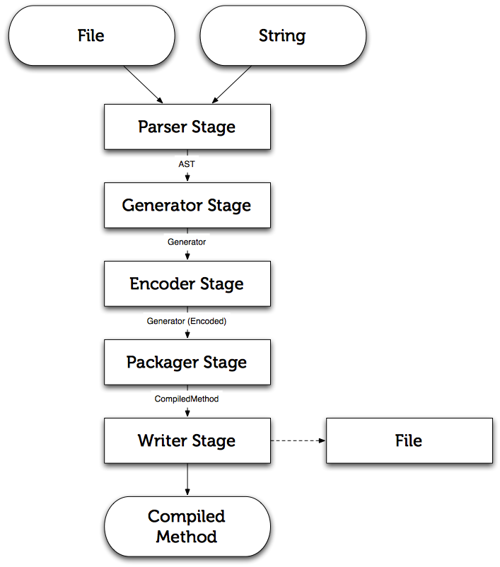
Anatomy of a compiler

Slide 3

What is natasha?
A simple programming language for doing basic arithmetic operations
Written because I wanted to learn more about how compilers worked and also get a deeper understanding of how source code moves plain text to actual applications
All “natasha” programs end with “.natasha”

Slide 4



Tokenization
; This is a comment
int a = 20
int b = a + 33
if a == b
a = a - 33 ; this also another comment
else
b = a
lexer
int
a
=
20
int
b
=
a
+
33
if
a
==
b
a
=
a
-
33
else
b
=
a

Slide 5
Details of the Lexer
File extension is checked “.natasha”
No processing is done if it is not a valid “.natasha” file
heavily based on RegEx
Unknown patterns causes compilation error

Slide 6
Demo Time

