Slide 1
Consumer Complaints
Graphing and Analysis
By
Tawheed Raheem
&
Nicholas Quirk

Slide 2
The Data
The data is consumer complaints against various financial companies and the companies response.
The schema contains the following:
  product
  customer complaint
  state and zip code of customer
  date
  company name
  company response

Slide 3
Sample Entry
Complaint ID → 1324677
Product → Mortgage
Sub-Product → Conventional Fixed Mortgage
Issue → Loan servicing, payments, escrow account
Sub-Issue → ''
State → CA
ZIP Code → 91405
Submitted Via → Web
Date Received → 4/10/2015
Date Sent to Company → 4/10/2015
Company → Arbor Residential Mortgage LLC
Company Response → In progress
Timely Response? → Yes
Consumer Disputed? → ''

Slide 4
Notes on the Data
There were 375,441 entries on complaint data spanning 2011 to 2015.
The data was very clean. There was no need to preprocess it prior to using the CSV module.
Some data wasn't useful:
  The timely response was usually 'yes'.
  The date received and date sent to company were usually the same.
  Less than a third of the complaints (113,881 entries) had a sub-issue. So we decided not to focus on this part of the dataset.

Slide 5
Our Questions
Total number of complaints by company by region?
  What part of the company has the most consumer complaints and which companies are the most complained about.
What's the total of each 'submit via' by year?
  Has the 'submit via' changed as smart phone become more common and tablets become cheaper?
What's the most complained product by company by year?
  Given the housing crash are mortgages the top complained product or is another loan type at the top?
What are the top complaints by year?
  Can we see if there one or many financial complaints that continue to recur year over year?
What companies are the best and worst at complaint responses?
  If a company is causing a lot of complaints are they also at the top of successfully resolving those complaints?
What question(s) are you trying to answer with the data?
Did you change your question(s) as your project progress? Why?

Slide 6
Our Process
We mostly worked remotely by sharing a Github repository.
We had a brief in-person meeting half-way through to discuss pending part and clarify goals.
We each picked questions to answer then coded and graphed them.
What was your process for developing a program to answer your question(s)?
Did you try to do some of the analysis by hand?
Did you work at the problem in pieces?
Did you check you program’s results against hand calculations?
How did you determine what your program needed to do?

Slide 7
Our Results
Show the results of running your program on your data.
Explain your results and what they mean.
How did you decide on the format of your results?
Did you consider any other output formats? Why did you choose not to use them?

Slide 8
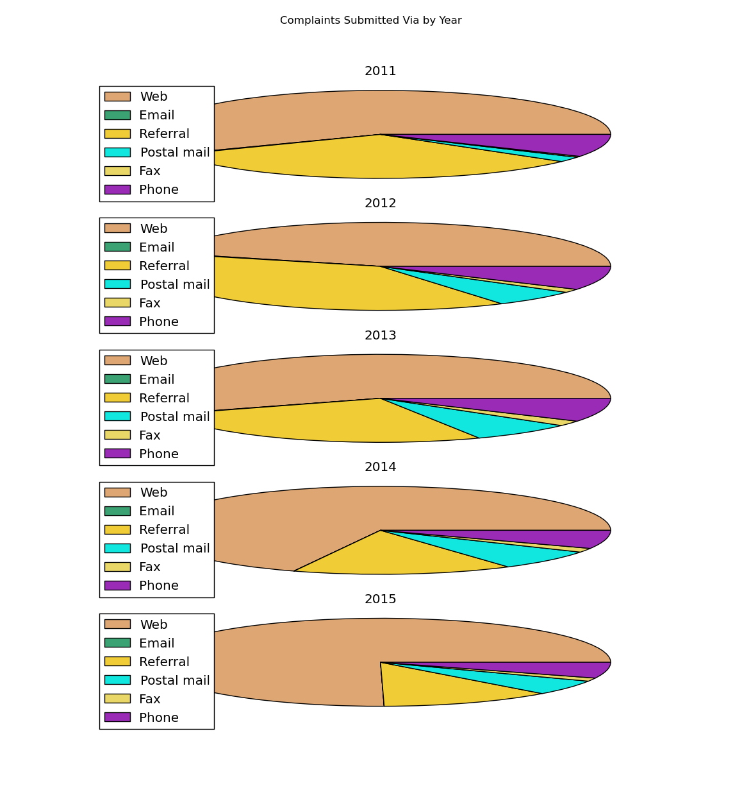
Complaints Submitted Via by Year
Phone, Post mail and Fax remained fairly constant
As expected, Web except for 2012 has increased year over year. Why 2012?
Referral has lost ground mostly to Web

Slide 9
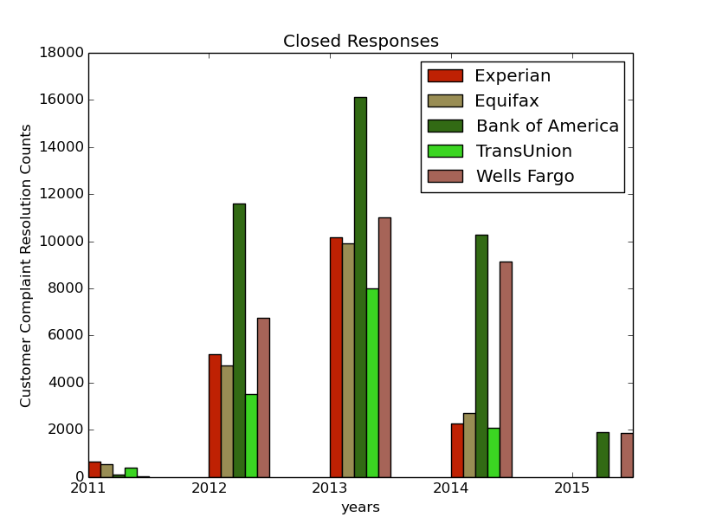
Successful (Closed With) Responses
Closed responses include 'closed with'
  Explanation
  Non-monetary relief (possibly with explanation?)
  Monetary relief
  Relief
This does not include just 'Closed', without some additional information we don't know if the company ever informed the customer of the resolution to the complaint.
Interesting notes:
  Experian and Equifax follow each other very closely.
  Bank of America, get a lot of complaints but also resolves the most of all the companies.

Slide 10
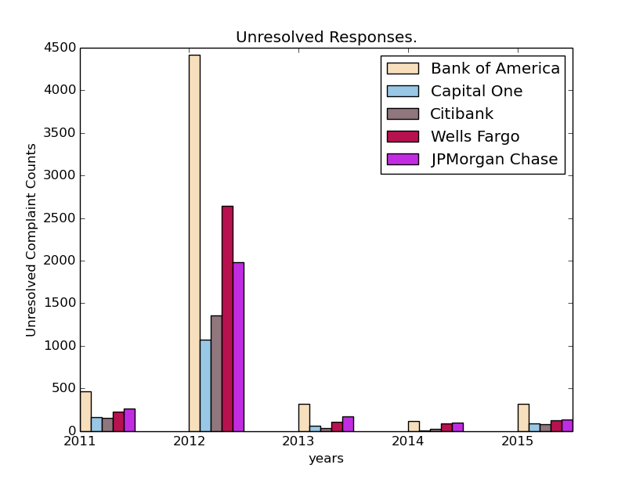
Unresolved Responses
These responses include:
  Closed
  In progress
  Untimely Response
Interesting notes:
  2012 has many responses that were just 'closed' or had a poor response time.
  'In progress' is mostly in 2015

Slide 11
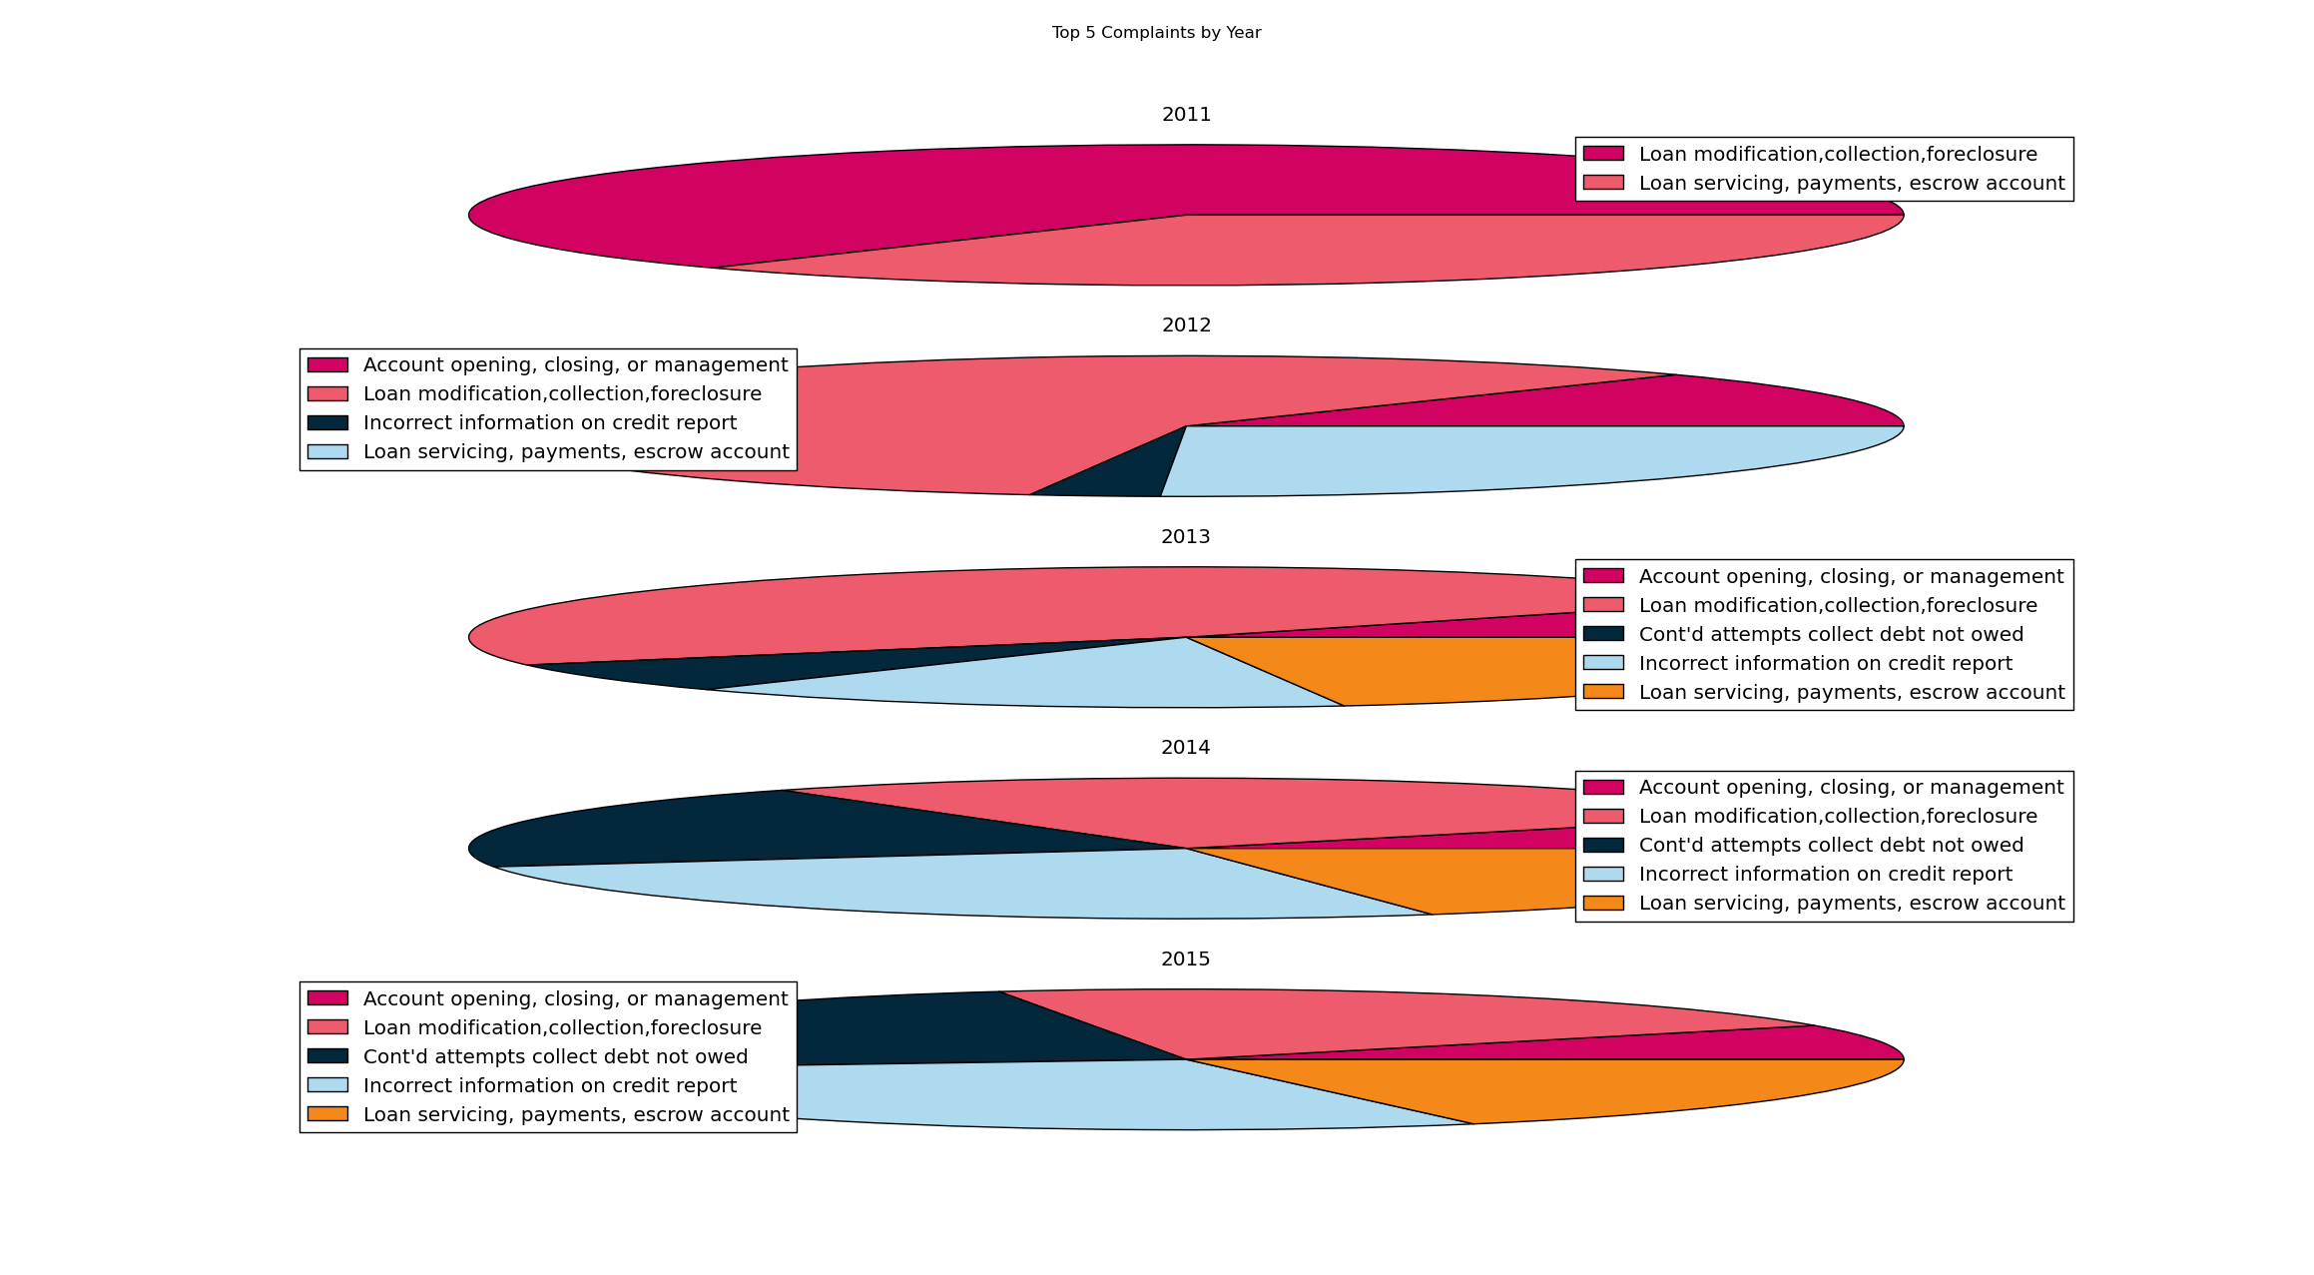
Top Complaints by Year
Found the top 5 complaints overall, then compare them by year.
Load modifications decrease every year since 2012.
Loan serving, payments, escrow account didn't exist for 2012

Slide 12
Our Code
Our code is hosted publicly on Github: https://github.com/tawrahim/PCP_Final_Project
Show your code on the screen.
Explain how your program works overall – you do not need to go over all of your code line-by-line.
For any sections of your code that were particularly difficult to write, or are non-obvious, or that you are particularly proud of, explain the code in detail.
What problems did you have?
Did you have any moments of enlightenment?

