Slide 1
Consumer Complaints
Graphing and Analysis
By
Tawheed Raheem
&
Nicholas Quirk

Slide 2
The Data
The data is consumer complaints against various financial companies and the companies response.
The schema contains the following:
  product
  customer complaint
  state and zip code of customer
  date
  company name
  company response

Slide 3
Sample Entry
Complaint ID → 1324677
Product → Mortgage
Sub-Product → Conventional Fixed Mortgage
Issue → Loan servicing, payments, escrow account
Sub-Issue → '‘
State → CA
ZIP Code → 91405
Submitted Via → Web
Date Received → 4/10/2015
Date Sent to Company → 4/10/2015
Company → Arbor Residential Mortgage LLC
Company Response → In progress
Timely Response? → Yes
Consumer Disputed? → ''

Slide 4
Notes on the Data
There were 375,441 entries on complaint data spanning 2011 to 2015.
The data was very clean.
There was no need to preprocess it prior to using the CSV module.
Some data wasn't useful:
  The timely response was usually 'yes'.
  The date received and date sent to company were usually the same.
  Less than a third of the complaints (113,881 entries) had a sub-issue. So we decided not to focus on this part of the dataset.

Slide 5
Our Questions
Total number of complaints by company by region?
What's the total of each 'submit via' by year?
What's the most complained product by company by year?
What are the top complaints by year?
What companies are the best at complaint responses?
What companies are the worst at complaint responses?
Notes:
As an analysts working for any of the companies that had complaints logged against them, I want to be able to drill down on stats about my company and also get a general sense of
what it means on a larger scale. We did not necessarily change our questions but we added additional questions to it

Slide 6
Our Questions Continued…
Some aspects of our questions changed while working on the project.
Company complaints by year was too ambitious. Given the rate of progress and deadline, this was too much. It was changed for complaints by year. And even had to only be only top 5 for visual purposes.

Slide 7
Our Process
We mostly worked remotely by sharing a Github repository.
We had a brief in-person meeting half-way through to discuss pending part and clarify goals.
We each picked questions to answer then coded and graphed them.
What was your process for developing a program to answer your question(s)?
Did you try to do some of the analysis by hand?
Did you work at the problem in pieces?
Did you check you program’s results against hand calculations?
How did you determine what your program needed to do?

Slide 8
Our Results
We graphed our results using matplotlib.
We used bar and pie charts to represent our data.
Show the results of running your program on your data.
Explain your results and what they mean.
How did you decide on the format of your results?
Did you consider any other output formats? Why did you choose not to use them?

Slide 9
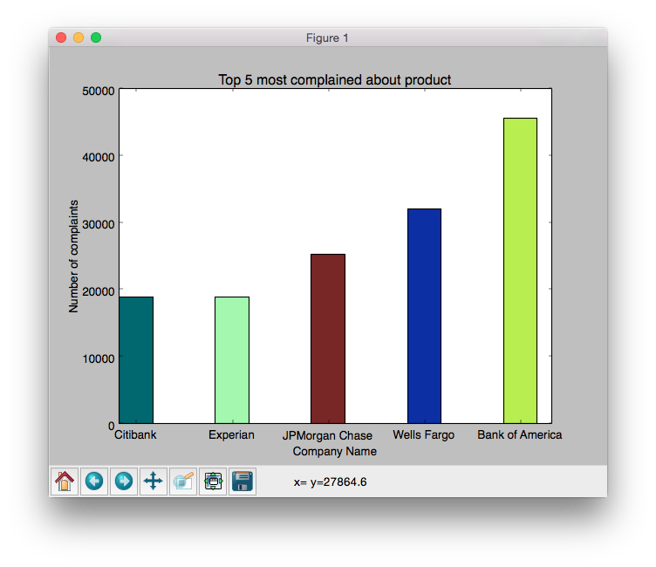
Top 5 complained about companies
It was a challenge to visually see all the companies in one shot so we decided to focus on the top 5 most complained about companies.
Notes:
To graph this, there is a function parameter that one can pass in as a function parameter

Slide 10
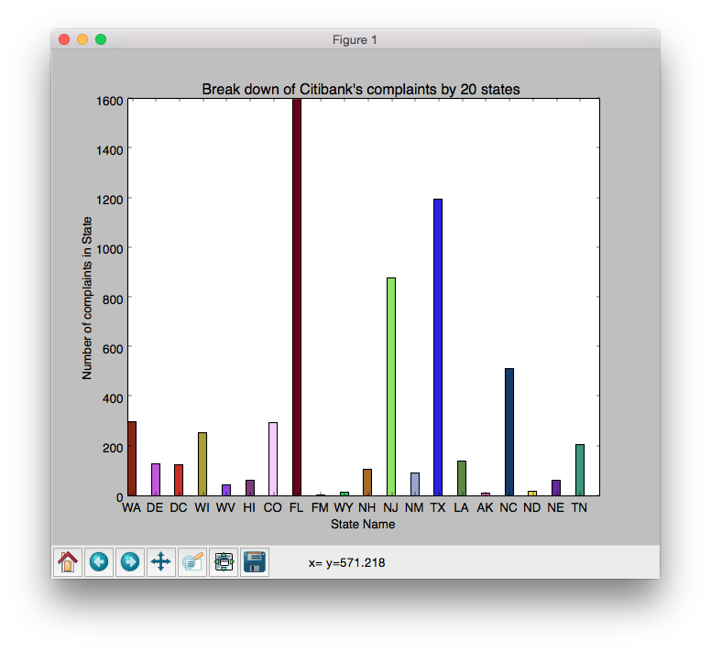
Drilling down to state level
Foo bar baz
Notes:
We cant possibly show all the states so we only show 20 of the states so that the analysts who is looking at this dataset can know which state to focus their resources on
It could be that there is a misinformation for that state that is why they having high complains

Slide 11
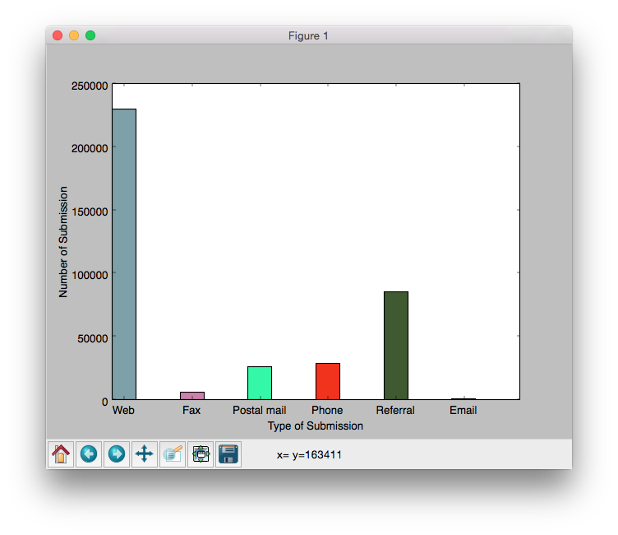
Where are the complaints coming from?
We want to know which group of people complains the most

Slide 12
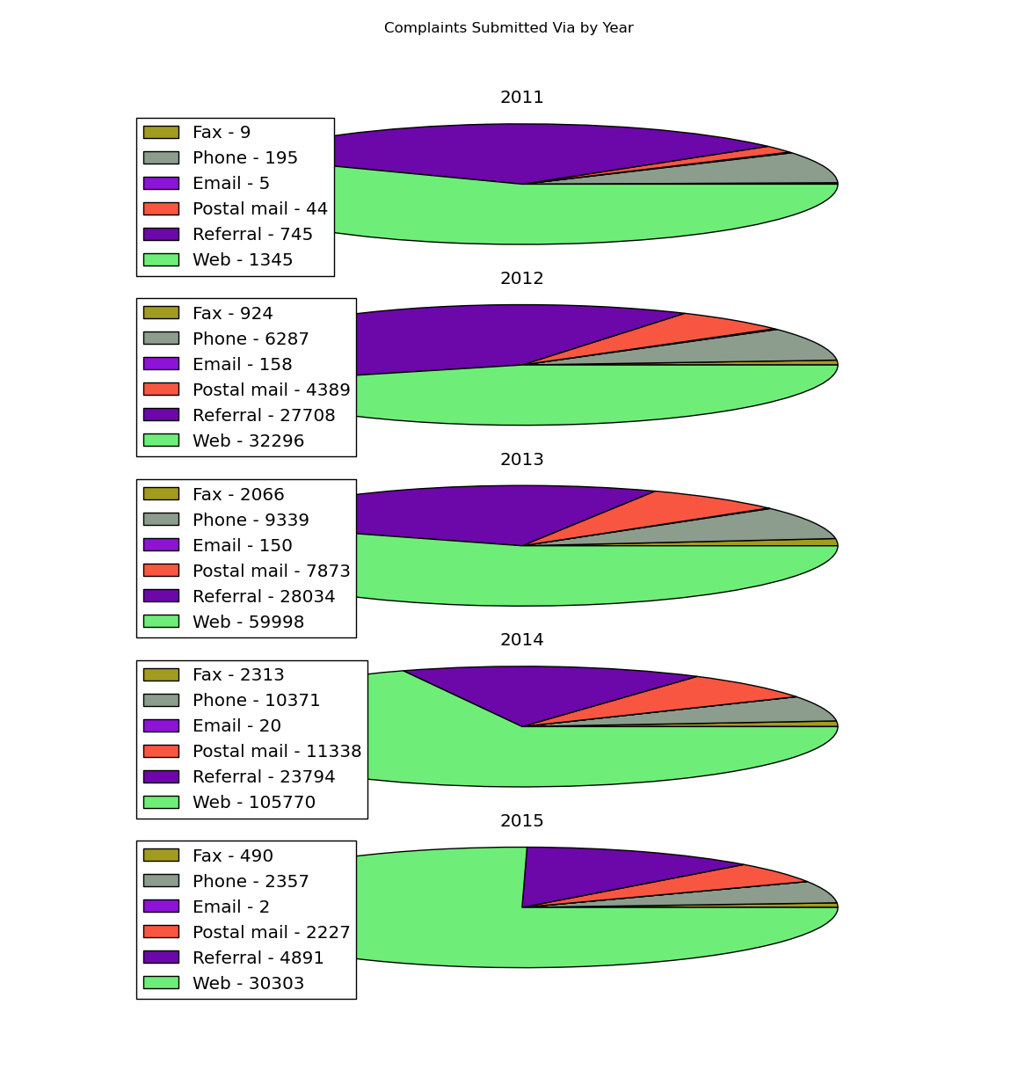
Complaints Submitted Via by Year
Phone, Post mail and Fax remained fairly constant as expected, Web except for 2012 has increased year over year.
Why 2012?
Referral has lost ground mostly to Web

Slide 13
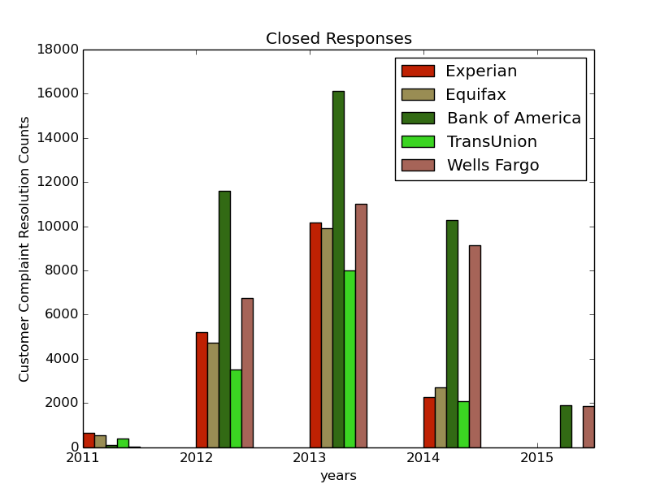
Successful (Closed With) Responses
Closed responses include 'closed with’
  Explanation
  Non-monetary relief (possibly with explanation?)
  Monetary relief
  Relief
This does not include just 'Closed', without some additional information we don't know if the company ever informed the customer of the resolution to the complaint.
Interesting notes:
  Experian and Equifax follow each other very closely.
  Bank of America, get a lot of complaints but also resolves the most of all the companies.

Slide 14
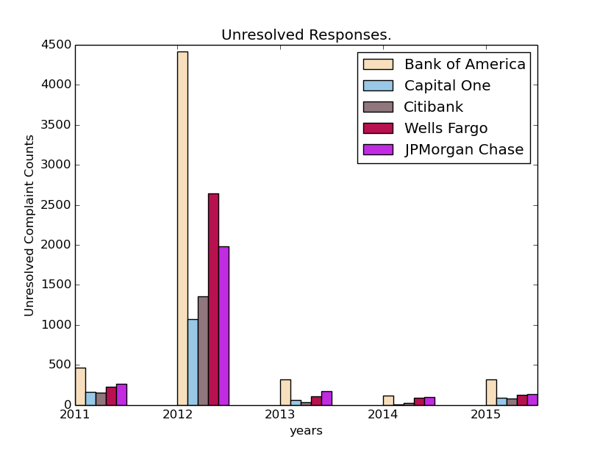
Unresolved Responses
These responses include:
  Closed
  In progress
  Untimely Response
Interesting notes:
  2012 has many responses that were just 'closed' or had a poor response time.
  'In progress' is mostly in 2015

Slide 15
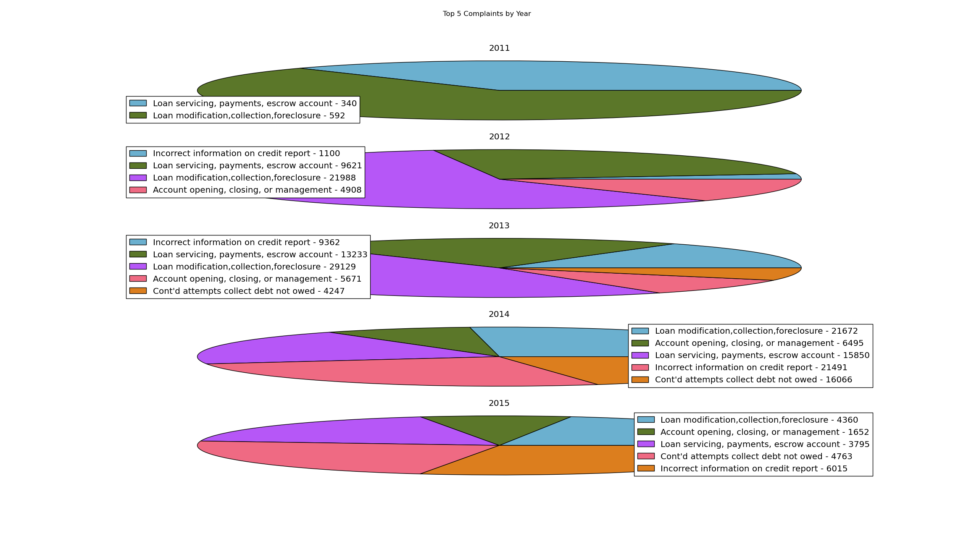
Top Complaints by Year
Found the top 5 complaints overall, then compare them by year.
Load modifications decrease every year since 2012.
Loan serving, payments, escrow account didn't exist for 2012

Slide 16
Our Code
Our code is hosted publicly on Github:
https://github.com/tawrahim/PCP_Final_Project
Show your code on the screen.
Explain how your program works overall – you do not need to go over all of your code line-by-line.
For any sections of your code that were particularly difficult to write, or are non-obvious, or that you are particularly proud of, explain the code in detail.
What problems did you have?
Did you have any moments of enlightenment?
Notes:
- We can show our code on github

