Slide 1
Software Project Lab – 1 Midterm Presentation
Project Title: ImCloneDetect (Image-Based Code Clone Detection Tool)
Student Details:
Md. Tawrat Hossen Nibir
Roll: BSSE 1625
Institute of Information Technology (IIT)
University of Dhaka
Supervisor Details:
Toukir Ahammed
Lecturer
Institute of Information Technology (IIT)
University of Dhaka
1

Slide 2
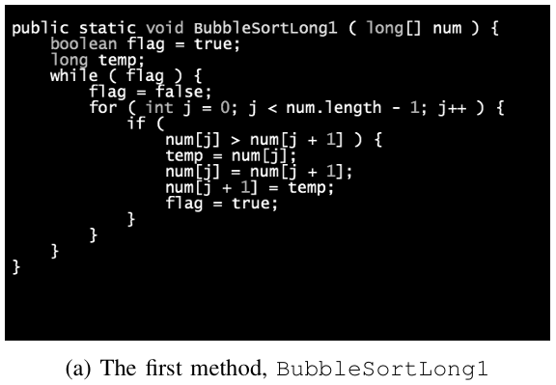
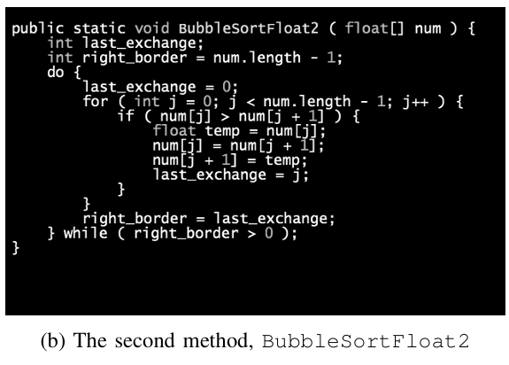
Introduction
What is code clone?
[2]
[2]
2
Notes:
A code clone is when two code fragments are identical or very similar—often due to copy-paste or minor edits. This can create maintenance issues, because changing one part may require changing others too.

Slide 3
Project Description – “What?”
Tool Development
Develop an Image-Based Code Clone Detection Tool designed for precision and efficiency.
3

Slide 4
Project Description – “How?”
Core Algorithms
Image Similarity
Utilize Jaccard Distance [1], Perceptual Hash (pHash) [1], and Earth Mover's Distance (EMD) [2].
Detect similarities among source code images (PNG files) using advanced algorithms.
Output & Visualization
Generate similarity results in CSV files and display them in the terminal, enabling visualization in future.
4

Slide 5
What I have Implemented So Far…
BMP image file handling
.bmp format images
Methods and constructors for reading and writing .bmp files
Properly handling exceptions thrown by the file operations
5

Slide 6
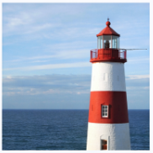
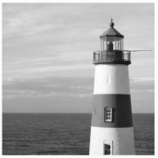

What I have Implemented So Far…
Normalization
Grayscale image generation
Gaussian blur image generation using ‘Gaussian kernel’
Negative image generation
Pixel vector extraction
Image resizing using ‘Bilinear Interpolation’
Colorful Image
Grayscale Image
Resized Image
Gaussian Blur Image
6

Slide 7
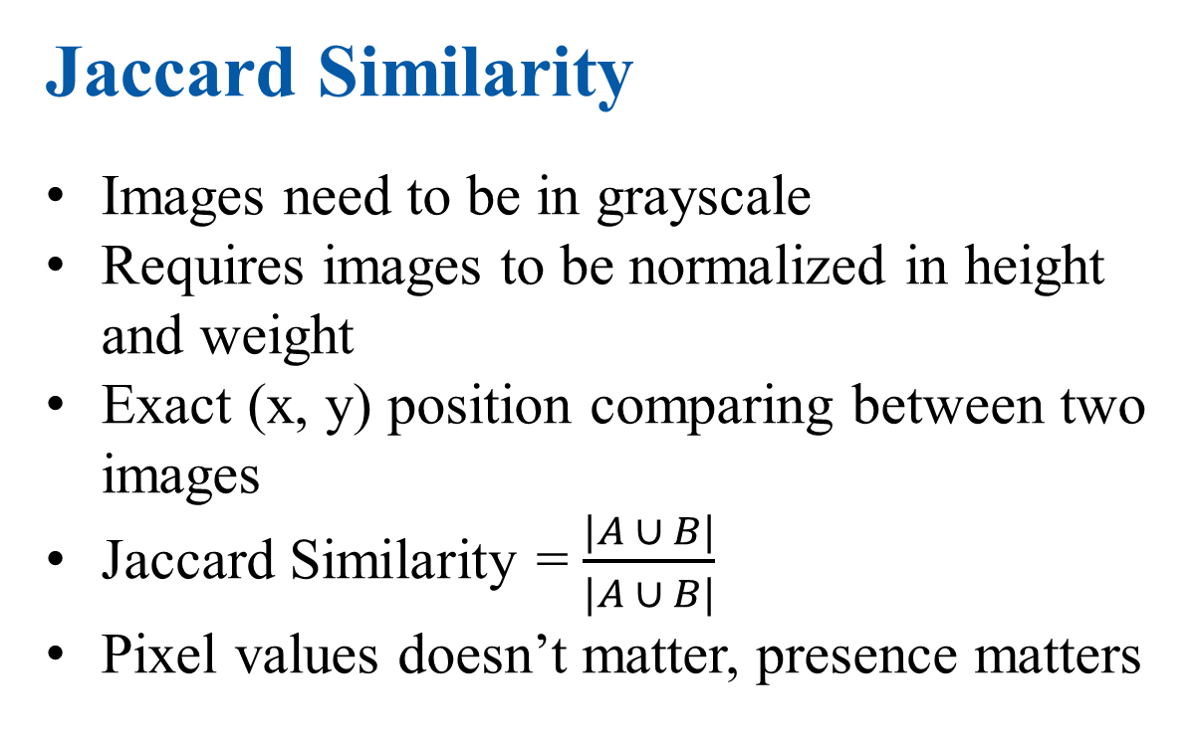
What I have Implemented So Far…
Jaccard Similarity
Images need to be in grayscale
Requires images to be normalized in height and weight
Exact (x, y) position comparing between two images
Jaccard Similarity = $\frac{|A ∪ B|}{|A ∪ B|}$
Pixel values doesn’t matter, presence matters
A = Nonzero pixels in image1
B = Nonzero pixels in image2
Nonzero pixels in both A and B
7

Slide 8
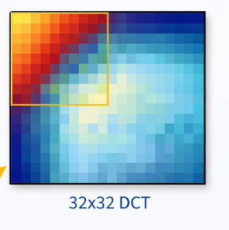
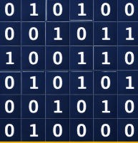
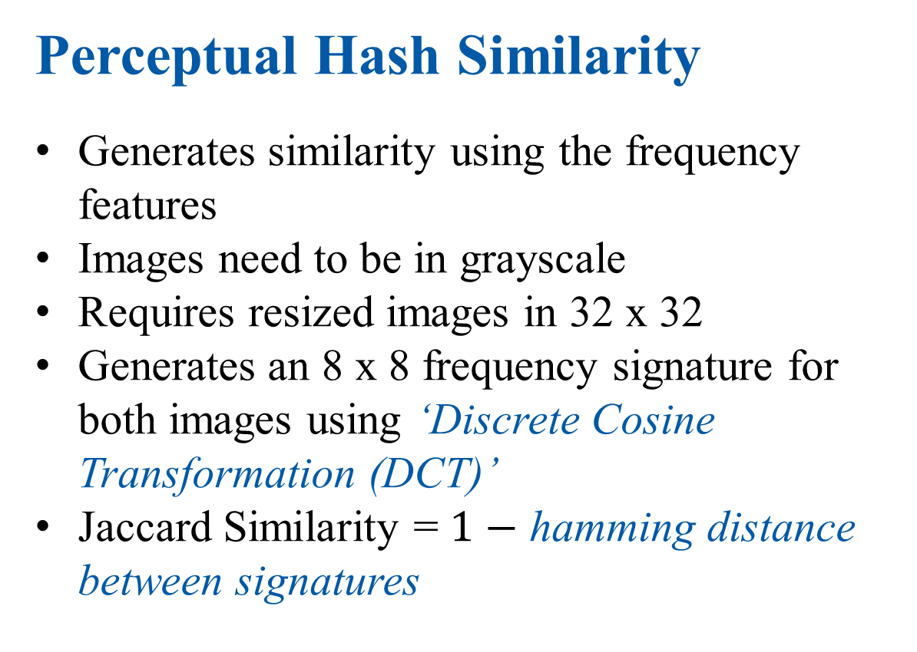
What I have Implemented So Far…
Perceptual Hash Similarity
Generates similarity using the frequency features
Images need to be in grayscale
Requires resized images in 32 x 32
Generates an 8 x 8 frequency signature for both images using ‘Discrete Cosine Transformation (DCT)’
Jaccard Similarity = $1−$ hamming distance between signatures
32 x 32 image
32 x 32 DCT
Hash signature:
010100001011100110010101001010010000
Top-left 8x8 grid
8

Slide 9
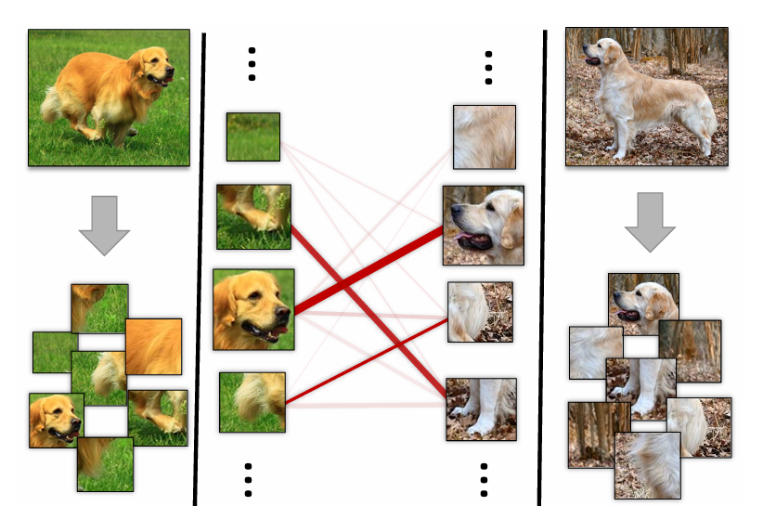
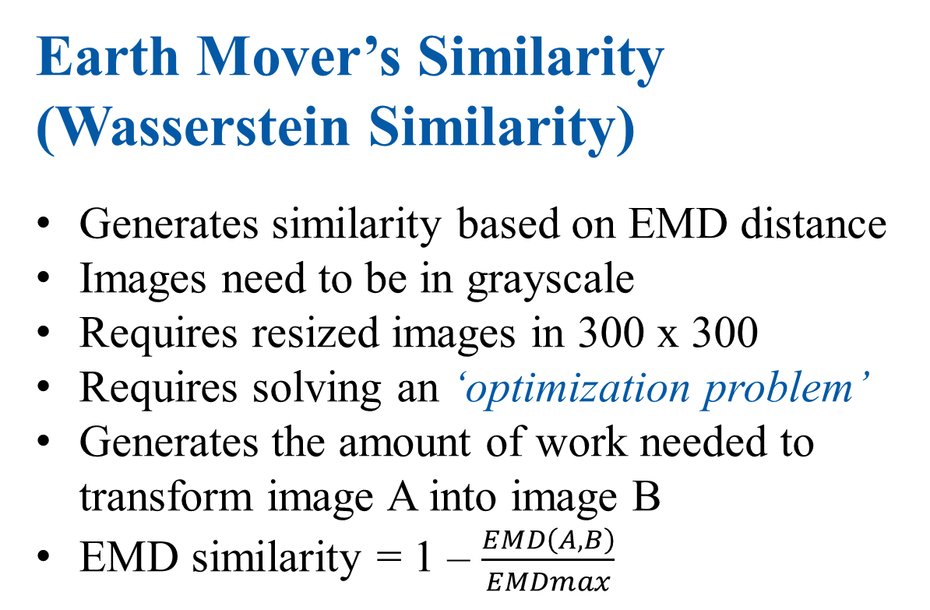
Future Plan
Earth Mover’s Similarity
(Wasserstein Similarity)
Generates similarity based on EMD distance
Images need to be in grayscale
Requires resized images in 300 x 300
Requires solving an ‘optimization problem’
Generates the amount of work needed to transform image A into image B
EMD similarity = 1 – $\frac{EMD\left(A,B\right)}{EMDmax}$
How Earth Mover’s Distance help finding similarities
9

Slide 10
Features Implemented
Interactive user-friendly menu
Directory based pairwise similarity scores
Single pair similarity score
Jaccard distance-based similarity
Bilinear interpolation to resize images
Gaussian kernel to generate blur images
Discrete Cosine Transformation (DCT) to generate perceptual hash-based similarity
10

Slide 11
Summary
Jaccard Similarity
Grayscale Image
Comparing and computing similarity
Perceptual Hash
Image resizing using ‘Bilinear Interpolation’
pHash similarity using ‘Discrete Cosine Transformation (DCT)’
EMD
Gaussian blur image generation using ‘Gaussian kernel’
Solving optimization problem to find the solution
11

Slide 12
Work Flow
Input Images
(Under the
assumptions)
Normalization
(Padding and
scaling)
Gray-scaling
Gaussian blur
Output
CSV files
(With similarity
Scores of files)
Similarity
Algorithms
(Jaccard [1], p-Hash [1],
EMD [2])
12

Slide 13
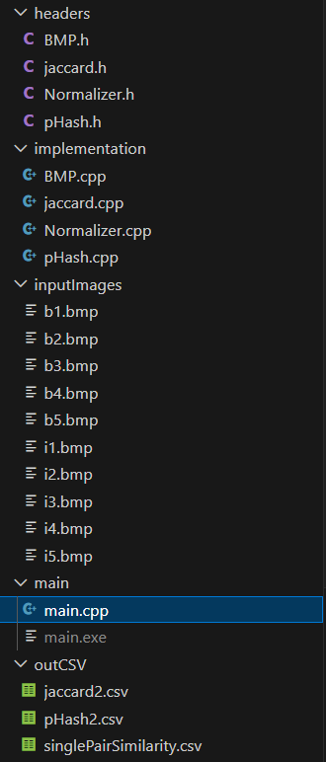
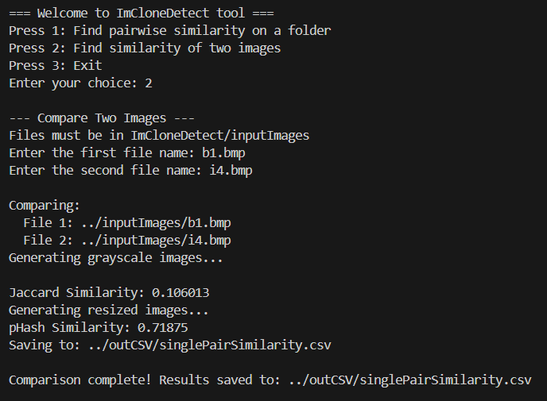
Project Screenshots
Directory Structure
Similarity of a pair of code image screenshots
13

Slide 14
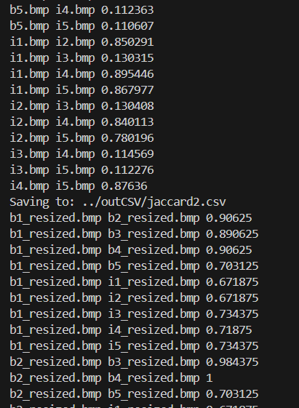
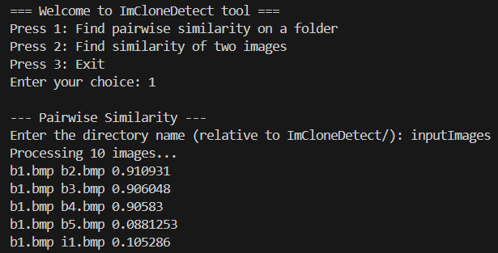
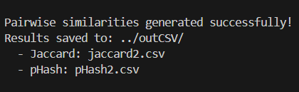
Project Screenshots
Directory based similarity
generation 3
Directory based similarity generation
Directory based similarity
generation 2
14

Slide 15
Reference
[1] Y. Wang and D. Liu, “Image-Based Clone Code Detection and Visualization,” 978-1-7281-4691-1/19/$31.00 ©2019 IEEE DOI 10.1109/AIAM48774.2019.00041, pp. 168–175, Oct. 2019, doi: 10.1109/aiam48774.2019.00041.
[2] C. Ragkhitwetsagul, J. Krinke, and B. Marnette, “A picture is worth a thousand words: Code clone detection based on image similarity,” 978-1-5386-6430-8/18 © 2018 IEEE IWSC 2018, Campobasso, Italy. Accepted 10.1109/iwsc.2018.8327318. Accepted 10.1109/iwsc.2018.8327318. for Publication by IEEE, Mar. 2018, doi:
[3] https://solarianprogrammer.com/2018/11/19/cpp-reading-writing-bmp-images/
[4] https://www.geeksforgeeks.org/dsa/discrete-cosine-transform-algorithm-program/
[5] https://www.geeksforgeeks.org/maths/what-is-bilinear-interpolation/
15

Slide 16
Github Repository Link
https://github.com/tawratnibir/SPL-1-ImCloneDetect
16

Slide 17
Thank you
17

