Slide 1
Software Project Lab – 1 Proposal Presentation
Project Title: ImCloneDetect (Image-Based Code Clone Detection Tool)
Student Details:
Md. Tawrat Hossen Nibir
Roll: BSSE 1625
Institute of Information Technology (IIT)
University of Dhaka
Supervisor Details:
Toukir Ahammed
Lecturer
Institute of Information Technology (IIT)
University of Dhaka
1

Slide 2
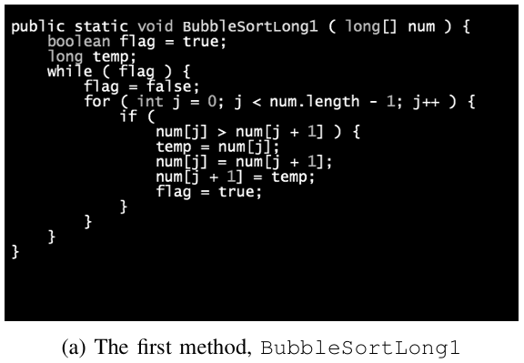
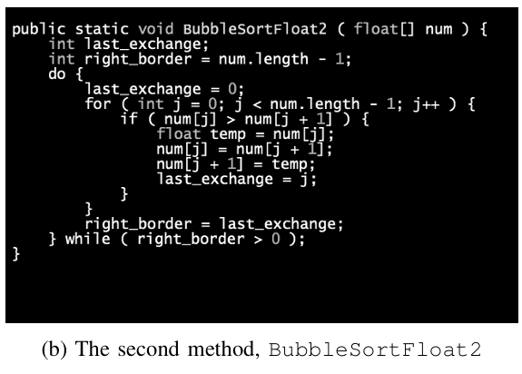
Introduction
What is code clone?
[2]
[2]
2

Slide 3
Project Description – “What?”
Tool Development
Develop an Image-Based Code Clone Detection Tool designed for precision and efficiency.
3

Slide 4
Project Description – “How?”
Core Algorithms
Image Similarity
Utilize Jaccard Distance [1], Perceptual Hash (pHash) [1], and Earth Mover's Distance (EMD) [2].
Detect similarities among source code images (PNG files) using advanced algorithms.
Output & Visualization
Generate similarity results in CSV files and display them in the terminal, enabling visualization in future.
4

Slide 5
Project Scope
What I Will Do:
Implement CLI-based image similarity system
Apply three independent algorithms
(Jaccard [1], pHash [1], EMD [2])
Store and display results effectively
Prepare CSV outputs for external visualization
Assumptions:
The input images contain codes without whitespaces and
comments
Images must be functions of same language
Codes in the images must be syntax highlighted
5

Slide 6
Work Flow
Input Images
(Under the
assumptions)
Normalization
(Padding and
scaling)
Gray-scaling
Gaussian blur
Output
CSV files
(With similarity
Scores of files)
Similarity
Algorithms
(Jaccard [1], p-Hash [1],
EMD [2])
6

Slide 7
Technology Stack
Programming Language
C++
IDE
Codeblocks, VS Code
Version Control
GitHub
7

Slide 8
References
[1] Y. Wang and D. Liu, “Image-Based Clone Code Detection and Visualization,” 978-1-7281-4691-1/19/$31.00 ©2019 IEEE DOI 10.1109/AIAM48774.2019.00041, pp. 168–175, Oct. 2019, doi: 10.1109/aiam48774.2019.00041.
[2] C. Ragkhitwetsagul, J. Krinke, and B. Marnette, “A picture is worth a thousand words: Code clone detection based on image similarity,” 978-1-5386-6430-8/18 © 2018 IEEE IWSC 2018, Campobasso, Italy. Accepted 10.1109/iwsc.2018.8327318. Accepted 10.1109/iwsc.2018.8327318. for Publication by IEEE, Mar. 2018, doi:
8

Slide 9
Thank You & Q&A
Thank You for your attention!
Questions and Answers
9

