Slide 1
Software Project Lab – 1 Final Presentation
Project Title: ImCloneDetect (Image-Based Code Clone Detection Tool)
Student Details:
Md. Tawrat Hossen Nibir
Roll: BSSE 1625
Institute of Information Technology (IIT)
University of Dhaka
Supervisor Details:
Toukir Ahammed
Lecturer
Institute of Information Technology (IIT)
University of Dhaka

Slide 2
Project Description – “Why?”
Why Image-Based Clone Detection?
Language-independent approach
Captures structural similarity visually
Robust to:
Variable renaming
Formatting changes
Goes beyond traditional text-based detection

Slide 3
Project Description – “What?”
Tool Development
Develop an Image-Based Code Clone Detection Tool designed for precision and efficiency.

Slide 4
Project Description – “How?”
Core Algorithms
Image Similarity
Utilize Jaccard Distance [1], Perceptual Hash (pHash) [1], and Earth Mover's Distance (EMD) [2].
Detect similarities among source code images (BMP files) using advanced algorithms.
Output & Visualization
Generate similarity results in CSV files and display them in the terminal, enabling visualization in future.

Slide 5
What I Had Implemented Till Midterm…
BMP image file handling
.bmp format images
Methods and constructors for reading and writing .bmp files
Properly handling exceptions thrown by the file operations

Slide 6
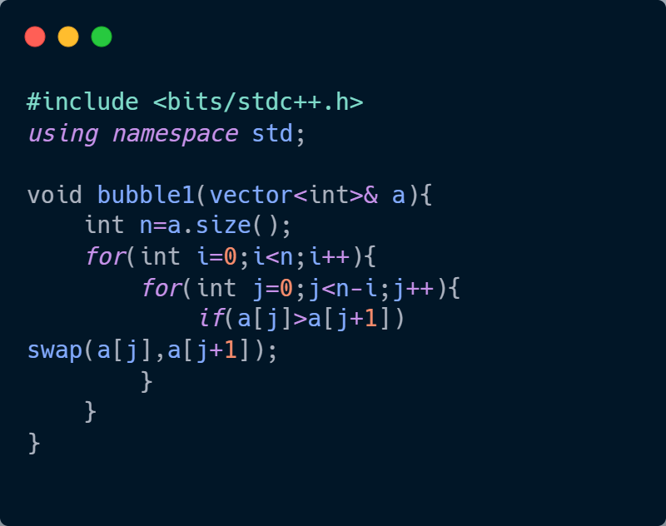
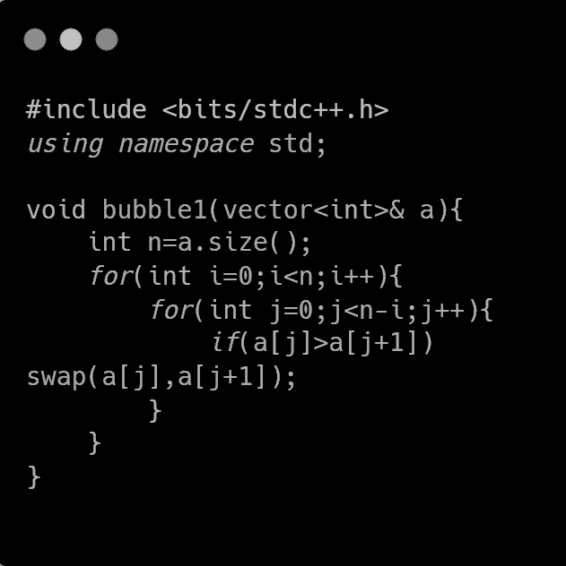
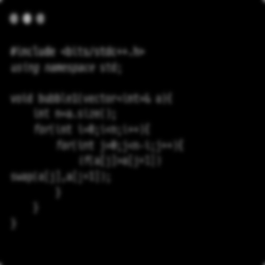
What I Had Implemented Till Midterm…
Normalization
Grayscale image generation
Gaussian blur image generation using ‘Gaussian kernel’
Negative image generation
Pixel vector extraction
Image resizing using ‘Bilinear Interpolation’
Colorful Image
Grayscale Image
Resized Image
Gaussian Blur Image

Slide 7
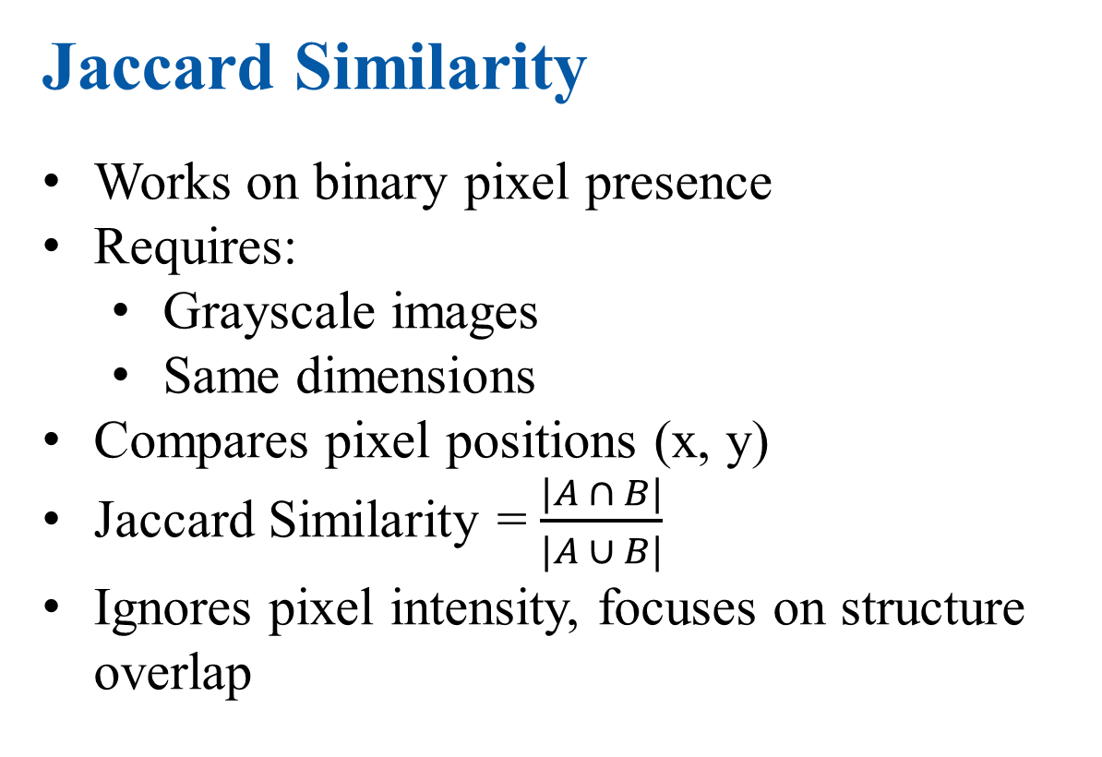
What I Had Implemented Till Midterm…
Jaccard Similarity
Works on binary pixel presence
Requires:
Grayscale images
Same dimensions
Compares pixel positions (x, y)
Jaccard Similarity = $\frac{|A ∩ B|}{|A ∪ B|}$
Ignores pixel intensity, focuses on structure overlap
A = Nonzero pixels in image1
B = Nonzero pixels in image2
Nonzero pixels in both A and B

Slide 8

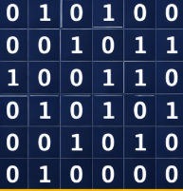
What I Had Implemented Till Midterm…
Perceptual Hash Similarity
Captures visual similarity using frequency domain
Steps:
Resize: 32 x 32
Apply DCT
Take top-left 8 x 8
Generate binary hash
Similarity based on Hamming distance of the signatures
Robust to minor changes (noise, formatting)
32 x 32 image
32 x 32 DCT
Hash signature:
010100001011100110010101001010010000
Top-left 8x8 grid

Slide 9

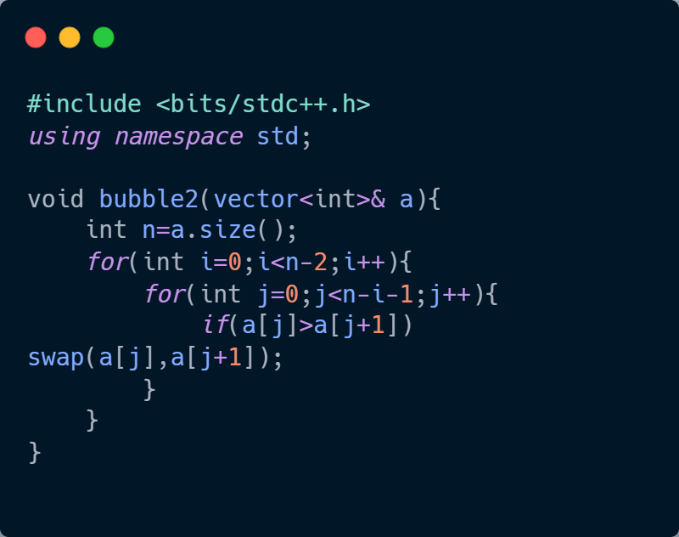
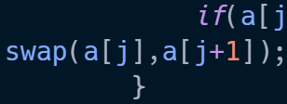

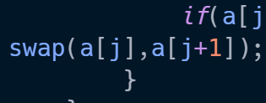

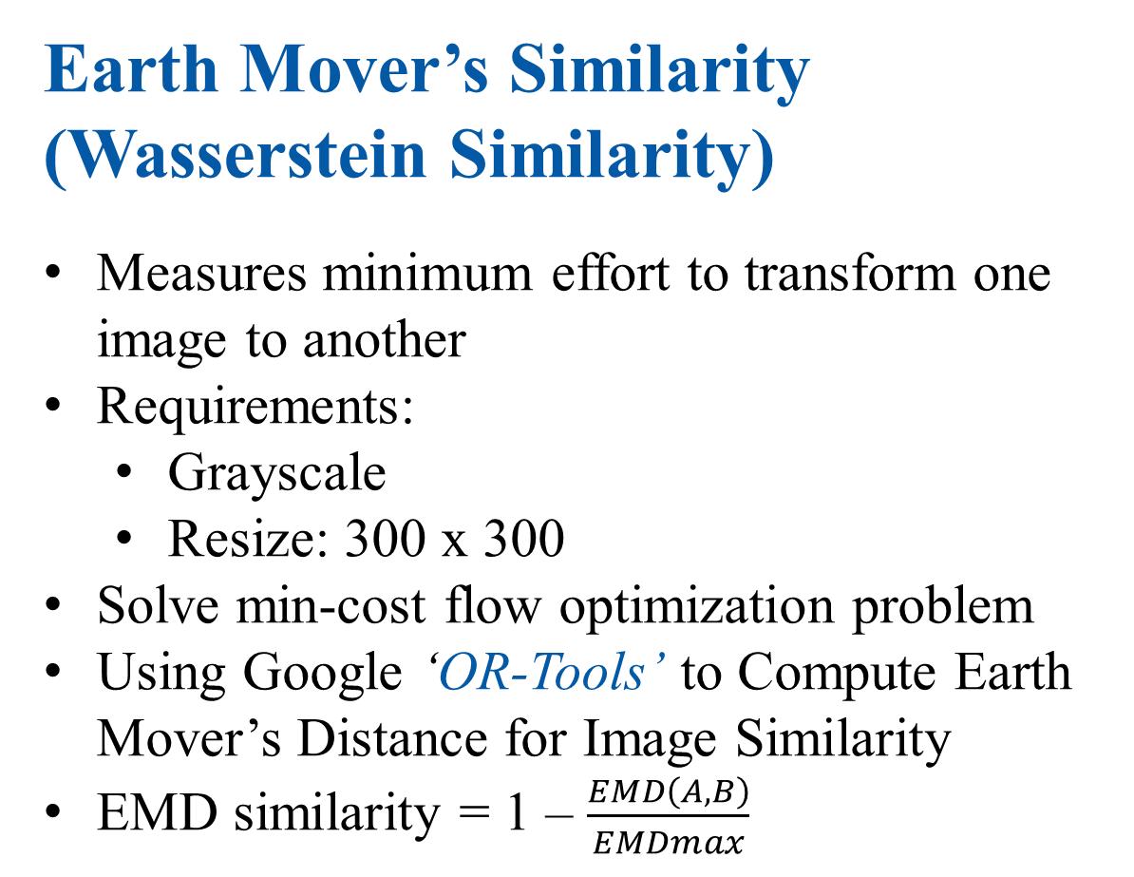
Post-mid Implementation
Earth Mover’s Similarity
(Wasserstein Similarity)
Measures minimum effort to transform one image to another
Requirements:
Grayscale
Resize: 300 x 300
Solve min-cost flow optimization problem
Using Google ‘OR-Tools’ to Compute Earth Mover’s Distance for Image Similarity
EMD similarity = 1 – $\frac{EMD\left(A,B\right)}{EMDmax}$
How Earth Mover’s Distance help finding similarities

Slide 10
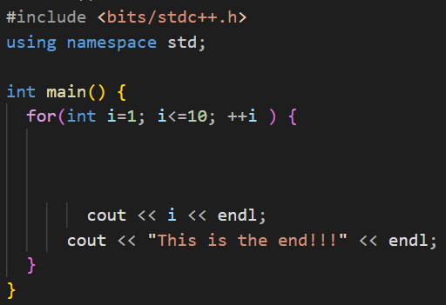
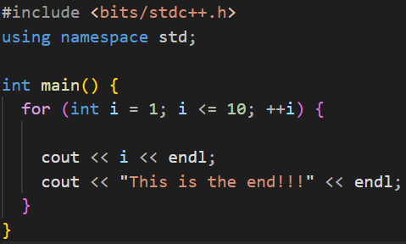
Post-mid Implementation
Clang-formatter
Clang-formatter used as linter to format codes before taking images
Implemented as an extension for the project
Clang-formatter applied

Slide 11
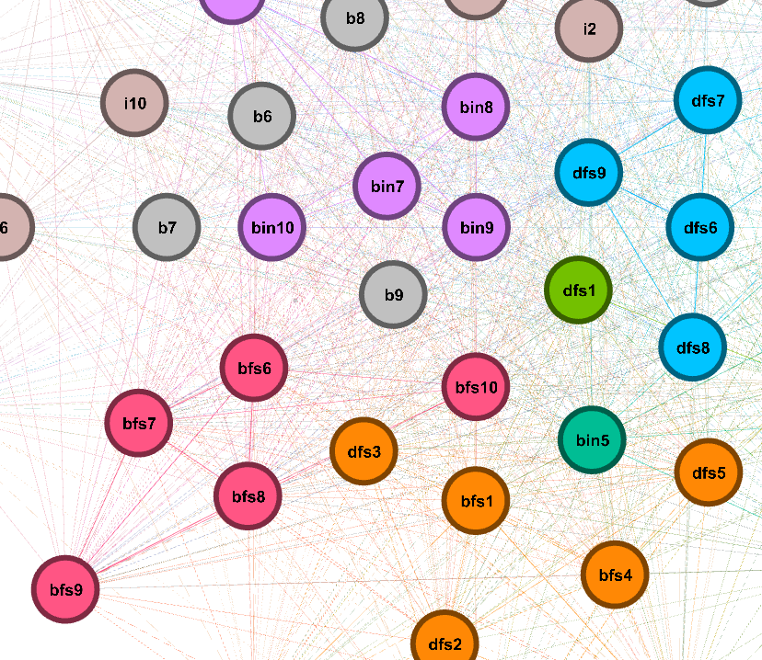
Post-mid Implementation
GEXF file generation
Gexf files are used for visualizing the similarity scores
More similar code fragments usually sticks together
Force Atlas 2 algorithm is used to visualize the scenario in Gephi Graph Visualizer

Slide 12
Features Implemented
Pairwise similarity (single & directory)
Multi-algorithm support:
Jaccard
pHash
EMD
Processing Pipeline:
Code to Image conversion
Normalization + Resizing
Feature extraction
Output
CSV (scores)
GEXF (graph visualization)
Extras
Weighted scoring system
Clang-based code formatting
Doxygen-style header comments

Slide 13
Work Flow
Input Images
(Under the
assumptions)
Normalization
(Padding and
scaling)
Gray-scaling
Gaussian blur
Output
GEXF files
(For visualization
With Force Atlas 2)
Output
CSV files
(With similarity
Scores of files)
Similarity
Algorithms
(Jaccard [1], p-Hash [1],
EMD [2])

Slide 14
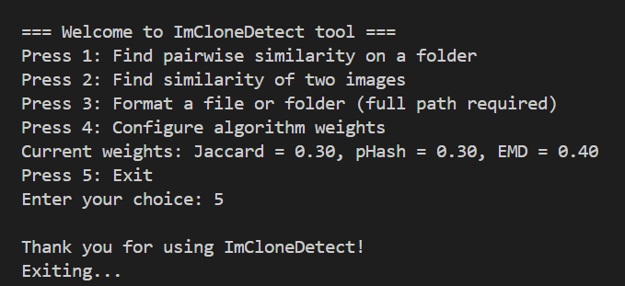
Project Screenshots
Intro Screen with interactive menu

Slide 15
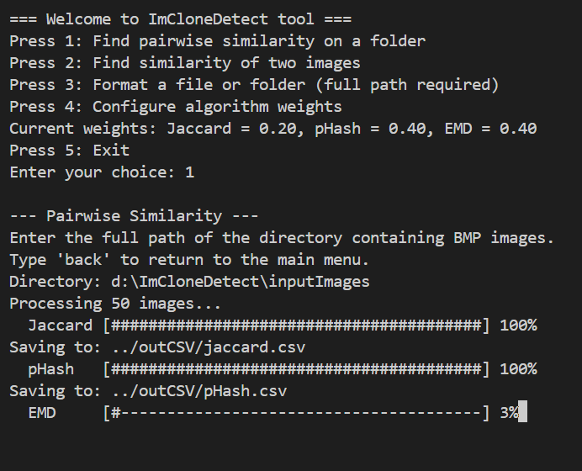
Project Screenshots
Directory based similarity generation

Slide 16
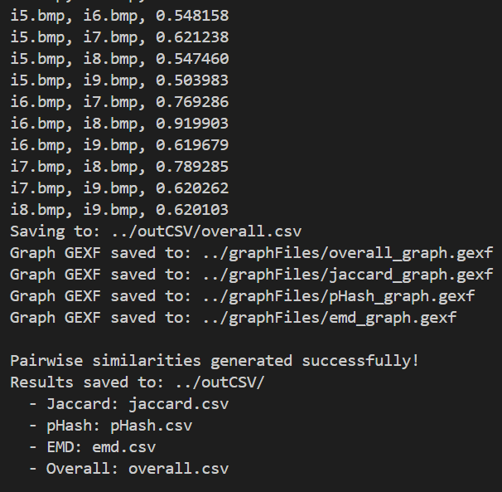
Project Screenshots
Similarities shown on console and .csv and .gexf stored on directories for further visualization

Slide 17
Project Screenshots
Similar Codes!!!
.gexf files visualized on Gephi Graph visualizer using Modularity Class and Force Atlas 2 algorithm

Slide 18
Conclusion
Built a multi-algorithm clone detection system
Combined:
Structural (Jaccard)
Frequency-based (pHash)
Distribution-based (EMD)
Result:
Accurate and flexible similarity detection

Slide 19
Thank you
Questions?

Slide 20
References
[1] Y. Wang and D. Liu, “Image-Based Clone Code Detection and Visualization,” 978-1-7281-4691-1/19/$31.00 ©2019 IEEE DOI 10.1109/AIAM48774.2019.00041, pp. 168–175, Oct. 2019, doi: 10.1109/aiam48774.2019.00041.
[2] C. Ragkhitwetsagul, J. Krinke, and B. Marnette, “A picture is worth a thousand words: Code clone detection based on image similarity,” 978-1-5386-6430-8/18 © 2018 IEEE IWSC 2018, Campobasso, Italy. Accepted 10.1109/iwsc.2018.8327318.
[3] https://solarianprogrammer.com/2018/11/19/cpp-reading-writing-bmp-images/
BMP images normalization
[4] https://www.geeksforgeeks.org/dsa/discrete-cosine-transform-algorithm-program/
Discrete Cosine Transformation on the image for pHash similarity
[5] https://www.geeksforgeeks.org/maths/what-is-bilinear-interpolation/
Bilinear Interpolation for resizing the images to desired dimension

Slide 21
References
[6] https://docs.gephi.org/desktop/User_Manual/Import/GEXF_File_Format/
Format used to generate GEXF files
[7] https://developers.google.com/optimization/introduction/cppopers
Or-tools used to solve the min-flow problem in EMD

Slide 22
Github Repository Link
https://github.com/tawratnibir/SPL-1-ImCloneDetect

