Slide 1
CSE 431
Leveraging GloVe Embeddings and LSTM Networks for Sarcasm Detection in News Headlines
Group No - 10
Group members:
Md. Tawsifur Rahman - 20141027
Siam Sadman Azad - 20141002
Sayma Akter Lubna - 20301450
Md Mahbub Alam Prithibi - 20101243

Slide 2
Overview
Introduction Literature Review Methodology Result & Analysis Limitations
Future Work Conclusion

Slide 3
Introduction
In the age of abundant digital content, identifying sarcasm in textual data poses a significant and intricate challenge in natural language comprehension. The focus on discerning sarcastic intent within news headlines, characterized by subtle incongruities between literal and intended meanings, has gained considerable attention. This paper explores sarcasm detection in news headlines, a domain rich in linguistic complexities and diverse contextual cues. Utilizing advanced deep learning techniques, specifically GloVe embeddings and LSTM neural networks, we aim to uncover the nuances of sarcastic language in news headlines. The incorporation of pre-trained word embeddings like GloVe allows the transformation of text into continuous vectors, capturing semantic and contextual information.
Additionally, LSTM networks, offer a promising approach to decipher the implicit sarcasm in headlines by understanding the underlying linguistic structures. This study addresses the limited research on sarcasm detection in the news domain, investigating the effectiveness of state-of-the-art deep learning methods. The methodologies, presenting the experimental setup, results, and discussions that illuminate the effectiveness and implications of leveraging GloVe embeddings and LSTM networks for the challenging task of sarcasm detection within news headlines.

Slide 4
Literature Review
Abaskohi et al. [2022] explored SVM, BERT, Attention, and LSTM models, employing generative and mutation-based data augmentation.
iSarcasm dataset (Oprea and Magdy [2019]) focuses on intended sarcasm, comprising 777 sarcastic and 3,707 non-sarcastic tweets.
RoBERTa fine-tuned for sentiment achieved an F1 score of 0.414, while Hercog et al.'s [2022] sarcasm detection model scored 0.526, using iSarcasm and a subset of SARC.
Self-Annotated Reddit Corpus (Khodak et al. [2017]) introduces noise; a balanced subset of SARC is pruned using a student-teacher setting (Sorscher et al. [2022])
Weighted Cross Entropy Loss addresses class imbalance, and Squared Hinge Loss is explored, recommended for noise robustness when augmenting with SARC (Janocha and Czarnecki [2017])

Slide 5



Methodology
DATASETS
Headline Datasets
The Headline dataset for sarcasm detection is collected from two news website. TheOnion aims at producing sarcastic versions of current events. The dataset includes all the headlines from News in Brief and News in Photos categories (which are sarcastic) and real (and non-sarcastic) news headlines from HuffPost. This dataset has following advantages over the existing Twitter datasets: Since news headlines are written by professionals in a formal manner, there are no spelling mistakes and informal usage. This reduces the sparsity and also increases the chance of finding
pre-trained embeddings. Furthermore, since the sole purpose of TheOnion is to publish sarcastic news, the dataset has high-quality labels with much less noise as compared to Twitter datasets. Unlike tweets which are replies to other tweets, the obtained news headlines are self-contained.

Slide 6
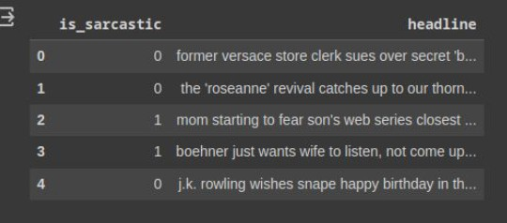
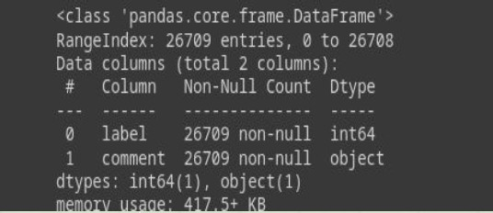
Headline Dataset

Slide 7
Preprocessing
Text Cleaning:
In preprocessing, a DataFrame column labeled 'headline' is being preprocessed for text cleaning.
All text in the 'headline' column is converted to lowercase using the ‘str.lower()` method.
The `str.replace()` method is used to remove any characters that are part of the string.punctuation set (which includes punctuation symbols) from each headline. Any numeric digits are removed using the regular expression '\d+' with `str.replace()`
Consecutive whitespace characters are replaced with a single space using `str.replace('\s+', ' ')`. These steps collectively aim to standardize the text, remove punctuation, eliminate numerical values, and ensure consistent spacing, contributing to a cleaner and more uniform representation of the headlines in the 'headline' column The resulting DataFrame is then displayed with the cleaned 'headline' column

Slide 8
Preprocessing
Removing any special characters, punctuation, or irrelevant information that doesn't contribute to sarcasm detection. Convert text to lowercase to ensure uniformity. Eliminate common words (stopwords) that may not hold significant meaning for sarcasm detection.
Ensuring that all sequences are of the same length by padding shorter sequences or truncating longer ones.
Text Cleaning
Converting the text into numerical vectors using techniques like TF-IDF (Term Frequency-Inverse Document Frequency) or word embeddings like Word2Vec, GloVe, or FastText.
Padding
Vectorization

Slide 9
Models
BernoulliNB
Simple and fast. Works well with text classification tasks, especially with a limited amount of training data.
MultinomialNB
Suitable for classification tasks involving discrete features, such as word counts for text classification.
Logistic Regression
Simple and interpretable. Works well as a baseline model for text classification tasks.
Recurrent Neural Networks (RNNs)
LSTM (Long Short-Term Memory) or GRU (Gated Recurrent Unit) variants. Captures sequential information in text effectively.

Slide 10
Models
Convolutional Neural Networks (CNNs)
Typically used in computer vision, but also effective for text classification by treating text as images (using 1D convolutions). Good at capturing local patterns in sequences.
BERT (Bidirectional Encoder Representations from Transformers)
Pre-trained transformer-based model capable of capturing bidirectional context in text. State-of-the-art performance in many NLP tasks, including sarcasm detection.
GPT (Generative Pre-trained Transformer)
Similar to BERT, a transformer-based model that can be fine-tuned for sarcasm detection tasks.

Slide 11
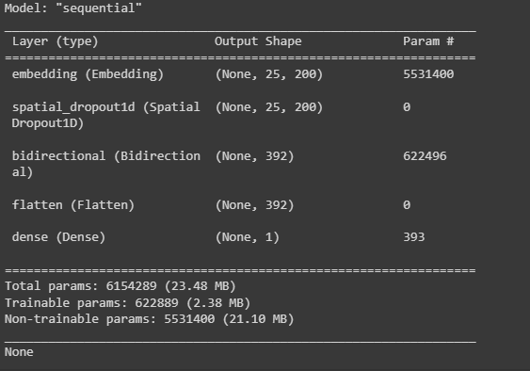

LSTM Model Architecture
Model Type:
Sequential
Layers:
Embedding Layer: Used for word embeddings, transforming input sequences into size 25 here which helps in representing words in a continuous vector space.
SpatialDropout1D Layer: A 1D spatial dropout layer that helps prevent overfitting by randomly setting a fraction of input units to zero at each update during training.
Bidirectional Layer (Bidirectional): Represents a bidirectional Long Short-Term Memory (LSTM) layer. Process the input sequence in both forward and backward directions.
Flatten Layer: Flattens the input, transforming it into a one-dimensional array
Dense Layer: A fully connected (dense) layer with one output unit, used for binary classification tasks. The activation function is not specified in the provided summary.

Slide 12
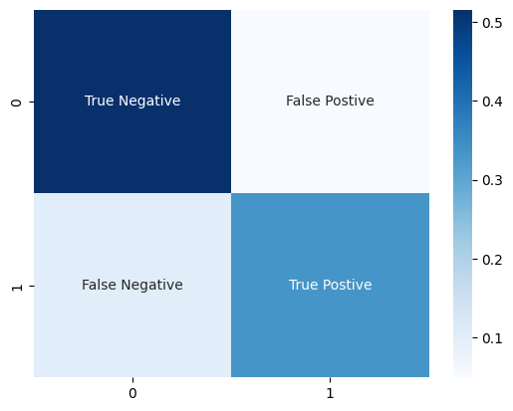
Result & Analysis
1. BernoulliNB
Classification Report:
precision
recall
f1-score
support
0.84
0.91
0.87
3017
0
0.87
0.77
0.82
2325
1
accuracy
0.85
5342
macro avg
0.85
0.84
0.84
5342
weighted avg
0.85
0.85
0.85
5342

Slide 13

2. MultinomialNB
Classification Report:
precision
recall
f1-score
support
0.81
0.93
0.87
3017
0
0.88
0.72
0.79
2325
1
accuracy
0.84
5342
macro avg
0.85
0.82
0.83
5342
weighted avg
0.84
0.84
0.83
5342

Slide 14
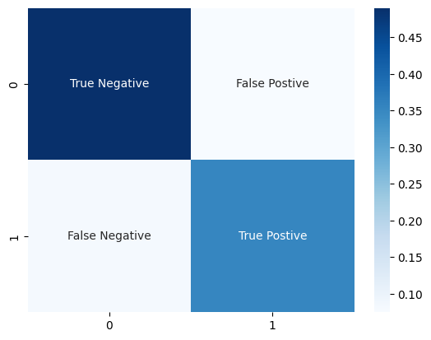
3. Logistic Regression
Classification Report:
precision
recall
f1-score
support
0.86
0.87
0.86
3017
0
0.82
0.81
0.82
2325
1
accuracy
0.84
5342
macro avg
0.84
0.84
0.84
5342
weighted avg
0.84
0.84
0.84
5342

Slide 15
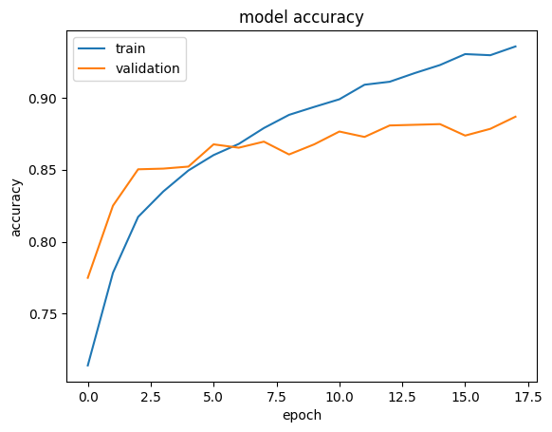
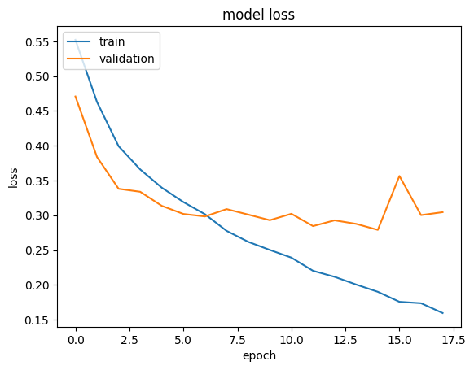
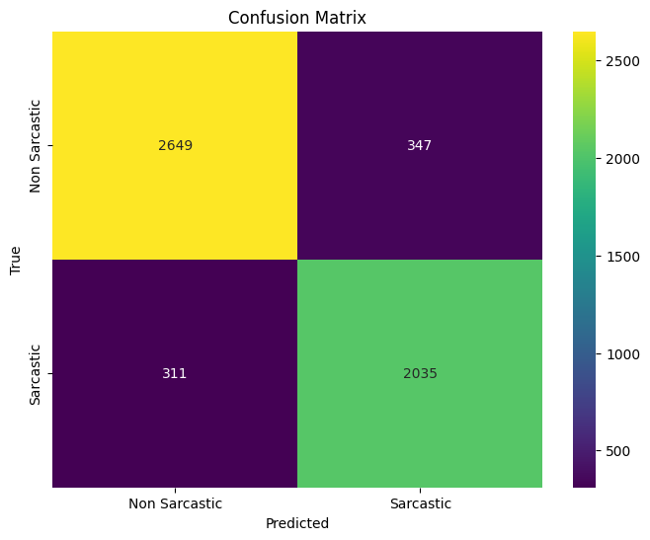
4. LSTM
Test Accuracy:
0.8768( 87.68%)
Test Loss:
0.3057 (30.57% )
Confusion Matrix

Slide 16
1.
Limitations
Reliance on Pre-trained Embeddings: May not capture domain-specific nuances in news headlines. Limits adaptability to specialized contexts.
Subjectivity and Context-dependency:
Inherent challenges due to sarcasm's subjective nature, Context-dependent; the same phrase may be sarcastic in one context and literal in another, Variations in contextual understanding may affect model performance.
2.
3.
Dataset Limitations:
Potential lack of comprehensiveness across diverse news sources, Possibility of introd biases or overlooking linguistic patterns in specific domains or regions.

Slide 17


Future Work
To address these limitations and further enhance the efficacy of sarcasm detection in news headlines, future research avenues present intriguing opportunities. One potential direction involves domain-specific fine-tuning of embeddings or utilizing transfer learning techniques to adapt pre- trained models to the specific linguistic nuances inherent in news headlines.
Exploring multimodal approaches that combine textual data with additional contextual cues, such as metadata, images, or user interactions with headlines.
Employing advanced techniques in contextual embeddings or transformer-based models might improve the model's ability

Slide 18
Conclusion
In conclusion, this study has demonstrated the viability of employing GloVe embeddings and LSTM networks for sarcasm detection within news headlines. Through the integration of pre-trained word embeddings and the utilization of LSTM architectures, our model showcased promising performance in discerning the nuanced sarcastic expressions present in news headlines.
While acknowledging the limitations inherent in the current approach, the findings underscore the potential of leveraging deep learning methodologies for sarcasm detection in textual data.
The study contributes to the evolving landscape of natural language understanding by shedding light on the complexities associated with sarcasm detection, particularly within the domain of news headlines.

Slide 19
Thank You

