Slide 1
SALMONN: TOWARDS GENERIC HEARING ABILITIES FOR LARGE LANGUAGE MODELS
Changli Tang1∗ , Wenyi Yu1∗ , Guangzhi Sun1 , Xianzhao Chen2, Tian Tan2
Wei Li2, Lu Lu2 , Zejun Ma2 , Chao Zhang1†

Slide 2

What is SALMONN??
Speech audio language music open neural network (SALMONN), which is a single audio-text multimodal LLM that can perceive and understand three basic types of sounds including speech, audio events, and music.

Slide 3



SALMONN is the first multimodal LLM that can perceive and understand general audio inputs with speech, audio events, and music, to the best of our knowledge

Slide 4

What is LLM??
Text based large language models which are the used for different Natural Language Processing tasks.
Researchers are working on developing LLMs that can process and understand both text and other types of data, such as images, videos, and audio. This would enable LLMs to perform a wider range of tasks, such as answering questions about images, generating captions for videos, and translating between different languages.

Slide 5
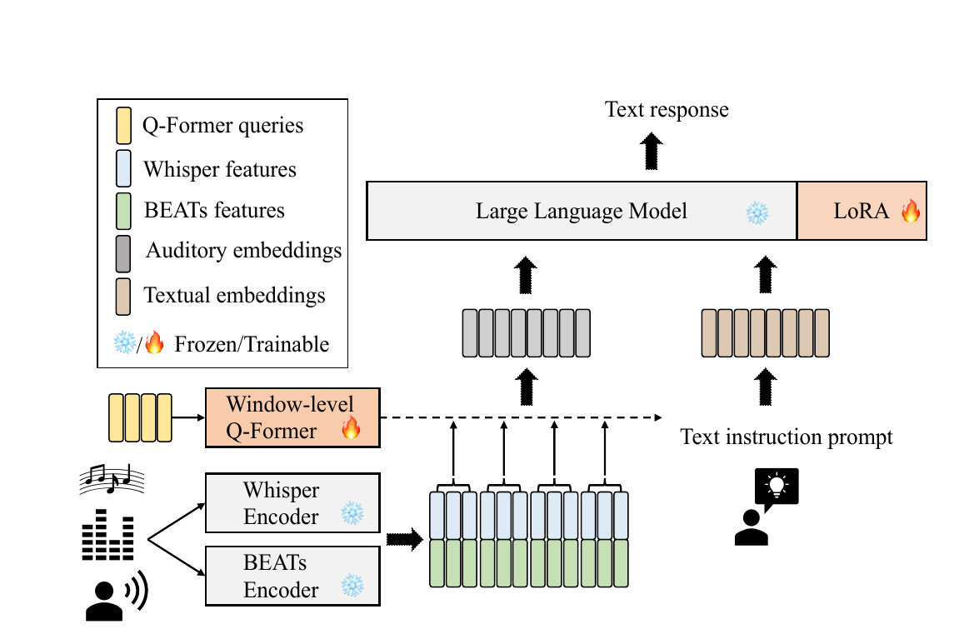
Model Architecture

Slide 6

Model Architecture
The model architecture of SALMONN. A window-level Q-Former is used as the connection module to fuse the outputs from a Whisper speech encoder and a BEATs audio encoder as augmented audio tokens, which are aligned with the LLM input space. The LoRA adaptor aligns the augmented LLM input space with its output space. The text prompt is used to instruct SALMONN to answer open-ended questions about the general audio inputs and the answers are in the LLM text responses. The LLM and encoders are kept frozen while the rest can be updated in training.

Slide 7

Training
The model is trained in three stages.
1)Pre Training stage
2)Instruction Tuning Stage
3)Task Over-fitting

Slide 8

Pre-training Stage
To improve the alignment between the LLM and the audio encoders, SALMONN pre-trains the window-level Q-Former and LoRA using a large amount of speech recognition and audio captioning data. These tasks contain key auditory information about the contents of speech and non-speech audio events, and they do not require complex reasoning or understanding. As a result, they can help SALMONN learn to align the auditory and textual information more accurately.

Slide 9
Instruction Tuning Stage
The second stage of SALMONN training is audio-text instruction tuning, which is similar to NLP and visual-language. A list of supervised speech, audio event, and music tasks is used to tune the model. The tasks are selected based on their importance (e.g. speech recognition and audio captioning) and the indispensability of having such ability in tests (e.g. overlapping speech recognition, phone recognition and music captioning). The instruction prompts are generated based on the texts paired with the audio data.

Slide 10

Task Over-fitting
We attribute task over-fitting to two reasons. First, compared to the text-only data used in LLM
training, only simpler instruction prompts are used in our cross-modal instruction tuning (Wei et al.,
2022a), and the resulting responses are not as complex and diverse. Meanwhile, some tasks included
in instruction tuning, in particular speech recognition and audio captioning, have more determinis-
tic outputs than the other tasks, such as speech and audio question answering. These two reasons
combined to cause the intrinsic conditional language model (LM) to bias to an ill-formed distribu-
tion with poor generalisation ability, which prohibits SALMONN from performing untrained cross-
modal tasks.

Slide 11

Conclusion
SALMONN is a new open neural network that can process and understand speech, audio events, and music. It is equipped with dual auditory encoders that enable it to achieve competitive performances on trained tasks such as speech recognition, audio captioning, and speech translation. SALMONN can also generalize to a range of untrained understanding tasks such as slot filling, speech translation for untrained languages, and keyword extracting. Additionally, a proposed activation tuning stage enables SALMONN with remarkable emergent abilities, such as audio-based storytelling and speech audio co-reasoning. Overall, SALMONN is a promising step towards developing generic hearing AI.

