Slide 1
Automatic Identification and Classification of Bragging in Social Media
Mali Jin
University of Sheffield
Seraphina Goldfarb-Tarrant
University of Bloomberg
A. Seza Dog ̆ruöz
Ghent University
Nikolas Aletras
University of Sheffield
Reproduction Study Conducted by
Syeda Tasnim Fabiha and Fazle Mohammed Tawsif
Notes:
Today we will be presenting our reproduction study on the paper titled as ---- I, syeda tasnim fabiha and my team mate fazle mohammod tawsif,
we will discuss aboout this base paper , their key concept, their contribution and our analysis on this study

Slide 2
Key Concept
Bragging in social media
Motivation
Bragging is not always desired
High risk act
Has yet to be studied at scale in computation linguistics
Automatic identification is important for:
linguists to better understand the context and types of bragging through empirical studies
social scientists to analyze the relationship between bragging and personality traits, online behavior and communication strategies
online users to enhance their self-presentation strategies
enhancing NLP applications such as intent identification and conversation modeling
Notes:
So the key concept of this paper is pretty easy to understand from the title. It's about bragging in social media
we all know what bragging is.
It’s a kind oof self representation strategy for being accepted positively and favorably by self promoting or self praising. And as we all know social media is the most common platform for bragg about things
And the reason we chose this paper, is that the topic itself seems interesting to us. We all have that friend who brags about almost everythhing
So the authors are highlighting the fact that bragging in social media can often lead to unwanted circumstances, and it is not always even desired, right?
High risk act
And despite the pervasive use of bragging in social media it is not yet studied on a large computational aspects.
And that’s where the motivation of this study lies.
The authors stated that this automatic identification is important specially for these particular user groups: linguistics, online users, and lastly it will help several nlp task like intent identification or conversion modeling

Slide 3
Contribution
A new dataset of English tweets annotated with bragging and their types
Experiments with transformer-based models for
Bragging Identification (Binary Classification)
Bragging Type Classification (Multiclass Classification)
A qualitative linguistic analysis of markers of bragging
Notes:
So following is the core contribution of this study.
They have contributed with a new publicly available dataset consisting of Almost seven thousand English tweeter annotated with bragging and their types, — we’ll show some example of the datasets in our the coming slide
They have experimented with three transformer based models, and they made comparison with the base classifiers,
They have also provided very in detail linguistic analysis of the given bragging dataset

Slide 4
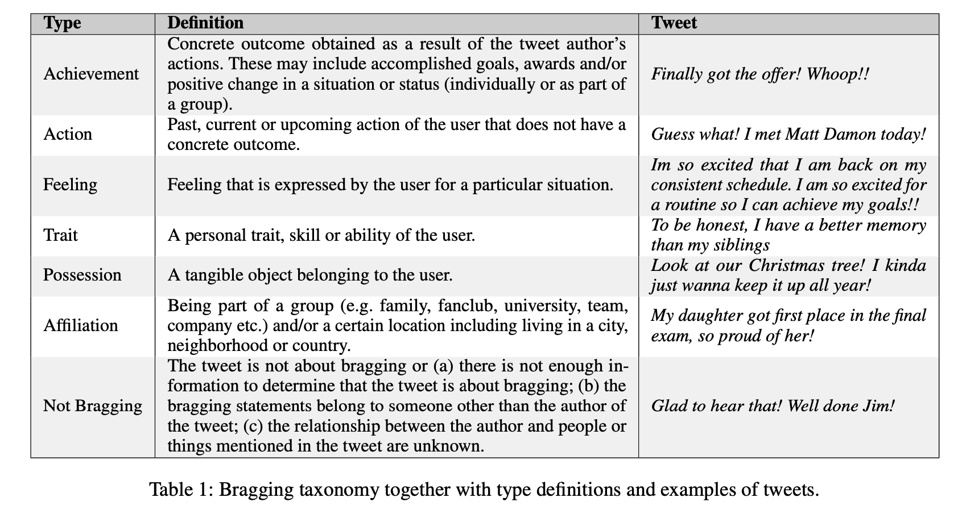
Bragging taxonomy together with type definitions and examples of tweets
Notes:
So here are the example of each seven types of bragging classification that they've annotted I will not read out loud each of the examples, but let me describe their data collection process a bit
They collected data by random sampling (1% tweeter feed one day per month from Jan 2019 to Dec 2020)
The majority of the dataset were constructed by keyword based sampling
They have built their queries based on positive self disclosure words; they have provided the in detailed description of the data collection process and the annotation proocess

Slide 5
Data Collection Process
a. Random Sampling
b. Keyword based sampling
6696 Tweets
Notes:
So here are the example of each seven types of bragging classification that they've annotted I will not read out loud each of the examples, but let me describe their data collection process a bit
They collected data by random sampling from 1% tweeter feed one day per month from Jan 2019 to Dec 2020)
The majority of the dataset were constructed by keyword based sampling, they have provied with the queries they have made
They have built their queries based on positive self disclosure words;
Finally they filtered out the collected tweets by excluding retweets and quoted tweets, they also removed advertise related tweets They only focused on the English tweets
This way they finally came up with a total 6696 potential tweets for the final dataset
(they exclude those with duplicate or no meaningful textual content (e.g. only @-mentions or images). We only focus on English posts and filter out non-English ones using the language code provided by Twitter. We also exclude retweets and quoted tweets, as these do not typically express the thoughts of the user who retweeted them. Moreover, we exclude 131 tweets containing a URL in the text because these were related to advertisements based on initial results from our annotation calibration rounds. This resulted in a total of 6,696 tweets which is of similar size with data sets recently released for social NLP )

Slide 6
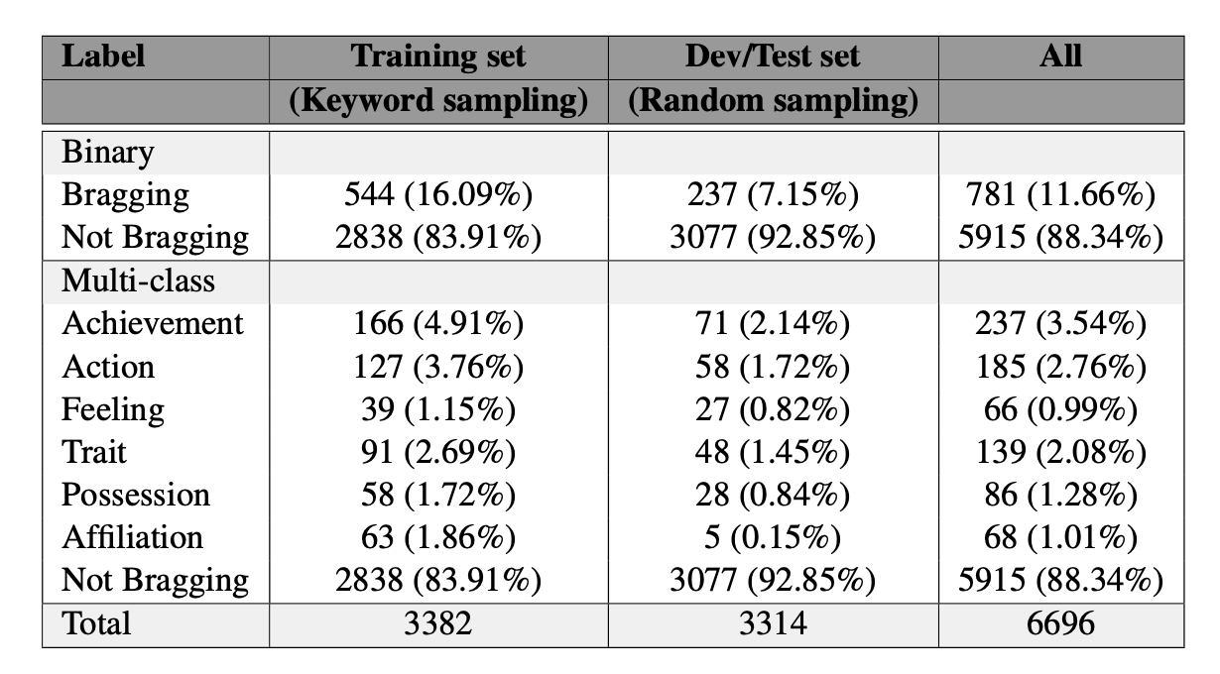
Dataset analysis
Notes:
After data collectioon they annotted the dataset by following manual annotation process.
They discussed disagreements, until a standard value of the metric for disagreement is reached The metric is called the Krippendorf’s Alpha
Soo the table shows the dataset analysis after they've annotted the enitre dataset

Slide 7
Transformer Models
BERT
RoBERTa
BERTweet
Linguistic Features on BERTweet
NRC
LIWC
Clusters
Best Performing
Notes:
The three transformer based models that they have experimented with are: BERT, RoBERTa, which is a more robust variant of BERT that oobtains better results on a wide range of tasks and BERTweet , which is pretrained on specifically on English tweets using RoBERTa as basis and this achieves better performance on Twitter tasks
SO it is obvious that their best performing model is BERTweet
For further analysis they've injected three linguistic features on BERTweet :
The NRC word-emotion lexicon , that contains a list of English words mapped to ten categories related to emotions and sentiment
Linguistic Inquiry and Word Count , which is a dictionary-based approach to count words in linguistic and psychological categories.
they have used LIWC 2015 version, which is not free- I'll come back to this later
Finally they used Word2Vec clusters ( to rep- resent each tweet as a 200-dimensional vector )

Slide 8
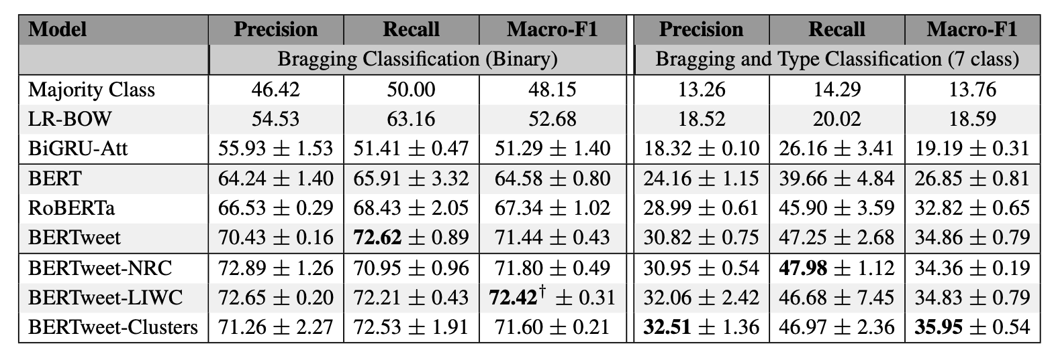
Original Results
Notes:
So this is the results oof the base study where binary and multi class classification are presented side-by –side
For comparison they experimented with the base classifiers as well: Majority class, Liner Regression Bag of Words and Binnary Gater Recurrent Unit with Attention
It is worth mentioning that the source code is not available for this study. So for this reproduction study we excluded the base classifiers. And we only focused on the binary classification task
So this is the scope of our reproduction study.

Slide 9
Extent of Communication With The Authors
Received the code for BERTweet with LIWC (binary classification)
Received the LIWC-2015 file
Notes:
So since I mentioned source code was not publicly available we reached out to authors for any kind of suggestion for our reproduction study. They appreciated our task and shared us the the code for the best performing model for Binary Classification task- which is BERtweet with LIWC , and they also orequested too share our results with them it that's possible
Hopefull we will do that as well
Our next hardle was LIWC is not free, it's a paid linguistic feature file So we further communicated with the authors if it was poossible to share the linguistic file as well
We were lucku and the authors were kind enough to share us the paid LIWC file as well

Slide 10
Reproduction Result for Binary Classification Task
Model | Precision | Recall | Macro-F1 | Runtime(CPU)
BERT | 56.80 / 64.24 | 66.18 / 65.91 | 63.34 / 64.58 | 210m 56s (3.5hrs)
RoBERTa | 67.10 /66.53 | 64.83 /68.43 | 65.85 / 67.34 | 249m 38.7s (4.1hrs)
BERTweet | 68.22 / 70.43 | 66.17 / 72.62 | 67.11 / 71.44 | 268m 38.3s (6.3hrs)
BERTweet-LIWC | 76.45 / 72.65 | 66.36 / 72.21 | 70.17 / 72.42 | 381m 67s (4.3hrs)
*** our result / original result
Notes:
So this is the result oof our reproduction study
It is aligned with the claim mentioned bby the authors that among the three base transfomer models BETweet is the best model
BERTweet combined with LIWC performs even better We were planning too use the google cloud GPU for this project
, However we both ran out of all the credits for our last homework
So we managed to run these models on our normal cpu laptops and it took more or less 3 to 6 hourse at max to run all these four models

Slide 11
Future Plan
Experimenting with recent tweets
Collect Tweets using API
Annotate data according author's approach
Extend the original dataset
Re-run all the models
Evaluate results on the extended dataset

Slide 12
Question

