Slide 1
Distill Diffusion model
Tawsif Mahmud-1912411042
Jiaul Haque Saboj-1912065042
Sadia Sifati Shammee-1912304042

Slide 2
Introduction
In Recent times, Diffusion model gained a lot of popularity for its its image generative capability. Yet it is still too large to be used in smaller devices. For this reason, working with distilling the model can be helpful for the usability.

Slide 3
Previous work
In 499A, we have explored various generative models to see which model will be better for our work. Stable diffusion, SimMIM are two models that we have been working on. But successful distilling this model can lead to working more with these model.

Slide 4
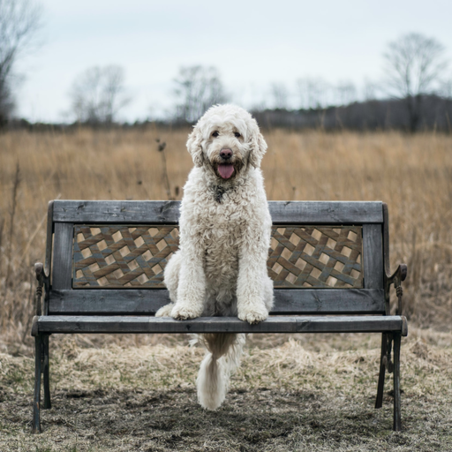

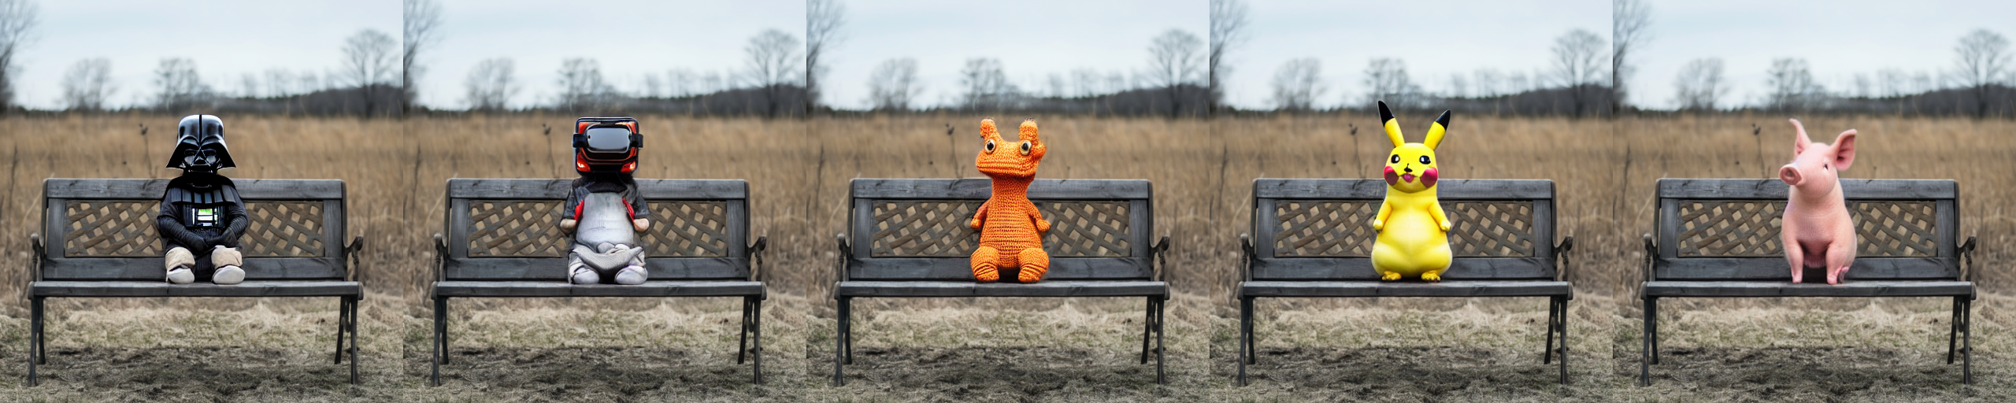
Specification
Resource efficient Inpainting

Slide 5
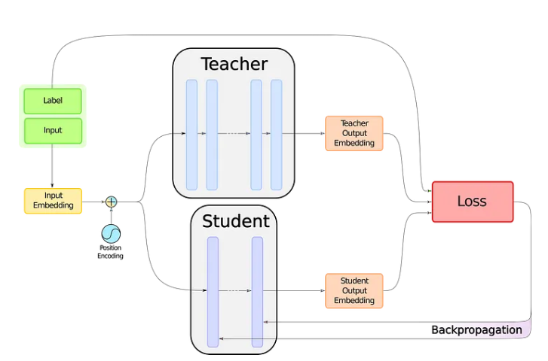
Working Plan
We can take a look at the graph below:
We need to create the student model, with the same architecture as the teacher but half the number of hidden layers. To do this, we simply need to use the configuration of the teacher model, which is a dictionary-like object that describes a Hugging Face model’s architecture

Slide 6
Thank You

