Slide 1
News Classification in English and Bangla Languages Using BERT model
Tawsif Mahmud 1912411042
Jiaul Haque Saboj 1912065042

Slide 2
INTRODUCTION
In today's fast-paced digital world, staying informed and up-to-date with the latest news is more important than ever. However, with the overwhelming amount of news articles available online, finding relevant and reliable information can be a daunting task. This project addresses this challenge by focusing on leveraging the BERT model for accurate news classification in both English and Bangla languages, enabling users to efficiently navigate through the vast sea of information.

Slide 3
Faculty Discussion
The project was discussed during the initial stages of its development. The inclusion of Bangla news classification alongside English news classification was proposed and approved during these discussions. As the project progressed, an experiment was conducted involving the swapping of models for Bangla and English news classification.

Slide 4
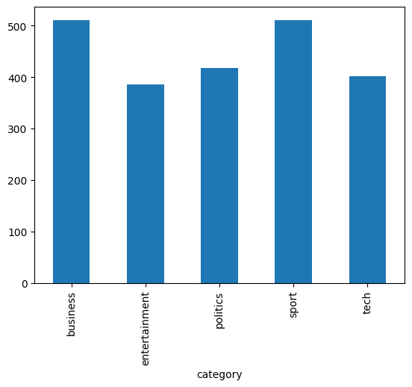
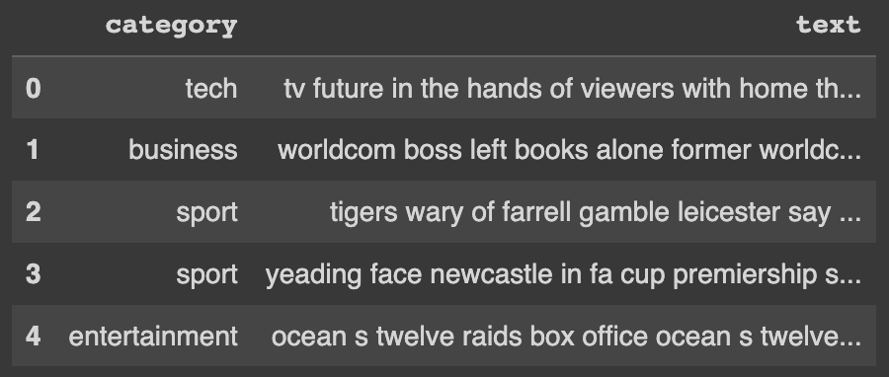
DATA SOURCES
English News Classification Data
We utilized the “BBC” text data for English news classification in our project. The dataset comprises a total of 2,225 articles, with each article meticulously labeled under one of five distinct categories: business, entertainment, politics, sport, and tech.

Slide 5
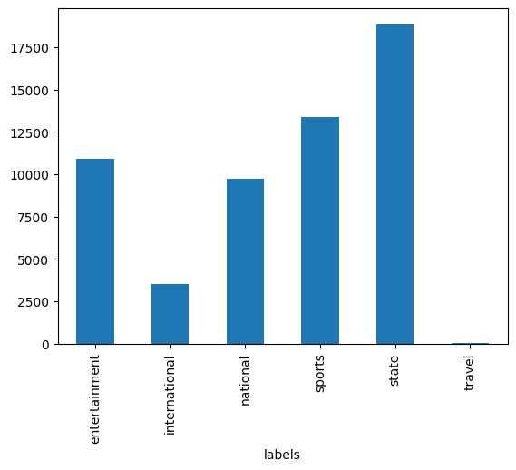
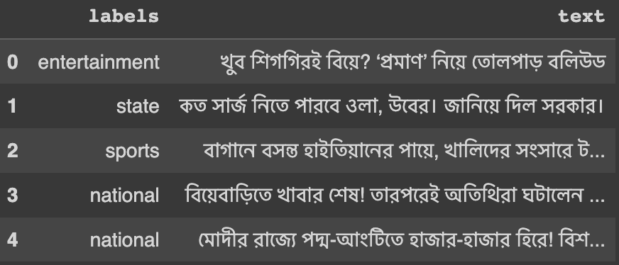
DATA SOURCES
Bangla News Classification Data
We utilized the “আনন্দবাজার পত্রিকা” text data for Bangla news classification in our project. The dataset comprises a total of 56,858 articles, with each article meticulously labeled under one of six distinct categories: entertainment, international, national, sports, state and travel.

Slide 6
Related Work
The field of news classification and language processing has seen significant research and advancements. Numerous studies have focused on news classification using various machine learning and natural language processing techniques, providing insights into methodologies, performance metrics, and findings. Language models, such as BERT, GPT, and Transformer-based architectures, have been widely utilized for news classification tasks.

Slide 7
ARCHITECTURE
English News Classification
BertTokenizer from the 'bert-base-cased' model was used to preprocess English news articles. It breaks down input text into tokens that can be understood by the model, ensuring proper encoding and contextual understanding. BertModel from the 'bert-base-cased' model served as the core architecture for English news classification. It has been pretrained on a large corpus and fine-tuned on specific NLP tasks, enabling accurate language understanding and classification. This model take approximately 10 hours to train and take almost 3 hours and 30 minutes per epoch.

Slide 8
ARCHITECTURE
Bangla News Classification
BertTokenizer from the 'bert-base-multilingual-uncased' model was used to preprocess Bangla news articles. It breaks down the input Bangla text into tokens that can be understood by the model, ensuring proper encoding and contextual understanding .BertModel from the 'bert-base-multilingual-uncased' model served as the core architecture for Bangla news classification. It has been pretrained on a diverse multilingual corpus, enabling it to understand and classify Bangla text effectively. This model take approximately 4 hours 20 minutes to train and take almost 1 hour 40 minutes per epoch.

Slide 9
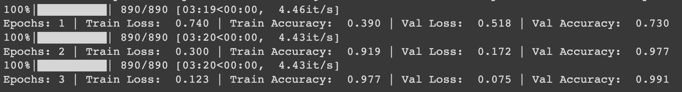
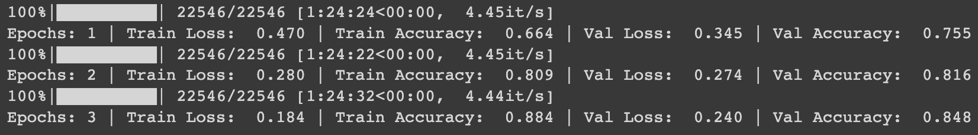
Results Comparison: English and Bangla News Classification
English News Classification
Bangla News Classifaction

Slide 10
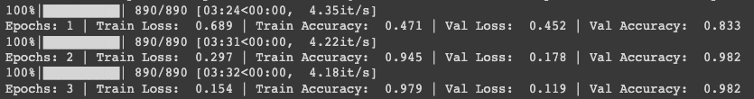
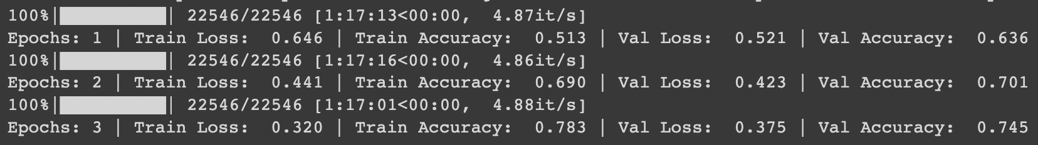
Results Comparison: Swapping both model
English News Classification Using Bagla model
Bangla News Classifaction Using English model

Slide 11
Future Work and Conclusion
Extending the project to domain-specific news classification tasks is another exciting area for future work. By training models on specific domains such as finance, health, or technology, we can achieve more accurate and tailored classification within specialized news areas. our project successfully utilized the BERT model for accurate news classification in both English and Bangla languages. The model swap experiment provided insights into the adaptability of language models. Our work contributes to advancing news classification techniques, highlighting the potential of language models in handling multilingual data.

Slide 12
Thank You!

