Slide 1
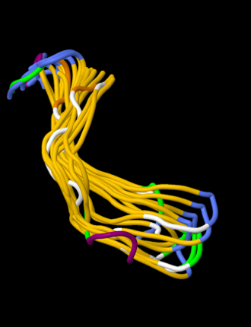
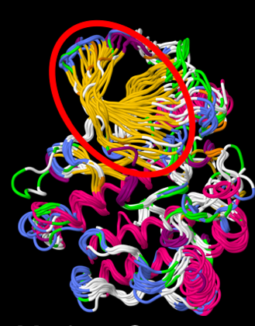
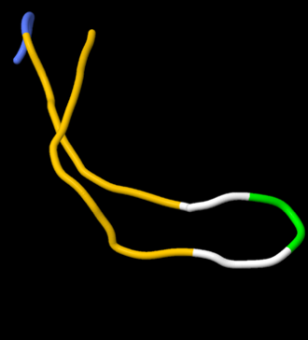
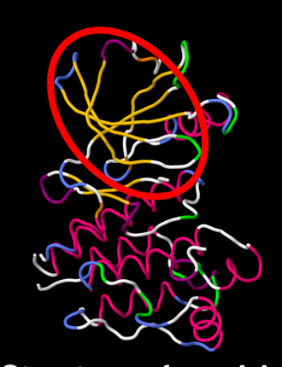
Modelling the evolution of protein secondary structure
Jhih-Siang Lai, Bostjan Kobe and Mikael Bodén
School of Chemistry and Molecular Biosciences, The University of Queensland, Brisbane, QLD 4072, Australia
js.lai@uqconnect.edu.au http://bioinf.scmb.uq.edu.au/EvoSS
Background
Aims
Attempts to reconstruct extremely ancient proteins and phylogenetic analyses of remote homologues must deal with the sequence diversity that results from extended periods of evolutionary change.
The number of protein structures in the Protein Data Bank has increased twenty-fold. Using the same principles pioneered by Dayhoff [4], we seize this wealth of structure data and develop a protein secondary structure evolutionary model, based on differences between discrete secondary structure states observed in modern proteins and those hypothesized in their immediate ancestors.
Develop an new evolutionary model, based directly on changes of secondary structure over evolutionary time.
Investigate evolutionary changes at both the structure and amino acid levels based on high-quality alignments.
Implement maximum likelihood-based phylogenetic inference tools based on secondary structure evolutionary model and apply them to the sequence-diverse but structurally-conserved domains.
Infer ancestral secondary structure based on secondary structure evolutionary model and compare our predictions with those of structure homology modelling and sequence-based secondary structure predictors.
Results
Evolutionary distances based on secondary structure are shorter than those based on amino acids
Evolutionary model of secondary structure (Evo-SS)
(Evo-SS)
Evolutionary distances are investigated at both the secondary structure (Evo-SS) and amino acid (JTT [5]) levels with maximum likelihood approach by high-quality alignments of 1,591 homologous domains from the Pfam database.
The Pearson correlation between the secondary structure and amino acid distances is 0.54 from total 22,293 pairs.
91.17% and 45.25% pairs of homologous domains have short distances (≤2), according to the Evo-SS and JTT models, respectively.
In the set of distant homologues according to JTT (>2), 84.85% of them are close homologues (≤2) according to Evo-SS.
A secondary structure evolutionary model (Evo-SS) was created by following Dayhoff’s approach [4], but using protein structure data of the entire Protein Data Bank.
1 PAM (left) and 100 PAM (right) define evolutionary change in terms of transition probabilities over distances t=0.01 and t=1.00, respectively. The values were multiplied by 10,000 and PAMs are interpreted row-wise.
The Helix-5 (I) has the highest probability to change to the other states.
100 PAM displays a significant deviation in probabilities for all states; the exchangeability between beta-sheet (B or E) and helix (G or H or I) increases with a longer distance.
(JTT)
Secondary structure-based phylogeny identifies biological properties of Toll/interleukin-1 receptor (TIR) domains that are not evident from a phylogenetic analysis based on amino acids
The TIR domain of IL-1RAPL shares the same ancestor with the TIR domains of Toll-like receptors (TLRs). This satisfies the observation that the TIR domains of
IL-1RAPL and the TLRs can interact with the same adaptor MyD88.
Secondary structure evolutionary model extracts information not available from modern structures or the ancestral protein sequences alone
⬤ ancestral common mammalian adaptor
★ancestral common mammalian receptor
Average pairwise sequence identity = 0.23
Mean pairwise sequence identity 0.44
Evo-SS based
(secondary structure) tree
(upper) 10 modern homologous proteins
(lower) Ancestral protein structure 4CSV [1]
The evolutionary distances from the common ancestral human adaptor to the origin of TRAM and TRIF doubles than that to the MyD88 and to MAL. This is consistent with the suggestion that the TIR domains of human adaptors TRAM and TRIF have evolved different interactions, to signal in a separate “MyD88-independent” pathway
The ancestral bacterial TIR domain is closer to both the ancestral human receptors and adaptors than to the ancestral plant receptors; thus, bacterial TIR domains may not function as simple mimics of these host proteins to interfere with TLR signalling pathways.
Evo-SS infers ancestral secondary structure by explicitly considering the evolutionary relationships between ancestral protein sequence and modern protein structures.
Evo-SS-based prediction outperforms the accuracy of homology modelling for 5 of 7 protein structures by 15% or over. Evo-SS based prediction outperforms all sequence-based predictors.
The best accuracy homology modelling achieves is at 79%, which demonstrates that ancestral protein structures are poorly represented by modern protein structures.
The single best accuracy is obtained for the ancestral protein structure with modern proteins exhibiting the greatest structural variation as determined by RMSD.
Ancestral secondary structure is recovered more accurately in the more compact trees, i.e. the trees with a small mean edge-length.
Neither of the above three observations are supported by the amino acid phylogenetic tree.
Acknowledgement
Amino acid-based tree
Materials & methods
This work was supported by Australian Research Council (ARC) Discovery Project (grant number DP160100865). Bostjan Kobe is a National Health and Medical Research Council (NHMRC) Principal Research Fellow (grant number 1110971).
To create the secondary structure evolutionary model, crystal structures with a resolution <4.0 Å were retrieved from the PDB. Secondary structure was assigned by DSSP. Amino acid sequences were clustered at 85% sequence identity. Short peptides and clusters with less than 5 proteins were excluded. Final dataset has 75 clusters, collectively containing 592 proteins. Dayhoff’s approach and eigenvalue decomposition were applied to the final dataset to derive Evo-SS.
The secondary structure phylogenetic tree inference method broadly follows the approach of PHYML [6]. Tree likelihood was calculated by Evo-SS. Multiple secondary structure alignment was created from jCE, by superposing 28 TIR structure data.
Three independent studies were used to compare ancestral secondary structure inferences. Ancestral secondary structure was determined with the greatest maximum joint probability from their published phylogenetic trees and multiple secondary structure alignments, using the Evo-SS. SWISS-MODEL [7] was used to model the 3D structure by assigning each modern protein structure in the tree as a template. PROF [8], JPred [9], and NetSurfP [10] were used to predict ancestral secondary structure by ancestral protein sequences.
References
[1] Wilson, C., et al., 2015. Using ancient protein kinases to unravel a modern cancer drug’s mechanism. Science, 347(6224): 882–886.
[2] Hudson, W. H., et al. 2016. Distal substitutions drive divergent DNA specificity among paralogous transcription factors through subdivision of conformational space. Proc Natl Acad Sci U S A, 113(2): 326-331
[3] Clifton, B. E. and Jackson, C. J. 2016. Ancestral protein reconstruction yields insights into adaptive evolution of binding specificity in solute-binding proteins. Cell Chem Biol, 23(2): 236-245.
[4] Dayhoff, M., Schwartz, R., and Orcutt, B. 1978. A Model of Evolutionary Change in Proteins, volume 5, pages 345-352. National Biomedical Research Foundation Silver Spring, MD.
[5] Jones, D. T., Taylor, W. R., and Thornton, J. M. 1992. The rapid generation of mutation data matrices from protein sequences. Comput Appl Biosci, 8(3): 275-282.
[6] Guindon, S. and Gascuel, O. 2003. A simple, fast, and accurate algorithm to estimate large phylogenies by maximum likelihood. Syst Biol, 52(5): 696-704.
[7] Biasini, M., et al. 2014. SWISS-MODEL: modelling protein tertiary and quaternary structure using evolutionary information. Nucleic Acids Res, 42: W252-W258.
[8] Rost, B. and Sander, C. 1993. Prediction of protein secondary structure at better than 70% accuracy. J Mol Biol, 232(2): 584-599.
[9] Drozdetskiy, A., et al. 2015. JPred4: a protein secondary structure prediction server. Nucleic Acids Res, 43: W389-W394.
[10] Petersen, B., et al. C. 2009. A generic method for assignment of reliability scores applied to solvent accessibility predictions. BMC Struct Biol, 9: 51.

