Slide 1

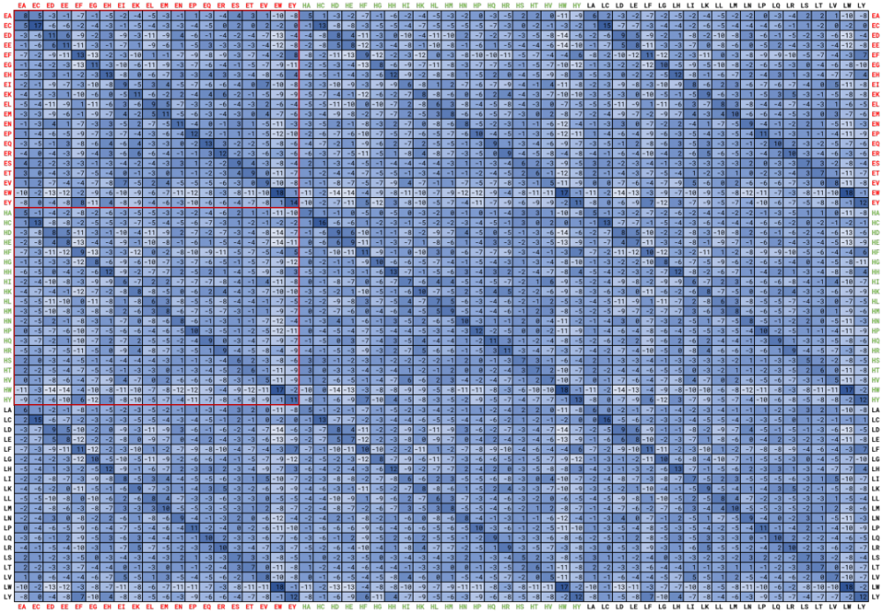
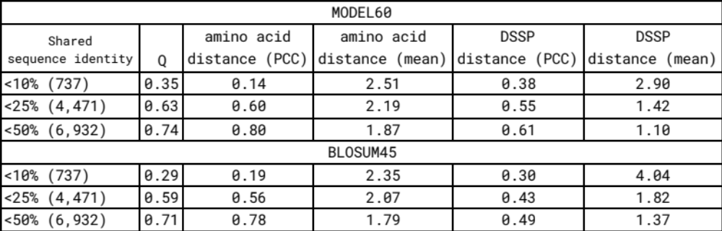
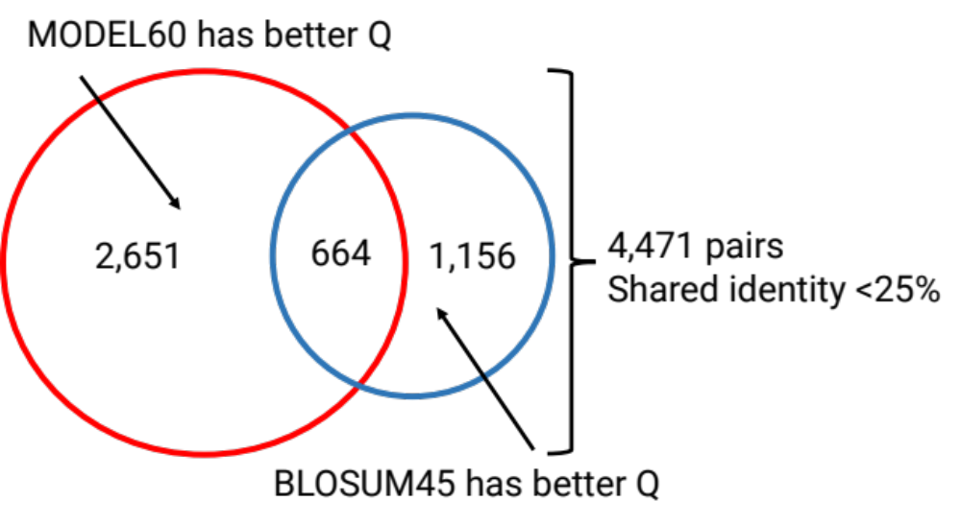
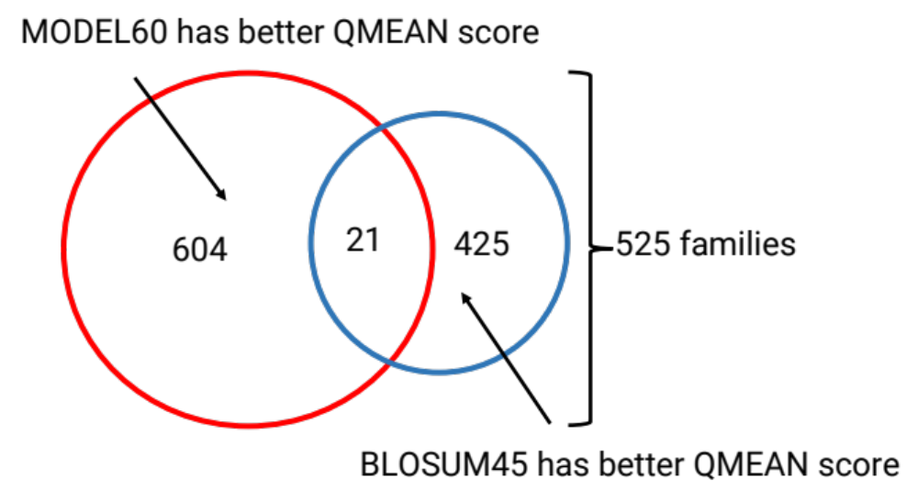
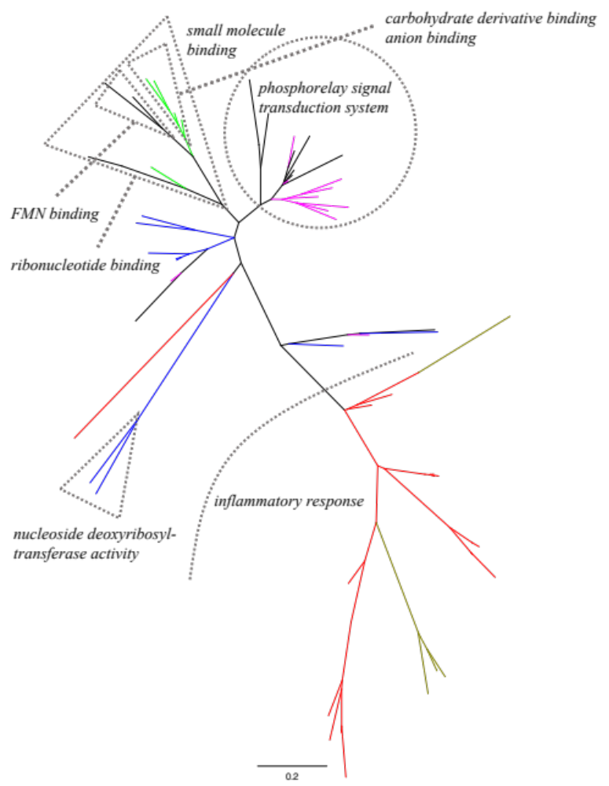
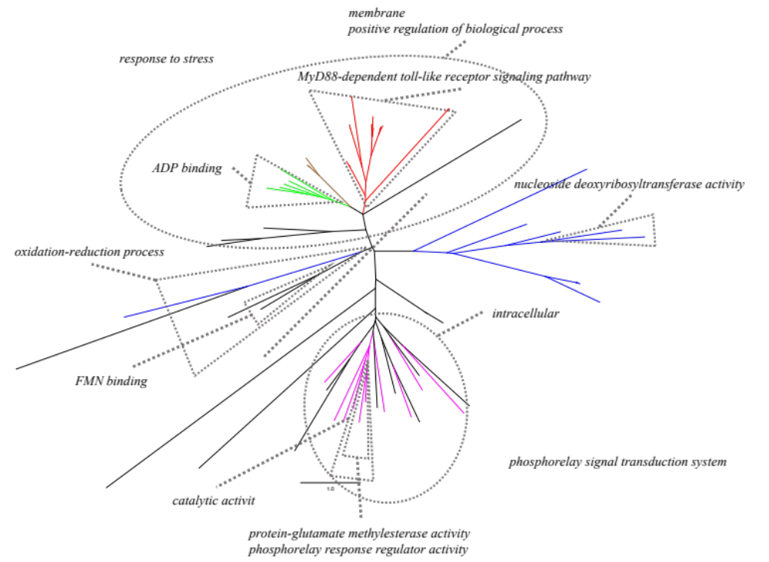
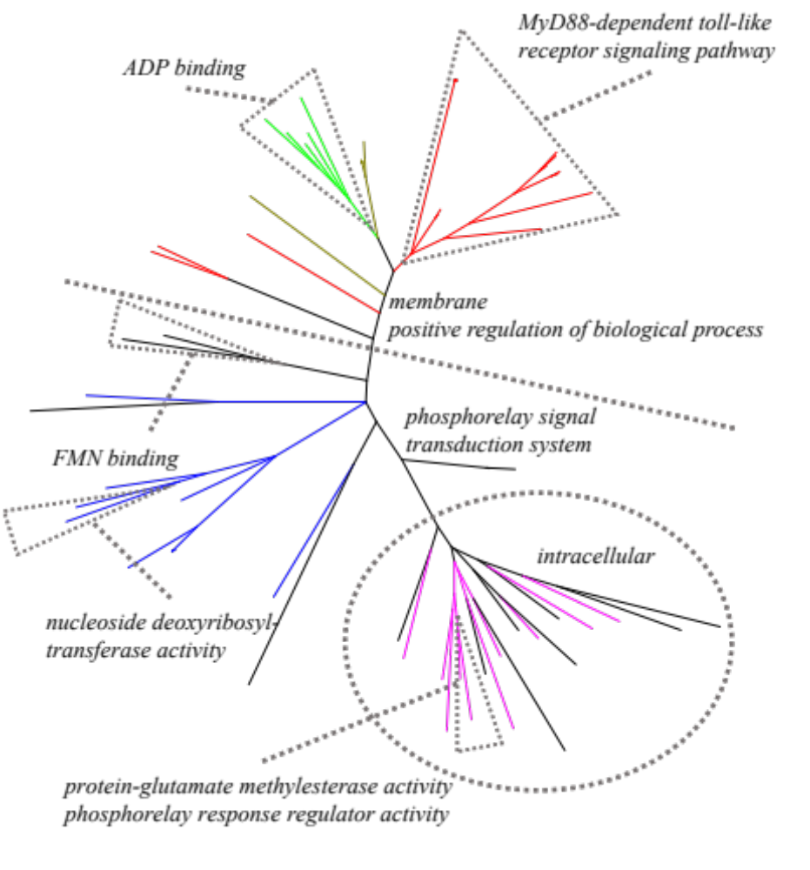
Phylogenetic analysis in the predicted secondary structure space
Jhih-Siang Lai, Burkard Rost, Bostjan Kobe and Mikael Bodén
School of Chemistry and Molecular Biosciences, The University of Queensland, Brisbane, QLD 4072, Australia
js.lai@uqconnect.edu.au
Background
Aims
The sequence-based 3-class secondary structure prediction reaches reasonable performances. The prediction model can be considered as a mapping from the “sequence” to the “predicted protein fold” space. In the sequence space, a residue has 20 standard amino acid states; in the prediction space, a residue has 60 states of 20 amino-acid states and 3 secondary-structure states jointly. This work proposed a generalised evolutionary model (MODEL60) in the prediction space of PredictProtein [1]. We implemented Needleman-Wunsch’s alignment method with the substitution matrix derived from MODEL60. We evaluated alignments with Q and QMEAN [3]. A maximum likelihood tree inference method was implemented with MODEL60. Based on the dataset of Toll/interleukin-1 receptor (TIR) domains proposed in our previous work [4], we compared the phylogenetic trees inferred by MODEL60, amino acid and the DSSP models.
Build a Markov-based evolutionary model for the joint states of the amino acid and the predicted secondary structure
Construct a substitution matrix of the model to perform the pairwise alignment
Evaluate the pairwise alignment performance using comparative modelling
Show the capability to infer the phylogenetic tree using the new model
Results
Generalised substitution matrix (amino acid and secondary structure)
Performance of pairwise alignment by using generalised model
Q is the number of true aligned pairs divided by total number of observed aligned pairs in the superposition
For each pairwise alignment, the amino acid and DSSP [2, 4] distances were estimated
The Pearson’s correlation coefficient (PCC) were calculated between all pairwise alignments and superpositions
The MODEL60 improves the pairwise alignment in terms of Q and the PCCs.
We selected a representative pairwise alignment for each family to build 1,050 models by comparative modelling. MODEL60 improves 57% of models by QMEAN (qualitative model energy analysis) [3] scores.
The 60-state substitution matrix at the evolutionary distance 2.50 (upper) of the MODEL60 is used to conduct pairwise alignments.
The sub-substitution matrices can be considered as amino acid exchanges conditioned to predicted secondary structure states [1], i.e., the amino acid changes conditioned to the same beta-sheet (E) formation (left top) and conditioned from helical (H) formation to beta-sheet formation (left middle). The label “L” stands for the loop region.
Phylogenetic trees of Toll/interleukin-1 receptor (TIR) domains, DSSP model vs. generalised model vs. amino acid model
mammalian TIR
bacterial TIR
plant TIR
enzyme
enzyme regulator
DSSP model
MODEL60
Amino acid model
All trees were inferred from the same multiple alignment (multiple structural superpositions).
Significant Gene Ontology terms were determined for each possible sub tree at the e-value 0.05.
The tree based on DSSP (left) and amino acid (right) are from our previous work [4]
Materials & methods
References
PredictProtein (http://predictprotein.org/) was used to predict secondary structure states [1].
147,667 proteins were used to generate 948,283 pairwise alignments that satisfy 85% sequence identities. Jones, Taylor and Thornton’s method [5] were used to construct the model, and MODEL60 was created by Dayhoff’s style (related odds matrix).
Needleman-Wunsch’s global alignment was used with affine gap penalties for both MODEL60-based substitution matrices and BLOSUM matrices [6].
We selected high-resolution structures from the Pfam A-seed [7], and only families or domains were considered.
7,442 pairwise structure superpositions were calculated, and were further divided into subsets based on “shared sequence identities”, i.e., <10% (737 pairs), <25% (4,471), <50% (6,932) and ≥50% (510).
Modeller [8] was used for the comparative modelling. QMEAN [3] was used to measure the quality.
The phylogenetic trees were constructed by bootstrapping. We used the dataset from our previous work [4], in which 64 Toll/interleukin-1 receptor domain structures were superimposed.
[1] Yachdav, Guy, et al. "PredictProtein—an open resource for online prediction of protein structural and functional features." Nucleic Acids Research 42.W1 (2014): W337-W343.
[2] Kabsch, Wolfgang, and Christian Sander. "Dictionary of protein secondary structure: pattern recognition of hydrogen‐bonded and geometrical features." Biopolymers: Original Research on Biomolecules 22.12 (1983): 2577-2637.
[3] Benkert, Pascal, Marco Biasini, and Torsten Schwede. "Toward the estimation of the absolute quality of individual protein structure models." Bioinformatics 27.3 (2010): 343-350.
[4] Lai, Jhih-Siang, et al. "Evolutionary model of protein secondary structure capable of revealing new biological relationships." bioRxiv (2019): 563452.
[5] Jones, David T., William R. Taylor, and Janet M. Thornton. "The rapid generation of mutation data matrices from protein sequences." Bioinformatics 8.3 (1992): 275-282.
[6] Henikoff, Steven, and Jorja G. Henikoff. "Amino acid substitution matrices from protein blocks." Proceedings of the National Academy of Sciences 89.22 (1992): 10915-10919.
[7] El-Gebali, Sara, et al. "The Pfam protein families database in 2019." Nucleic acids research 47.D1 (2018): D427-D432.
[8] Webb, Benjamin, and Andrej Sali. "Comparative protein structure modeling using MODELLER." Current protocols in Bioinformatics 47.1 (2014): 5-6.

