Slide 1

Instagram and happy faces
What is the added value of analyzing a person’s face to find their happiness on instagram?
Aswathy George
Antonios-Minas Krasakis
Taxiarchis Papakostas-Ioannidis
Maarten Mol

Slide 2
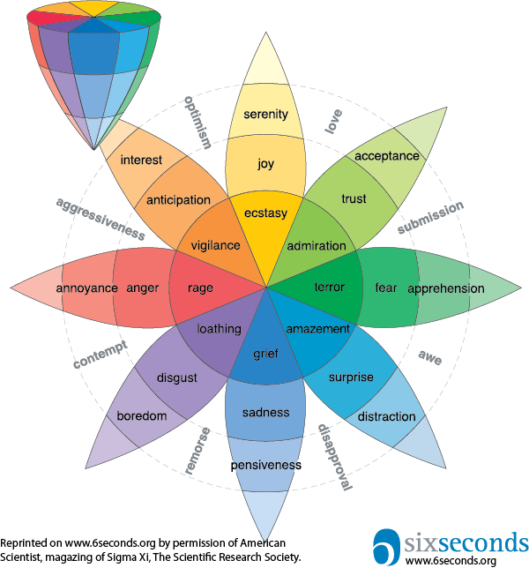
Feature engineering
- ANP scores
- Link modal face id to user
- Metrics
From image to user…

Slide 3
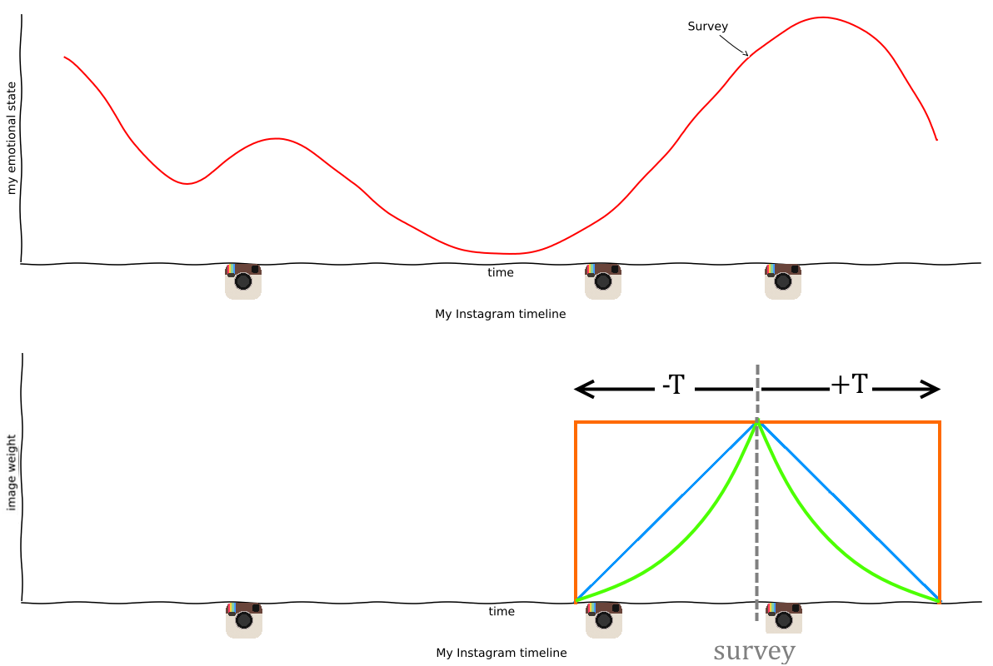

Images to user and P.E.R.M.A.
- Aggregate happiness to user level
- Inverse time weighting
$X_{emotion}=\sum{\frac{emotion strength}{Time from survey}}$

Slide 4
Expected results:
Regression model:
Relevant features
Predict P.E.R.M.A. score

Slide 5
Questions?

