Slide 1
nanoCAS
A real-time classification and alerting system
for pathogen detection during nanopore sequencing
Plant Health, Environmental Surveillance, and Biosecurity: A Joint UK–Canada Symposium · 15 October 2026
Tayab Soomro
Bioinformatics Study Leader, Agriculture and Agri-Food Canada
Notes:
Thank you. I lead bioinformatics at the Brandon Research and Development Centre. I want to tell you about a small piece of software, but I want to start with the problem it came from, because the problem is the interesting part.
Pause. Let the title sit.

Slide 2
The answer was in the data at 11 pm. Nobody was there.
Friday, 4 pm
Friday, 11 pm
Monday, 9 am
A sample from a suspected
interception goes on the MinION.
Enough reads to call the pathogen
are already on the disk.
Someone opens the laptop
and looks.
Sixty hours between the answer existing and the answer being known.
Notes:
This is a composite of things that have happened to us and to colleagues. A run starts late on a Friday. Nanopore gives you reads continuously, so by late evening the evidence for the organism you were worried about is sitting in the FASTQ files. And then nothing happens until Monday, because the only way to find out was to look.
The technology delivered real time. The workflow threw it away.
Slow down here. This is the whole talk in one slide.

Slide 3
Real time is the whole point of nanopore
Short-read sequencing
Result at the end of the run
Nanopore sequencing
Reads arrive every few minutes, from the first minute
run start
run end
A positive sample can be called hours before the flow cell is spent. A negative one needs the whole run, and someone has to know which is which.
Notes:
A quick reminder of why we use this platform for diagnostics at all. With short reads, the answer comes when the run finishes. With nanopore, reads land on disk every few minutes, so for a strongly positive sample the answer can exist within the first hour.
The catch is that someone has to be watching to benefit from that.

Slide 4



Three ways the real-time advantage gets lost
Someone has to watch
The instrument fails quietly
The confirmation lives elsewhere
Live plots exist, but a plot does not decide anything. A person has to notice the line crossing a value they carry in their head.
Pores die, a run never starts, output stalls. You find out when you come back, not when it happens.
The qPCR result is in a spreadsheet. Comparing sequencing with the reference test is redone by hand, every study.
Notes:
When we looked at how real-time nanopore data is actually used in a diagnostic setting, the advantage leaked away in three places.
First, a plot is not a decision. Second, the sequencer itself can be the thing that fails, and it fails quietly. Third, the test you compare against, usually qPCR, is kept somewhere else entirely.
Take one card at a time. No need to rush.

Slide 5
Good tools already exist. They all stop at the plot
Live
analysis
Decide on
a threshold
Notify
a person
Watch the
instrument
Keep the
qPCR result
MinKNOW live alignment
EPI2ME workflows
RAMPART
minoTour
MARTi
Nanometa Live
yes
partly (ARTIC milestones, listed pathogens)
From the published descriptions of each tool, 2021 to 2025. Any of these can be the classifier underneath what comes next.
Notes:
I want to be fair to the field. These are good tools and we use several of them. MinKNOW will align during a run. minoTour, MARTi and Nanometa Live classify reads as they arrive and show you beautiful live reports.
What none of them do is let a lab say, in advance, what a positive result is, and then tell a person when it happens. And none of them watch the sequencer for you, or keep the qPCR result alongside.
So the gap is not classification. The gap is what happens after the plot.

Slide 6
So we did not build another classifier.
We built the layer that decides, and tells you.
nanoCAS: Nanopore Classification and Alerting System
Notes:
That was the design decision. Do not compete with minimap2 or Kraken. Sit on top of whichever one the lab already trusts, and own the part nobody owned: the rule, the alert, the record.
Pause here before the next slide.

Slide 7


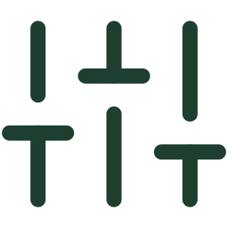

How it works
Sequencer writes
nanoCAS classifies
Rules you set
A person is told
FASTQ batches and the
sequencing summary,
as MinKNOW already does
minimap2 built in
Kraken2, Centrifuge
or your own plug-in
depth, breadth, reads, fraction
per target or per gene (GFF)
plus seven instrument rules
e-mail, SMS, desktop
and a MinKNOW message,
the moment a rule fires
One Python process on the laptop that runs the MinION. No cloud, no account, nothing leaves the lab. Every alert fires once per run and is written to a log.
Notes:
Four steps. The sequencer writes files exactly as it does today, nothing changes on the instrument side. nanoCAS watches that folder, classifies each batch with whatever tool you chose, evaluates the rules you wrote down before the run, and when one fires it tells a person.
The rules are the important bit. Depth, breadth, read count, read fraction, on an organism or on a single gene from an annotation. And a second set of rules about the instrument itself.
It runs on the same laptop as MinKNOW. Nothing goes to a cloud.

Slide 8
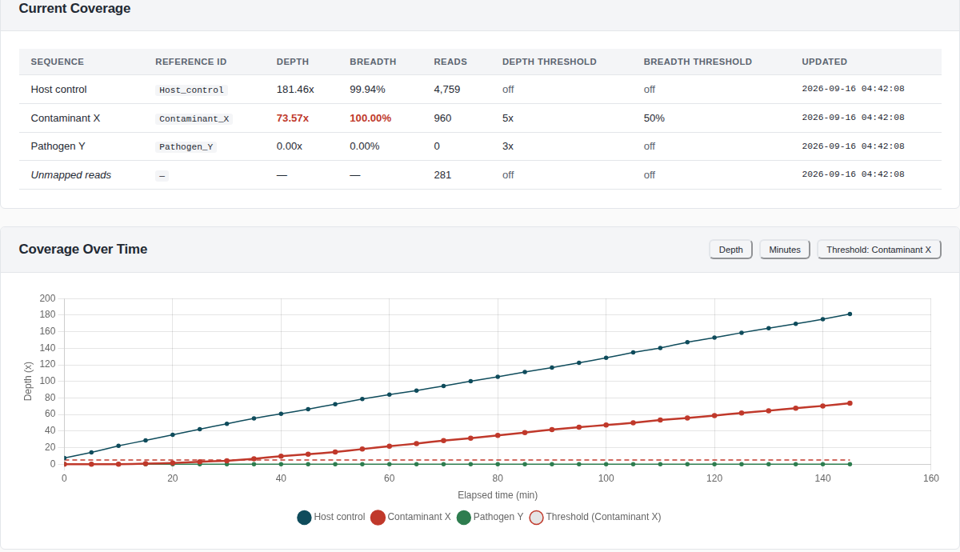
The moment a threshold is crossed
Notes:
This is the coverage view on a simulated run. Three targets, a contaminant appears part way through, and the moment its depth and breadth cross the thresholds we set, the row turns red and the alert goes out. The dashed line on the chart is the threshold.
Everything you see here was produced without a sequencer. I will come back to that.

Slide 9
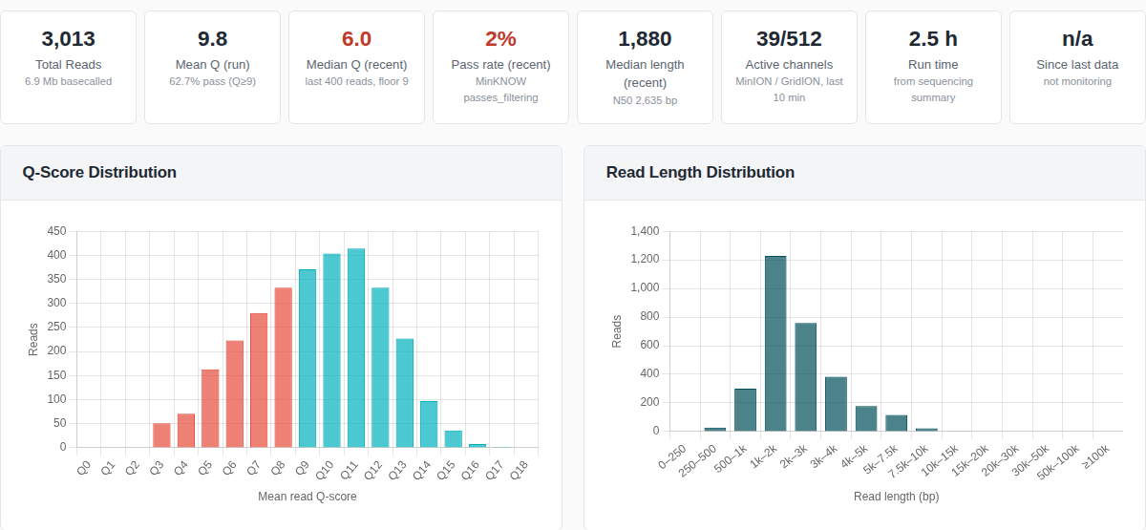
When the instrument is the problem
Seven rules, evaluated every 30 seconds
Run never started
Output stalled
Read quality collapsed
Pores declining
Too few active channels
Low pass rate
Reads too short
Each rule fires after two consecutive checks and logs a recovery when it clears, so a slow batch does not raise an alarm.
Notes:
This is the part that came out of painful experience. The same sequencing summary that you look at after a run with NanoPlot is read live, and seven rules watch it.
This simulated flow cell is dying: median quality has dropped to six, two percent of recent reads pass, thirty-nine channels left out of five hundred and twelve. On a real run you would get a text message when that started, not a surprise in the morning.

Slide 10
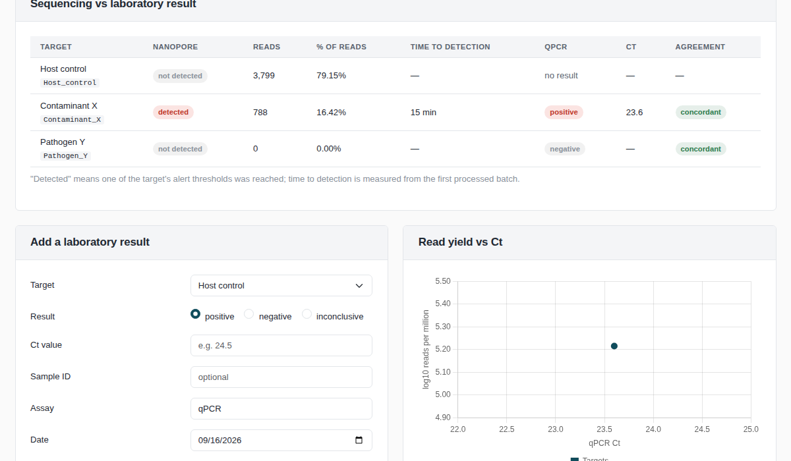
Sequencing next to the test you already trust
Record the qPCR result and Ct per target. nanoCAS reports agreement, time to detection, and the relationship between Ct and read yield, and pools them across runs.
Notes:
The third gap. For every target you can enter the result of the confirmatory test, in practice a qPCR Ct. nanoCAS then does the comparison that every validation paper does by hand: did sequencing agree, how long did it take, and how does read yield track Ct. Across runs it reports sensitivity, specificity and kappa.
The idea is that every routine run becomes a row in your validation dataset instead of a line in a spreadsheet.

Slide 11
Case study 1: a plant pathogen, naturally infected tissue
Xylella fastidiosa · quarantine organism, low titre in host tissue, qPCR is the reference method
1
Samples
2
Runs
3
Compare
Naturally infected plant material spanning a range of qPCR Ct values, each with absolute quantification.
Direct nanopore sequencing with nanoCAS watching, same thresholds for every sample.
Time to first alert, depth and breadth, and read yield against the Ct of each sample.
Which sequencing metric tracks the qPCR quantity best, and how early can a lab trust the alert?
in progress
Notes:
The first case study is the plant one, and the one closest to this audience. Xylella is a quarantine organism, unevenly distributed in the plant and present at low titre. The reference method is qPCR, so every sample has a Ct and an absolute quantity.
We sequence the same extracts directly, with nanoCAS watching and the same rules for every sample, and ask a simple question: which of depth, breadth, read count or read fraction tracks the qPCR quantity, and at what Ct does the alert stop arriving in time.
The runs are done, the analysis is being finished for the paper. If you have your own Ct series, this is exactly the kind of dataset we would like to compare against.

Slide 12
Case study 2: an animal pathogen, a dilution series
Brucella abortus · notifiable zoonosis, spiked into bovine DNA at decreasing levels, adaptive sampling on
1
Dilution series
2
Runs
3
Compare
B. abortus genomic DNA in a constant bovine background, from easy to find to very rare.
30 minutes of plain sequencing as a baseline, then three days with adaptive sampling enriching the pathogen genome.
How far down the series an alert still fires, how much sooner with enrichment, and what the instrument rules caught over three days.
How rare can the target be before real-time detection is no longer real time?
in progress
Notes:
The second case study is the One Health side. Brucella abortus, a notifiable zoonosis, spiked into bovine DNA at decreasing levels. The background is the same for every level, so the only thing changing is how rare the target is.
Each run starts with thirty minutes of ordinary sequencing, then adaptive sampling is switched on in MinKNOW so that reads that are not Brucella are ejected from the pore. nanoCAS watches the whole three days. The questions are how far down the series it can still raise an alert, how much sooner it arrives with enrichment, and what the run-health rules caught over a three-day run, because flow cells do not last three days gracefully.

Slide 13
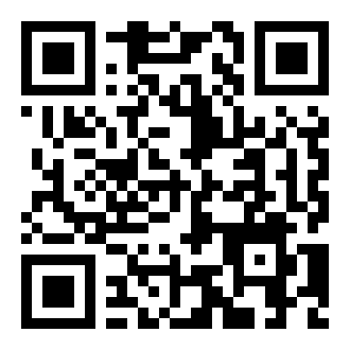
Try it this afternoon, without a sequencer
1
Built-in simulator
Writes FASTQ batches and a sequencing summary the way MinKNOW does. Six scenarios: clean run, contamination, rare pathogen, failing flow cell, stalled run, run that never starts.
2
One-click demo projects
Every screen you saw today, including the alerts, the run-health rules and the qPCR comparison, populated on a laptop in a minute.
3
Open source
github.com/tayabsoomro/nanoCAS
Python and React, one process, runs on Linux and macOS. 123 automated tests. Plug in your own classifier with a short Python class.
Notes:
I promised to come back to the simulator. Everything in this talk was shown on simulated runs because we wanted anyone to be able to see the whole system without a MinION and without their own data.
The simulator writes files exactly the way MinKNOW does, with scripted failure modes. So you can scan this code, run it on a laptop over coffee, and see a flow cell die on purpose.
It is open source. If your lab has a classifier you prefer, it plugs in with a short Python class.

Slide 14




What we would like to explore together
Validation on your samples
Agreed thresholds
Run nanoCAS beside your qPCR on the organisms you regulate, and compare Ct against time to alert.
What depth, breadth or read fraction should count as positive for a given regulated pathogen? That is a shared question, not a software one.
Shared classifiers
A pooled concordance dataset
Plug in the databases and tools each side already trusts, and compare them on the same runs.
Every run adds a row. Across two countries that becomes evidence a regulator can use.
The session discussion is on validation, interpretation and implementation. These four are where we think that conversation can become concrete.
Notes:
This is a UK–Canada symposium, so let me end with what we would actually like to do with the people in this room.
First, validation on your sample types, beside your qPCR. Second, thresholds. What should count as positive for a regulated pathogen is a question for diagnosticians and regulators, not for a software developer, and the tool makes it a concrete number you can argue about. Third, plug in the classifiers and databases each side trusts and compare them on identical runs. Fourth, pool the concordance data. Across two countries that becomes something a regulator can actually use.

Slide 15
Thank you
github.com/tayabsoomro/nanoCAS
Sam Horovatin, Tim Dumonceaux, Matthew G. Links
Agriculture and Agri-Food Canada · University of Saskatchewan
tayab.soomro@agr.gc.ca
Notes:
Thank you. Sam built much of the application with me, Tim provided the samples and the laboratory work, and Matthew has been the scientific lead on nanopore work with me since the first MinION in his lab.
I am happy to take questions now or in the discussion session.

