Slide 1

NEXTHIKE IT SOLUTIONS
USER ANALYTICS IN THE TELECOMMUNICATION INDUSTRY. A DATA-DRIVEN INVESTMENT ANALYSIS.
Mr. Aniket G. Tayade.

Slide 2

Introduction & Background
Who is TellCo? A telecom company operating in Pefkakia.
The Opportunity: An investor is considering acquisition.
The Challenge: TellCo has not yet leveraged its extensive user data for strategic insights.
Why this analysis? To uncover growth opportunities, identify churn risks, and inform the investment decision.

Slide 3

Problem Statement
The Investor's Dilemma: To buy or not to buy TellCo?
Key Questions:
What are the core growth avenues within TellCo's existing user base?
Are there hidden churn risks that could impact profitability?
Is TellCo a truly profitable and sustainable investment?

Slide 4

Project Objectives
Objective 1: Analyze user behavior, device usage, and application activity.
Objective 2: Measure user engagement and network experience.
Objective 3: Calculate customer satisfaction based on usage and quality.
Objective 4: Segment users and build predictive models (e.g., for churn).
Objective 5: Deliver actionable insights to support the investment decision.

Slide 5

Data Overview & Initial Scan
Dataset Source: telcom_data (2).xlsx - Sheet1.csv
Scale: 150,001 rows and 55 columns – a substantial amount of user data.
Data Types: Predominantly numerical (50 float64 columns) with some categorical/object types (5 columns) requiring careful handling.
Memory Footprint: Approximately 100.85 MB

Slide 6
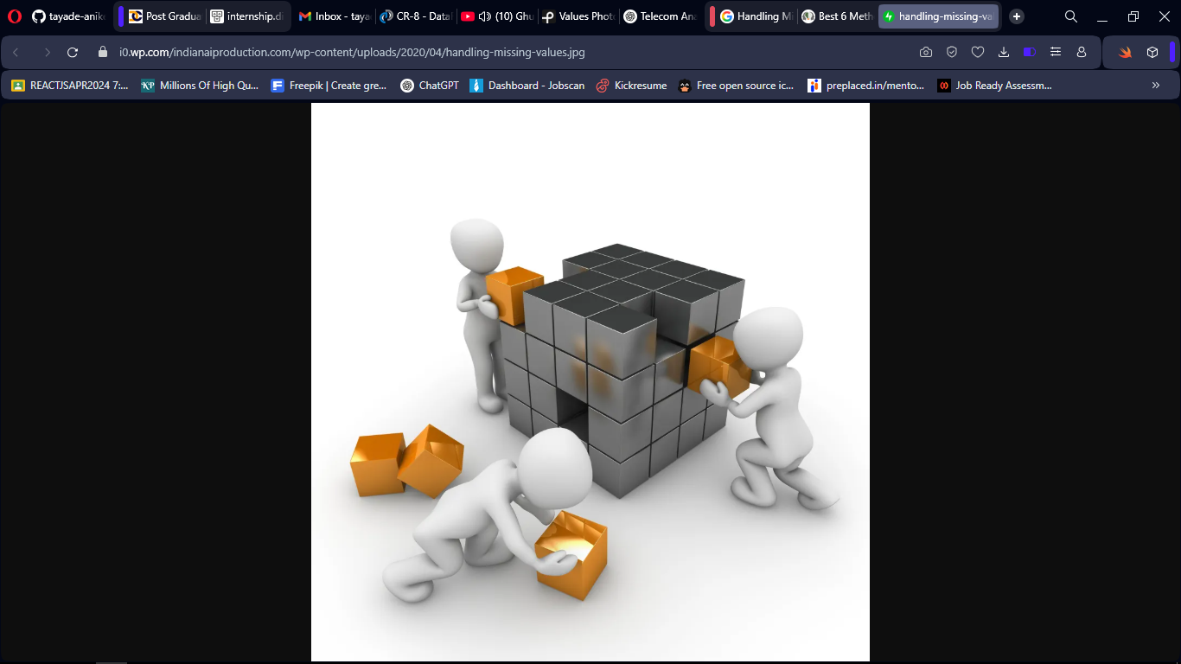
Data Preprocessing: Handling Missing Values
The Challenge: Significant missing data, especially in columns related to specific application usage and network statistics (e.g., Youtube DL/UL, Netflix DL/UL, Gaming DL/UL).
Top Missing Columns (Examples):
Nb of sec with 37500B < Vol UL: 86.84% missing
Nb of sec with 6250B < Vol UL < 37500B: 74.56% missing
TCP UL Retrans. Vol (Bytes): 64.43% missing
Strategy: Imputation and careful consideration of columns with very high missing percentages.

Slide 7
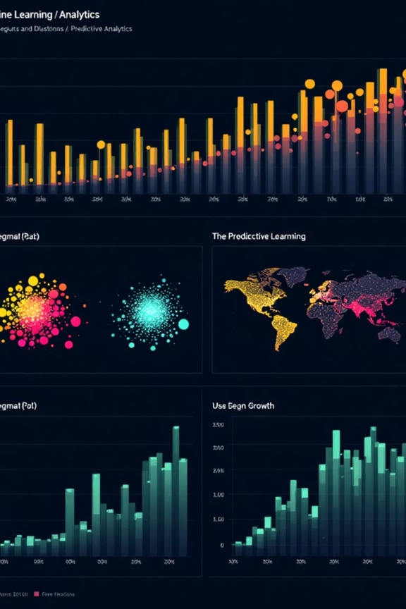
Data Preprocessing
Duplicate Records: Checked for and removed to ensure data integrity and prevent skewed analysis.
Outlier Detection: Addressed extreme values that could distort statistical measures and model training.
Specific Handling: Focus on critical columns like `Dur. (ms)` and `Total DL/UL (Bytes)`.
Insight: Clean data means reliable insights. Every step in cleaning removes noise, making the signal stronger.

Slide 8

Feature Engineering
New Metrics Created:
`Total Data (Bytes)`: Sum of Total DL and Total UL.
Total App Data (Bytes)`: Aggregate data for specific applications (Youtube, Netflix, Gaming, Other).
`Session Frequency`: How often a user initiates a session.
`Duration per Session (ms)`: Average duration of user sessions.
Purpose: To create more meaningful indicators of user behavior and network impact.
Insight: Raw data can only tell us so much. Feature engineering is like giving the data a voice to tell a richer story.

Slide 9

User Engagement Analysis: Overall Traffic & Top Users
Total Data Consumed: Identified the overall data traffic patterns.
Top 10 Engaged Users: Highlighted users with the highest total data usage. These are the "power users" driving significant traffic.
Engagement Distribution: Visualized the distribution of engagement metrics (e.g., session duration, data usage).
Insight: Understanding who uses the most data helps us target high-value customers and capacity planning.

Slide 10
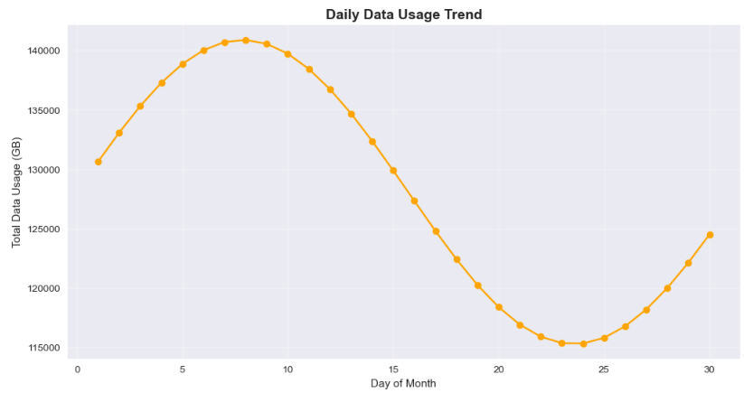
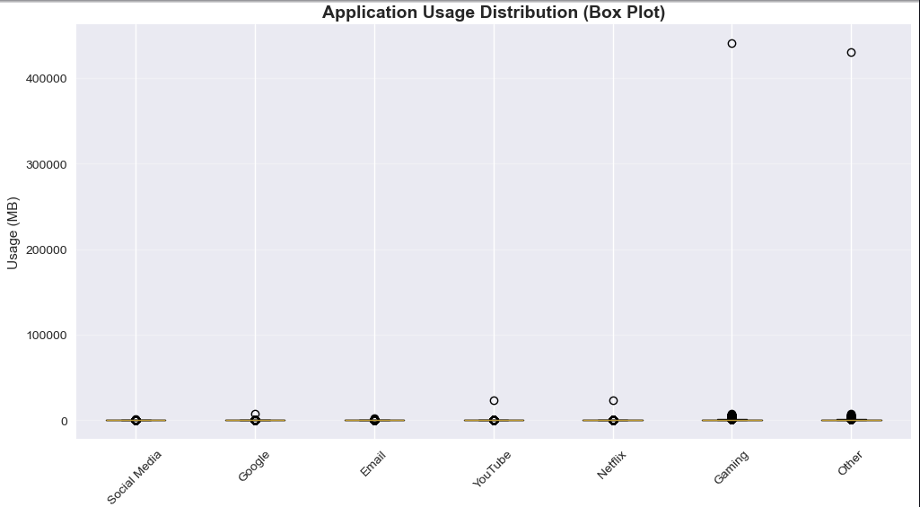
User Engagement: Application Activity
Most Consumed Applications: Quantified data usage across different application categories (Social, Google, Email, Youtube, Netflix, Gaming, Other).
Key Findings:
Gaming, Other, and Youtube are the top 3 applications by data volume.
Netflix and Google also represent significant data consumption.
Implications: These applications are critical for network planning and service quality.
Insight: Knowing what apps are driving traffic helps TellCo prioritize network investment and optimize user experience.

Slide 11
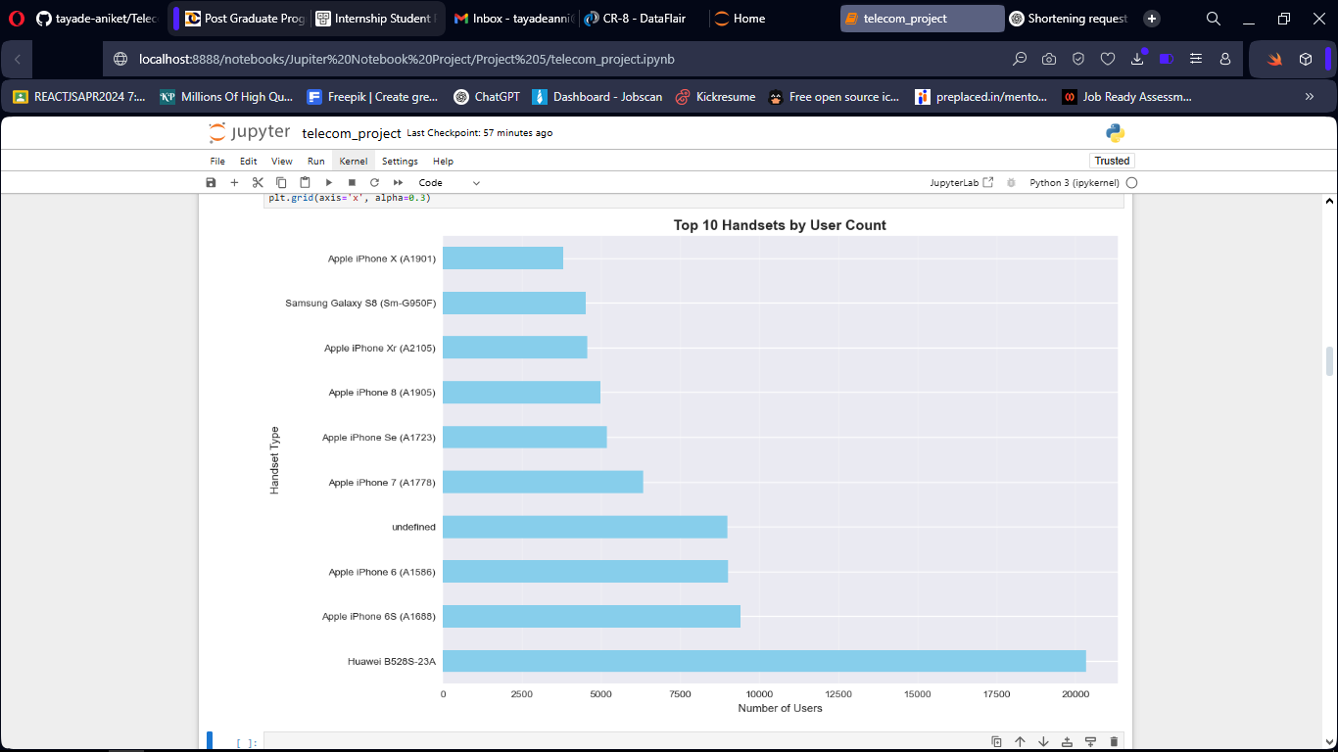
Customer Experience: Handset Analysis
Top 5 Handsets: Identified the most popular device manufacturers and models.
Samsung and Apple devices dominate the user base.
Operating System Distribution: Analyzed the breakdown between Android and Apple OS users.
Experience Correlation: Examined how device type and OS correlate with session duration and data throughput.
Insight: Device diversity means varied network demands. Optimizing for top handsets ensures a smoother experience for the majority.

Slide 12
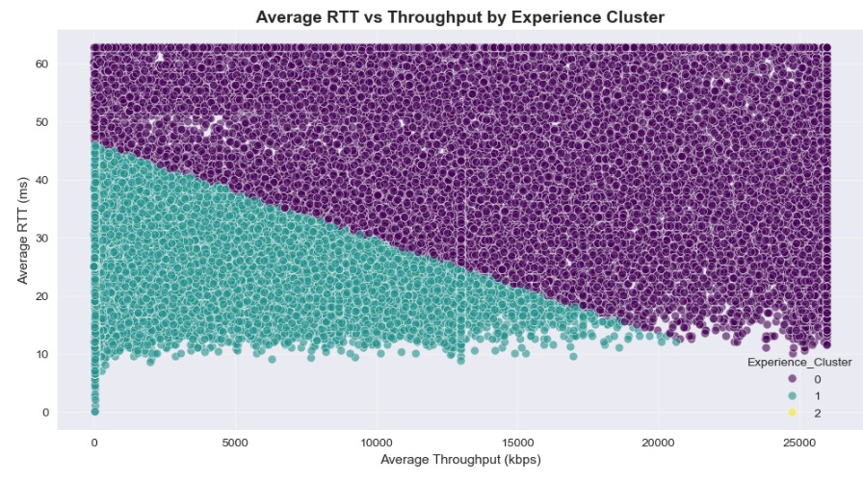
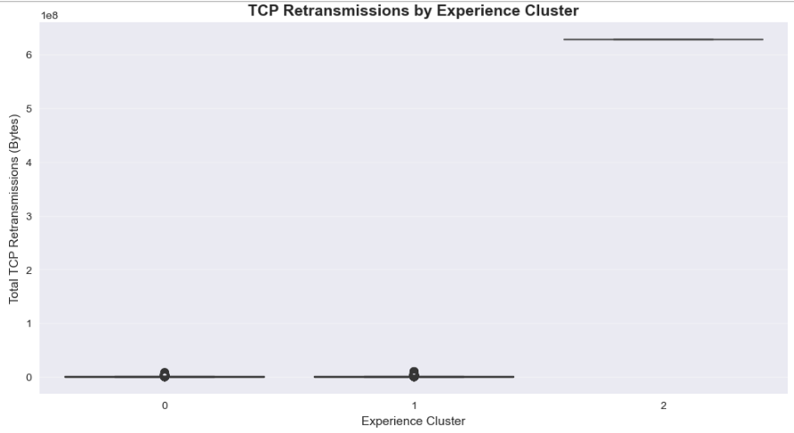
Customer Experience: Network Performance
Data Throughput Analysis: Assessed the average download and upload speeds experienced by users.
Retransmission Rates: Identified instances of data retransmissions, a key indicator of network congestion or poor signal quality.
Experience Score Calculation: A composite score reflecting overall network performance and user experience.
Insight: Fast, reliable network performance isn't a luxury, it's the bedrock of customer satisfaction. High retransmissions are red flags.

Slide 13

Customer Satisfaction & Churn: Metrics
Satisfaction Score: Developed a metric to quantify user satisfaction based on engagement and experience data.
Engagement vs. Satisfaction:
Explored the relationship between how much users engage and their reported satisfaction.
Low engagement could signal dissatisfaction or impending churn.
Churn Definition: Defined churn based on inactivity or significant drop in engagement over a period.
Insight: Satisfaction isn't just a feeling; it's a measurable outcome directly tied to usage and network quality.

Slide 14
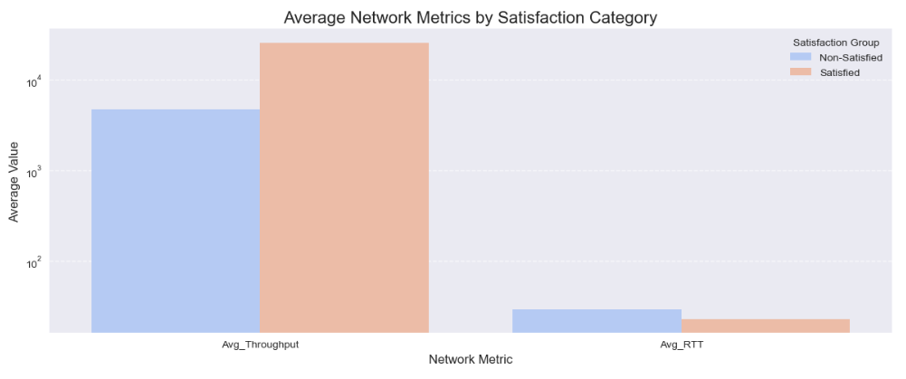
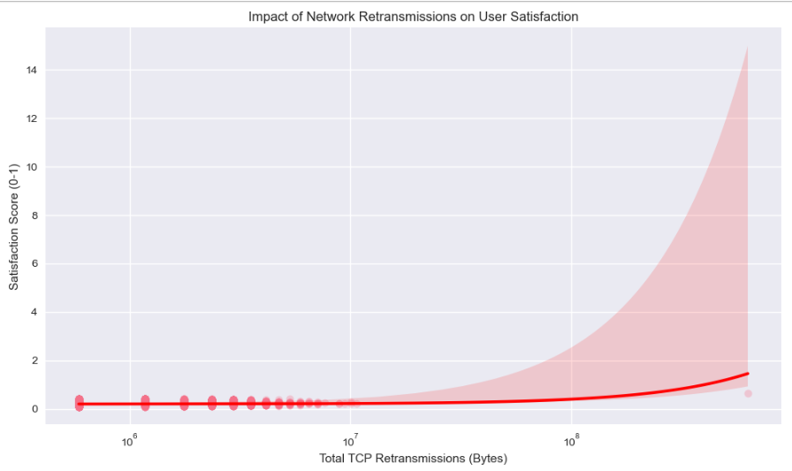
Customer Satisfaction & Churn: Churn Drivers
Identification of Churn-Prone Users: egmented users into groups (e.g., highly engaged, moderately engaged, low engaged, dormant) to identify potential churners.
Key Churn Factors: Analyzed which factors (e.g., poor experience score, low data usage, high retransmissions, specific app issues) are most correlated with churn.
Predictive Modeling: Used machine learning models (e.g., KMeans Clustering for segmentation, RandomForest Regressor for predicting engagement) to anticipate churn.
Insight: Proactive churn prevention is far more cost-effective than customer re-acquisition. Knowing the "why" is half the battle.

Slide 15

Key Findings & Opportunities
High Data Consumption: Gaming and video streaming are major traffic drivers, indicating strong demand for high-bandwidth services.
Device Dominance: Apple and Samsung users form a significant portion of the customer base, highlighting the importance of optimizing for these ecosystems.
Network Experience Impacts Churn: Direct correlation between poor network experience (e.g., high retransmissions) and user dissatisfaction/churn risk.
Untapped Potential: Opportunities exist to increase engagement among moderate users and re-engage dormant users.
Insight: The data paints a clear picture: robust network, targeted engagement, and understanding user segments are the keys to growth.

Slide 16
Recommendations for TellCo
Network Optimization: Invest in improving network quality, especially in areas with high retransmission rates and for data-intensive applications like gaming and video.
Targeted Engagement Campaigns:
Develop personalized offers for moderate users to boost their engagement and move them into high-value segments.
Design re-engagement strategies for dormant users, possibly with incentives or tailored content.
Churn Alert System: Implement a system to identify users with deteriorating experience scores and proactively offer support or incentives.
Partnerships: Collaborate with top handset brands (Apple, Samsung) for bundled offers and device-network optimization.
Analytics Team: Strengthen the analytics team to continuously monitor usage, satisfaction, and network data for faster, data-driven decisions.
Insight: These aren't just suggestions; they're direct actions TellCo can take to secure its future.

Slide 17

Investment Decision Support
Growth Potential: Strong demand for data-intensive services and opportunities to increase engagement among existing users indicate good growth potential.
Addressable Risks: Churn risks are identifiable and actionable through targeted interventions and network improvements.
Data-Driven Future: TellCo has a wealth of untapped data that, with proper analysis and strategy, can lead to significant ROI.
Overall Conclusion: Based on the comprehensive data analysis, TellCo presents a promising investment opportunity, provided strategic recommendations are implemented.
Insight: TellCo's data isn't just a record of the past; it's a blueprint for a profitable future.

Slide 18

Thank you so much for taking the time to review my presentation. I truly appreciate your support!

