Slide 1



MIT ARTS, COMMERCE AND SCIENCE COLLEGE
Department of Computer Science · Pune, Maharashtra
Indian Road Accident Severity Prediction
A crash-level machine learning approach: from 131,404 occupant records to a triage-ready severity classifier
GUIDE Prof. Ram Agrawal Sir.
Assistant Professor, Department of Computer Science
PRESENTED BY Aniket Tayade
Roll No. SM1111 · M.Sc. Computer Science
Academic Year 2026–2027 · Semester III · September 2026
Notes:
[Title, 45 sec] Introduce yourself and the question: can a computer sort road crashes into minor, major or fatal from what is known at the scene? Animations run automatically: title, subtitle, guide, presenter. Fill the bracketed fields (guide name, roll number, semester) before presenting. Replace the dashed logo box with the official college logo (right-click, Change Picture).

Slide 2
00
Contents
01
The Problem and the Data
Why severity matters; what the dataset contains
Slides 3–5
02
Methodology
Pipeline, crash-level rebuild, leakage control, models
Slides 6–11
03
Insights from the Data
Class balance, time, speed, feature relationships
Slides 12–16
04
Results and Evaluation
Model comparison, errors, what the model relies on
Slides 17–22
05
Conclusion and Way Forward
Summary, limits, next steps, questions
Slides 23–24
Notes:
[TOC, 40 sec] Five parts: the problem, the method, what the data says, the results, and the way forward. Rows fly in one by one (0.25 s apart) after the slide loads.

Slide 3
01
The Problem and the Data
Why crash severity matters, and what we have to work with
Notes:
[Divider, 10 sec] The circle and title glide into the header of the next slide (Morph).

Slide 4
01
Why predicting crash severity matters
Indicator | Value | Source
Road deaths worldwide, per year | 1.19 million | WHO, 2023
Road accidents in India, 2023 | 4,80,583 | MoRTH, 2025
Deaths in India, 2023 | 1,72,890 | MoRTH, 2025
Injured in India, 2023 | 4,62,825 | MoRTH, 2025
Crash facts
speed, vehicles, road, people
Model
learns from 20,000 crashes
Severity
minor · major · fatal
WHY IT MATTERS Knowing severity early helps the right help be planned.
Notes:
[2 min] Left: verified statistics. WHO estimates 1.19 million road deaths a year worldwide. India's 2023 report (MoRTH): 4,80,583 accidents, 1,72,890 deaths, 4,62,825 injured. Right: the idea, in one line: crash facts go in, a model sorts the crash into minor, major or fatal, and that helps decide what help is sent. ANIMATION: table fades in, blocks fly in left to right (0.25 s apart); on click, the death figure pulses.

Slide 5
01
The dataset: 131,404 people, 20,000 crashes
Group | Examples | Cols | Role
Identifiers | record_id, crash_ref_id … | 4 | Excluded / key
Location | city, state, lat, lon | 4 | Predictor
Temporal | year, hour, weekday … | 9 | Predictor
Road & environment | weather, surface, cause … | 11 | Predictor
Crash composition | vehicle type, occupants | 4 | Predictor
Occupant attributes | speed, age, seat, license | 7 | Aggregated
Derived risk score | computed_risk_score | 1 | Excluded
Post-crash outcomes | survived, hospitalized … | 9 | Excluded
Target | crash_severity | 1 | Target
131,404
rows: one per person
20,000
crashes (6.6 people each)
2022–25
8 city clusters
WHY IT MATTERS The gap between 131,404 rows and 20,000 crashes drives our method.
Notes:
[2 min] The raw file has one row per person: 131,404 rows and 50 columns, describing 20,000 crashes (about 6.6 people per crash). The table groups the 50 columns by meaning. Point out the last two rows: 9 columns describe what happened afterwards and 1 is the target. Be candid: the file's origin is not documented, so we treat it as a study dataset. ANIMATION: table fades in, the three chips zoom in one by one.

Slide 6
02
Methodology
From raw records to a trustworthy classifier, stage by stage
Notes:
[Divider, 10 sec] Next slide: the nine-stage pipeline.

Slide 7
02
The pipeline at a glance
1
2
3
4
5
6
7
8
9
Ingest
131,404 rows × 50 cols
Clean
0 duplicates, 0 range errors
Rebuild
groupby crash → 20,000 rows
Govern
14 columns excluded
Explore
14 EDA figures
Split
80 / 20 stratified
Tune
4 models, 5-fold CV
Evaluate
XGBoost macro-F1 0.9423
Deploy
joblib bundle + Streamlit
WHY IT MATTERS Each stage removes one way of fooling ourselves.
Notes:
[2 min] Nine stages from raw file to deployment. The dots appear one by one; then an orange data packet travels along the track (motion path) to show data flowing through the pipeline. Under each stage is the key number. On the next slides these nodes shrink to a progress tracker at the bottom (Morph) so the audience always knows where we are.

Slide 8
02
Step 3 · One crash, four rows
Before: one row per person
0_P1 license: expired
A 30-person bus crash counts 30 times
Rows of one crash can land in both train and test
Result: inflated, unfair scores
0_P2 license: valid
0_P3 license: expired
131,404 rows, but only 20,000 crashes
0_P4 license: valid
1
2
3
4
5
6
7
8
9
Notes:
[1.5 min] THE IDEA: the raw file lists every person separately. Here is one real crash (crash 0, Pune): four occupants, four rows, with license statuses expired, valid, expired, valid. Problem: a crash with 30 people would count 30 times, and its rows could land in both training and test. ANIMATION: rows fly in from the left, 0.25 s apart. The next slide morphs these four cards into one.

Slide 9
02
Step 3 · One crash, one row
After: one row per crash
Crash-level feature | Value
occupant_record_count | 4
valid_license_ratio | 0.50
male / female ratio | 0.50 / 0.50
rider / pillion ratio | 0.75 / 0.25
safety_noncompliance_rate | 0.50
crash_ref_id = 0 · Pune
4 occupants summarised into 1 row
131,404 rows → 20,000 crashes (6.6× smaller)
1
2
3
4
5
6
7
8
9
Notes:
[1.5 min] WOW MOMENT: the four cards slide together (Morph) into one crash row. We summarise the people: occupant count, license shares, gender shares, seat roles, safety-rule breaking. These are the real values for crash 0. Result: 131,404 rows become 20,000 independent crashes, described by 18 aggregate features plus context. ANIMATION: table fades in, then on click the crash row pulses.

Slide 10
02
Step 4 · No peeking: the leakage rule
50 raw columns
Outcomes · 9
Crash context · 28
Occupant · 7
49 model features
Context · 28
Occupant summaries · 18
+1 count, +2 engineered → 37 numeric and 12 categorical inputs
Excluded | Columns | Why
Identifiers (4) | record_id, occupant_unique_id, crash_ref_id, occupant_seq_no | No generalizable signal
Post-crash outcomes (9) | survived, injury_outcome, hospitalized_flag, total_casualties_reported … | Consequences of severity
Risk score (1) | computed_risk_score | Formula unknown
1
2
3
4
5
6
7
8
9
Notes:
[2 min] Rule: if something is only known AFTER the crash, the model may not see it. Top bar: the 50 raw columns, colored by fate: 4 identifiers, 9 post-crash outcomes and 1 opaque risk score are removed (14 in all), plus the target. Bottom bar: the 49 predictors we keep: 28 context + 18 occupant summaries + 1 count + 2 engineered. ANIMATION: bars build segment by segment; on click the outcome segment pulses.

Slide 11
02
Steps 6–7 · Model architecture and tuning
ColumnTransformer
Crash-level features
49 columns
Estimator
LR · Tree · Forest · XGBoost
fatal
major
minor
Numeric (37): median fill → scale (LR only)
Categorical (12): mode fill → one-hot
Model | Best setting found | CV macro-F1
Logistic regression | C = 10 | 0.9298
Decision tree | depth 3, leaf ≥ 5 | 0.9288
Random forest | 150 trees, depth 20 | 0.9315
XGBoost | 150 rounds, depth 5, rate 0.03 | 0.9352
Randomized search · 5-fold stratified CV · scoring: macro-F1 · seed 42 · 175 fits in under 8 minutes
1
2
3
4
5
6
7
8
9
Notes:
[2 min] Every model is a pipeline: the feature table splits into a numeric branch (fill gaps with the median, scale only for logistic regression) and a categorical branch (fill with most frequent, one-hot encode). Then one of four estimators. Preprocessing lives inside cross-validation, so test data never influences it. Table: best settings found by randomized search with 5-fold cross-validation and the resulting macro-F1. ANIMATION: blocks appear left to right, table last.

Slide 12
03
Insights from the Data
Class balance, time, speed, and how features relate
Notes:
[Divider, 10 sec] What does the data actually say?

Slide 13
03
The severity mix: an imbalanced target
Split | Fatal | Major | Minor
Full data | 2,987 | 5,988 | 11,025
Train (80%) | 2,390 | 4,790 | 8,820
Test (20%) | 597 | 1,198 | 2,205
14.9%
of crashes are fatal: the rarest, most critical class
Notes:
[1.5 min] Minor crashes are 55%, major 30%, fatal 15%. So a model that always says minor would already be 55% accurate and find zero fatal crashes. That is why we split with stratification (same mix in train and test) and judge with macro-F1, which counts all three classes equally. ANIMATION: bars appear category by category; on click the fatal share pulses.

Slide 14
03
What does not matter: the day of the week
Hour of day
Flat curve: no rush-hour effect on severity
Weekday test
χ²(12) = 8.15, p = 0.77: no link
Monthly “trend”
An artifact: 2025 covers only part of a year
WHY IT MATTERS Focus safety effort on factors that move severity.
Notes:
[2 min] Bars: share of each weekday's crashes that were fatal. The line: overall average 14.9%. If weekends were deadlier, they would tower over the line. They range only 14.2 to 15.9%. A chi-square test on the day-by-severity counts gives p = 0.77: no evidence of a link. Hourly counts are also flat. The apparent monthly decline is an artifact: 2025 covers only part of a year. ANIMATION: chart builds by category, then the three cards fly in from the right.

Slide 15
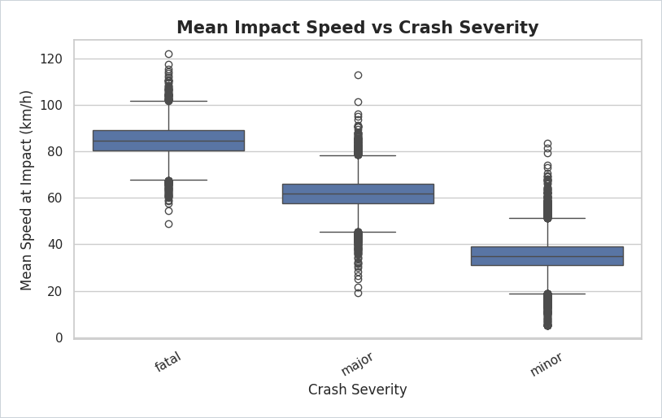
03
Speed separates the severity classes
Severity | Median km/h | Middle half
Fatal | ≈ 85 | ≈ 80–89
Major | ≈ 62 | ≈ 58–66
Minor | ≈ 35 | ≈ 31–39
45%
of the model’s importance comes from mean impact speed
Values read from the chart; importance from the fitted XGBoost model.
Notebook box plot: mean impact speed by severity
Notes:
[2 min] This box plot from the notebook is the key picture. Each box holds the middle half of crashes of that type. The three boxes do not overlap: fatal crashes sit around 85 km/h, major 62, minor 35 (read from the chart). The model agrees: 45% of its importance is average impact speed. CAUTION: in this dataset the relationship is unusually sharp; real records are noisier. ANIMATION: image and table fade in, 45% zooms in; on click it pulses.

Slide 16
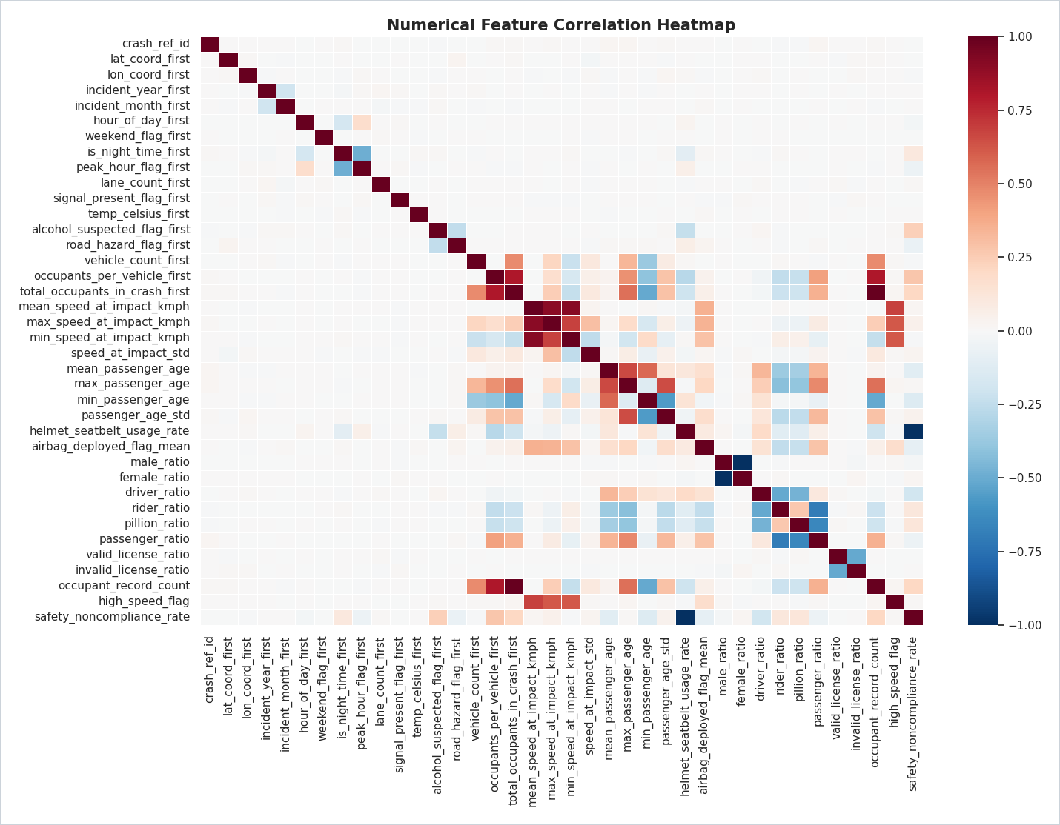
03
How the features relate to each other
Speed block
mean, max and min speed correlate about 0.9 or more
Group-size block
occupants and vehicles move together
Exact opposites
male vs female share; helmet use vs rule-breaking (−1)
So what
trees cope; do not over-read linear weights
Notes:
[1.5 min] Heatmap of numeric features (the categorical target cannot appear). Read the red squares: the three speed measures are almost the same signal; group-size features move together; some pairs are exact opposites (male/female ratio; helmet-use and rule-breaking rate) because one is 1 minus the other. Consequence: tree models cope well but split importance across duplicates, so linear coefficients should not be over-read. ANIMATION: the heatmap fades in, points fly in one by one.

Slide 17
04
Results and Evaluation
Which model won, where it errs, and what it relies on
Notes:
[Divider, 10 sec] Now the exam results.

Slide 18
04
Model showdown: XGBoost wins every metric
Model | Accuracy | Macro-F1 | AUC | Errors / 4,000
XGBoost | 95.28% | 94.23% | 0.995 | 189
Random forest | 94.65% | 93.65% | 0.993 | 214
Logistic regression | 94.48% | 93.30% | 0.990 | 221
Decision tree | 94.15% | 92.99% | 0.983 | 234
Macro-F1: grades minor, major and fatal equally. AUC: how well crashes are ranked by seriousness (1.0 = perfect).
Axis starts at 90% to show small gaps (real gap ≈ 1 point).
Notes:
[2 min] All four models sat the same 4,000-crash exam. Table: accuracy, macro-F1 (fairness across the three classes), AUC (how well the model ranks crashes by seriousness), and the number of mistakes: XGBoost 189, random forest 214, logistic regression 221, decision tree 234. Be honest: gaps are about one point, similar to test-set sampling error (about +/-0.7 pt), so the ranking is consistent but not proven by a paired test. ANIMATION: table fades in; chart builds by element in series.

Slide 19
04
Where the errors are: the confusion matrix
Predicted by the model
fatal
major
minor
fatal
557
40
0
3,811
of 4,000 test crashes sorted correctly
major
44
1,105
49
Actual
189
mistakes in total (4.7%)
minor
1
55
2,149
WHY IT MATTERS A scoreboard of right and wrong answers, by type.
Notes:
[1.5 min] Read row by row: rows are what really happened, columns what the model said. 557 of 597 fatal crashes were found; 1,105 of 1,198 major; 2,149 of 2,205 minor. 3,811 of 4,000 correct overall (95.28%). ANIMATION: cells zoom in one by one. Next slide morphs the same grid into percentages.

Slide 20
04
Where the errors are: as percentages
Predicted by the model
fatal
major
minor
fatal
93.3%
6.7%
0.0%
188 of 189
mistakes land in a neighboring class. Only 1 crash jumped two levels, and no fatal crash was called minor.
Weak spot: 40 of 597 fatal crashes were called major.
major
3.7%
92.2%
4.1%
Actual
minor
0.0%
2.5%
97.5%
WHY IT MATTERS Errors behave like a blurred boundary on a severity scale.
Notes:
[1.5 min] WOW MOMENT 2: the same grid, now as percentages of each true class (Morph replaces the numbers and re-colors the cells). Fatal 93.3% correct, major 92.2%, minor 97.5%. The callout: 188 of 189 mistakes are to a neighbouring class; a fatal crash was never called minor. Weak spot: 40 of 597 fatal crashes were called major, so keep a human in the loop. ANIMATION: callout fades in; on click it pulses.

Slide 21
04
What the model relies on
≈ 49%
from speed features alone (mean + max + min)
Read with care
Speed and airbag are measured during the collision, so this is a post-crash triage aid.
City features can act as a location proxy.
Notes:
[2 min] Top 10 features by the model's built-in importance. Mean impact speed is 45.1%; together with max and min speed the speed family is about 48.7%. Airbag deployment is second, but it is also a collision-time measure. So the model is a post-crash triage aid, not a pre-crash predictor. City indicators (Bengaluru) appear in the top 10, a fairness flag. Importance describes what the model uses, not causes. ANIMATION: bars appear category by category; on click the speed callout pulses.

Slide 22
04
Limits and responsible use
Limitation | Why it matters | Mitigation
Data may be curated or simulated | Scores may not transfer to real records | Validate on official crash data
Collision-time predictors | Post-crash triage, not pre-crash forecast | Ablate speed and airbag
7 of 9 engineered features did not run | Small metric change possible | Fix column names and re-run
2025 is a partial year | Monthly pattern is an artifact | Flag or drop; time-based split
Fatal recall 93.3% | 40 of 597 fatal called major | Threshold tuning, human review
City acts as a proxy | Possible location bias | Drop city; audit by city
WHY IT MATTERS Honest limits make a result usable, not just impressive.
Notes:
[2 min] Be upfront. 1) The dataset's origin is undocumented and unusually regular, so 95% is a method demonstration, not a real-world estimate. 2) Speed and airbag are collision-time measures: post-crash triage only. 3) During review we found seven planned features did not run because of a column-name mismatch after grouping; the reported results are exactly what was trained; fix identified. 4) 2025 is a partial year. 5) Fatal recall is 93.3%, so keep humans in the loop. 6) City features can act as a proxy; age and gender barely matter and can be removed.

Slide 23
05
Conclusion and the road ahead
1
Count crashes, not people
2
Never peek at the answer
3
Speed decides severity, in this data
Now
Baseline built and tested
Next
Real data · pre-crash model · feature fix
Later
Live prediction page
Result: 95.28% accuracy · macro-F1 0.9423 · AUC 0.9946 on 4,000 unseen crashes
Notes:
[2 min] Three conclusions: structure the data around the crash; never let the model see the outcome; speed dominates severity in this data. Roadmap: NOW baseline done (95.28% accuracy, macro-F1 0.9423); NEXT validate on real police records, build a pre-crash version, fix the engineered features; LATER a live prediction page in the dashboard. ANIMATION: points fly in; the orange dot travels along the timeline (motion path).

Slide 24
Thank you
Questions and discussion
Aniket Tayade
M.Sc. Computer Science · MIT Arts, Commerce and Science College, Pune
tayadeanni@gmail.com
aniket-tayade-nine.vercel.app
LinkedIn / GitHub: aniket-tayade
Notes:
[Close, 1 min] Thank you. Invite questions. Backup topics: why macro-F1, the 2025 partial-year trap, how the 14 excluded columns were chosen, the Streamlit dashboard demo.

