Slide 1

Predicting Mobile Phone Prices Using Machine Learning
NEXTHIKE IT SOLUTIONS
Mr. Aniket G. Tayade.

Slide 2

PROBLEM STATEMENT
Objective: Predict mobile prices based on key features to optimize pricing strategies.
Challenges:
High competition in the mobile market.
Pricing depends on technical specs, brand value, and market trends.
Business Impact: Accurate pricing → Increased sales and profitability.

Slide 3

Understanding Our Data
Source: Processed_Flipdata.csv (541 records).
Key Features:
Technical: RAM, Memory, Battery, Camera (MP), Processor.
Categorical: Brand, Color, AI Lens.
Data Quality:
Cleaned outliers (e.g., unrealistic battery capacities).
Handled high cardinality (e.g., 163 unique models).

Slide 4

Data Cleaning & Preprocessing
Total Records
541 Rows and 12 Columns
Features:
Model, RAM, Battery, Camera, Processor, Color
Feature Types: Numerical and Categorical
Observations: Minor missing values, slight data imbalance on models

Slide 5
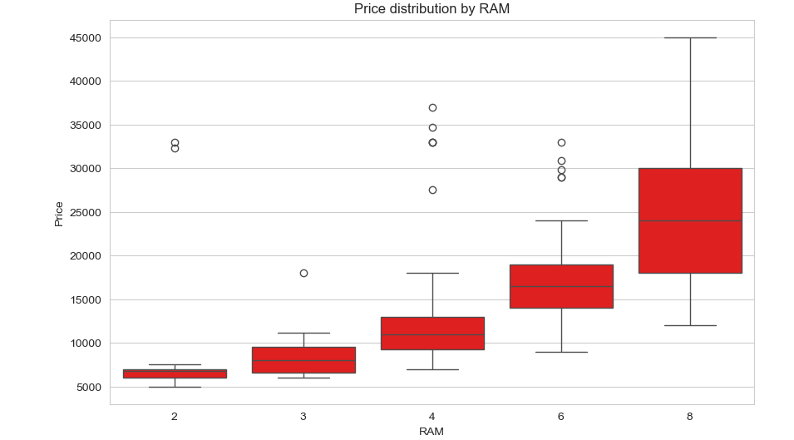
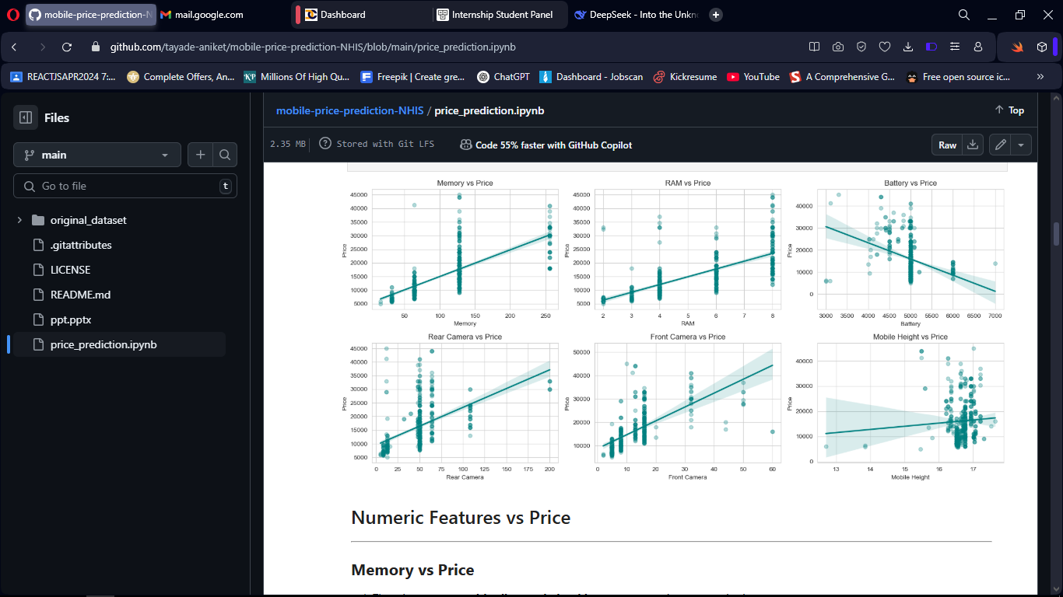
Exploratory Data Analysis (EDA)
Visuals:
Boxplot: Price distribution by RAM (higher RAM = higher price).
Scatterplot: Rear Camera MP vs. Price (positive correlation).
Key Insights:
Premium phones (>₹30k) have 8GB RAM, 128GB+ storage, 50MP+ cameras.
Budget phones (<₹10k) cluster around 4GB RAM, 64GB storage.

Slide 6
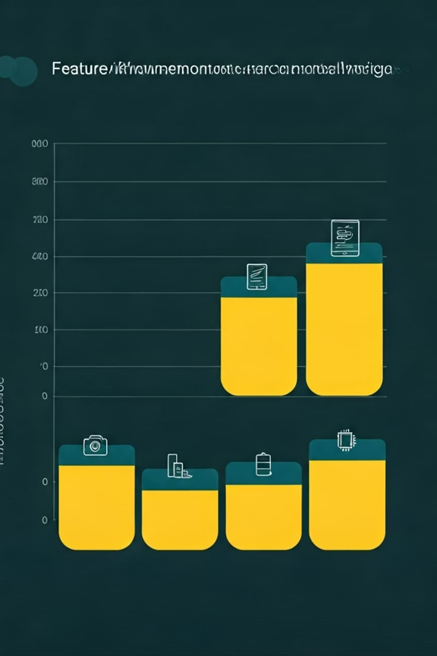
Feature Engineering
Engineered Features:
Total_Camera_MP: Sum of front + rear cameras.
Memory_to_RAM_ratio: Memory(GB)/RAM(GB).
Is_High_End: Binary flag (RAM ≥ 8GB & Memory ≥ 128GB).
Encoding:
Label encoding for brands/processors.
One-hot encoding for colors

Slide 7
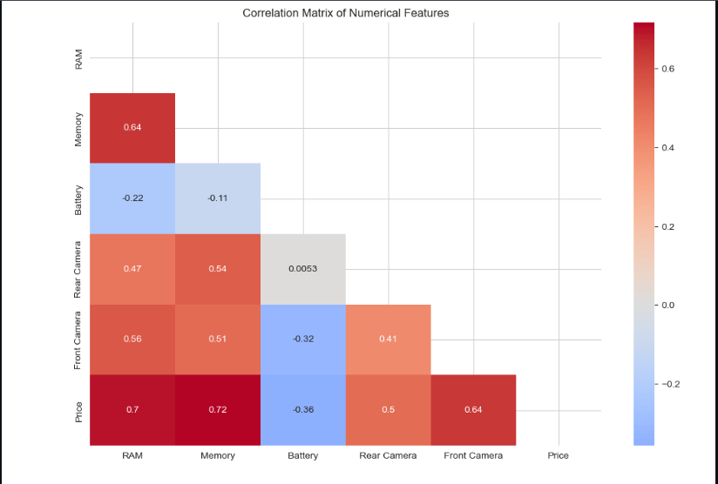
Feature Importance
Random Forest Results (Top 5 Features):
RAM (25% importance).
Memory (20% importance).
Brand_Avg_Price (15% importance).
Rear Camera MP (12% importance).
Battery (8% importance).
Heatmap: Correlation matrix highlighting strong RAM-Price relationship (r=0.72).

Slide 8
INTRODUCTION
At Krypto Logics, we empower investors to maximize their portfolios to help them meet their financial goals responsibly. By offering customized and sophisticated strategies, we help clients' portfolios grow organically and foster a trusted consumer-consultant relationship.

Slide 9
TRADING & INVESTING
Crypto can be complicated but getting started doesn’t have to be

Slide 10
LONG-TERM VS. SHORT-TERM

Slide 11
GLOBAL CURRENCY MARKETS
 | $USD | £EUR | ¥JPY | ₿BTC
Q1 | 4.5 | 2.3 | 1.7 | 5.0
Q2 | 3.2 | 5.1 | 4.4 | 3.0
Q3 | 2.1 | 1.7 | 2.5 | 2.8
Q4 | 4.5 | 2.2 | 1.7 | 7.0

Slide 12
WEALTH IS THE ABILITY TO FULLY EXPERIENCE LIFE.
-Henry David Thoreau

Slide 13
TYPES OF TOKENS
Payment
Utility
Security
NFT
Gaming
Used to complete transactions anywhere crypto is accepted
These tokens have a specific use within a blockchain
Tokens backed by securities
Authenticates ownership of specific assets
Used as in-game currency and traded with real world value

Slide 14





PORTFOLIO BUILDUP
Step 1
Step 2
Step 3
Step 4
Step 5
Choose a cryptocurrency exchange
Purchase preferred coins & create "wallet"
Research investment and trading options
Stake preferred coins in chosen company
Set exponential growth goals

Slide 15
AREAS OF FOCUS
Portfolio diversification
Short and long-term goals
Develop winning combinations to stay ahead of the market
Capitalize on direct ownership of digital coins
Invest in multiple blockchains​
Create an emergency fund
Add a second stream of income
Buy a house
Supplement retirement fund

Slide 16
HOW TO GET THERE
Strategize
Minimize risk
Utilize resources
Do your research and develop a plan with goals
Diversify your portfolio through coin ownership​
Follow the markets closely​
Be cautious of scams and "too good to be true" scenarios
Avoid "all-in" strategies
Apps and platforms help streamline user experience
Seek expert guidance from Krypto Logics team members​

Slide 17

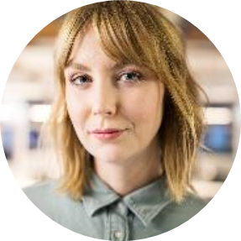


MEET OUR TEAM
Takuma Hayashi​
Mirjam Nilsson​
Flora Berggren​
Rajesh Santoshi​
President
Chief Executive Officer
Chief Operations Officer
VP Marketing

Slide 18




MEET OUR EXTENDED TEAM
Takuma Hayashi​
Mirjam Nilsson​
Flora Berggren​
Rajesh Santoshi​
President
Chief Executive Officer
Chief Operations Officer
VP Marketing
Graham Barnes
Rowan Murphy
Elizabeth Moore
Robin Kline
VP Product
SEO Strategist
Product Designer
Content Developer

Slide 19
SUMMARY
At Krypto Logics, we believe in giving 110%. By using our next-generation data architecture, we help investors virtually manage their portfolios. We thrive because of our market knowledge and great team. As our CEO says, "Efficiencies will come from proactively transforming how we do business."

Slide 20
THANK YOU
Mirjam Nilsson​
mirjam@greatsiteaddress.com
www.greatsiteaddress.com

