Slide 1

Predicting Mobile Phone Prices Using Machine Learning
NEXTHIKE IT SOLUTIONS
Mr. Aniket G. Tayade.

Slide 2

PROBLEM STATEMENT
Objective: Predict mobile prices based on key features to optimize pricing strategies.
Challenges:
High competition in the mobile market.
Pricing depends on technical specs, brand value, and market trends.
Business Impact: Accurate pricing → Increased sales and profitability.

Slide 3

Understanding Our Data
Source: Processed_Flipdata.csv (541 records).
Key Features:
Technical: RAM, Memory, Battery, Camera (MP), Processor.
Categorical: Brand, Color, AI Lens.
Data Quality:
Cleaned outliers (e.g., unrealistic battery capacities).
Handled high cardinality (e.g., 163 unique models).

Slide 4

Data Cleaning & Preprocessing
Total Records
541 Rows and 12 Columns
Features:
Model, RAM, Battery, Camera, Processor, Color
Feature Types: Numerical and Categorical
Observations: Minor missing values, slight data imbalance on models

Slide 5
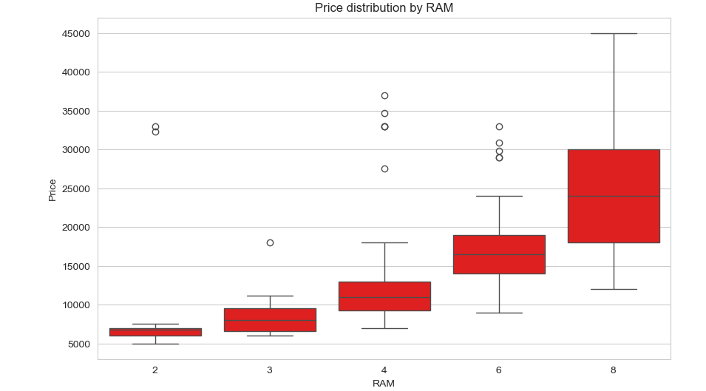
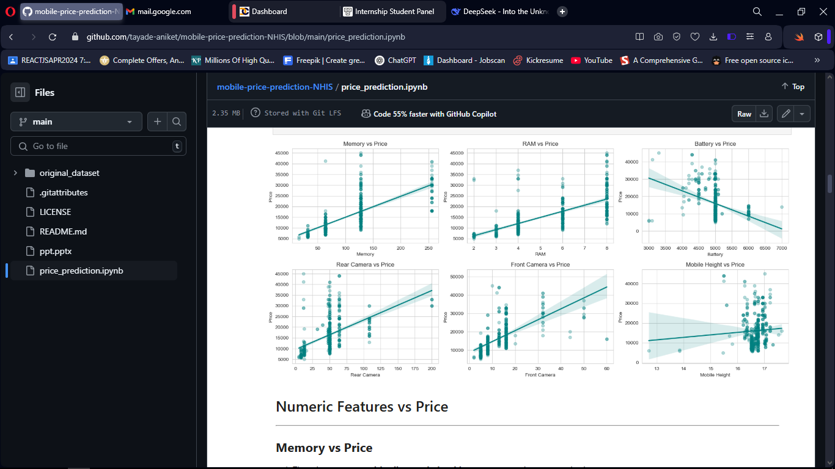
Exploratory Data Analysis (EDA)
Visuals:
Boxplot: Price distribution by RAM (higher RAM = higher price).
Scatterplot: Rear Camera MP vs. Price (positive correlation).
Key Insights:
Premium phones (>₹30k) have 8GB RAM, 128GB+ storage, 50MP+ cameras.
Budget phones (<₹10k) cluster around 4GB RAM, 64GB storage.

Slide 6
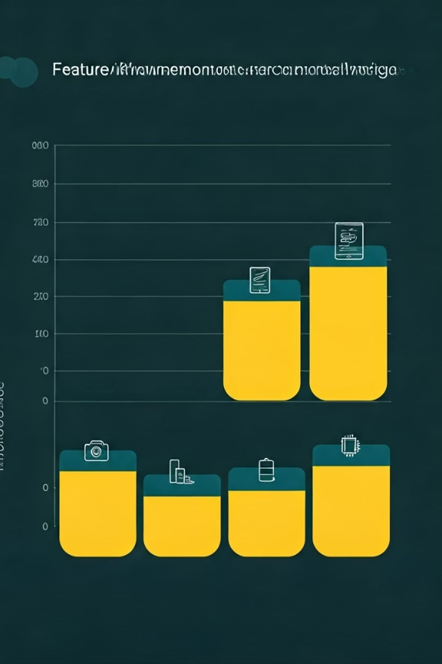
Feature Engineering
Engineered Features:
Total_Camera_MP: Sum of front + rear cameras.
Memory_to_RAM_ratio: Memory(GB)/RAM(GB).
Is_High_End: Binary flag (RAM ≥ 8GB & Memory ≥ 128GB).
Encoding:
Label encoding for brands/processors.
One-hot encoding for colors

Slide 7
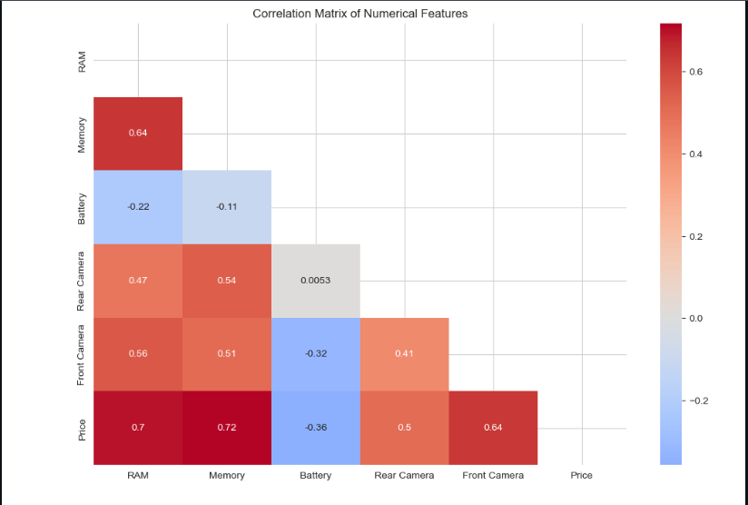
Feature Importance
Random Forest Results (Top 5 Features):
RAM (25% importance).
Memory (20% importance).
Brand_Avg_Price (15% importance).
Rear Camera MP (12% importance).
Battery (8% importance).
Heatmap: Correlation matrix highlighting strong RAM-Price relationship (r=0.72).

Slide 8
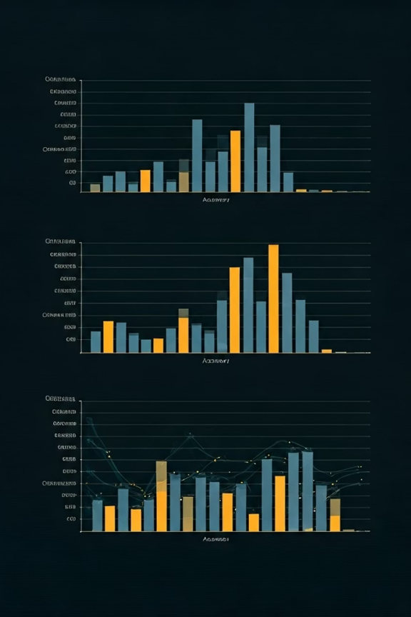
Model Comparison
Performance Metrics (R2 Score):
Random Forest:0.992 (Best)
Gradient Boosting: 0.991
Decision Tree:0.983.
Linear Regression:0.789.
Why Random Forest?
Handles non-linear relationships.
Robust to outliers.

Slide 9
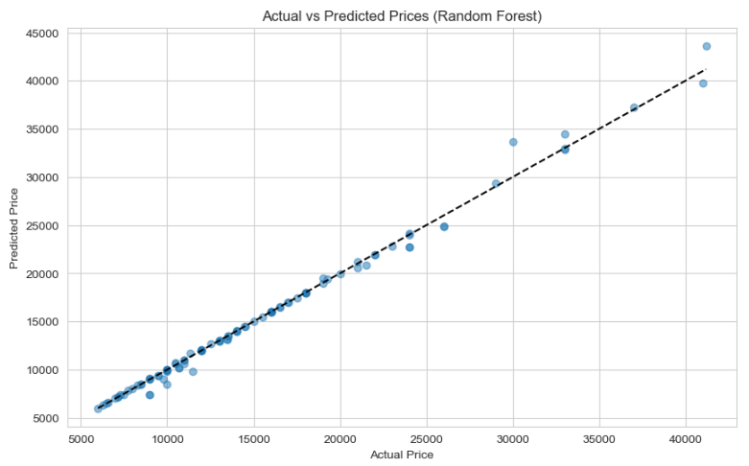
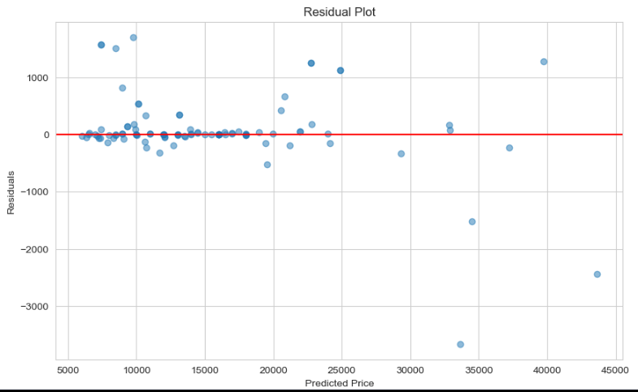
Model Evaluation
Visualizations:
Actual vs. Predicted Prices: Near-perfect diagonal line.
Residual Plot: Errors centered around zero (no bias).
Metrics:
CV R2 Mean - 0.984089
CV R2 Std - 0.003253
MAE - 301.386771
RMSE - 661.057137
R2 - 0.992606
Adj R2 - 0.991832

Slide 10
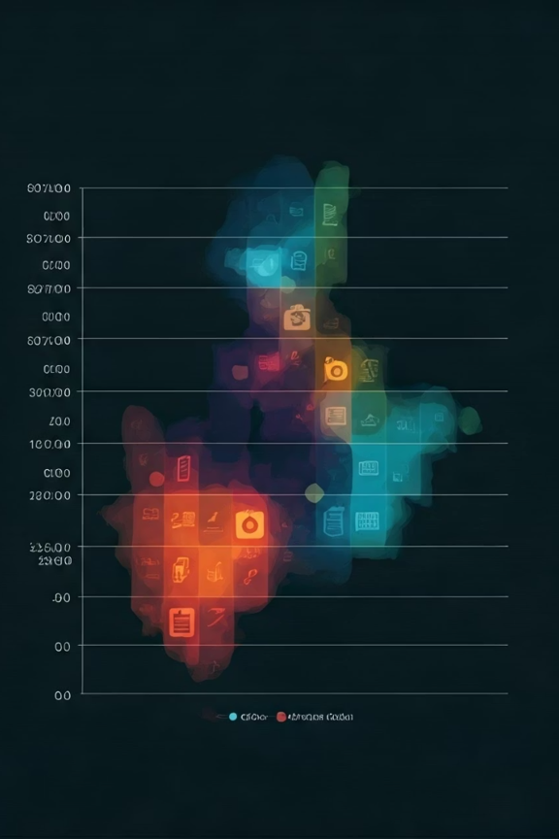
Business Insights
Pricing Recommendations:
Premium phones: Price higher for 8GB RAM + 128GB storage.
Budget phones: Compete on camera specs (e.g., 50MP at <Rs. 15k).
Marketing Strategies:
Highlight RAM/Memory for budget segments.
Emphasize camera/processor for premium segments.

Slide 11
Conclusion
Random Forest achieved 99.2% accuracy in price prediction. RAM, Memory, and Brand are top price drivers.

Slide 12

THANK YOU
Grateful for your time and attention. Your feedback and insights are deeply appreciated!
Mr. Aniket G. Tayade.
tayadeanni@gmail.com

