Slide 1
Welcome to our cake bakery

Slide 2
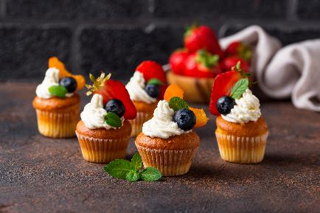
Bake My Cake project By: Meenakshi Tayade

Slide 3

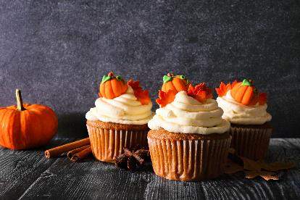
Agenda
To develop a single page application using Angular, that allow customers to make an online request for cakes, cookies , brownies or cupcakes of their choice.

Slide 4

Introduction
Bake by cake is a single page web application for cake ordering made with JavaScript framework called angular.

Slide 5
Problem Statement
In the contemporary landscape of confectionery, the demand for cakes, cookies, and brownies is ubiquitous. However, the traditional methods of acquiring these delightful treats often fall short of meeting the dynamic needs of both customers and businesses. To address this, the "Bake My Cake" project aims to revolutionize the ordering experience by introducing an online platform. This system will not only cater to the preferences of customers but also empower businesses to extend their reach and enhance customer satisfaction.

Slide 6





TECHNOLOGIES USED
HTML
CSS
Angular Framework
Material Ui
JSON Server

Slide 7
COMPONENTS | SERVICES | MODELS
App component | Auth Service | Item
Header | Item-service | order
Home
item
Login
Order page
Order-dashboard
Page not found
Search
footer

Slide 8













Slide 9
Home-Front Page
Display images of cakes, cookies, and brownies.
Fetch data using json-server.
Set Home view as default.
Enable selection of items.
Upon selection, navigate to the order view.
Implement search by item name and filtering by category.

Slide 10
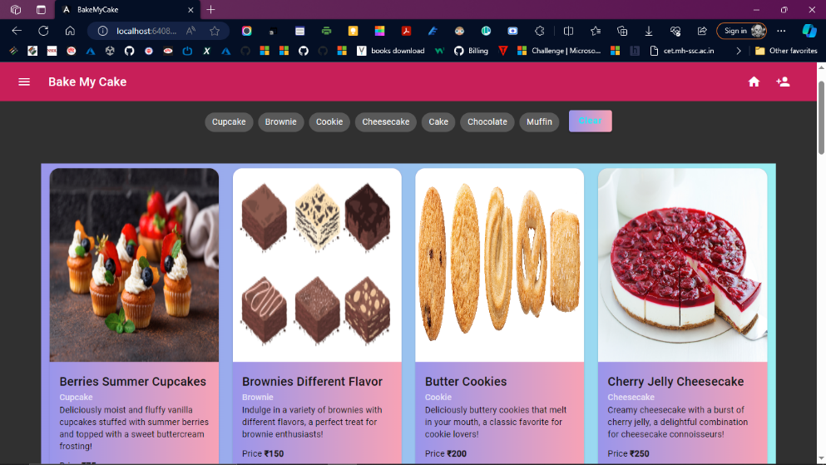

Slide 11
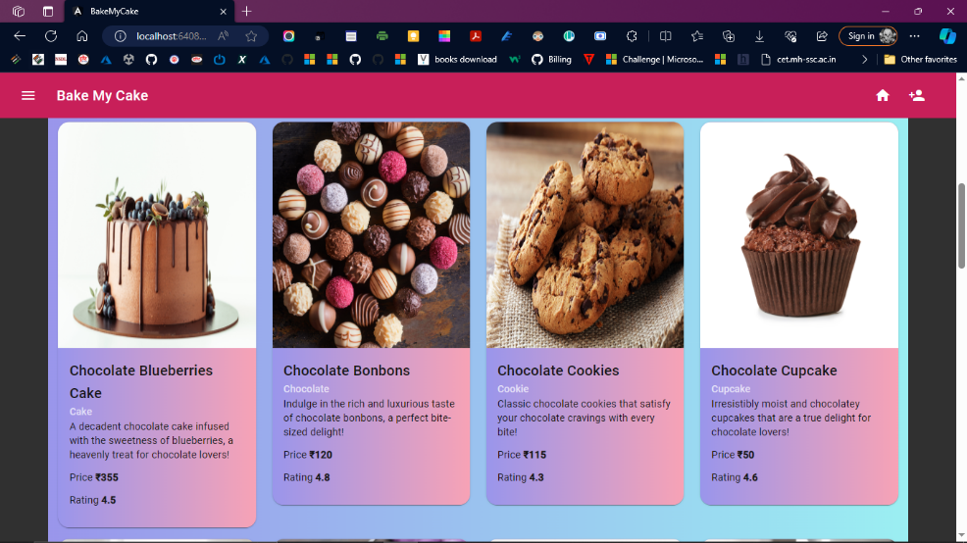

Slide 12
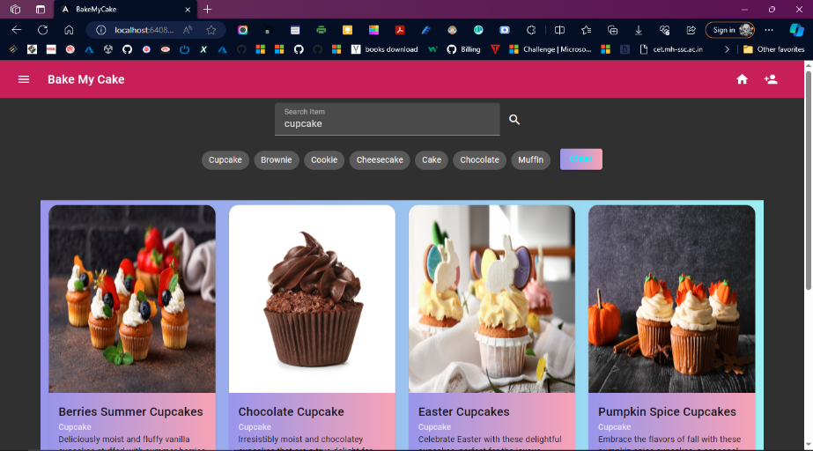
Search - Cupcake

Slide 13
Order page
Customer want to the order pleased.
Select the item you want to order.
It display the details of this item.
It can be allow to the filed detail of customers like name, email, contact number.

Slide 14
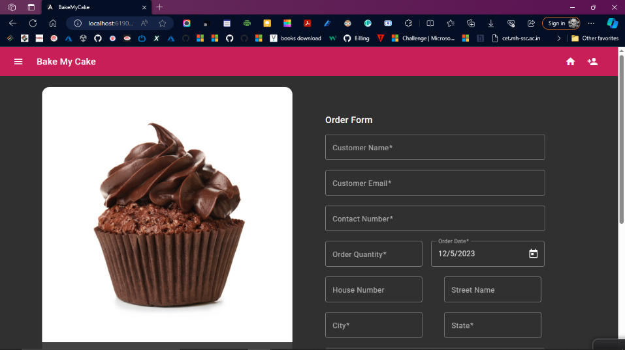

Slide 15
Login-Administration page
The view will request to the user to enter security id and password as a administrator.
Then successfully login to the page then display cake request view and display all bakery orders.

Slide 16
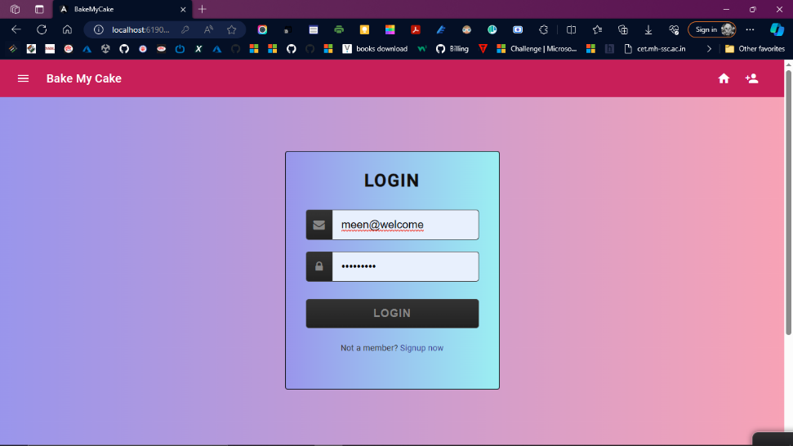

Slide 17
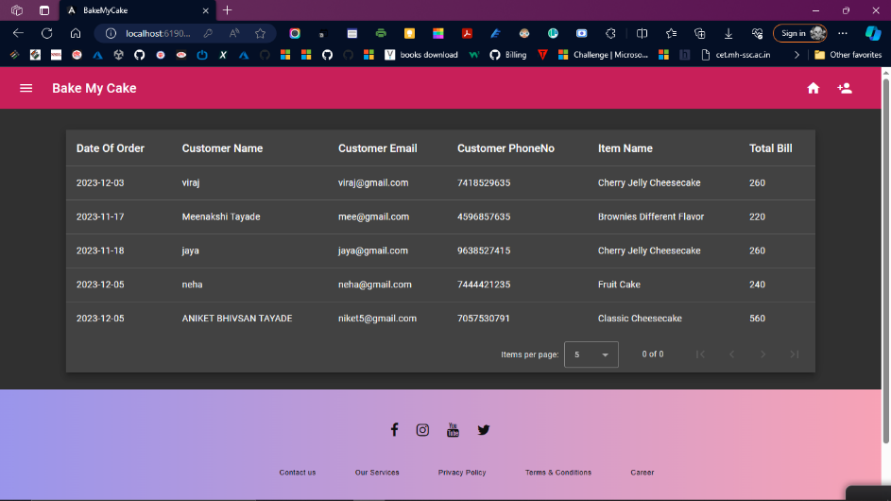
Admin Page

Slide 18
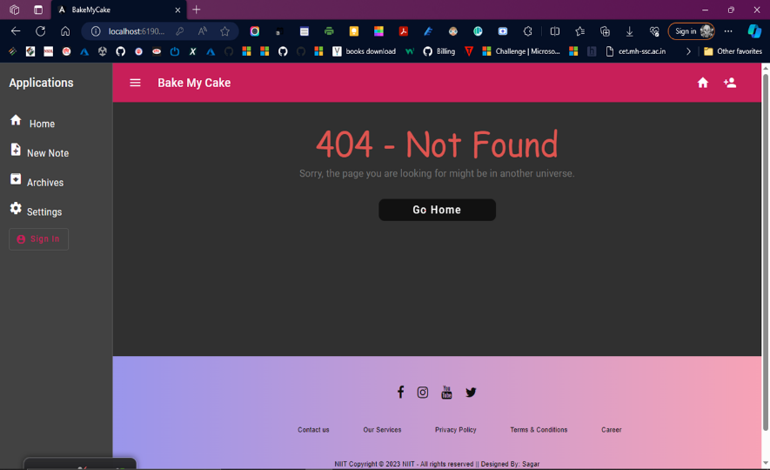

Slide 19
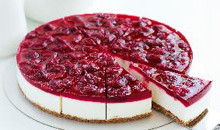


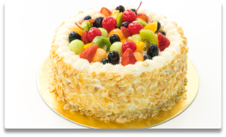

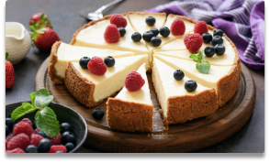

Thank you….

