Slide 1

Development of a AI/ML based predictive model for estimation of Monthly Per Capita Expenditure (MPCE)
INSIGHT SEEKERS
SANDESH TAYDE NIRAJ PATIL
SHRUITI KHAPEKAR
ADITI PAWAR
RONALD CHETTIAR

Slide 2
SUMMARY
PROBLEM STATEMENT:
HCES is conducted every five years, delaying MPCE estimates. This project aims to build an AI/ML model to predict household expenditure more frequently using demographic data.
SOLUTION:
We engineered diverse features from the provided demographic data and explored multiple models to predict MPCE at the household level. Among them, our Gradient Boosting model delivered best performance in terms of R-squared, RMSE, and MAPE.

Slide 3




UNIQUENESS
State-Wise Focus for Data Integrity
Targeted Feature Selection Using Lasso
Dimensionality Reduction of Nominal Variables
Simplified and Robust Model

Slide 4




Technical Aspects & Feasibility
DATA:
Household Level Data-
HH_Level_train_data
HH_Level_test_dat
Personal Level Data-
Person_Level_train_data
Person_Level_test_data
Data loading
1
Merging To Household Level
2
4
3
Model Training And Comparison
Feature Engineering

Slide 5
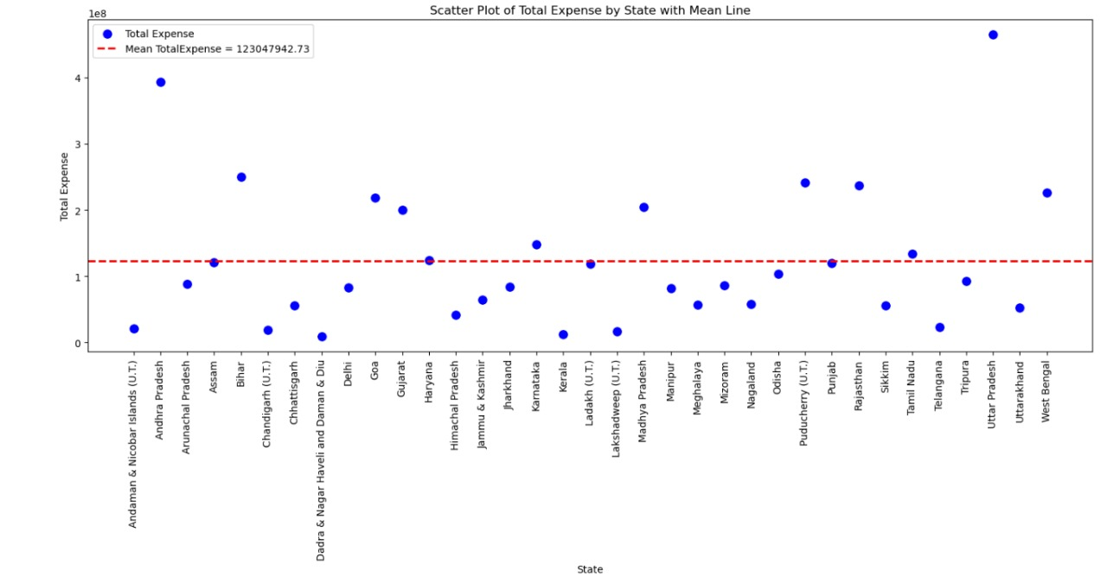
KEY FEATURES

Slide 6
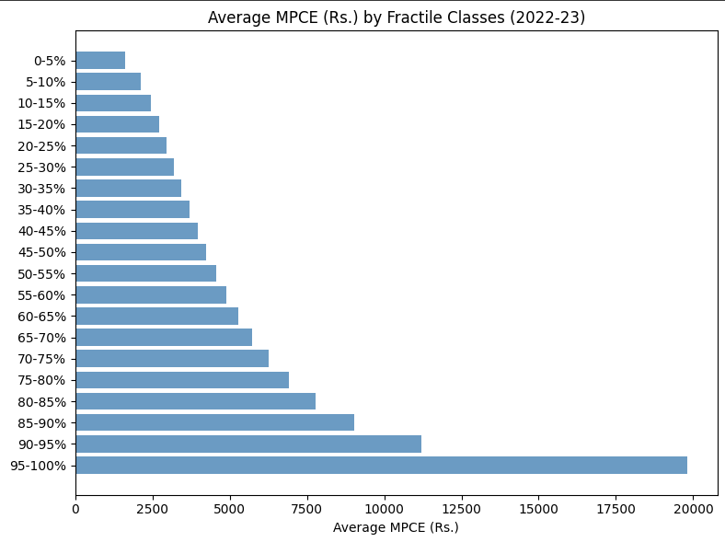
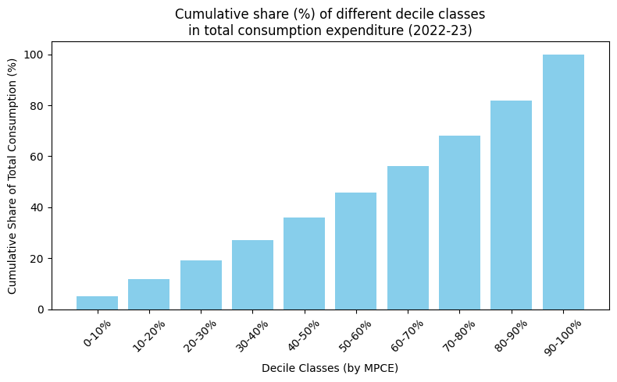
KEY FEATURES

Slide 7
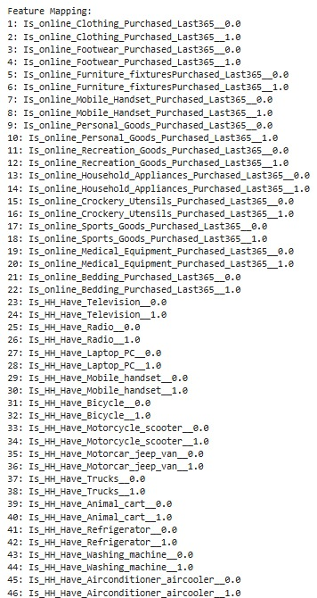
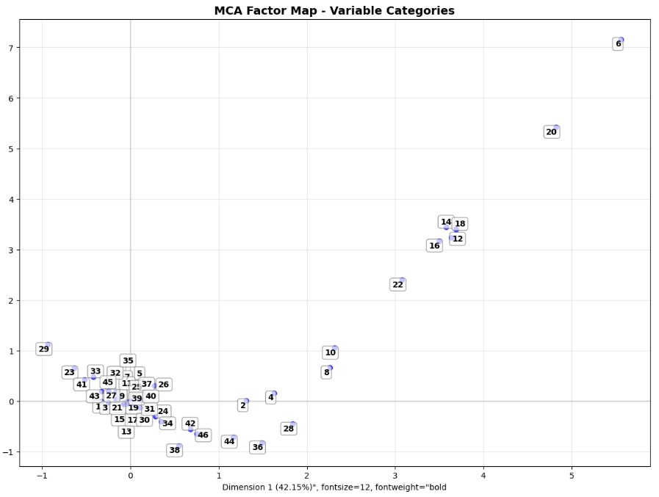
KEY FEATURES

Slide 8
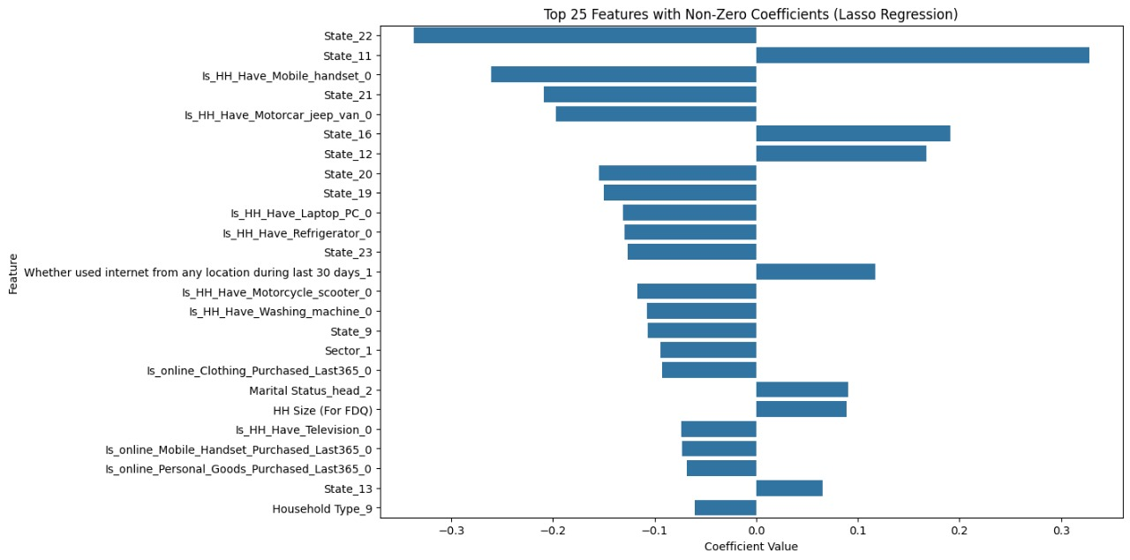
KEY FEATURES

Slide 9
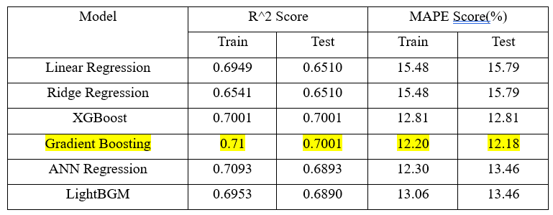
SUMMARY

Slide 10
BENIFITS
01
02
03
Cost-Effective Policy Planning
Saves Time And Money
Improved targeted government policies

Slide 11
SCALABILITY
01
02
03
Adaptability to different states
Handles Large-scale Data
Flexible for different use cases

Slide 12
IMPACT
01
02
03
Bridging Data Gaps
Boosting Economic Research
Effective Resource Allocation

Slide 13
ROLE OF THE TEAM MEMBERS
Team Members:
1. Shruti Khapekar :- Model building
2. Sandesh Tayde : Model building & feature scaling
3. Niraj Patil :- Feature Selection
4. Aditi Pawar : Data Preprocessing
5. Ronald Chettiar : Data Preprocessing & Documentation

Slide 14
FUTURE SCOPE
01
02
03
If time series data is available, applying time series models can yield accurate results
Leveraging advanced deep learning techniques for more accurate predictions
Collaboration for real-world deployment and optimization
THANK YOU

Slide 15
THANK YOU

