Slide 1




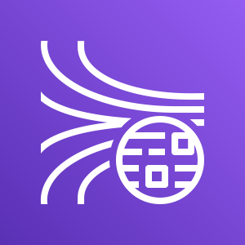


AWS Cloud
VPC
Push data
to Kinesis data streams.
Trigger Kinesis Firehose.
EC2
API to fetch slack data.
Push data to s3
Post messages
Get
request
Slack
Landing Bucket
Users

