Slide 1

©2007 SugarCRM Inc. All rights reserved.

Slide 2

7 Common Customizations
Anyone Can Do
Andy Dreisch
VP, Online Services
©2007 SugarCRM Inc. All rights reserved.

Slide 3
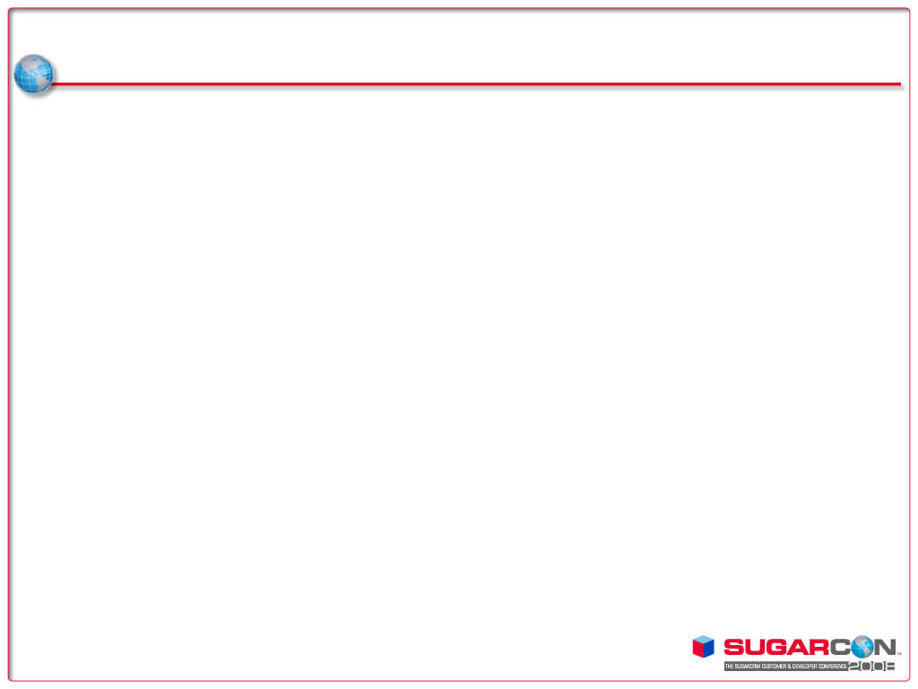
Or, as I like to call it …
7 Common Customizations
Even a VP Can Do!!
©2007 SugarCRM Inc. All rights reserved.

Slide 4
Today’s task is simple
Create a new field and make that field read-only for certain members of the organization and then use that field in a report pinned to the dashboard while you go about augmenting Sales stages, creating a workflow process triggered by a new stage value, and then building an entirely new upgrade-safe module that captures input obtained from your cell phone using some nifty web services APIs and then build a report to display the
promo codes gather via the audience.
©2007 SugarCRM Inc. All rights reserved.

Slide 5

Task Breakdown
Create a custom field (“Promo Code”) on Opportunities module
Restrict access by making it read-only
Involve field on a report pinned to the Dashboard
Add a new “Sales Stage” called “Closed Promo”
Create a Workflow based on new Sales Stage field value
Create a new module to capture live audience feedback
Create a report displaying Promo responses
©2007 SugarCRM Inc. All rights reserved.

Slide 6
How are we doing so far?
Create a custom field (“Promo Code”) on Opportunities module
Restrict access by making it read-only
Involve field on a report pinned to the Dashboard
Add a new “Sales Stage” called “Closed Promo”
Create a Workflow based on new Sales Stage field value
Create a new module to capture live audience feedback
Create a report displaying Promo responses
©2007 SugarCRM Inc. All rights reserved.

Slide 7
How are we doing so far?
Create a custom field (“Promo Code”) on Opportunities module
Restrict access by making it read-only
Involve field on a report pinned to the Dashboard
Add a new “Sales Stage” called “Closed Promo”
Create a Workflow based on new Sales Stage field value
Create a new module to capture live audience feedback
Create a report displaying Promo responses
©2007 SugarCRM Inc. All rights reserved.

Slide 8
How are we doing so far?
Create a custom field (“Promo Code”) on Opportunities module
Restrict access by making it read-only
Involve field on a report pinned to the Dashboard
Add a new “Sales Stage” called “Closed Promo”
Create a Workflow based on new Sales Stage field value
Create a new module to capture live audience feedback
Create a report displaying Promo responses
©2007 SugarCRM Inc. All rights reserved.

Slide 9
Time for Live Participation
SMS 32075 on your cell
Enter ‘SugarCon’ and a value for Promo Code, like ‘Radio’ or ‘TV’ or ‘Coupon’
Ex: SugarCon TV
©2007 SugarCRM Inc. All rights reserved.

Slide 10
Final thoughts
The SMS functionality will soon be part of the standard demo system for your use
Everything done today is 100% upgrade-safe

