Slide 1
Single Moms of U.S. Need for Childcare and Employment
Taylor Woodington

Slide 2
Introduction
For just one child, childcare prices can range between $4,810 to $15,417 a year.
This may not seem like a lot but this is for one child and can add up.
Many families do not have a second income and have other responsibilities or more children to provide for.

Slide 3
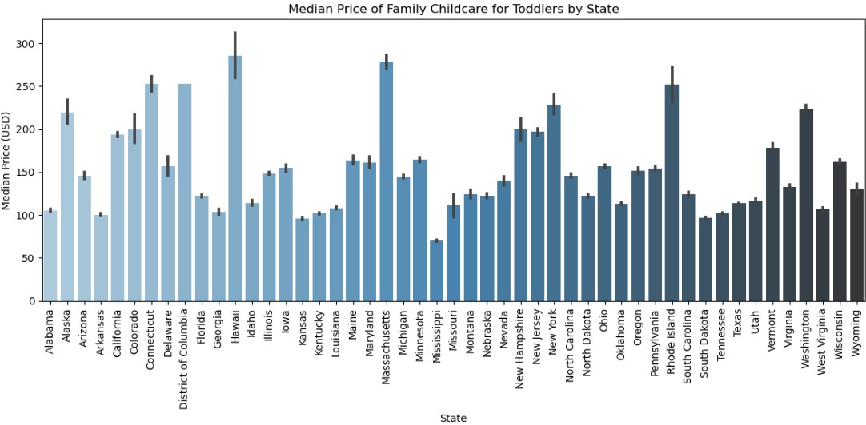
Which States have the most expensive and least expensive childcare?

Slide 4
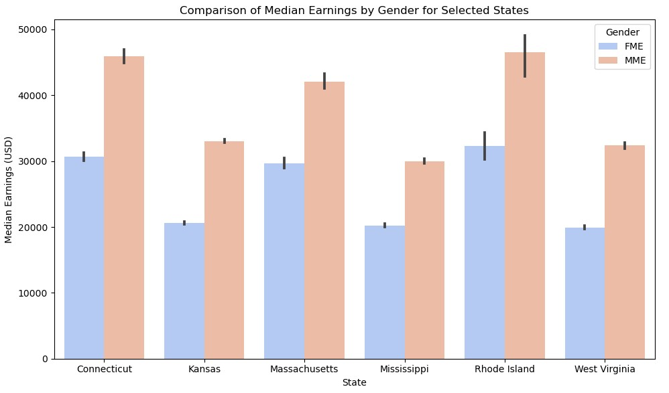
The Three Most Expensive and Least Expensive States, Earnings by Gender Compared
From this graph we see the Males earn more overall than the females in every state.

Slide 5
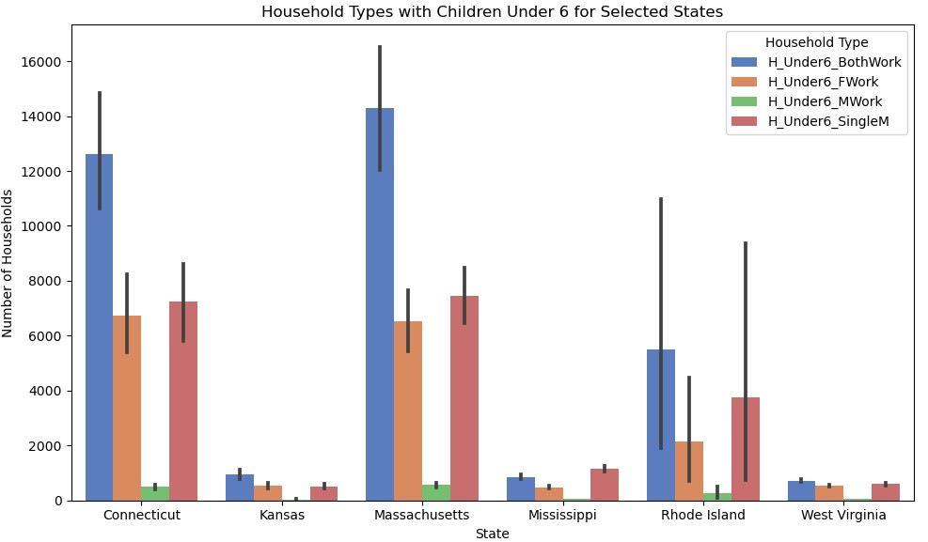
How many households are supported by single mothers?
Majority of the population has two working parents.
Next most popular household type is a single working mother home.

Slide 6
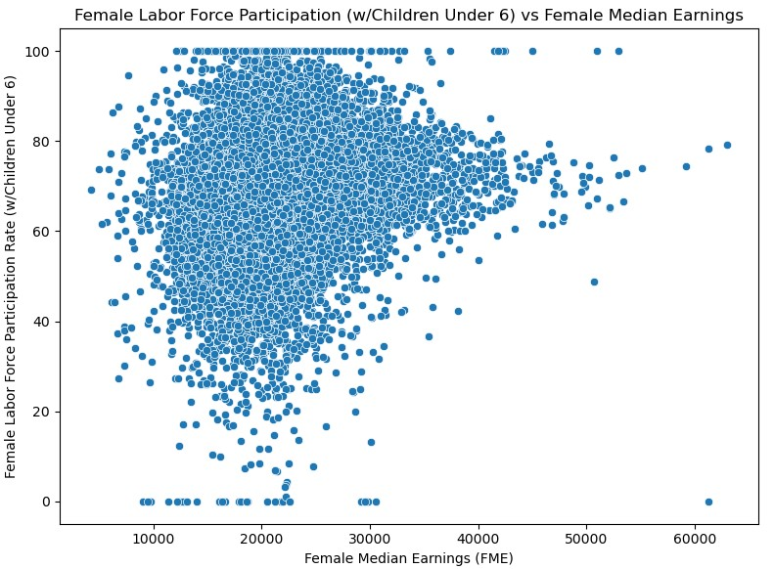
How many women are employed with children under 6 and what does their income look like.

Slide 7
What the data says:
Males yield higher earnings than females across multiple states.
Besides two working parent families, the second highest household type in multiple states are single working mothers.
Majority of women earn less than $35,000 (USD) a year.

Slide 8
Proposal:
Daycares could be a significant part of the solution.
By providing a program where single mothers could be marketed toward for employment at these local daycares with a benefit of receiving free childcare for their kids.

