Slide 1


Competency Assessment Report
{{#if logo1}}{{pptxImage src=logo1 usePlaceholderSize=true}}{{/if}}
{{ firstCharUpper firstName}} {{ firstCharUpper lastName}}
Name:
{{assessmentName}}
Target Position:

Slide 2
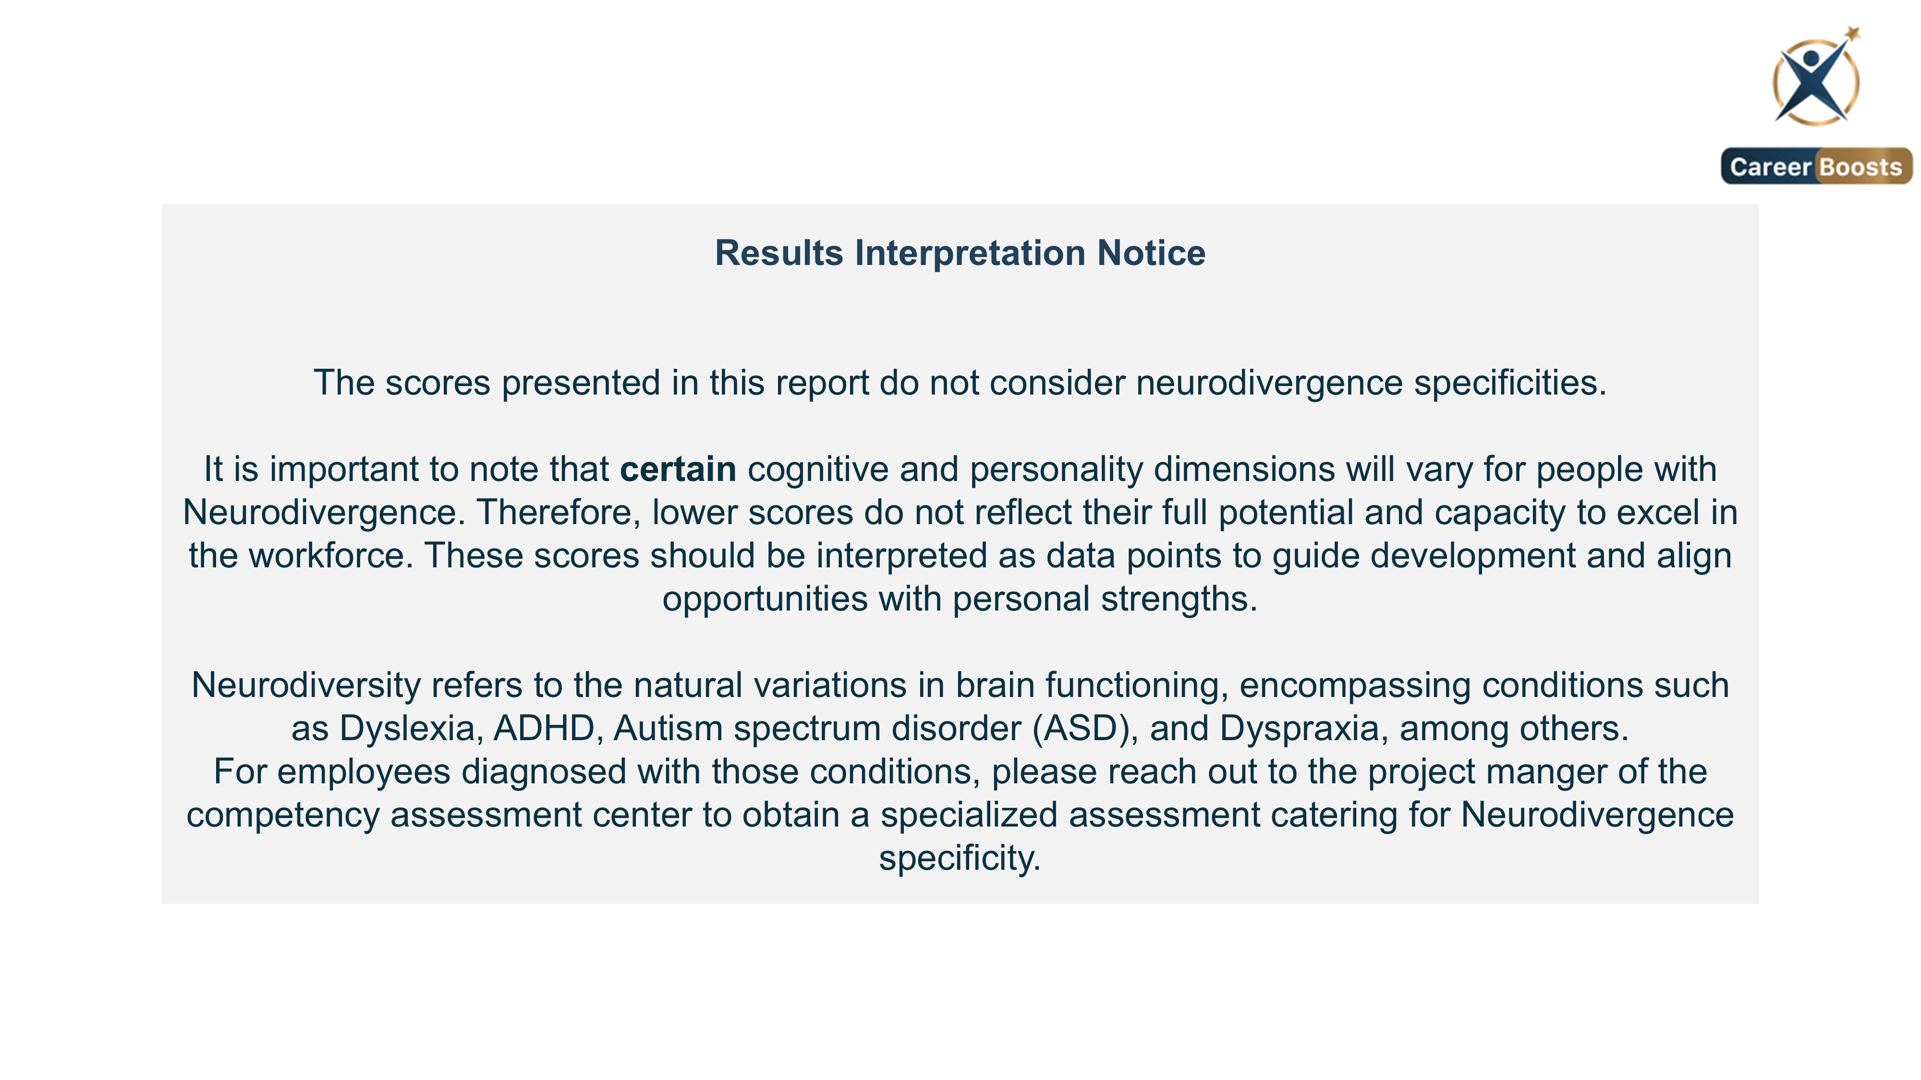
2

Slide 3
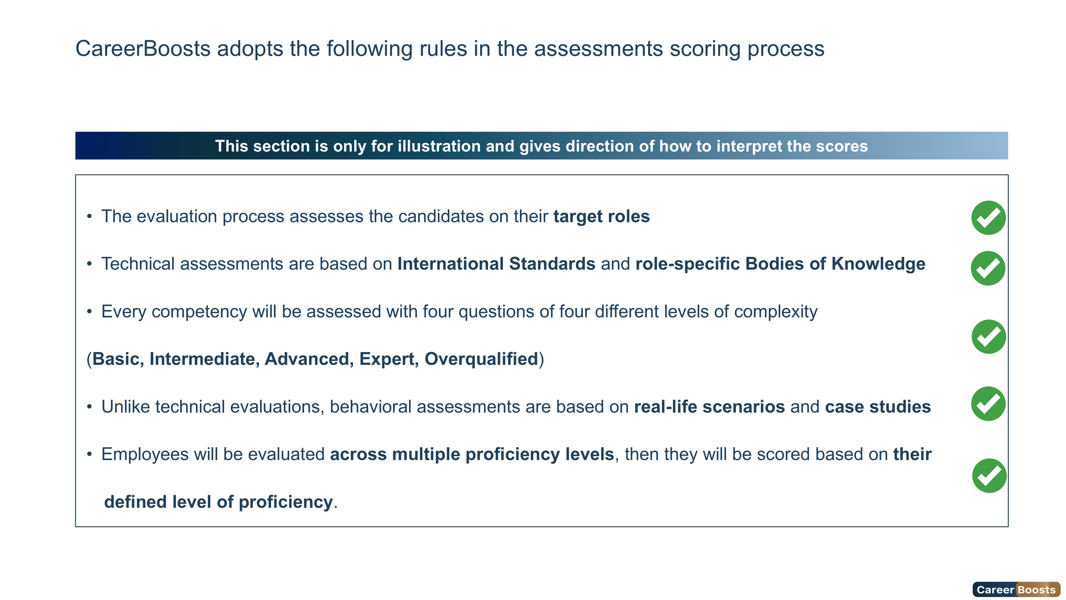
3

Slide 4
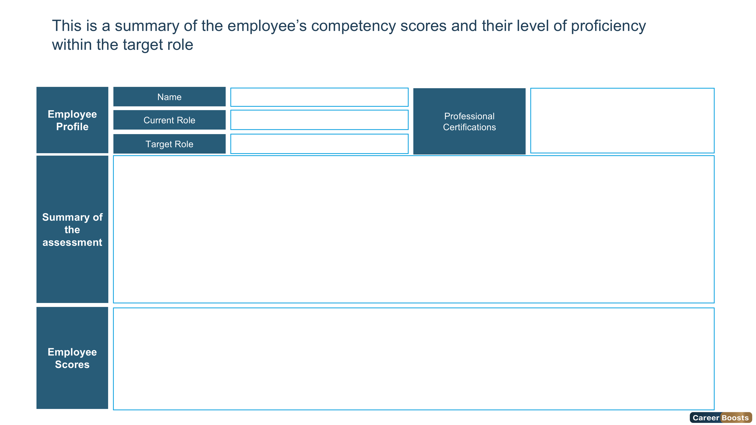

{{#if logo1}}{{pptxImage src=logo1 usePlaceholderSize=true}}{{/if}}
{{#if (eq overallLevel 1)}} Foundation {{else}} Foundation {{/if}}
{{#if (eq overallLevel 2)}} Intermediate{{else}} Intermediate{{/if}}
{{#if (eq overallLevel 3)}} Advanced{{else}} Advanced{{/if}}
{{#if (eq overallLevel 4)}} Expert {{else}} Expert{{/if}}
{{#if (eq overallLevel 5)}} Overqualified {{else}} Overqualified{{/if}}
{{ firstCharUpper firstName}} {{ firstCharUpper lastName}}
{{roleName}}
{{assessmentName}}
{{ternary (eq gender "Female") "Mrs" "Mr"}}. {{firstCharUpper firstName}} {{ firstCharUpper lastName}} has secured the {{overallLevelName}} Level of the role {{assessmentName}} with an Overall Score of {{overallScore}}%. {{ ternary (eq gender "Female") "She" "He" }} Scored {{assessmentSentence assessment}} {{competencyHighlights gender technical behavioral}} {{competencyImprovements technical behavioral}} {{developmentPlanSentence gender}}
Overall Score
{{#if assessment.[1].name}} {{assessment.[1].name}} Score{{/if}}
{{#if assessment.[2].name}} {{assessment.[2].name}} Score{{/if}}
{{#if assessment.[3].name}} {{assessment.[3].name}} Score{{/if}}
{{#if assessment.[4].name}} {{assessment.[4].name}} Score{{/if}}
{{#if assessment.[5].name}} {{assessment.[5].name}} Score{{/if}}
{{#if overallScore}}{{pptxImage src=(concat chartUrl overallScore ".png") usePlaceholderSize=true}}{{/if}}
{{#if assessment.[1].score}}{{pptxImage src=(concat chartUrl assessment.[1].score ".png") usePlaceholderSize=true}}{{/if}}
{{#if technical.technicalScore}}{{pptxImage src=(concat chartUrl technical.technicalScore ".png") usePlaceholderSize=true}}{{/if}}
{{#if behavioral.behavioralScore}}{{pptxImage src=(concat chartUrl behavioral.behavioralScore ".png") usePlaceholderSize=true}}{{/if}}
{{pptxImage src=(concat chartUrl cognitive.cognitiveScore ".png") usePlaceholderSize=true}}
{{#if personality.personalityScore}}{{pptxImage src=(concat chartUrl personality.personalityScore ".png") usePlaceholderSize=true}}{{/if}}
{{#if cognitive.cognitiveScore}}{{pptxImage src=(concat chartUrl cognitive.cognitiveScore ".png") usePlaceholderSize=true}}{{/if}}
4

Slide 5
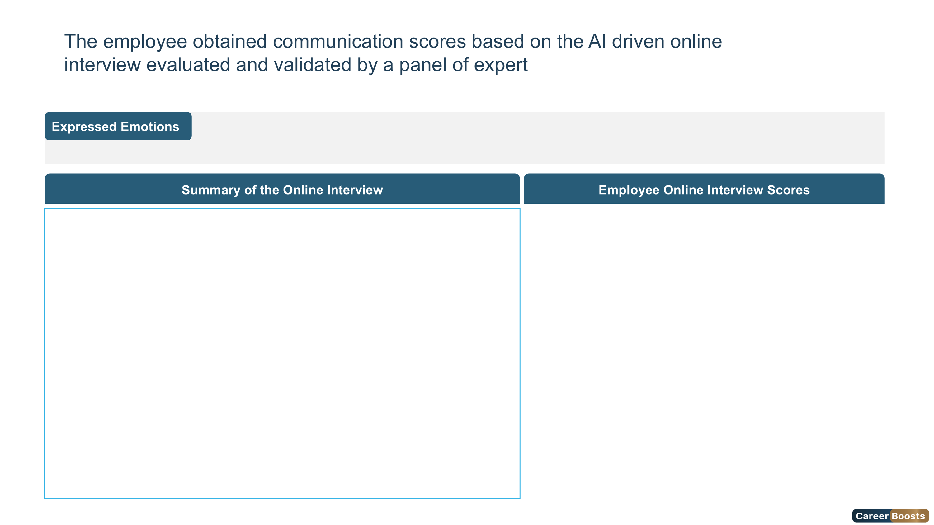

Joy
Surprise
Neutral
Sad
Fear
Angry
{{#if (eq emotion "disgust")}}
Disgust
{{else}}
Disgust
{{/if}}
5

Slide 6
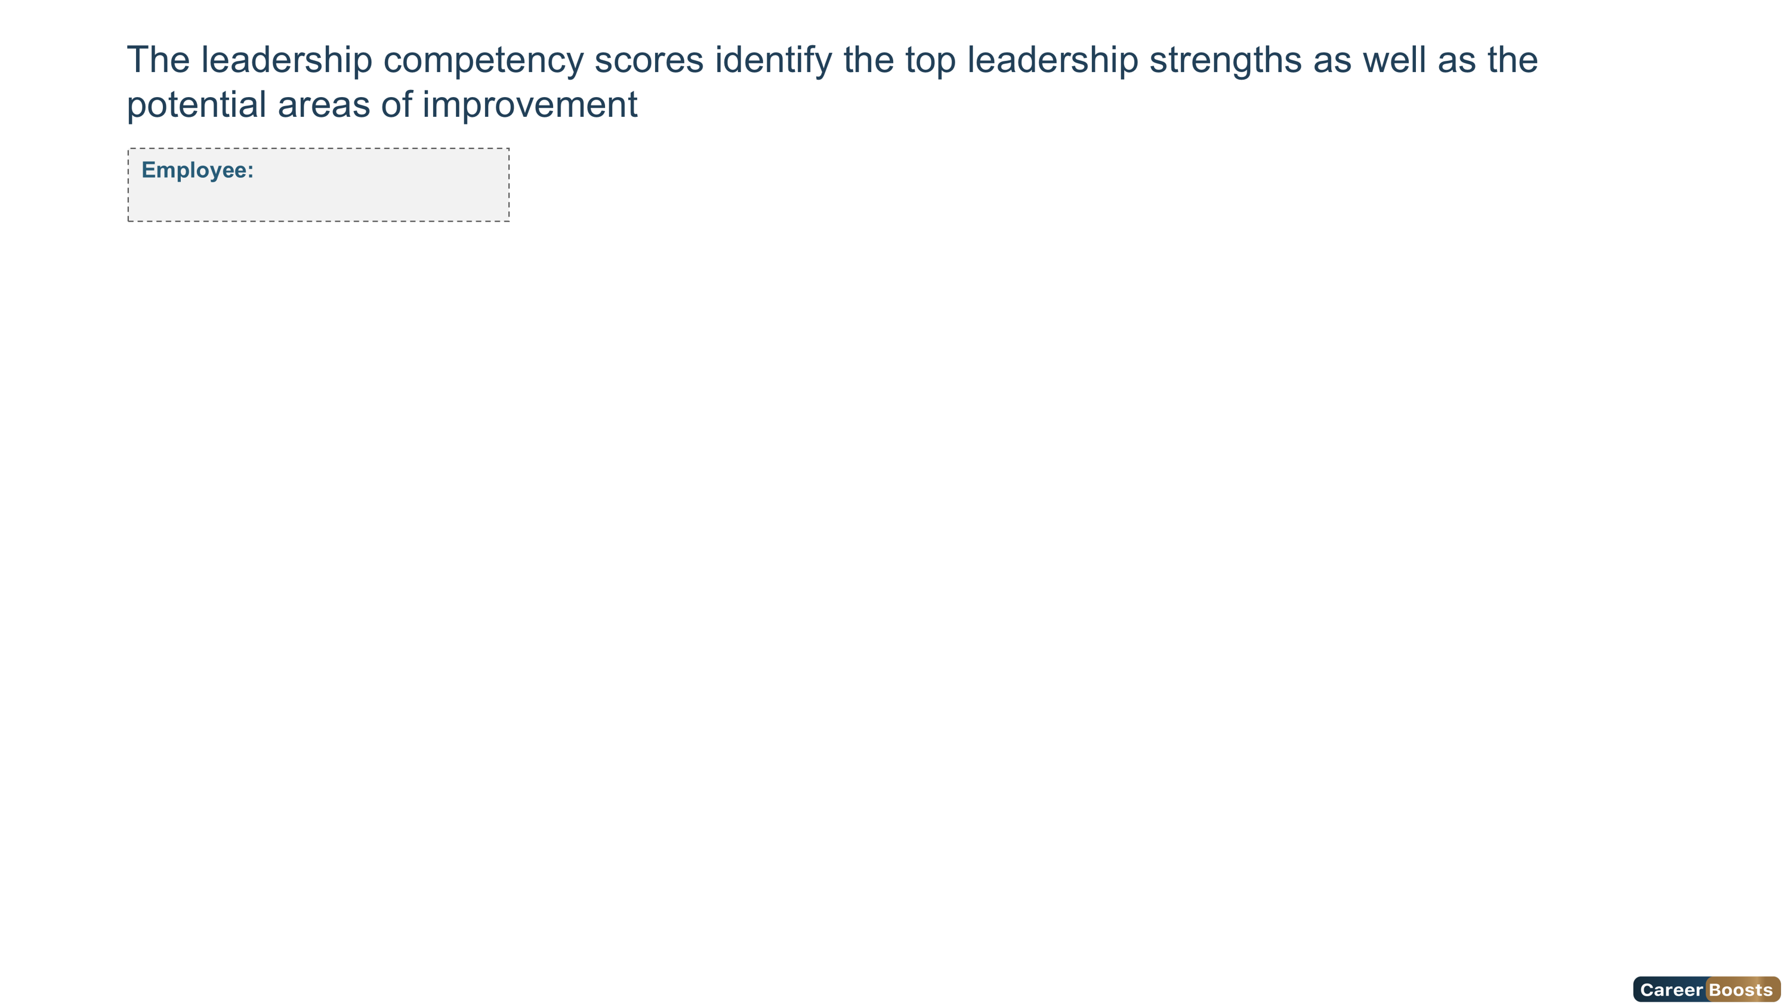
{{#if (eq overallLevel 1)}} Foundation {{else}} Foundation {{/if}}
{{#if (eq overallLevel 2)}} Intermediate{{else}} Intermediate{{/if}}
{{#if (eq overallLevel 3)}} Advanced{{else}} Advanced{{/if}}
{{#if (eq overallLevel 4)}} Expert {{else}} Expert{{/if}}
{{#if (eq overallLevel 5)}} Overqualified {{else}} Overqualified{{/if}}
Ms. ahlem masouad
Leadership Competencies Scores
6

Slide 7
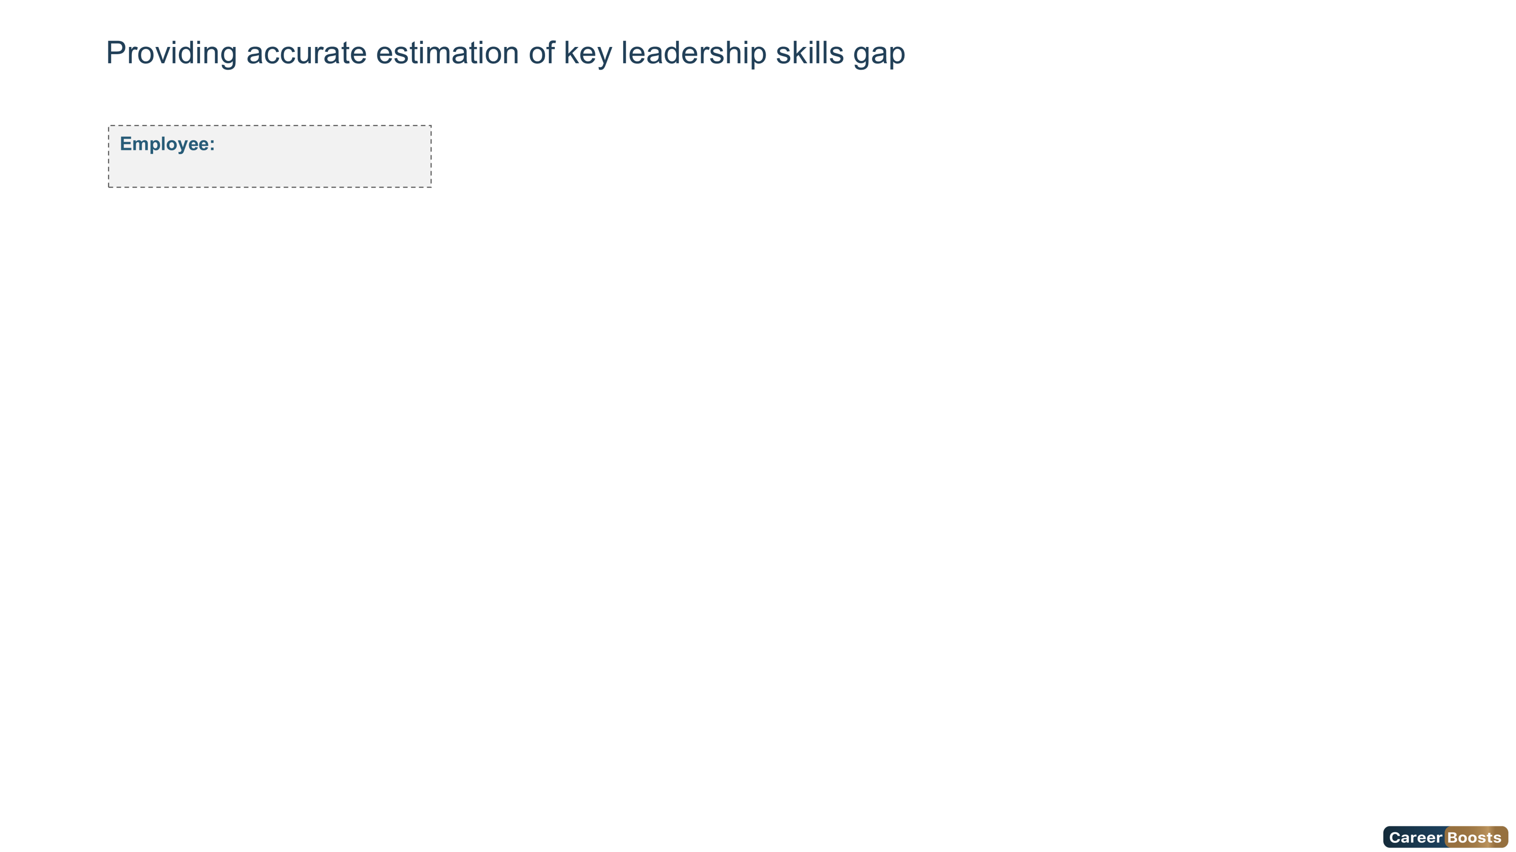
{{#if (eq overallLevel 1)}} Foundation {{else}} Foundation {{/if}}
{{#if (eq overallLevel 2)}} Intermediate{{else}} Intermediate{{/if}}
{{#if (eq overallLevel 3)}} Advanced{{else}} Advanced{{/if}}
{{#if (eq overallLevel 4)}} Expert {{else}} Expert{{/if}}
{{#if (eq overallLevel 5)}} Overqualified {{else}} Overqualified{{/if}}
Ms. ahlem masouad
7

Slide 8
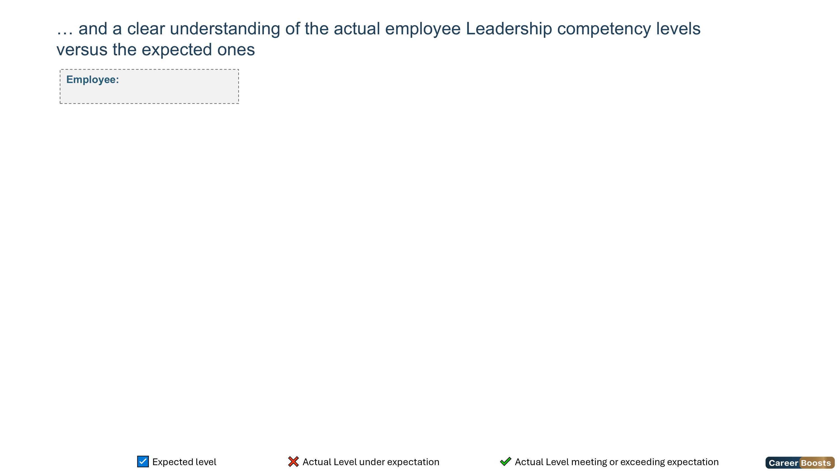
{{#if (eq overallLevel 1)}} Foundation {{else}} Foundation {{/if}}
{{#if (eq overallLevel 2)}} Intermediate{{else}} Intermediate{{/if}}
{{#if (eq overallLevel 3)}} Advanced{{else}} Advanced{{/if}}
{{#if (eq overallLevel 4)}} Expert {{else}} Expert{{/if}}
{{#if (eq overallLevel 5)}} Overqualified {{else}} Overqualified{{/if}}
Ms. ahlem masouad
Competency Name | Foundation | Intermediate | Advanced | Expert | Overqualified
8

Slide 9
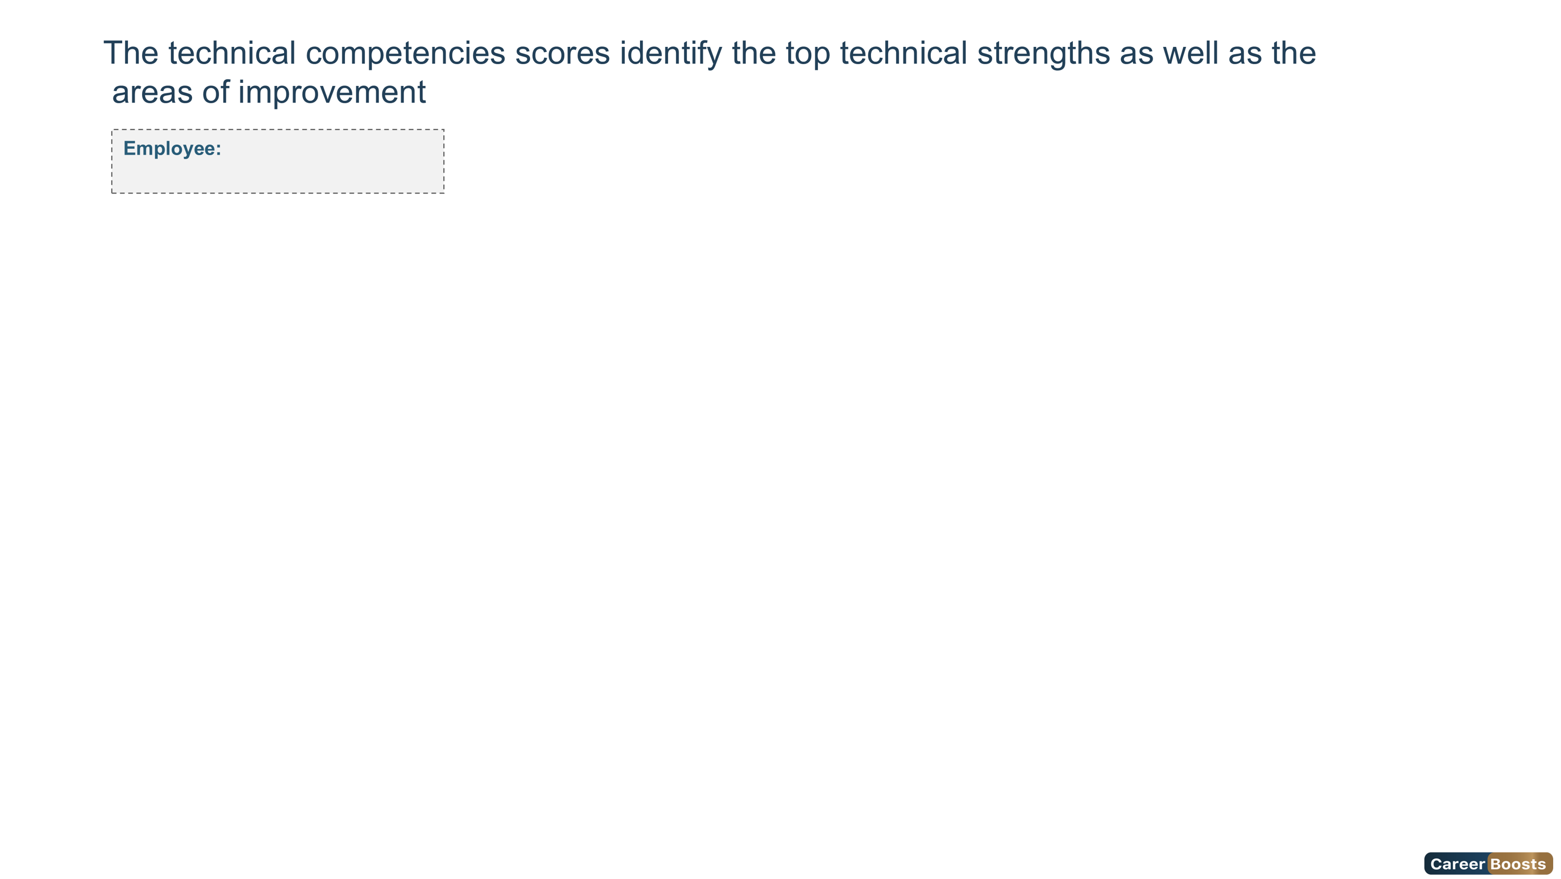
{{#if (eq overallLevel 1)}} Foundation {{else}} Foundation {{/if}}
{{#if (eq overallLevel 2)}} Intermediate{{else}} Intermediate{{/if}}
{{#if (eq overallLevel 3)}} Advanced{{else}} Advanced{{/if}}
{{#if (eq overallLevel 4)}} Expert {{else}} Expert{{/if}}
{{#if (eq overallLevel 5)}} Overqualified {{else}} Overqualified{{/if}}
Ms. ahlem masouad
Technical Competencies Scores
9

Slide 10
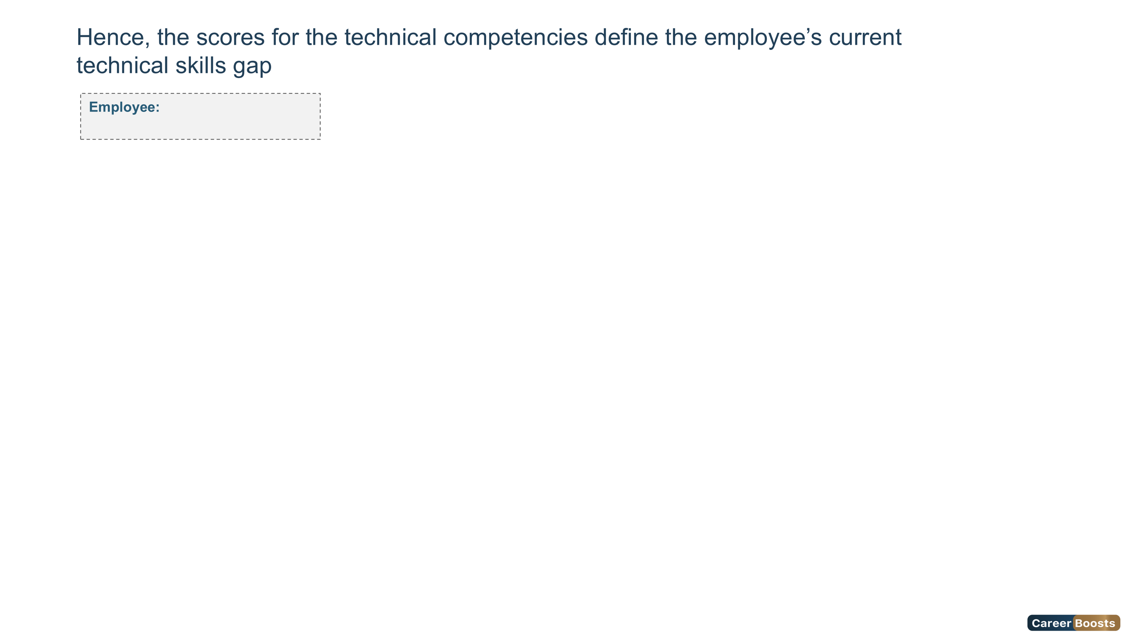
{{#if (eq overallLevel 1)}} Foundation {{else}} Foundation {{/if}}
{{#if (eq overallLevel 2)}} Intermediate{{else}} Intermediate{{/if}}
{{#if (eq overallLevel 3)}} Advanced{{else}} Advanced{{/if}}
{{#if (eq overallLevel 4)}} Expert {{else}} Expert{{/if}}
{{#if (eq overallLevel 5)}} Overqualified {{else}} Overqualified{{/if}}
Ms. ahlem masouad
10

Slide 11

{{#if (eq overallLevel 1)}} Foundation {{else}} Foundation {{/if}}
{{#if (eq overallLevel 2)}} Intermediate{{else}} Intermediate{{/if}}
{{#if (eq overallLevel 3)}} Advanced{{else}} Advanced{{/if}}
{{#if (eq overallLevel 4)}} Expert {{else}} Expert{{/if}}
{{#if (eq overallLevel 5)}} Overqualified {{else}} Overqualified{{/if}}
Ms. ahlem masouad
Competency Name | Foundation | Intermediate | Advanced | Expert | Overqualified
11

Slide 12
{{#if (eq overallLevel 1)}} Foundation {{else}} Foundation {{/if}}
{{#if (eq overallLevel 2)}} Intermediate{{else}} Intermediate{{/if}}
{{#if (eq overallLevel 3)}} Advanced{{else}} Advanced{{/if}}
{{#if (eq overallLevel 4)}} Expert {{else}} Expert{{/if}}
{{#if (eq overallLevel 5)}} Overqualified {{else}} Overqualified{{/if}}
Ms. ahlem masouad
Competency Name | Foundation | Intermediate | Advanced | Expert | Overqualified
12

Slide 13
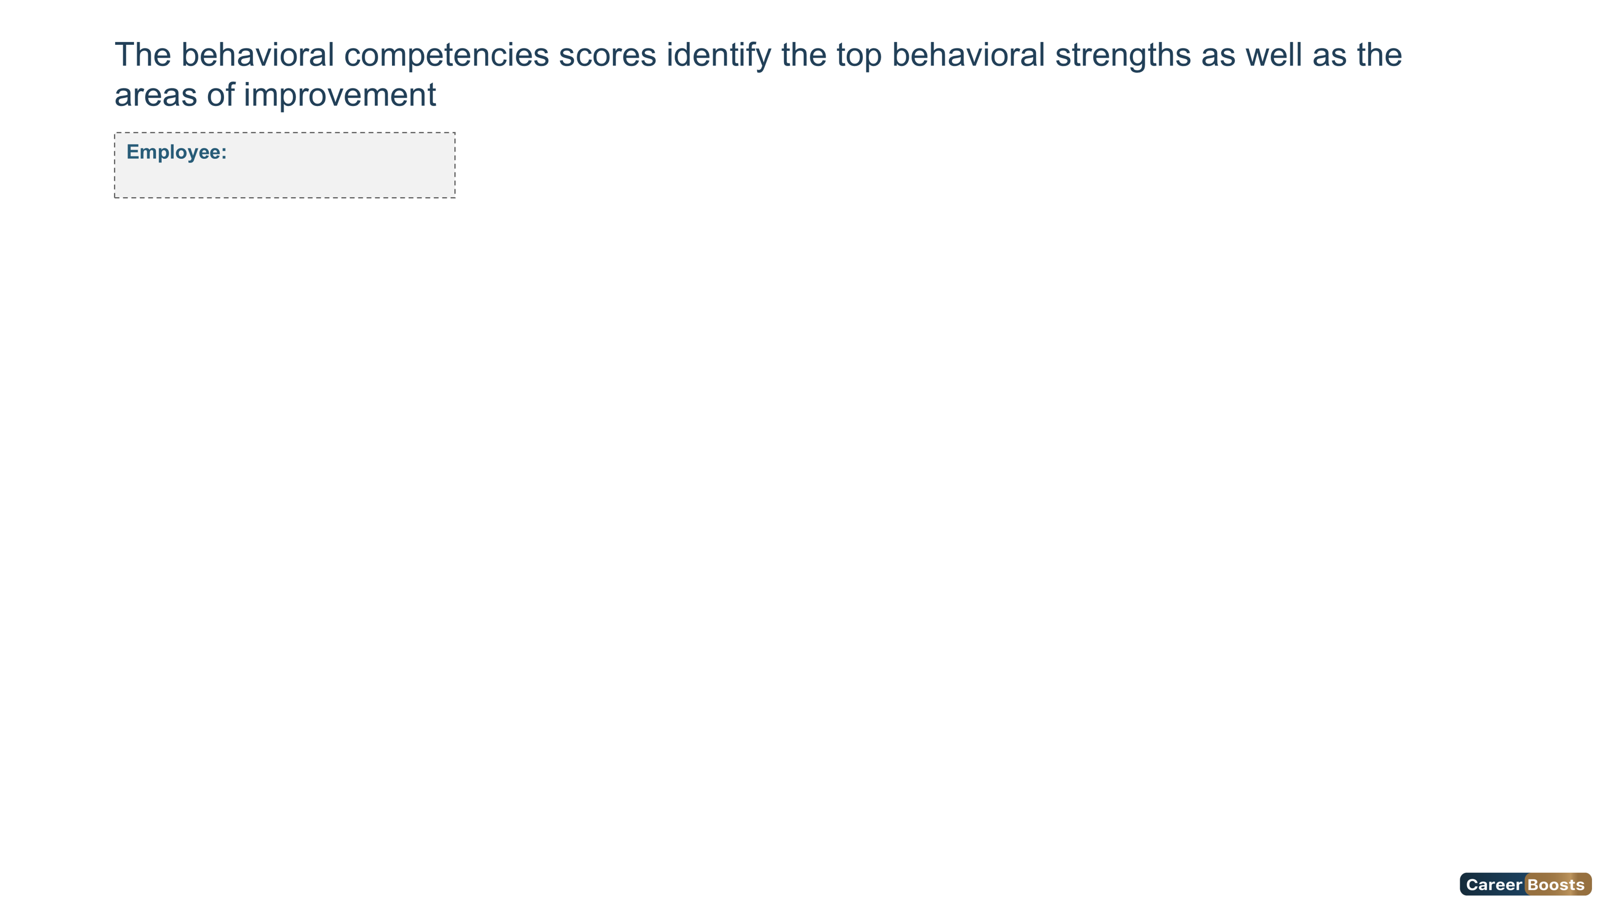
{{#if (eq overallLevel 1)}} Foundation {{else}} Foundation {{/if}}
{{#if (eq overallLevel 2)}} Intermediate{{else}} Intermediate{{/if}}
{{#if (eq overallLevel 3)}} Advanced{{else}} Advanced{{/if}}
{{#if (eq overallLevel 4)}} Expert {{else}} Expert{{/if}}
{{#if (eq overallLevel 5)}} Overqualified {{else}} Overqualified{{/if}}
Ms. ahlem masouad
Behavioral Competencies Scores
13

Slide 14

{{#if (eq overallLevel 1)}} Foundation {{else}} Foundation {{/if}}
{{#if (eq overallLevel 2)}} Intermediate{{else}} Intermediate{{/if}}
{{#if (eq overallLevel 3)}} Advanced{{else}} Advanced{{/if}}
{{#if (eq overallLevel 4)}} Expert {{else}} Expert{{/if}}
{{#if (eq overallLevel 5)}} Overqualified {{else}} Overqualified{{/if}}
Ms. ahlem masouad
14

Slide 15

{{#if (eq overallLevel 1)}} Foundation {{else}} Foundation {{/if}}
{{#if (eq overallLevel 2)}} Intermediate{{else}} Intermediate{{/if}}
{{#if (eq overallLevel 3)}} Advanced{{else}} Advanced{{/if}}
{{#if (eq overallLevel 4)}} Expert {{else}} Expert{{/if}}
{{#if (eq overallLevel 5)}} Overqualified {{else}} Overqualified{{/if}}
Ms. ahlem masouad
Competency Name | Foundation | Intermediate | Advanced | Expert | Overqualified
15

Slide 16
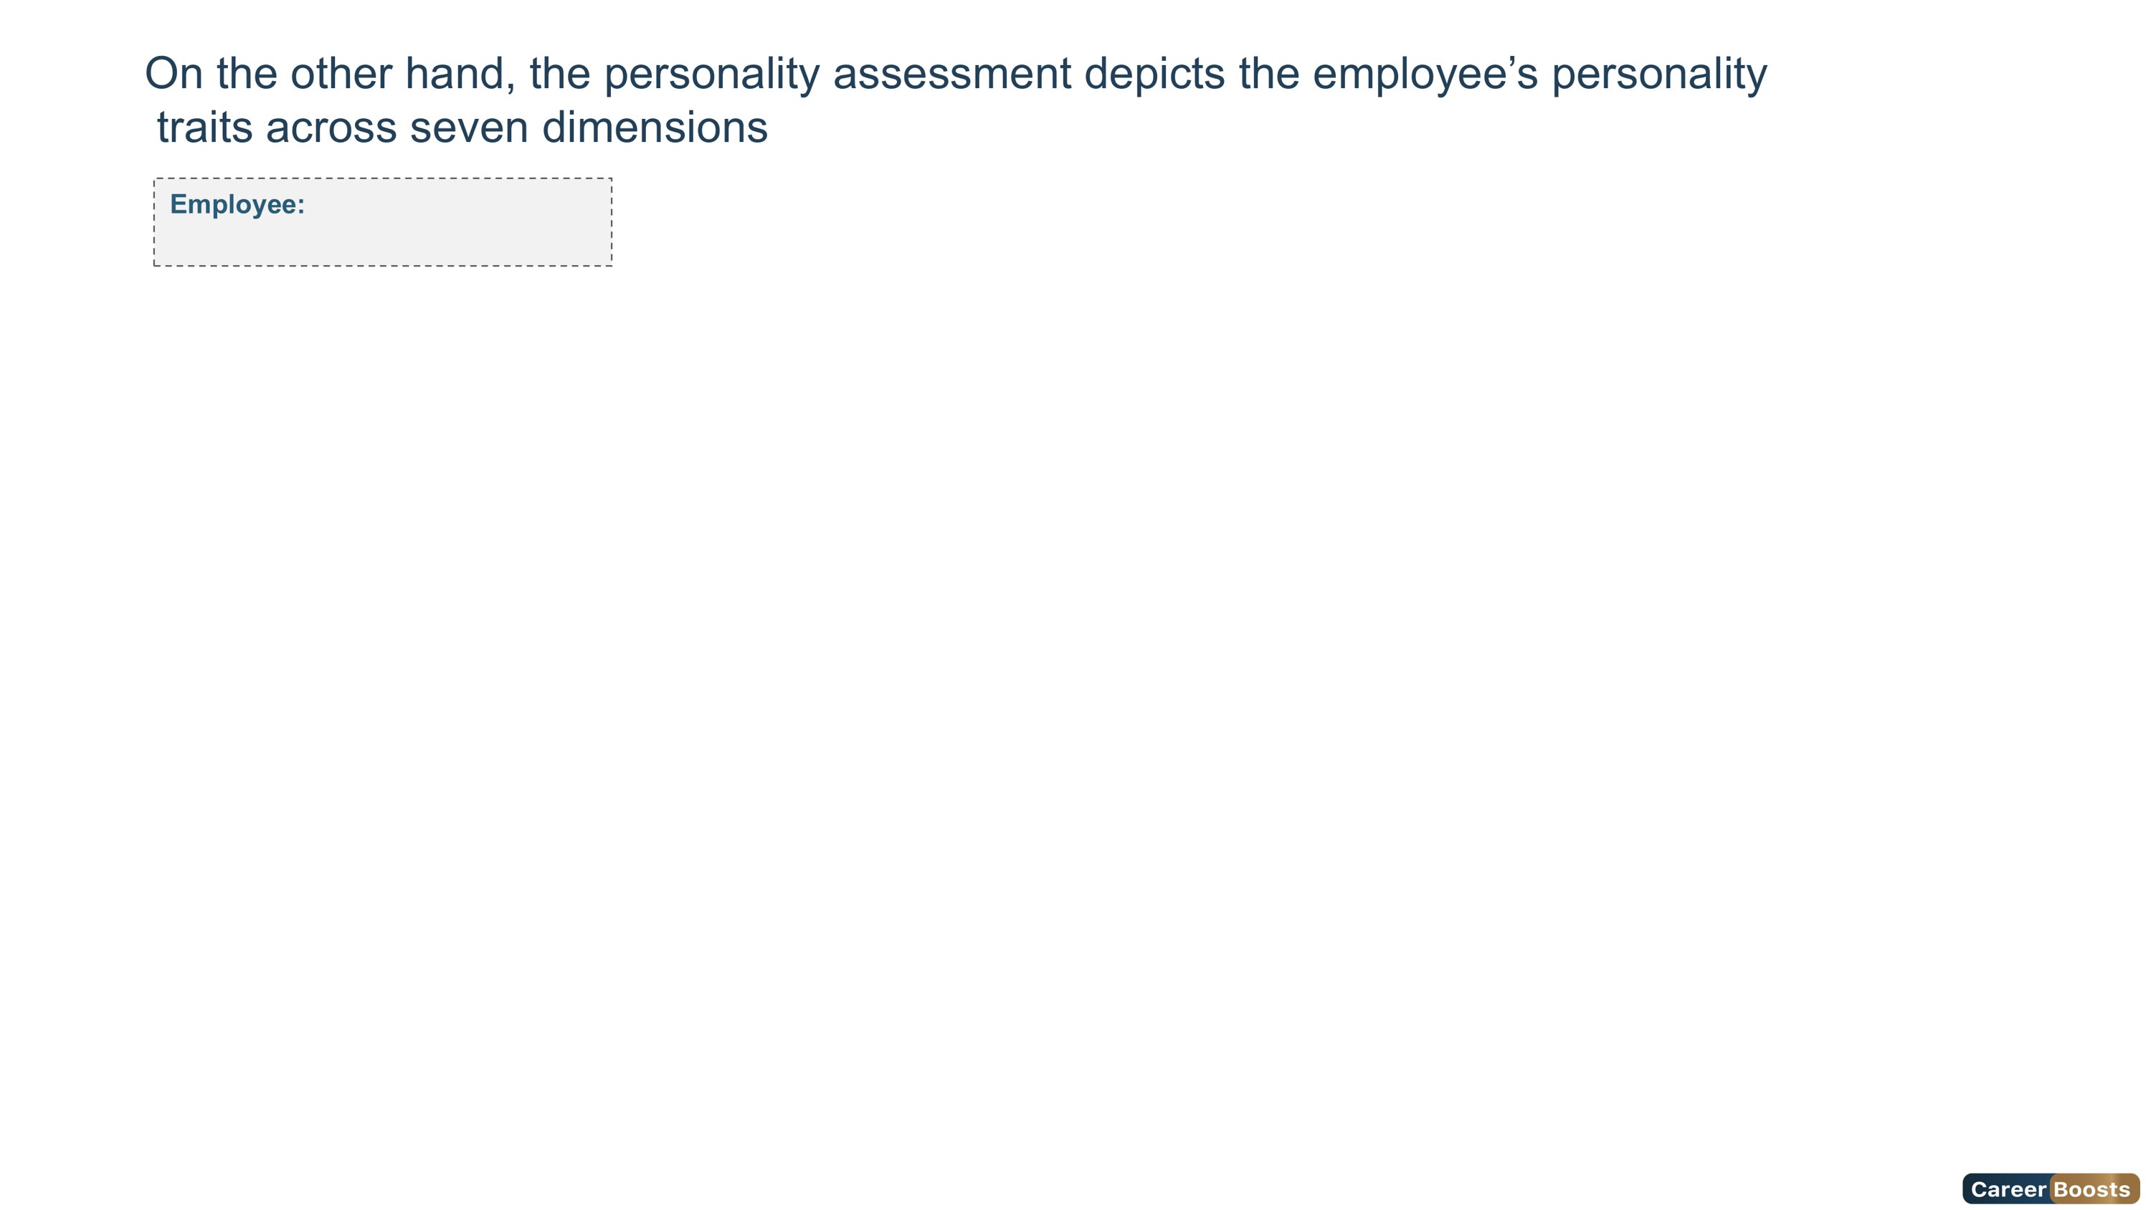
Ms. ahlem masouad
HPI - Personality Scale
16

Slide 17
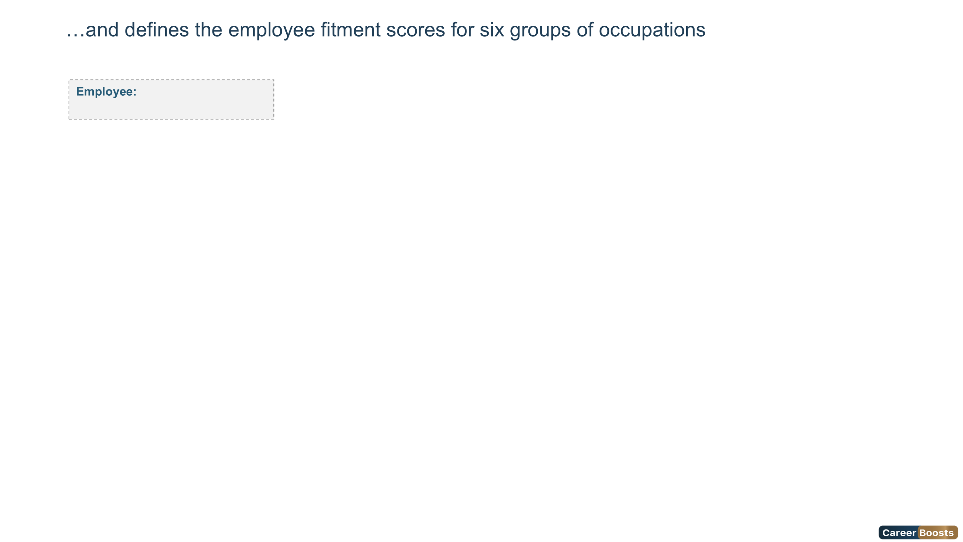
Ms. ahlem masouad
HPI - Professional Scale
17

Slide 18
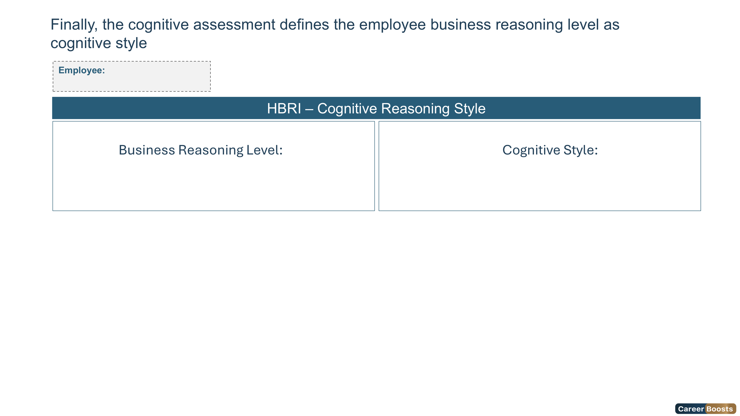
Low
Contextual
18

Slide 19
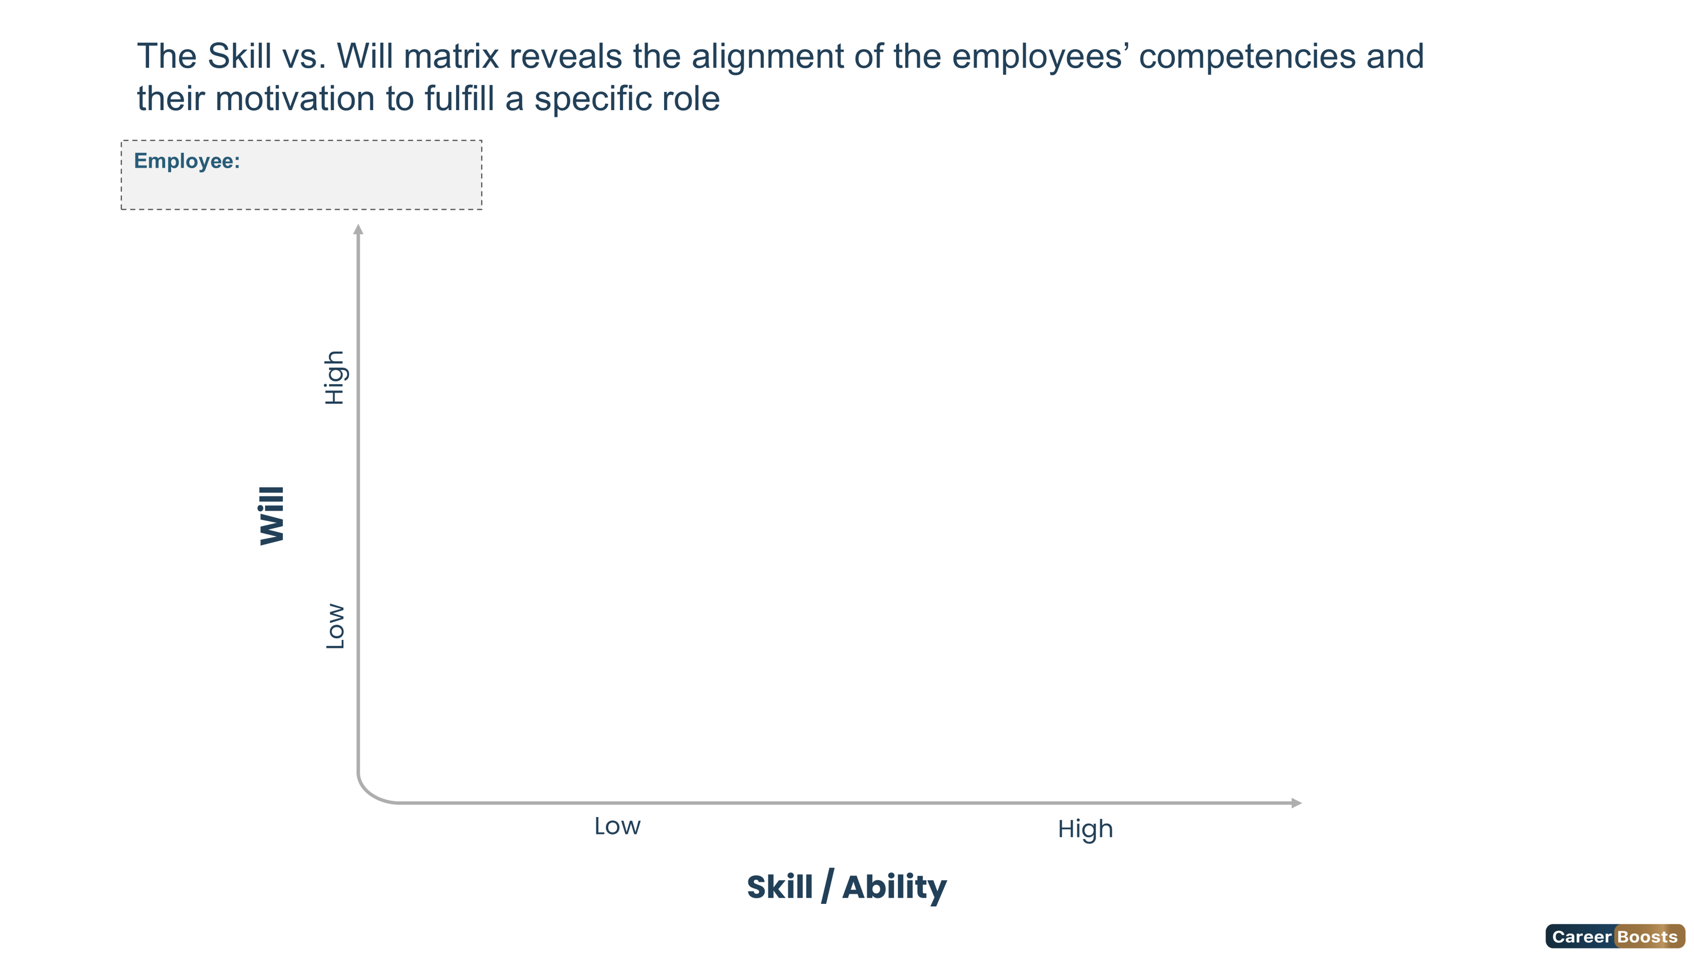


Ms. ahlem masouad
Low Skill / High Will
Guide
High Skill / High Will
Delegate
Low Skill / Low Will
Direct
High Skill / Low Will
Excite
19

Slide 20
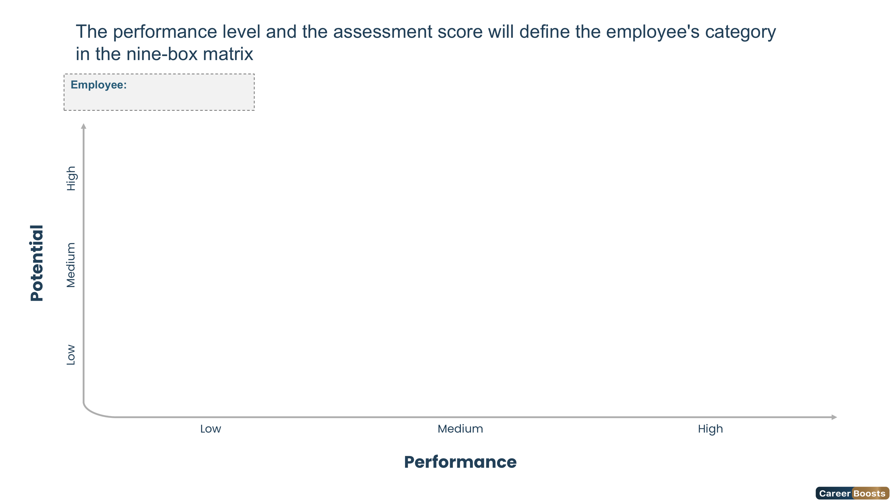


Ms. ahlem masouad
Long-Term Potential
Future Leader
Outstanding Leader
Marginal Contributor
Solid Contributor
Stretch Potential
Underperformer
Sound Contributor
Seasoned Professional
20

Slide 21
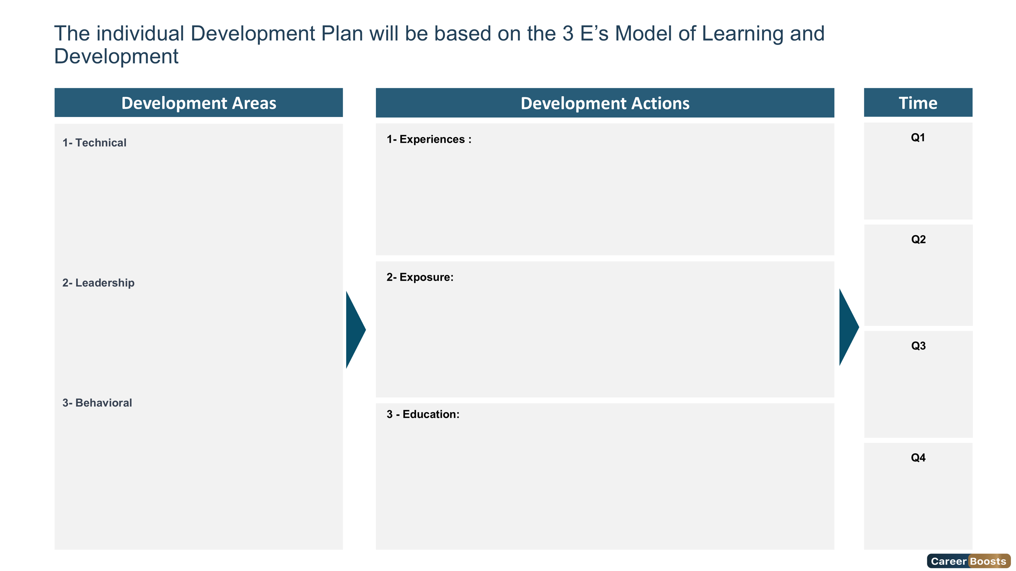
21

Slide 22
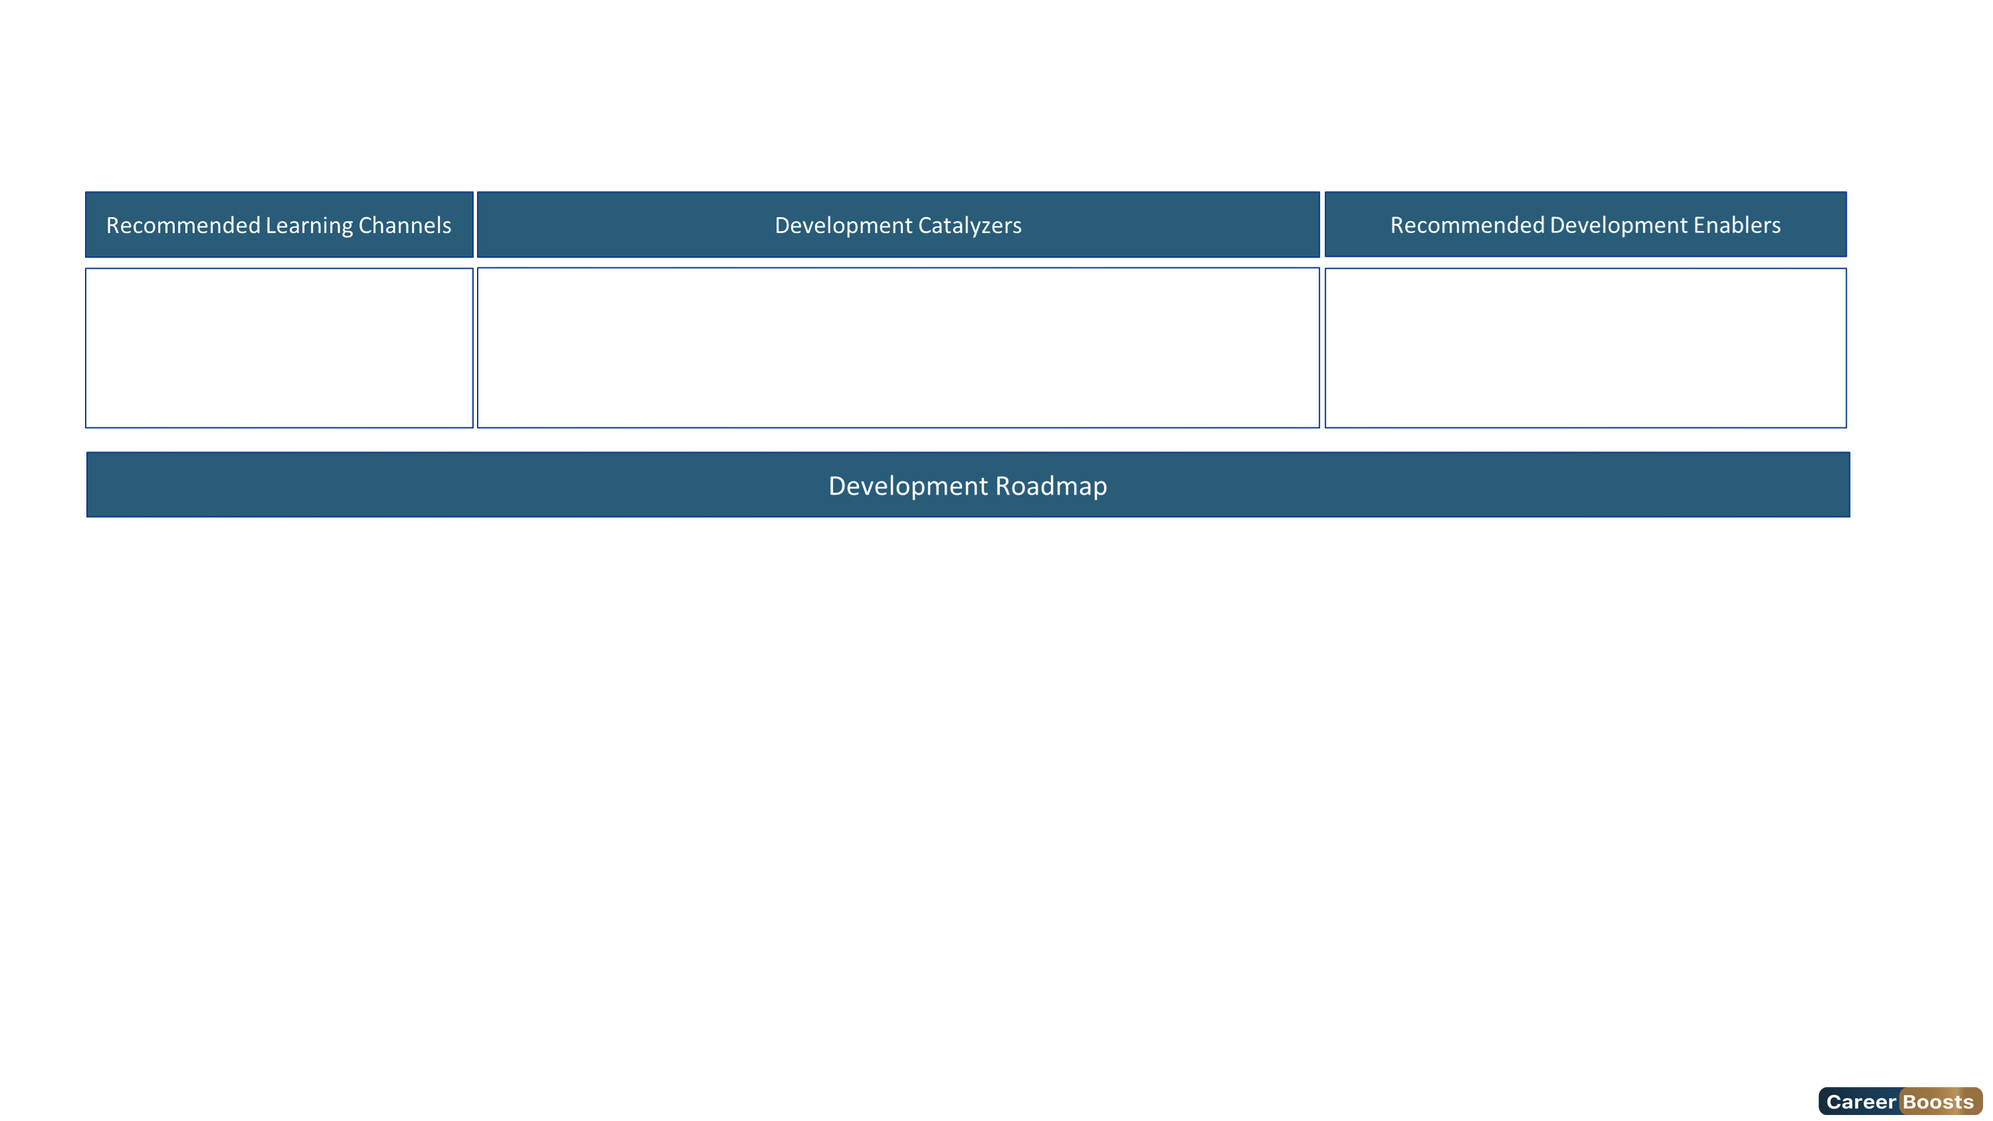
Based on the evaluation results, Ms. masouad will benefit from a development plan to reach the "Expert Level" of this role
Key Trainings | M1 | M2 | M3 | M4 | M5 | M6 | M7 | M8 | M9 | M10 | M11 | M12
Certified Information Security Manager | ★
Certified Threat Intelligence Analyst |  |  |  | ★
Certified in Risk and Information Systems Control (CRISC) |  |  |  |  | ★
22

Slide 23
