Slide 1
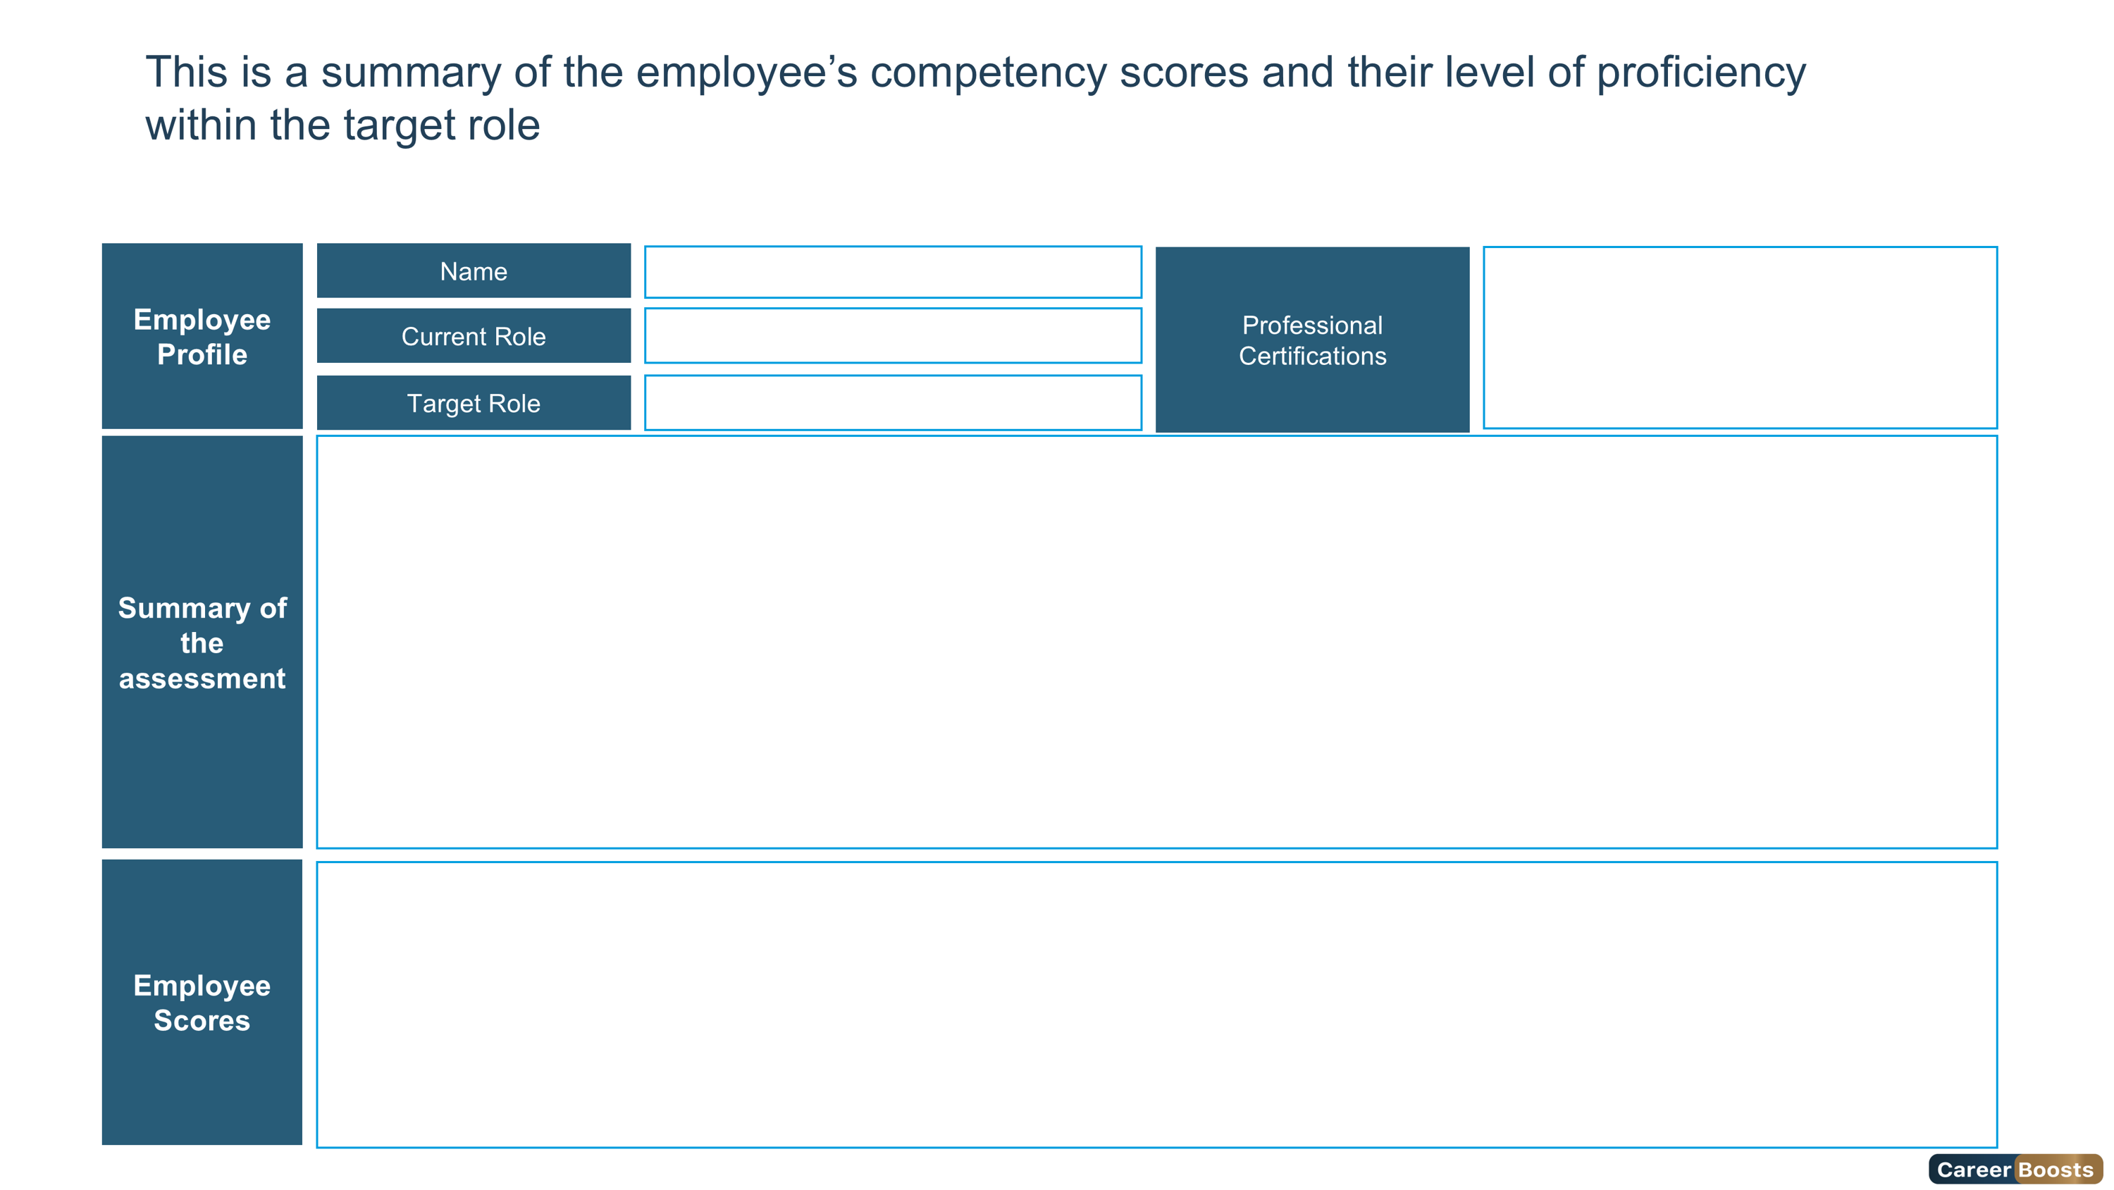

Intermediate
Expert
Overqualified
Foundation
Advanced
{{firstName}}
{{roleName}}
{{assessmentName}}
Overall Score
Leadership Score
Technical Score
Behavioral Score
Cognitive Score
Personality Score
{{overallScore}}%
{{leadership.leadershipScore}}%
{{technical.technicalScore}}%
{{ behavioral.behavioralScore}}%
{{cognitive.cognitiveScore}}%
{{ personality.personalityScore }}%
4

