Slide 1
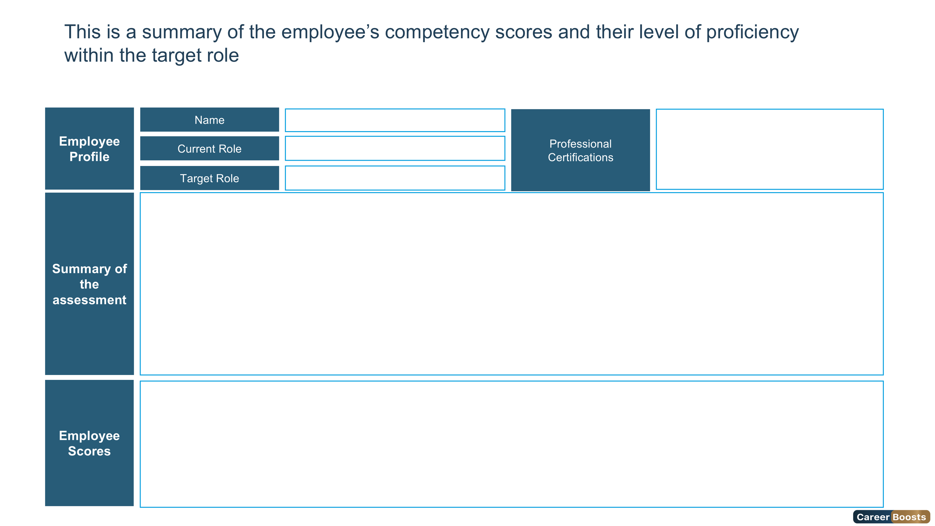

Intermediate
Expert
Overqualified
Foundation
Advanced
{{ firstCharUpper firstName}} {{ firstCharUpper lastName}}
{{roleName}}
{{assessmentName}}
{{ternary (eq gender "Female") "Mrs" "Mr"}}. {{firstCharUpper firstName}} {{ firstCharUpper lastName}} has secured the {{overallLevelName}} Level of the role {{assessmentName}} with an Overall Score of {{overallScore}}%
To further elevate her skills and achieve the Expert Level, She should accomplish the recommended individual development plan.
Overall Score
Leadership Score
Technical Score
Behavioral Score
Cognitive Score
Personality Score
{{overallScore}}%
{{leadership.leadershipScore}}%
{{technical.technicalScore}}%
{{ behavioral.behavioralScore}}%
{{cognitive.cognitiveScore}}%
{{ personality.personalityScore }}%
4

