Slide 1
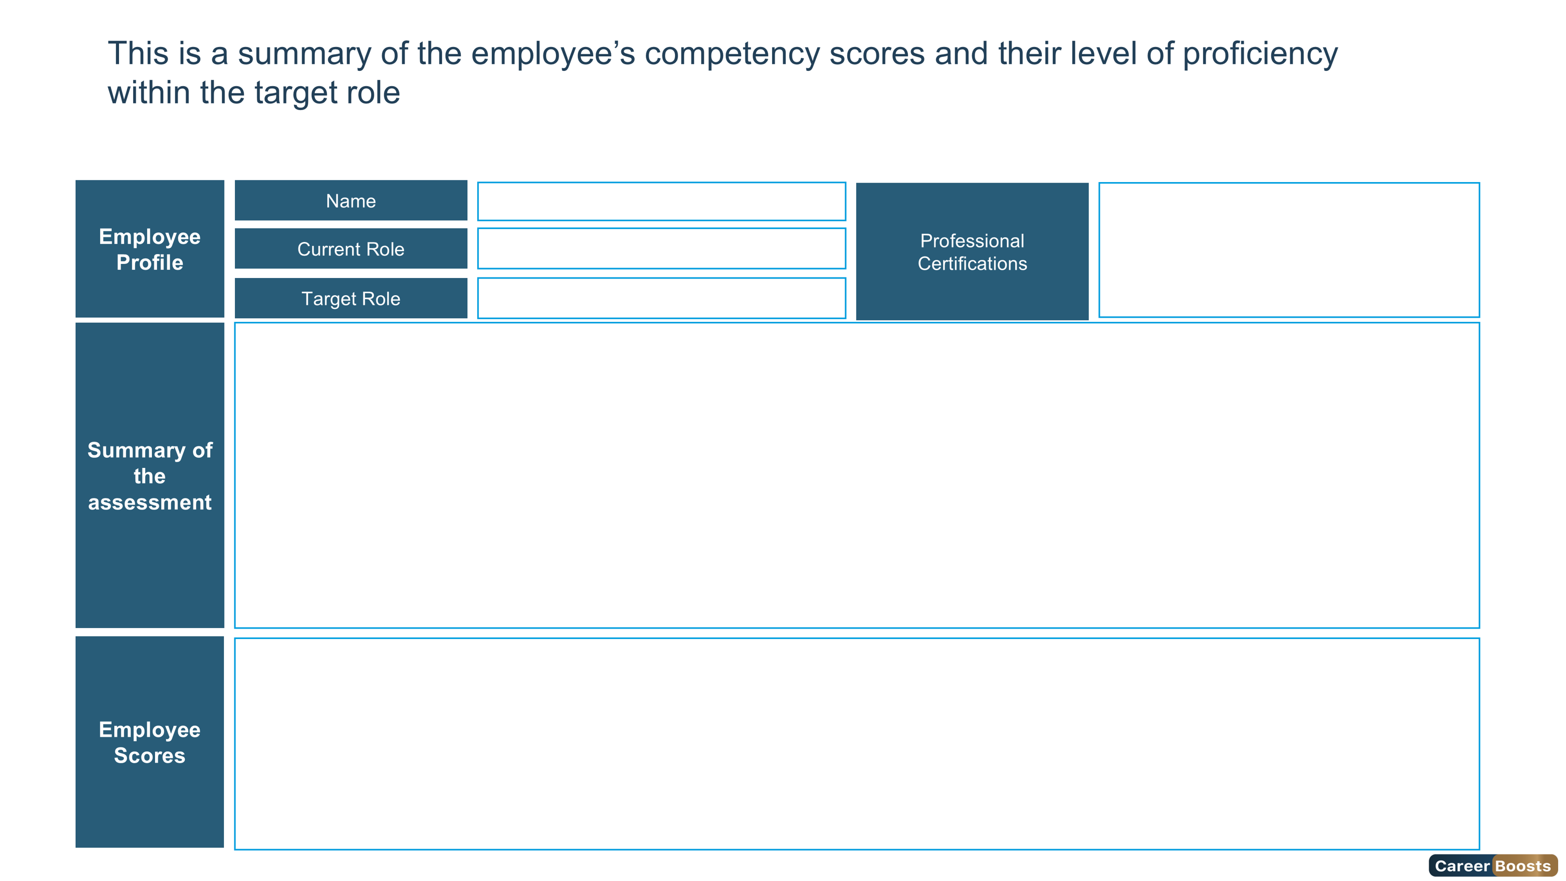


Intermediate
Expert
Overqualified
Foundation
Advanced
{{ firstCharUpper firstName}} {{ firstCharUpper lastName}}
{{roleName}}
{{assessmentName}}
{{ternary (eq gender "Female") "Mrs" "Mr"}}. {{firstCharUpper firstName}} {{ firstCharUpper lastName}} has secured the {{overallLevelName}} Level of the role {{assessmentName}} with an Overall Score of {{overallScore}}%
To further elevate her skills and achieve the Expert Level, She should accomplish the recommended individual development plan.
Overall Score
Leadership Score
Technical Score
Behavioral Score
Cognitive Score
Personality Score
{{#if overallScore}}{{pptxImage src=(concat chartUrl overallScore ".png") usePlaceholderSize=true}}{{/if}}
{{#if leadership.leadershipScore}}{{pptxImage src=(concat chartUrl leadership.leadershipScore ".png") usePlaceholderSize=true}}{{/if}}
{{#if technical.technicalScore}}{{pptxImage src=(concat chartUrl technical.technicalScore ".png") usePlaceholderSize=true}}{{/if}}
{{#if behavioral.behavioralScore}}{{pptxImage src=(concat chartUrl behavioral.behavioralScore ".png") usePlaceholderSize=true}}{{/if}}
{{pptxImage src=(concat chartUrl cognitive.cognitiveScore ".png") usePlaceholderSize=true}}
{{#if personality.personalityScore}}{{pptxImage src=(concat chartUrl personality.personalityScore ".png") usePlaceholderSize=true}}{{/if}}
{{#if cognitive.cognitiveScore}}{{pptxImage src=(concat chartUrl cognitive.cognitiveScore ".png") usePlaceholderSize=true}}{{/if}}
4

