Slide 1
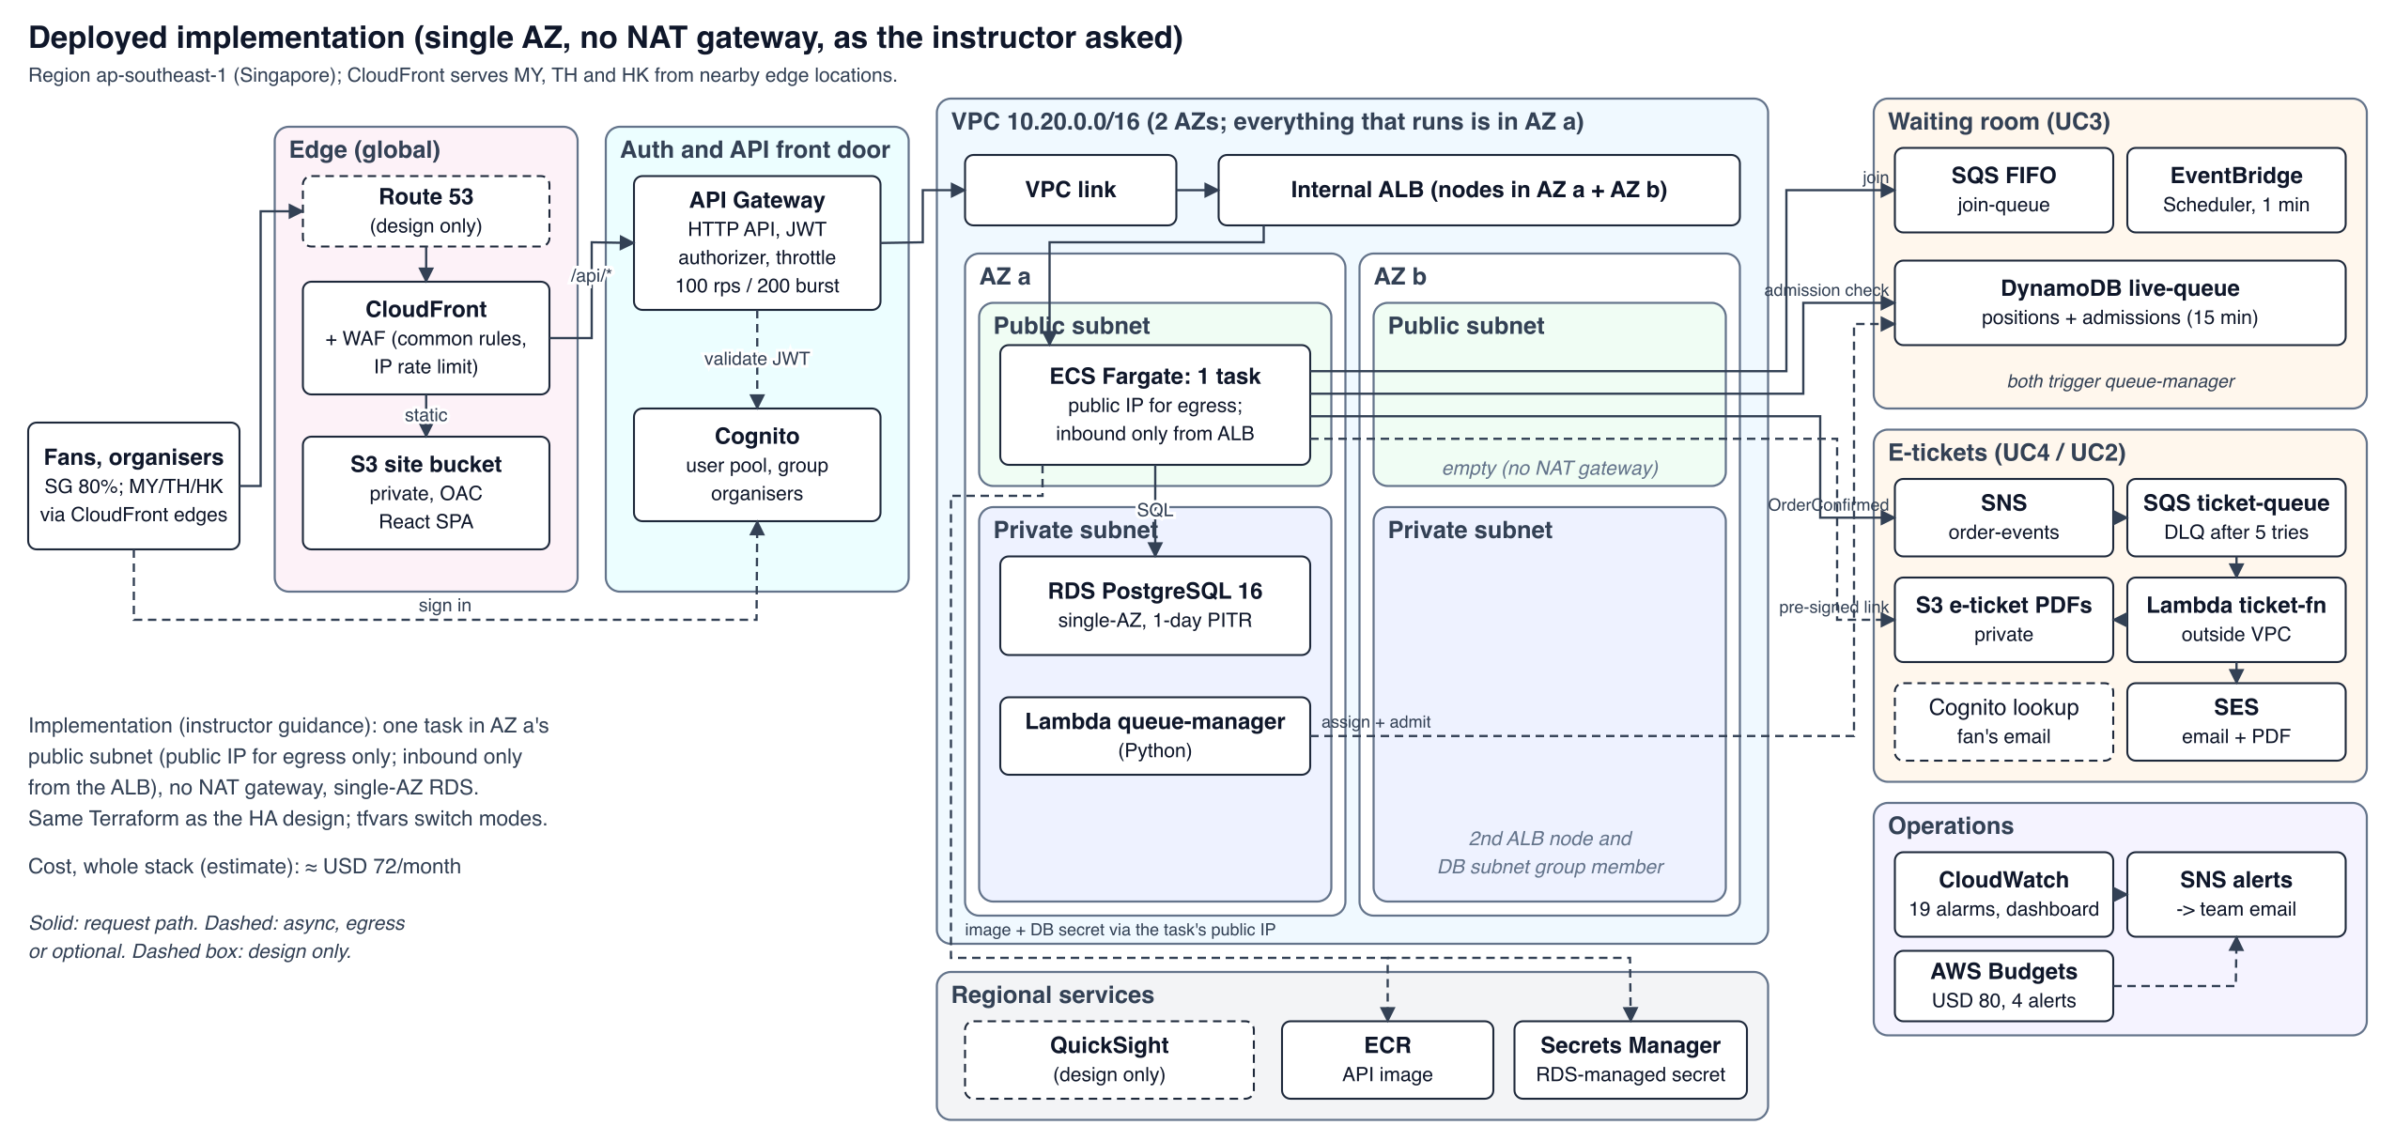
TicketMastery: concert ticketing on AWS
Group 4 · IS458 Cloud Management and Engineering · final presentation, 10 Nov 2026
Owners: UC1 Discovery Cody & Nai Xin · UC2 My Tickets Andrew · UC3 Waiting room Yan Ting · UC4 Checkout Shi Hui · UC5 Management + base stack Elroy
Agenda: changes since the proposal → architecture → use cases → live demo → operations
Elroy · 0.5 min
Notes:
Good afternoon, we are Group 4, and this is TicketMastery, a concert ticketing platform on AWS. All five use cases from our proposal are now built and running in our dev account in Singapore, and you will see them live halfway through. Each of us presents the use case we own. I'm Elroy: I own concert management and the shared base, monitoring and our management process.

Slide 2
Business context and requirements
B2C concert ticketing based in Singapore (theme: Online Shopping System); guests, fans and organisers
Base requirement: Asia-Pacific; 80% of customers in Singapore, the rest split evenly across Malaysia, Thailand and Hong Kong
On-sales spike to 50,000–100,000 concurrent fans, about 10× a normal day (≈ 5,000)
Goals: stay up in the spike, sell every seat exactly once, e-tickets within seconds, live sales view
11 NFRs, e.g. p95 < 300 ms, 0 oversold seats, seat free ≤ 30 s after a hold expires, spend < USD 80
Origin | Share | How it is served
Singapore | 80% | CloudFront edge in Singapore; API in ap-southeast-1
Malaysia, Thailand, Hong Kong | ≈ 6.7% each | CloudFront edge in-country; dynamic calls cross the AWS backbone to Singapore
Cody · 0.75 min
Notes:
TicketMastery sells concert tickets across Asia-Pacific. We use the specification's base requirement: 80% of customers in Singapore, the rest split evenly between Malaysia, Thailand and Hong Kong; our proposal draft had a different split, so we corrected it. The conclusion holds either way: one region in Singapore plus CloudFront edges in all four markets. The hard part is the spike: a big on-sale brings 50,000 to 100,000 fans in minutes. So our two key requirements are staying up during that spike and never selling a seat twice.

Slide 3
What changed since the proposal, and why
Proposal | Built
All-serverless write-up: one Lambda per module, DynamoDB for seats and orders | Core on ECS Fargate + RDS PostgreSQL: holds, orders and seats change in one SQL transaction
All-serverless write-up (report §3.1) | Serverless kept where it fits: waiting room (SQS FIFO, DynamoDB, Lambda) and the e-ticket worker (SNS → SQS → Lambda)
Public ALB with a secret header | API Gateway VPC link to an internal ALB
Hold-sweeper Lambda and ElastiCache | Dropped: the hold UPDATE itself reclaims expired holds
Two AZs with a NAT gateway per AZ (the instructor asked for 1 AZ, no NAT) | Deployed in implementation mode (1 AZ, no NAT); the HA design stays in the same Terraform behind variables
Elroy · 0.75 min
Notes:
Our first write-up was all-serverless, with DynamoDB for seats and orders. We moved the core to Fargate and PostgreSQL for four reasons: correctness is easier to prove in SQL, organiser reporting is relational, it lets us show VPC topics like subnets, security groups and Multi-AZ failover, and the cost is predictable. We kept serverless for the waiting room and the e-ticket worker. Three smaller changes: the public ALB with a secret header became a VPC link to an internal ALB; the hold-sweeper and Redis went away because one SQL statement handles expired holds; and we deploy the cheaper single-AZ mode the instructor asked for.

Slide 4
Instructor feedback and our response
# | Feedback | Our response | Status
a | API Gateway in front of Fargate | HTTP API with Cognito JWT authorizer, throttling, access logs, VPC link | done
b | Per-feature containers | One service, five isolated modules with their own migrations; split later | trade-off
c | DynamoDB for dynamic session data | Queue and admissions in DynamoDB; seat holds stay in Postgres | justified
d | Cost of a 1-minute EventBridge schedule | ≈ 43,800 runs/month, inside the free tiers, ≈ USD 0 | done
e | Internal reporting | Live dashboard + five tested SQL views; QuickSight designed, not deployed | data layer done
Elroy · 0.75 min
Notes:
At the proposal review we got five pieces of feedback. A: put API Gateway in front; done, and it now checks tokens and throttles before anything reaches our task. B: per-feature containers. We kept one service, split into modules that never import each other, so a later split is one ECS service per module. C: DynamoDB for session data; the queue is in DynamoDB, but holds stay in Postgres so a hold and an order can never disagree. D: the schedule is free-tier. E: reporting views are built and tested; QuickSight would cost 30 dollars a month, so it stays a design.

Slide 5
Architecture: deployed vs target HA
Edge: CloudFront (PriceClass_200) + WAF; the SPA from private S3 via OAC; /api/* to API Gateway
API Gateway HTTP API (Cognito JWT, 100 rps / 200 burst) → VPC link → internal ALB → Fargate ticketmastery-api (all five modules) → RDS PostgreSQL 16
Beside the request path: waiting room (SQS FIFO → queue-manager → DynamoDB, Scheduler every minute) and e-tickets (SNS → SQS → ticket-fn → S3 + SES)
Deployed: 1 AZ, no NAT, 1 task, single-AZ RDS, ≈ USD 72/month · Target HA: 2 AZs, NAT per AZ, 2–4+ tasks, Multi-AZ RDS, ≈ USD 194/month
One tfvars block switches between the two; check blocks reject invalid combinations
Elroy · 1 min
Notes:
This is what is deployed. Fans hit CloudFront with WAF; the React app comes from a private S3 bucket, and API calls go to API Gateway, which checks the Cognito token and reaches an internal load balancer through a VPC link, so the ALB is never on the internet. One Fargate task runs all five modules against PostgreSQL. Two event-driven parts sit beside it: the waiting room and the e-ticket pipeline. As the instructor asked, we deploy one AZ with no NAT gateway, about 72 dollars a month.

Slide 6
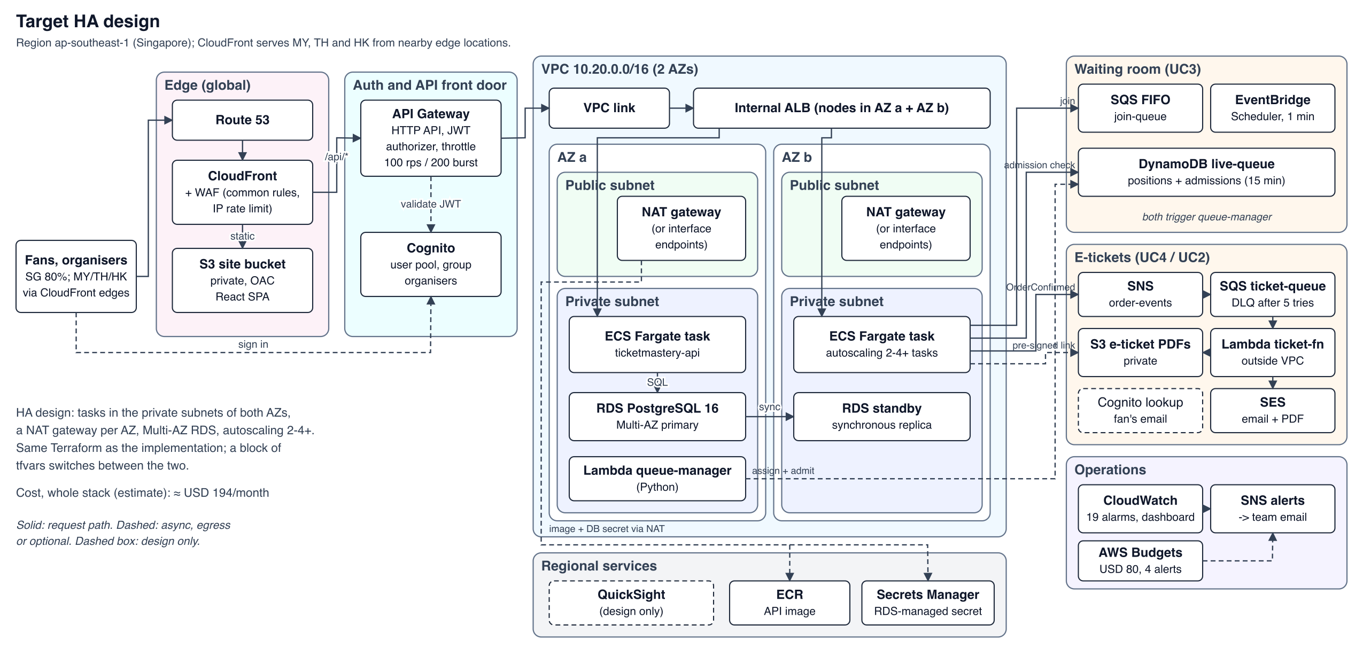
Architecture: target HA
Elroy · (part of slide 5)
Notes:
The target HA design on this slide adds a second AZ, NAT per AZ, autoscaling and Multi-AZ RDS for about 194. Both come from the same Terraform; one variable block switches them.

Slide 7
Resource allocation and justification
Fargate 1 × 0.25 vCPU / 0.5 GB; autoscaling targets CPU 60% and 500 requests per task per minute (≈ USD 11.3)
RDS db.t4g.micro, 20 GB gp3, encrypted, single-AZ (≈ USD 21): transactions for zero double-booking
Internal ALB (≈ 24.2) and a task public IP (3.65) instead of a NAT gateway (≈ 43 per AZ)
HTTP API, not REST: its VPC link targets the ALB directly; REST would need an extra NLB (≈ 18+)
Spiky parts are pay-per-request: SQS, DynamoDB on-demand, Lambda, Scheduler ≈ USD 0; WAF ≈ 8
Layer | Configuration | ≈ USD/mo
Edge | CloudFront PriceClass_200; WAF, 3 rules | ≈ 8
Static site | Private S3 + OAC | < 1
API front door | HTTP API, JWT, VPC link, 100 rps / 200 burst | per request
Load balancer | Internal ALB | 24.2
Compute | Fargate 1 × 0.25 vCPU / 0.5 GB | 11.3
Public IPv4 | Task × 1 (no NAT) | 3.65
Database | RDS PostgreSQL 16 db.t4g.micro, 20 GB gp3, single-AZ | 18.3 + 2.8
Secrets, ECR, logs | Secrets Manager, ECR, CloudWatch Logs | ≈ 1.5
Waiting room, e-tickets | SQS, DynamoDB, Lambda, Scheduler, SNS, S3, SES | ≈ 0
Monitoring | Alarms, dashboard, custom metrics, SNS email | ≈ 1.3
Whole stack | Implementation mode | ≈ 72
Cody · 0.75 min
Notes:
We picked the smallest sizes and let the waiting room protect them. One quarter-vCPU Fargate task and a micro Graviton database are enough because only 500 new buyers per concert per minute ever reach them. The biggest decision was no NAT gateway: it would have been our largest line item, so the task uses its own public IP for egress, and its security group still only accepts traffic from the ALB. We chose the HTTP API because its VPC link talks to an ALB directly. We rejected ElastiCache for holds, because two stores can disagree, and QuickSight because it bills per user.

Slide 8
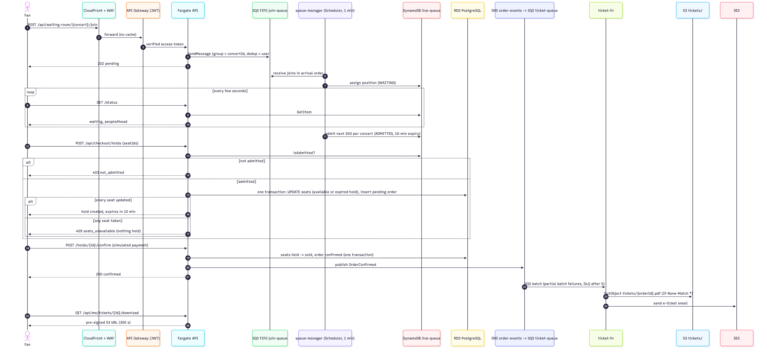
Linkage of resources
Request path: CloudFront → API Gateway (JWT) → VPC link → internal ALB → Fargate → RDS
Waiting room: API → SQS FIFO join-queue (group = concert) → queue-manager → DynamoDB live-queue; Scheduler → admit step
E-tickets: checkout → SNS order-events → SQS ticket-queue (DLQ after 5) → ticket-fn → Cognito, S3, SES
Security-group chain: VPC link SG → ALB SG (80) → task SG (container port) → RDS SG (5432)
One least-privilege IAM role per component; the module that owns a resource grants the API access to it
Andrew · 0.75 min
Notes:
This sequence shows how the resources link during an on-sale. The fan's join goes through the API into a FIFO queue grouped by concert, so arrival order is kept, and the queue-manager Lambda writes a position into DynamoDB. Every minute the scheduler admits the next batch. When the fan holds seats, the API first reads DynamoDB to check admission, then runs the hold in Postgres. Payment publishes OrderConfirmed to SNS, which fans out to SQS and the ticket Lambda. Inside the VPC each hop only accepts the one before it, and every component has its own IAM role with only the actions it needs.

Slide 9
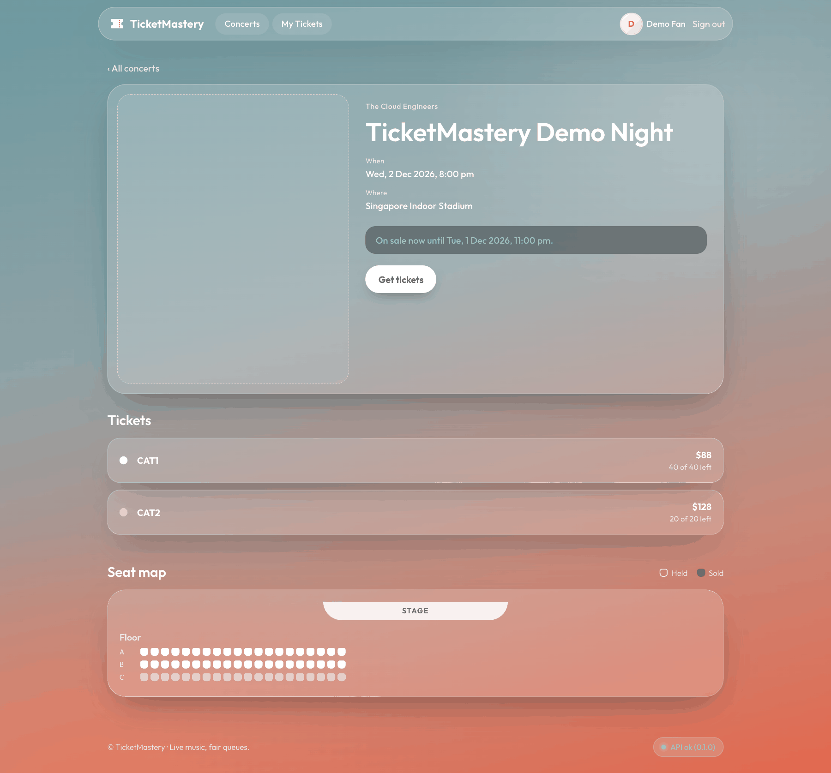
UC1 Concert discovery
Public, no sign-in: list, search (title, artist, venue) and date filters
Concert page: ticket types, prices, "N of M left"; seat map with held and sold seats
An expired hold shows as available (same rule as checkout)
Cache headers: list max-age=60, detail max-age=15, seat map no-store
Cody & Nai Xin · 0.5 min
Notes:
Cody: Discovery is the public front door. Anyone can browse and search published concerts by title, artist or venue without signing in, and the list and detail are cacheable. Nai Xin: the concert page shows each ticket type with its price and how many are left, plus a seat map that refreshes every 15 seconds during a sale. The seat map is never cached, and an expired hold already shows as available.

Slide 10
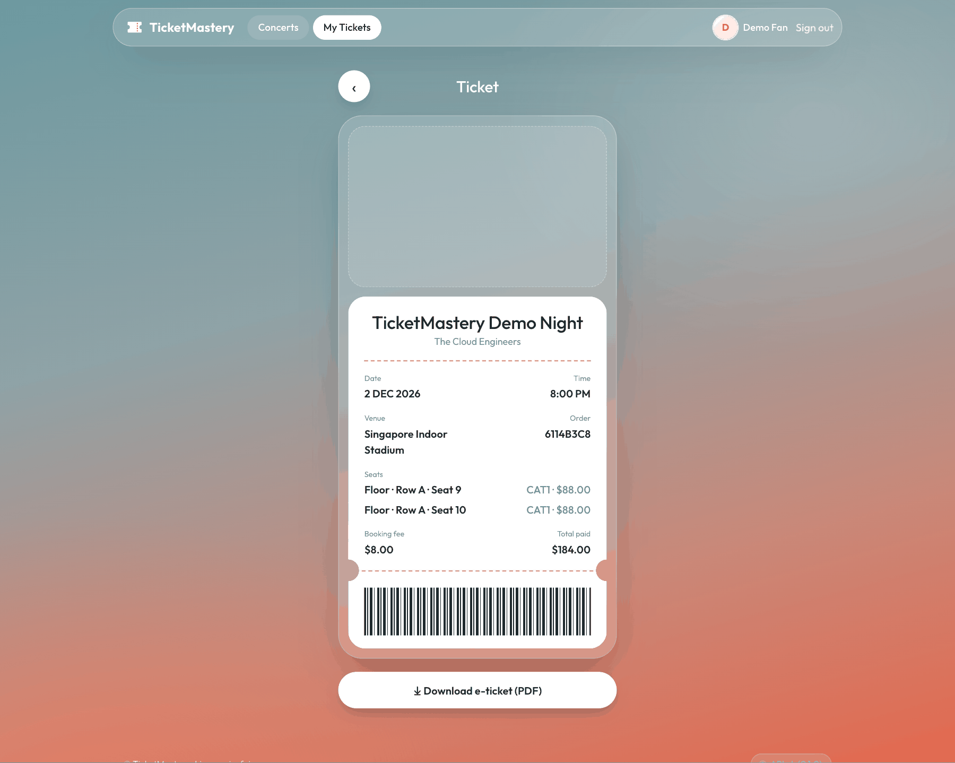
UC2 My Tickets & Account
Cognito sign-up with email verification; display name edited in the Profile card
Token checked twice: API Gateway JWT authorizer, then again inside the API
My Tickets: the fan's confirmed orders only; another fan's order answers 404
PDF download: API checks S3, returns a 300 s pre-signed link; 409 until the PDF exists
Andrew · 0.5 min
Notes:
Fans sign up with Cognito and verify their email. API Gateway checks the access token and the API verifies it again, so a misconfigured route can't bypass authorisation. My Tickets lists only your own confirmed orders; anyone else's order returns not found. The PDF stays in a private bucket: the API checks it exists and returns a five-minute pre- signed link, so the file downloads straight from S3.

Slide 11
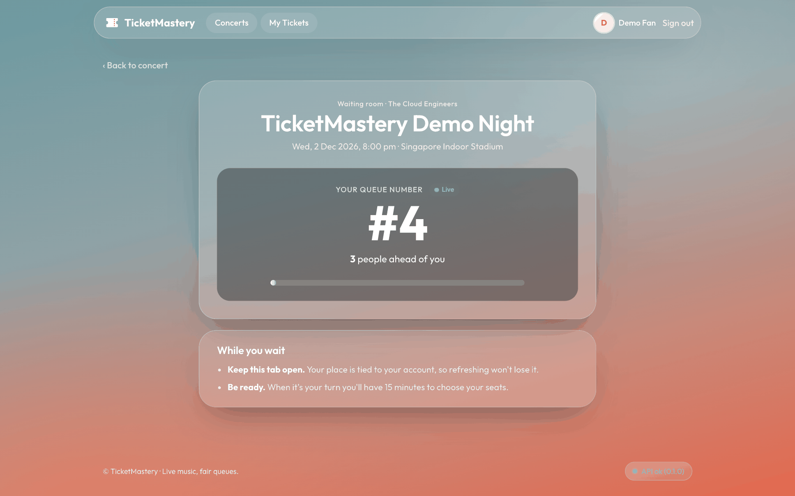
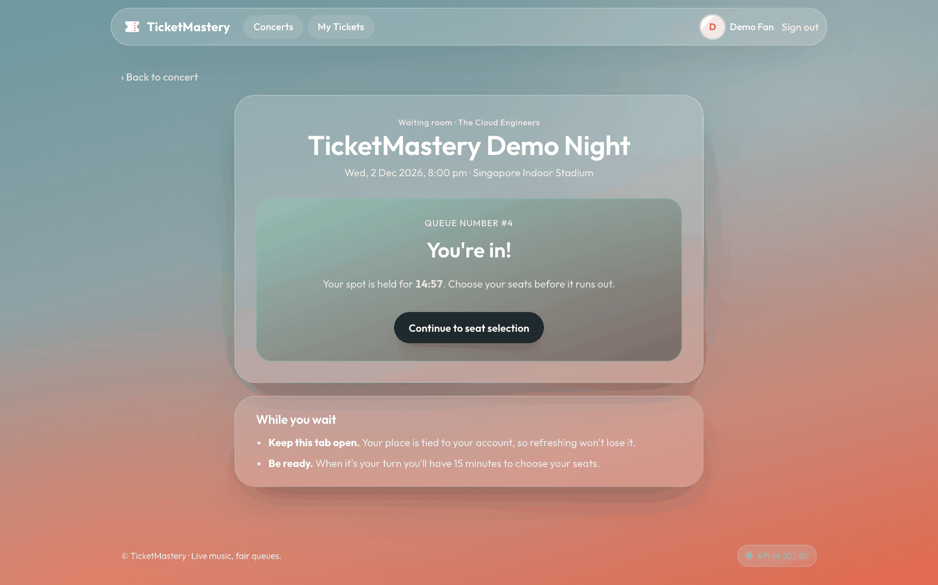
UC3 Virtual waiting room
Join: API → SQS FIFO (group = concert, dedup = fan + concert) → queue-manager gives a position in DynamoDB
Admit: EventBridge Scheduler every minute → next 500 fans per concert, only inside the sale window; 15 minutes each
Conditional updates: overlapping runs never admit anyone twice; the page polls the status every 5 s
Checkout refuses a hold without a current admission: 403 not_admitted
NFR-6: 20 fans, 4 admit runs, 0 order inversions
Yan Ting · 0.75 min
Notes:
The waiting room turns a crowd of 100,000 into a steady stream. Joining sends a message to a FIFO queue grouped by concert, so order is kept and a double click is dropped. The queue-manager Lambda hands out positions in DynamoDB. Every minute EventBridge Scheduler runs it again to admit the next 500 fans, but only while that concert's sale is open, so early joiners keep their place. Admission lasts 15 minutes and checkout enforces it. In our fairness test, 20 fans were admitted over four runs with zero inversions.

Slide 12
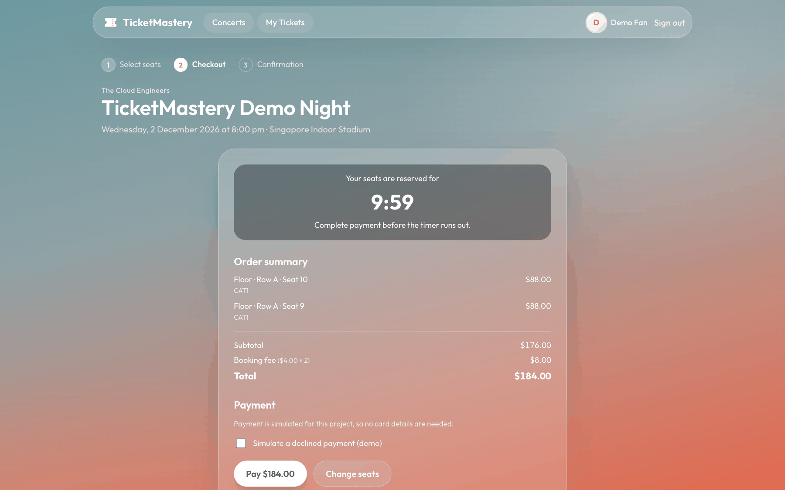
UC4 Seat holds, checkout and e-tickets
A hold is one SQL UPDATE: every seat or none, 10 minutes, otherwise 409 seats_unavailable
No sweeper: the same predicate reclaims expired holds (NFR-4: seat free 0.6 s after expiry)
Simulated payment: success sells the seats and confirms the order in one transaction; decline or timeout releases them
OrderConfirmed → SNS → SQS → ticket-fn: PDF to S3, email through SES; a .sent marker makes redeliveries do nothing
UPDATE seats SET status = 'held', held_by = $3, hold_id = $4,
held_at = now(), hold_expires_at = now() + make_interval(mins => 10)
WHERE concert_id = $1 AND id = ANY($2::uuid[])
AND (status = 'available' OR (status = 'held' AND hold_expires_at < now()))
RETURNING id;
Shi Hui · 0.75 min
Notes:
This statement is why no seat is sold twice. It updates only seats that are available or whose hold has expired, and if fewer rows come back than requested, the whole transaction rolls back. Postgres row locks serialise competing fans, and we sort seat IDs so there are no deadlocks. Because expiry is part of the condition, we need no sweeper; our test saw a seat free again 0.6 seconds after expiry. Payment is simulated. After it, an event goes to the ticket Lambda, which renders the PDF, emails it and writes a marker so a repeat delivery sends nothing.

Slide 13
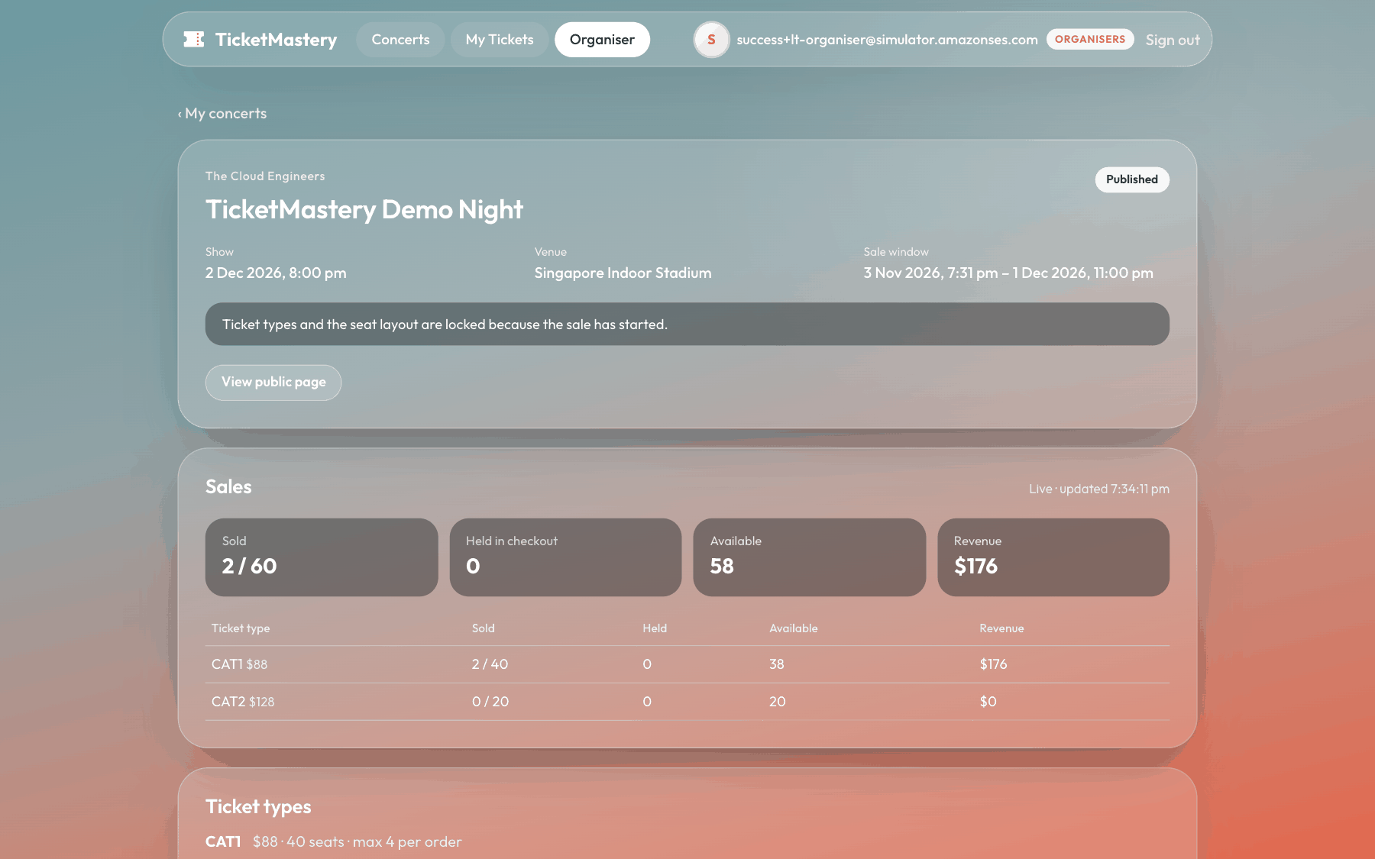
UC5 Concert management and reporting
Cognito group organisers, checked by the API; organisers see only their own concerts
Draft → ticket types → seat layout (one transaction) → publish; layout locks when the sale opens
Live dashboard: available, held, sold and revenue per ticket type, refreshed every 5 s
Cancel: every ticket holder is emailed (one ConcertCancelled per order → ticket-fn → SES)
Five tested SQL reporting views; QuickSight designed, not deployed
Elroy · 0.5 min
Notes:
Organisers create a draft, add ticket types and a seat layout, and publish. The whole layout is replaced in one transaction, and publishing needs exactly one seat per ticket. Once the sale opens the layout locks, enforced in the service and by database triggers. The live dashboard reads the same seat rows checkout updates. Cancelling a concert emails every ticket holder through the same pipeline as e-tickets, with Shi Hui's message design. For reporting we built five SQL views with tests; QuickSight on top is designed but not deployed.

Slide 14
Live demo
https://d1ubso1416lulu.cloudfront.net
Organiser: create and publish a concert, open the live dashboard (UC5)
Fan: browse (UC1) → waiting room (UC3) → hold and pay (UC4) → My Tickets, PDF and email (UC2)
Operations: CloudWatch dashboard ticketmastery-dev and an alarm email
Nai Xin (driver) + UC owners · 5.5 min
Notes:
Nai Xin: We'll now show everything live on our CloudFront URL. On the left is an organiser, on the right a fan. The organiser publishes a concert and watches sales; the fan buys two seats for a concert already on sale and gets the e-ticket. Each owner explains their part as we go, and Elroy ends with the CloudWatch dashboard and an alarm email.

Slide 15
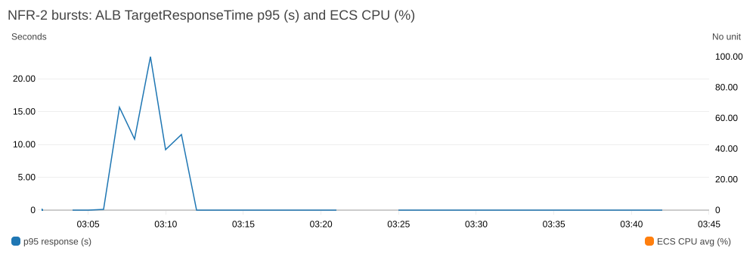
Monitoring and alerts
19 CloudWatch alarms in modules/monitoring + the ticket-DLQ alarm in messaging; ALARM and OK → SNS → email
Thresholds from the NFRs: ALB p95 > 300 ms, 5xx > 1%, healthy hosts < 1, ticket-queue age > 60 s, any DLQ message
Custom metrics without a NAT: WaitingRoomSize and ETicketDeliveryLatency as EMF log lines; checkout failures from log metric filters
Dashboard ticketmastery-dev: alarm panel + 16 graphs with threshold lines
Alerts fired for real in the burst test (API Gateway 5xx and latency, ALB 5xx and latency, then at-max-capacity); forced join-dlq-not-empty → ALARM and OK emails within the same minute, 0 failed deliveries
Elroy · 0.75 min
Notes:
Monitoring is its own Terraform module. The proposal's monitoring table became alarms, adapted to what we built: EC2 checks became ECS and target-health alarms, and the Redis rows went away. Thresholds come from the NFRs, for example ALB p95 above 300 milliseconds, or an e-ticket waiting more than a minute. The queue-manager has no NAT, so it can't call the CloudWatch API; it prints its metric as an embedded metric log line instead. Checkout failures are counted from request logs with no extra code. Every alarm emails on both alarm and recovery, which is the email you just saw in the demo.

Slide 16
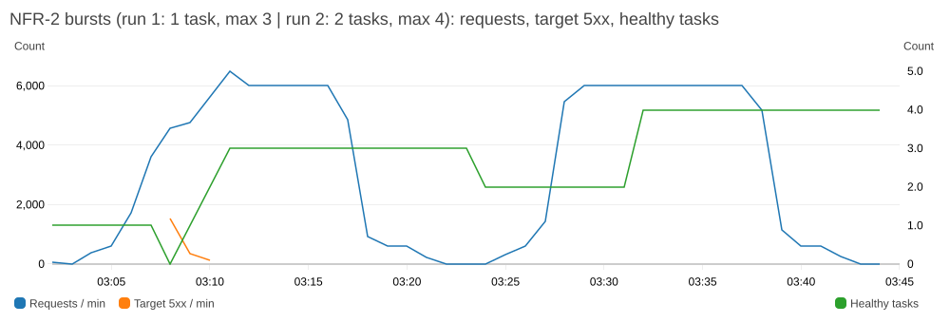
Scalability and availability
Layers: CloudFront edge cache → WAF 2,000 req / 5 min per IP → API Gateway 100 rps / 200 burst → waiting room 500 per concert per minute → ECS autoscaling (CPU 60%, 500 req/task/min)
Measured: one 0.25 vCPU task saturates at ≈ 60 req/s; autoscaling takes 4–5 min, so on-sales need pre-scaling
Spike-facing parts are on-demand: SQS, SNS, DynamoDB, Lambda
Deployed: a lost task is replaced by ECS (76 s outage in drill F1); AZ a is a single point of failure (accepted)
Target HA: tasks in 2 AZs + Multi-AZ RDS failover (typically 60–120 s, no committed data lost); design only
Yan Ting · 0.75 min
Notes:
Scalability is layered: CloudFront serves the app from the edge, WAF and the API Gateway throttle shed floods, and the waiting room lets only 500 new buyers per concert per minute reach the API. The burst test taught us something: one small task saturates at about 60 requests a second and autoscaling needs four to five minutes, so starting from one task we dropped 3% of requests before it caught up. Starting from two tasks, as in the HA design, the same 10-times burst had zero errors. So organisers' sale times should trigger pre-scaling.

Slide 17
Evidence: NFR results
Method: k6 and scripts in loadtest/, against the API Gateway URL, 125 Cognito test users; every run saved in loadtest/results/
NFR-3 oversell: 100 admitted fans × 2 runs race for 20 seats → 278 lost races, 0 seats sold twice (SQL in VPC)
NFR-4 hold expiry: seat available 0.6 s after expiry (≤ 30 s) · NFR-6 fairness: 4 admit runs, 0 inversions
NFR-1 browse p95 30 ms (< 300) · NFR-2 10× burst: 0 errors from 2 tasks, 3.3% failed from 1 task
NFR-5 task loss: 76 s outage (≤ 5 min) · NFR-7 e-tickets: 10/10 within 60 s, p95 9.9 s
NFR-8/9 restore: RPO 2.8 min, RTO 9 min · NFR-10 security config: pass · NFR-11 spend USD 22.92, all credits
NFR | Target | Measured | Pass
NFR-1 | p95 < 300 ms | p95 30 ms | Pass
NFR-2 | 10×, 0 dropped | 1 task 3.3% failed; 2 tasks 0 | Run 1 fail, run 2 pass
NFR-3 | 0 oversold | 0 sold twice | Pass
NFR-4 | free ≤ 30 s | 0.6 s | Pass
NFR-5 | task loss ≤ 5 min | 76 s outage | Pass
NFR-6 | queue order | 0 inversions | Pass
NFR-7 | 95% in 60 s | 10/10, p95 9.9 s | Pass (after fix)
NFR-8/9 | RPO ≤ 30 min, RTO ≤ 1 h | RPO 2.8 min, RTO 9 min | Pass
NFR-10 | HTTPS, encrypted, private DB | config checks | Pass
NFR-11 | < USD 80 | USD 22.92 | Pass so far
Shi Hui · 0.75 min
Notes:
Every NFR has a repeatable script, run against the live stack. The key result is correctness: two hundred admitted fans raced for twenty seats, 278 lost the race cleanly, and SQL run inside the VPC found no seat sold twice. Expired holds come back within a second, and the queue admits strictly in arrival order. We also report what didn't pass first time: from a single task, the 10-times burst dropped 3% of requests, and the first e-ticket run hit an IAM gap that we fixed; those orders were retried from the queue and none were lost.

Slide 18
Management approach: code, pipeline, review
Terraform: one root infra/envs/dev, one module per area with one owner; remote state in versioned S3 with S3-native locking
Every change is plan -out → review → apply of that plan, announced to the team first
CI/CD: frontend type-check and build on PRs; deploy from main through GitHub OIDC (no AWS keys); API image tagged with the git SHA, scanned in ECR, circuit-breaker rollback
Trunk-based branches, Conventional Commits, CODEOWNERS per module, migration and Lambda, PR template checklist
API tests against real Postgres: seat-hold race, layout triggers, reporting views
Module | Owner
network, security, ecr, rds, ecs-service, github-deploy, monitoring | Elroy
edge | Cody
auth-apigw | Andrew
waiting-room | Yan Ting
messaging | Shi Hui
Elroy · 0.75 min
Notes:
Everything is Terraform. One root module wires one module per area, and each module has one owner, the same person who presents that part today. State is shared in a versioned S3 bucket with locking, so only one apply runs at a time, and every change is planned, reviewed and applied from the saved plan after telling the team. The frontend deploys from main through GitHub OIDC, so no AWS keys are stored in GitHub. CODEOWNERS routes each pull request to the owner of what it touches. Our tests run against real Postgres, including the race for the same seats.

Slide 19
Security, backup and DR
HTTPS at the edge, WAF, S3 only through OAC; database private, encrypted, TLS from the API
DB password generated by RDS in Secrets Manager, never in code, tfvars or state
Task loss target ≤ 5 min (drill F1: 76 s outage); data corruption: point-in-time restore, RPO ≤ 30 min, RTO ≤ 1 h (drill F4: RPO 2.8 min, database back in 9 min 14 s)
AZ and region loss: design only · Accepted dev gaps: HTTP inside the VPC, MFA off, SES sandbox
Layer | Control
Edge | HTTPS only; WAF; S3 only through OAC
Identity | Cognito, email verification; JWT checked twice
Network | Internal ALB; SG chain → task → RDS; RDS private
Data | RDS encrypted, TLS; private e-ticket bucket
Secrets | DB password from RDS in Secrets Manager
Ops / App | GitHub OIDC limited to main; zod input validation
Scenario | RPO | RTO | Status
Task loss | n/a | ≤ 5 min | Drill F1
AZ loss | 0 | ≤ 5 min | Design only
Data corruption | ≤ 30 min | ≤ 1 h | Drill F4: RPO 2.8 min, RTO 9 min 14 s
Region loss | ≤ 24 h | ≤ 4 h | Design only
Lost e-ticket | 0 | minutes | DLQ alarm
Andrew · 0.5 min
Notes:
Security is layered from the edge in: HTTPS only, WAF rules, a bucket reachable only through CloudFront, tokens checked twice, and a private, encrypted database. No password is in our code or state; RDS generates it in Secrets Manager. We ran both drills: stopping the only task caused a 76-second outage, and a point-in-time restore had the database back in nine minutes with under three minutes of data loss. AZ and region loss are design-only.

Slide 20
Cost and Budgets
Deployed ≈ USD 72/month for the whole stack (≈ 2.4/day); target HA ≈ USD 194/month (≈ 6.4/day)
Largest saving: no NAT gateways (two with Elastic IPs ≈ USD 94/month)
AWS Budgets, USD 80/month: alerts at 20, 40, 60, 80 actual and on a forecast above 80
terraform destroy after work sessions; about 15 minutes to recreate
Spend to date: USD 22.92 of usage in October (USD 2.02/day measured), all covered by credits (NFR-11)
Item (≈ USD/month) | Deployed | Target HA
NAT gateways + EIPs | none · 0 | 2 + 2 EIPs · 86.5 + 7.3
ALB (internal) | 24.2 | 24.2
RDS db.t4g.micro | single-AZ · 18.3 | Multi-AZ · 36.6
RDS storage 20 GB gp3 | 2.8 | 5.5
Fargate 0.25 vCPU / 0.5 GB | 1 task · 11.3 | 2 tasks · 22.6
Public IPv4 | 3.65 | 0
Secrets Manager, Logs, ECR | ≈ 1.3 | ≈ 1.5
Base stack | ≈ 62 | ≈ 184
WAF (1 ACL, 3 rules) | ≈ 8 | ≈ 8
Monitoring, pay-per-request | ≈ 2 | ≈ 2
Whole stack | ≈ 72 (2.4/day) | ≈ 194 (6.4/day)
Cody · 0.5 min
Notes:
Our deployed stack is about 72 dollars a month, against about 194 for the HA design; the difference is mostly NAT gateways, Multi-AZ RDS and a second task. To stay under our 80-dollar budget, AWS Budgets emails us at 20, 40, 60 and 80 dollars, and we destroy the stack after work sessions. October cost 23 dollars of usage, about two dollars a day, all covered by credits.

Slide 21
Limitations and future work
HA, Multi-AZ RDS and permanent autoscaling are design-only: a tfvars change, ≈ USD 194/month
QuickSight not deployed; refunds on cancellation are only promised in the email, not processed
Concert list not cached at CloudFront (/api/* uses CachingDisabled); API image still deployed by hand
Before production: real payments (Stripe), SES production access, HTTPS on the ALB, Cognito MFA, bot protection
Nai Xin · 0.5 min
Notes:
Some things are deliberately not done. HA is designed and one variable change away, but costs almost three times as much. QuickSight is designed but not deployed. Cancelling a concert emails every ticket holder, but the refund it promises is not processed, because payments are simulated. Before real customers we'd cache the concert list at CloudFront and add Stripe payments, SES production access, HTTPS on the ALB, MFA and bot protection.

Slide 22
Summary and Q&A
Five use cases built, deployed and shown live on CloudFront
No seat sold twice: one all-or-nothing SQL UPDATE, tested under a race
The waiting room caps the spike at 500 buyers per concert per minute
Run as code: Terraform modules, CI/CD, CloudWatch alarms and Budgets
Elroy · 0.5 min
Notes:
To sum up: all five use cases are built, and you saw them work together live. Two choices carry the system: one SQL statement that holds seats all-or-nothing, so no seat is sold twice, and a waiting room that admits 500 fans per concert per minute, so a small stack survives an on-sale. Thank you; we're happy to take questions.

