Slide 1


BRDG
Studio
ITAIF 2026 · 17 OCTOBER · ROYAL CULTURAL CENTER, AMMAN
The power of AI
in business
What AI changes inside real companies, and what it asks of the people who build it
Nidal Khalifeh · Founder, BRDG Studio
Notes:
Good morning. I have thirty minutes, and I want to spend them on what AI is actually doing inside companies here in Jordan and the region, using projects my team has built. Then I will turn to what this means for the students in the room, because most of you will be the people building these systems.

Slide 2

ABOUT THE SPEAKER
Banker, then builder
THE CASES
I created AODC, a method for building software where a small team directs AI agents.
The cases in this talk are projects we built with it. I describe the clients without naming them.
BANKING
Chief Innovation Officer, Jordan Ahli Bank. Helped set up Qawn, a digital-first bank, and the bank's fintech venture studio.
BUILDING
Founder, BRDG Studio: 8 people in Amman building AI systems for banks, regulators and public bodies.
GROUP
Partner and Group Chief Product and AI Officer, Ard Group.
POLICY
Worked with the Central Bank of Jordan on its AI framework. AI advisor to Jordan's Minister of Education.
BRDG Studio
ITAIF 2026 · The power of AI in business
Notes:
Briefly: I spent years on the bank side, buying technology and setting up a digital bank and a venture studio. Today I run a small studio that builds AI systems for banks, regulators and public bodies. That mix matters for this talk: I have sat on both sides of the table when an AI project gets approved or killed.

Slide 3
WHY NOW
The price of machine reasoning is collapsing
13x
A PhD-level science question cost USD 0.30 to answer in January 2025. About 18 months later, the same accuracy cost USD 0.0004.
Work that was too expensive to give a person is now cheap enough to give a machine: every contract read, every invoice checked, every customer call reviewed in Arabic and English.
Yearly fall since 2023 in the cost of reaching a given level of AI performance, across five benchmarks in maths, science and games.
Source: Epoch AI, The plunging price of thought, 22 September 2026 (example: GPQA Diamond, OpenAI o3 and GPT-5.6 Luna)
BRDG Studio
ITAIF 2026 · The power of AI in business
Notes:
This is the number behind everything else today. Epoch AI published it three weeks ago: the cost of a given level of AI performance has fallen about 13 times every year since 2023. Epoch says that is faster than any other major technology it measured: six times faster than computing power fell, and 54 times faster than electricity. The example on the right: a PhD-level science question that cost 30 cents to answer in January 2025 cost four hundredths of a cent 18 months later. When a price falls that far, businesses start using it for tasks nobody would have paid a person to do. The power comes from making thorough work affordable. One caution from McKinsey's August 2026 survey: about one in five organizations now say AI operating costs limit their use, because cheaper reasoning invites far more usage.

Slide 4
THE GAP
Adoption is high. Returns are rare.
McKinsey, The State of AI in 2026 (25 August 2026): 1,719 respondents, 97 countries
89%
44%
37%
of organizations use AI regularly in at least one business function
are scaling AI across the enterprise, up from 38% a year earlier
attribute any EBIT impact to AI, flat on the year before
80% say AI improved their own productivity. The share of high performers, at 6%, did not move.
BRDG Studio
ITAIF 2026 · The power of AI in business
Notes:
These numbers are from McKinsey's survey published in August this year. Almost nine in ten organizations use AI, and 44 percent are scaling it. Yet only 37 percent can point to any profit impact, the same as last year. Eight in ten people say AI makes them personally more productive, but that gain stays on the individual's desk and does not reach the company's results. The 6 percent of high performers are the ones who change how the work is done. Keep that in mind through the cases.

Slide 5
BRDG
Studio
01
FROM OUR PROJECTS
Where the power shows up
Notes:
Four cases from our own work. I will keep the clients anonymous.

Slide 6
CASE · BANKING KNOWLEDGE
The rulebook answers back
SYNTHETIC QUERY
“Which KYC procedure applied to accounts opened in March 2024?”
Version 3.2, section 4.1, effective 1 January 2024. Replaced by version 4.0 on 1 July 2024.
Source: KYC Procedure v3.2, page 14
A Jordanian bank: thousands of pages of circulars, policies and procedures in Arabic and English.
BEFORE
Staff searched shared drives, or emailed compliance and waited for an answer.
AFTER
Staff ask in Arabic or English. Every answer cites its source clause, and superseded versions stay searchable for audit.
THE HARD PART
Cleaning documents, tagging versions and proving answers to auditors. The model was the easy part.
Built on Intrados, BRDG's retrieval product for regulated institutions.
BRDG Studio
ITAIF 2026 · The power of AI in business
Notes:
Every bank has a rulebook nobody can find anything in. We built a system where staff ask a question and get an answer with the exact clause it came from. Note the example: the question is about March 2024, so the system answers from the version that was in force then. Auditors care about that. Most of the effort went into the documents, not the AI model.

Slide 7
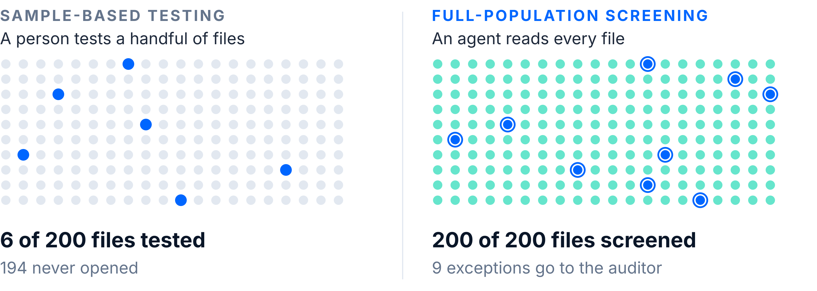
CASE · INTERNAL AUDIT
Every file checked, instead of a sample
Audit proof of concept for a Jordanian customs clearance and logistics company
Illustrative figures. The auditor reviews every flag and signs the finding.
BRDG Studio
ITAIF 2026 · The power of AI in business
Notes:
Auditors have always tested samples because reading every file costs too much. Once reading is cheap, you can screen the whole population. The auditor's job moves from reading routine files to judging the exceptions. The AI does not sign anything. A qualified person still does.

Slide 8
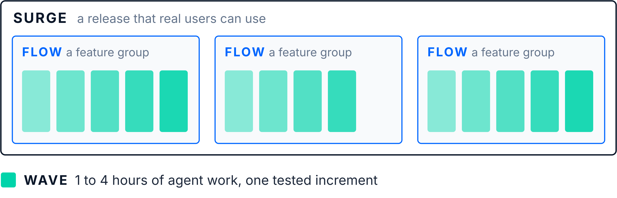
CASE · HOW WE BUILD SOFTWARE
A small team directing many agents
AODC is the method BRDG uses to ship production software in 8 to 16 weeks
People write the specification and own the quality gate. Agents build inside each Wave.
BRDG Studio
ITAIF 2026 · The power of AI in business
Notes:
This is the case closest to most of you. We are eight people. We replaced two-week sprints with Waves: one to four hours of agent work, each producing something shippable and tested. People write the specification and own quality. Agents do the implementation. The skill that matters most here is writing a clear specification, and I will come back to that.

Slide 9
CASE · AI INSIDE A BANK
The model stays in the bank
WHY IT MATTERS
Where the model runs decides which data you may use.
Banks hold their most valuable data under the strictest rules. On-premise AI opens use cases a public cloud API cannot reach.
A Jordanian bank wanted AI on its own servers, with no customer data leaving its walls.
MODEL
An open-weight model with 30 billion parameters, on the bank's own hardware.
SEARCH
Multilingual retrieval over Arabic and English documents in one index.
CONTROLS
Each use case classified against the risk tiers in the Central Bank of Jordan's 2025 AI framework.
BRDG Studio
ITAIF 2026 · The power of AI in business
Notes:
A lot of AI news is about the biggest model. In banking, the first question is where the model runs. This bank wanted everything on its own servers. Open-weight models are now good enough to make that practical. The design work was mostly about data, Arabic language support and regulatory controls.

Slide 10
THE PATTERN
What the cases share
The process changed first
The data was already there
Sampling became full screening before anyone chose a model.
Circulars, shipment files and code repositories: each organization owned the raw material.
A named person signs off
Trust is built in
The auditor, the compliance officer, the quality reviewer. AI drafts and an accountable person decides.
Citations, logs and version history a regulator can read.
BRDG Studio
ITAIF 2026 · The power of AI in business
Notes:
None of the cases started with choosing a model. Each started with a process that only existed because reading and checking were expensive. Each used data the client already had. And in each, a named human is still accountable for the decision.

Slide 11
BRDG
Studio
02
THE COMMON MISTAKE
Why most AI projects stall
Notes:
So why do most companies get so little from AI?

Slide 12
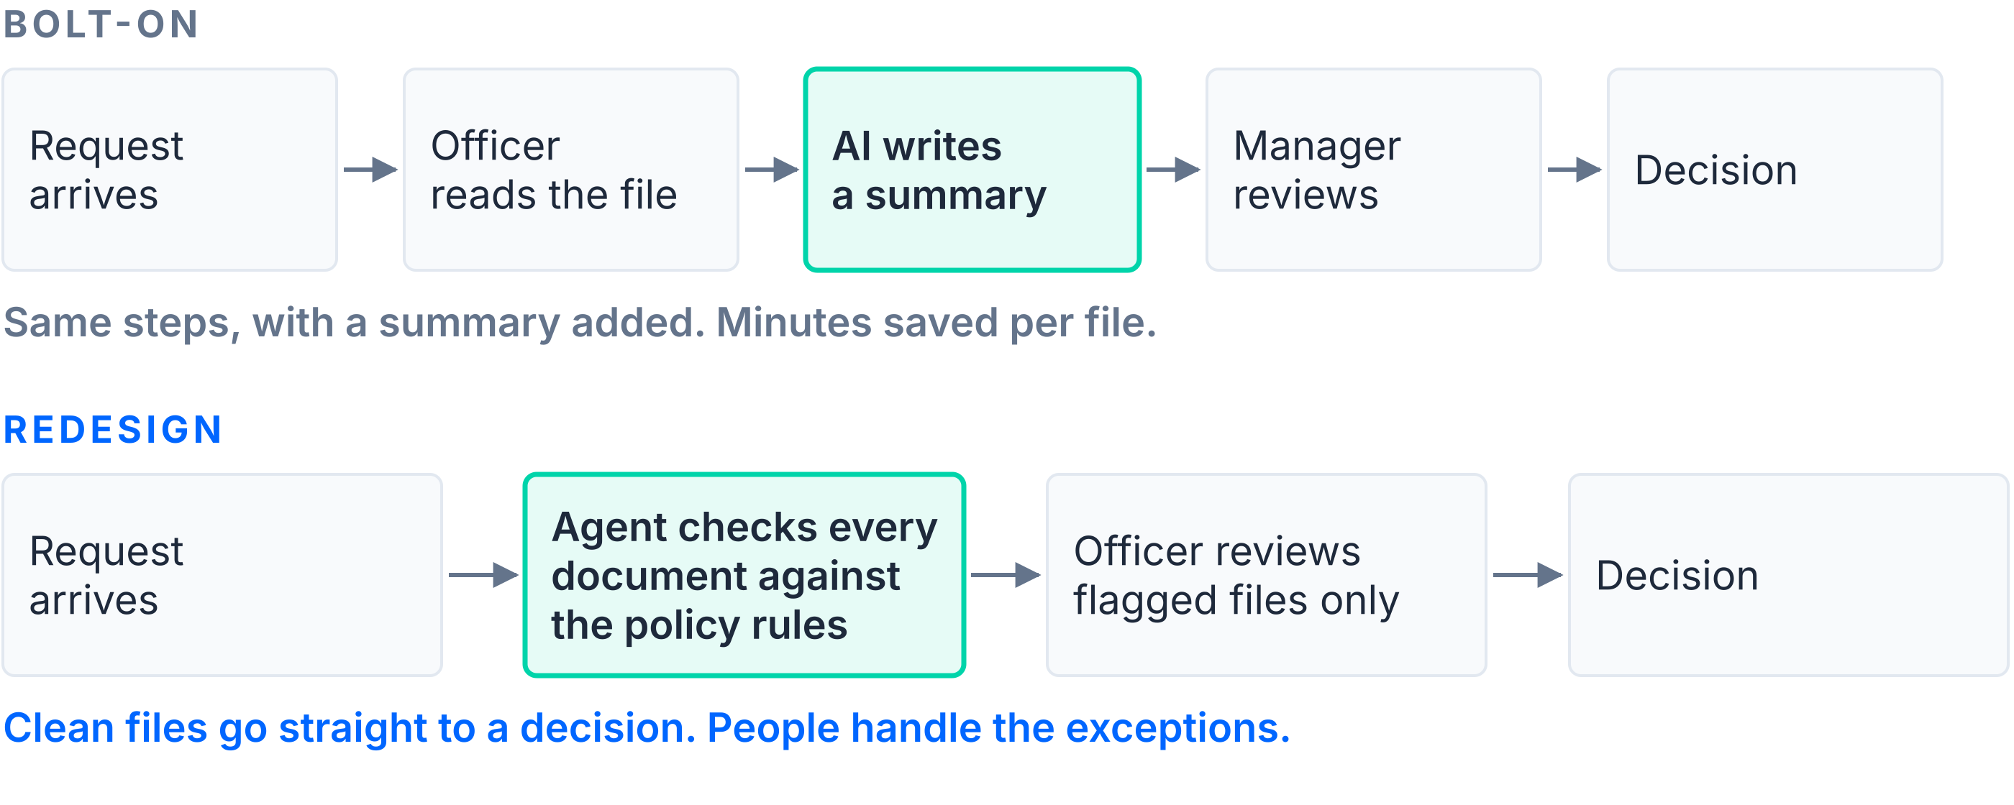
BOLT-ON OR REDESIGN
Adding AI to old steps saves minutes
Illustrative process: a loan or claims approval
BRDG Studio
ITAIF 2026 · The power of AI in business
Notes:
Most companies do the top row. They add a chatbot or a summary to the existing process and get a few minutes back. The bottom row asks a different question: which steps exist only because a person had to read everything? Remove those, and people spend their time on the cases that need judgement. McKinsey's high performers are the ones redesigning workflows.

Slide 13
REGULATED MARKETS
Trust decides what goes live
THE SECOND QUESTION
After “does it work?”, every bank and ministry asks how you will prove it.
Teams that log decisions, cite sources and explain outputs get approval to go live.
Central Bank of Jordan, 2025
AI regulatory framework for banks. AI risk sits inside the bank's risk governance, with board and executive accountability.
Jordan PDPL, Law No. 24 of 2023
Covers any system that processes customer data. Supervised by MoDEE's data protection directorate.
ISO/IEC 42001:2023
The international management-system standard for AI, which auditors certify against.
Picked up at 11:00 in “When AI Makes the Call: Who's Responsible?”
49th Jordan's global rank, and 2nd in the Middle East, on the Global Index on Responsible AI 2026.
BRDG Studio
ITAIF 2026 · The power of AI in business
Notes:
In Jordan, a bank cannot launch an AI system on enthusiasm. Jordan starts well, ranking 49th in the world and second in the Middle East on the 2026 Global Index on Responsible AI. The Central Bank issued its AI framework in 2025, Jordan has a personal data protection law, and ISO 42001 gives auditors a standard to check against. Governance done well is what gets a project approved. The next panel goes deeper on responsibility.

Slide 14
BRDG
Studio
03
FOR THE PEOPLE IN THIS ROOM
What this means for you
Notes:
Now to the students and graduates here.

Slide 15
THE JOB MARKET TO 2030
Net job growth, with new skills required
World Economic Forum, Future of Jobs Report 2025, covering 2025 to 2030
170M
92M
39%
jobs expected to be created worldwide
jobs expected to be displaced in the same period
of core skills employers expect to change
AI and big data top the employers' list of fastest-growing skills. In McKinsey's 2026 survey, nearly a third of organizations dropped a software purchase because they expect to build it with AI.
BRDG Studio
ITAIF 2026 · The power of AI in business
Notes:
The global picture from the World Economic Forum: more jobs created than lost, but the skills inside those jobs are changing fast. Employers expect about 39 percent of core skills to change by 2030, and AI and data skills top their list. Stanford's 2026 AI Index found four in five university students already use generative AI, so the differentiator is building with it. One more signal from McKinsey's August survey: nearly a third of companies cancelled a software purchase because they plan to build it themselves with AI. That is demand for people who can build.

Slide 16
WHERE VALUE MOVES
The work that rises in value
RISING IN VALUE
Defining the problem and writing the specification
Judging output, and building tests that catch errors
Domain knowledge: how a bank, a hospital or a port works
Owning the result when the model is wrong
GETTING CHEAPER
First drafts of code, emails and slides
Summaries and standard translations
Searching a thousand pages for one answer
Data entry
In the US, employment of software developers aged 22 to 25 is nearly 20% below its 2022 peak (Stanford AI Index 2026). AI now does the first-draft work that trained juniors, and employers, mine included, have not worked out how graduates will learn on the job.
BRDG Studio
ITAIF 2026 · The power of AI in business
Notes:
On the left, work that is getting cheap. On the right, work that is getting more valuable: knowing what to build, judging whether it is right, understanding a domain, and taking responsibility. There is a problem I have not solved, and Stanford's 2026 AI Index puts a number on it: in the US, employment of the youngest software developers is nearly 20 percent below its 2022 peak. The first-draft work on the left is how juniors used to learn. Companies, including mine, have to design new ways for graduates to build experience.

Slide 17
START THIS WEEK
What I would do in your position
Ship one complete thing
A working tool with real users, in a portfolio an employer can open.
Learn one domain's rules
AI skill plus banking, health or logistics knowledge is the profile I hire for.
Write the spec before the prompt
State the user, the input, the expected output and how you will test it.
Build a test set
Thirty real examples with known answers, rerun every time you change the prompt.
Enter the Solutions Competition
ITAIF's February 2027 track gives you a real challenge, mentors and an audience.
BRDG Studio
ITAIF 2026 · The power of AI in business
Notes:
Practical advice. Build one complete thing with real users. Pick a domain and learn its rules, because AI skill alone is becoming common. Learn to write a clear specification. Build a small test set so you can prove your system works. And use the ITAIF Solutions Competition in February: it is a real challenge with mentors, which is exactly the experience employers look for.

Slide 18
BRDG
Studio
THANK YOU
Build something
real this term
nidal@brdg.studio · brdg.studio
Questions now, or find me after the session.
Notes:
Thank you. I am happy to take questions.

