Slide 1

THE USE OF NLP AND DEEP LEARNING ON NEWS HEADLINES TO PREDICT STOCK MOVEMENTS
Tayfun Ayazma, Ph.D.
May 20, 2020

Slide 2
Outline
Problem Statement
Dow Jones Industrial Average (DJIA)
Data
Data Preparation and Text Preprocessing
Model Building
Most Important Features
Results
Business Recommendations

Slide 3
Problem Statement
Vast amount of resources dedicated to quantify and analyze qualitative data
Complexities of modeling stock market dynamics
A variety of resources:
SEC reports (8-K and 10-K)
Financial news articles (Financial Times and Wall Street Journal)
Media Outlets (Twitter, Facebook, and Reddit)
NLP and Deep Learning to predict Dow Jones stock movements

Slide 4
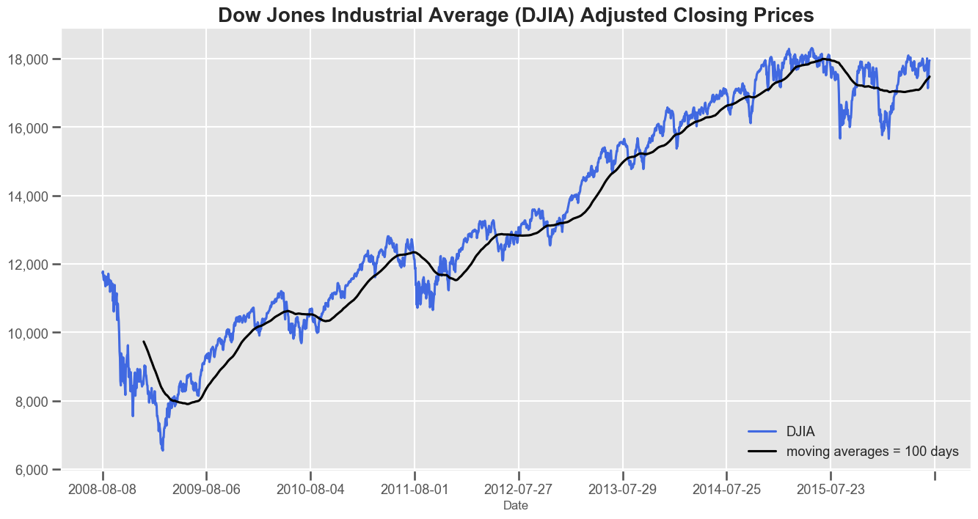
Dow Jones Industrial Average (DJIA)
Stock market index
Tracks the stock performance of 30 large companies
Components of DJIA

Slide 5
Data
Reddit historical news headlines
Only the top 25 news headlines for a single date
DJIA stock data downloaded from the Yahoo Finance
Target feature - the “Label” column:
1 if DJIA adjusted close value stayed the same or went up
0 if it dropped

Slide 6
Data Preparation and Text Preprocessing
Inspect for quality (outliers, missing value, data types)
Preprocessing the textual data (NLTK library):
Lowercasing
Removing stopwords, punctuation and numbers
Lemmatizing words
Combine text columns
Splitting the data into train and test sets:
Train set → 08-08-2008 to 12-31-2014 (80%)
Test set → 01-01-2008 to 07-01-2016 (20%)

Slide 7
Model Building
Six supervised machine learning models:
Logistic Regression
Multinomial Naïve Bayes
Random Forest Classifier
Support Vector Machine Classifier
XGBoost Classifier
Bernoulli Naïve Bayes
Deep learning neural network architectures:
A fully connected multilayer perceptron (MLP)
Recurrent neural network (RNN) – LSTM
Convolutional neural network (CNN)

Slide 8
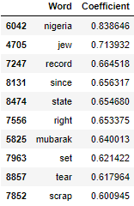
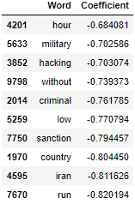
Most Important Features
For logistic regression model, the most important features both positive and negative
“Military”, “Hacking”, “Criminal” , “Low” and “Sanction”

Slide 9
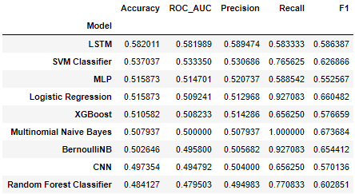
Results
RNN – LSTM network with a 58% accuracy
Model tuning for hyper-parameters for LSTM and SVM Classifier
The complexity of modeling stock market dynamics
Limited data

Slide 10
Business Recommendations
Textual data to provide informed decisions
The potential of deep learning to revolutionize the stock market trading
Changes in stock movements in days following the release of news headlines

Slide 11
Questions?

